Slide 1
Amazon Review Data Warehouse
- A case study
By : Kulamani Pradhan

Slide 2
Agenda
About Me
The Challenge
High level Solution
Solution Details
Staging Layer
Data Model
OLAP Model
Job Process Model
Business Intelligence(KPIs)
Demo
Questions
Future Improvements
Appendix

Slide 3

About me
Kulamani Pradhan
Native from India
Bachelor of Engineering in Information Technology
Professional experience > 7 years
Senior DWH Specialist
Hobbies include playing cricket, cooking.

Slide 4

The Challenge
“Design and implement Data Warehouse (DWH) with Extract/Transform/Load (ETL) pipeline for Amazon reviewed products and perform analytics”

Slide 5
High Level Solution : Approach
DWH
Staging Area
Raw Data
Analytics

Slide 6





High Level Solution : Approach
DWH
Staging Area
Raw Data
Analytics

Slide 7


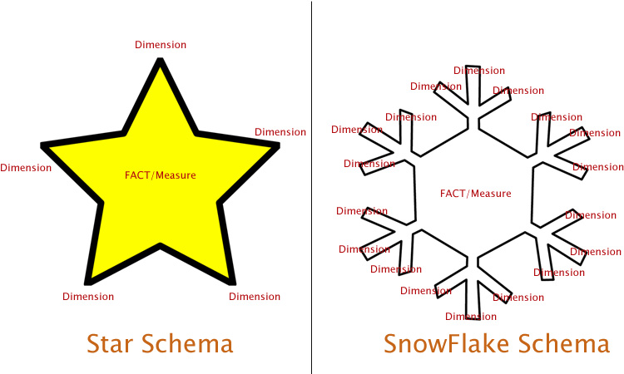

High Level Solution : Approach
ETL
Data Cleansing & Transform
ETL
OLAP Views
RAW Data
Staging Layer
Warehouse
Analytics

Slide 8



Solution Details : Staging Layer
Staging Layer
Two ways of implementation :
Parallel Processing by splitting the large file into smaller pieces to improve scalability and performance ( reviews)
Direct Processing file to database for partially smaller files
Staging Layer
.
.
.

Slide 9
Solution Details : Data Cleansing
Data Integrity Level Check
Data-Type Constraints
Mandatory Constraints
Referential Integrity Constraints
Storing bad records in error_log table to monitor and discuss with source systems to fix if required.

Slide 10
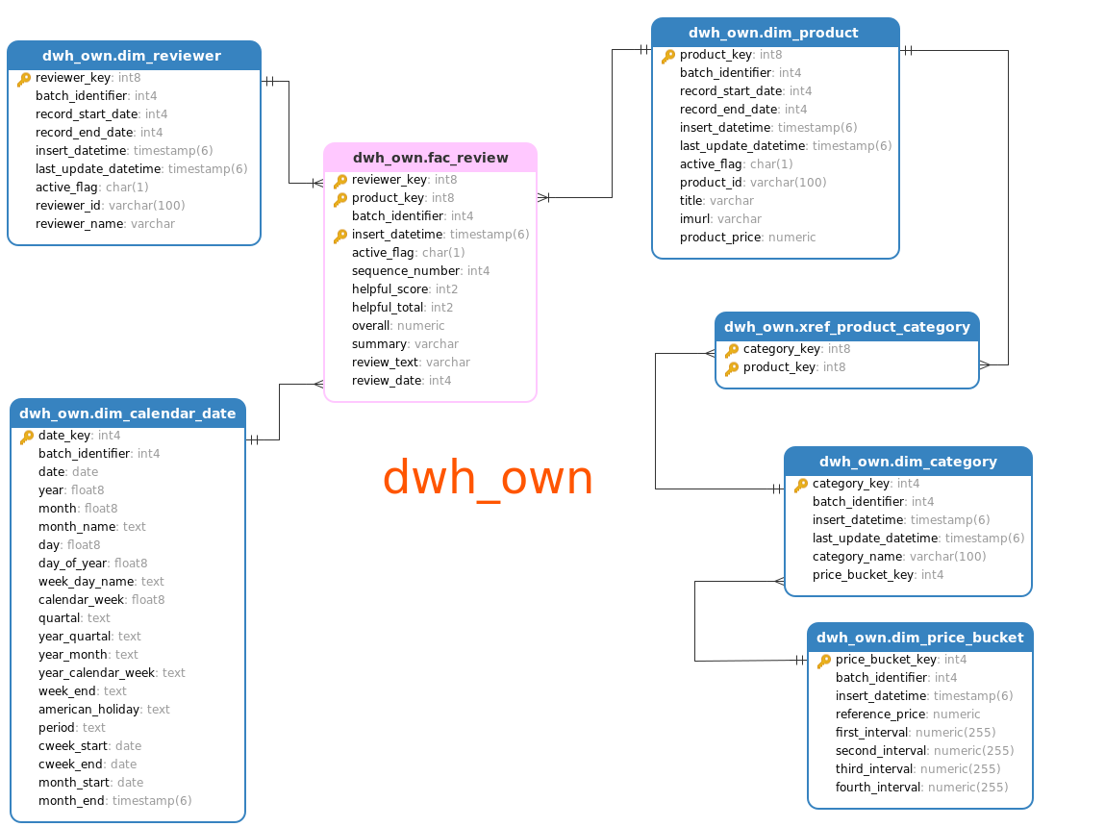
Solution Details : Data Model(DWH)

Slide 11
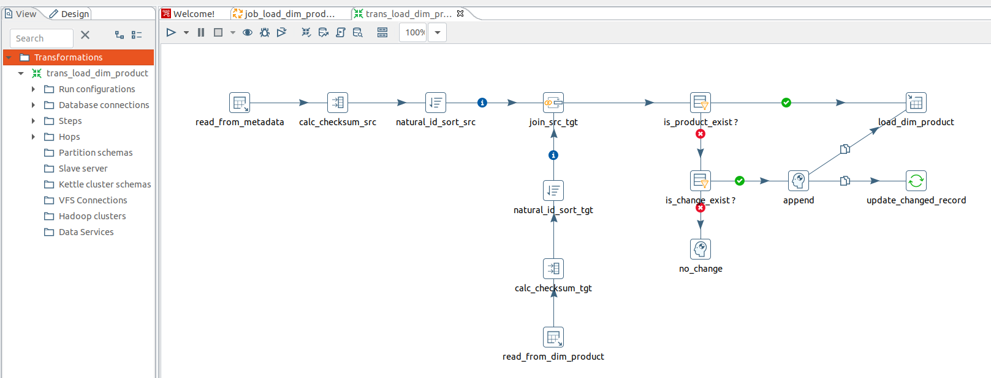
Solution Details : SCD Type-2

Slide 12
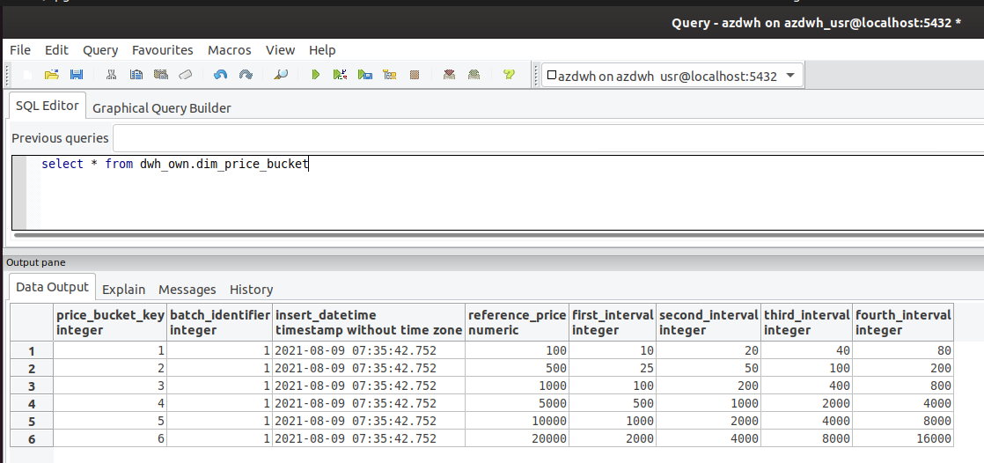
Solution Details : Price Bucket

Slide 13
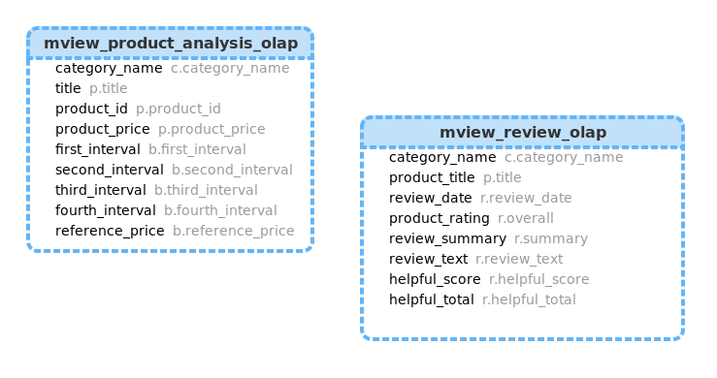
Solution Details : M-Views for OLAP

Slide 14
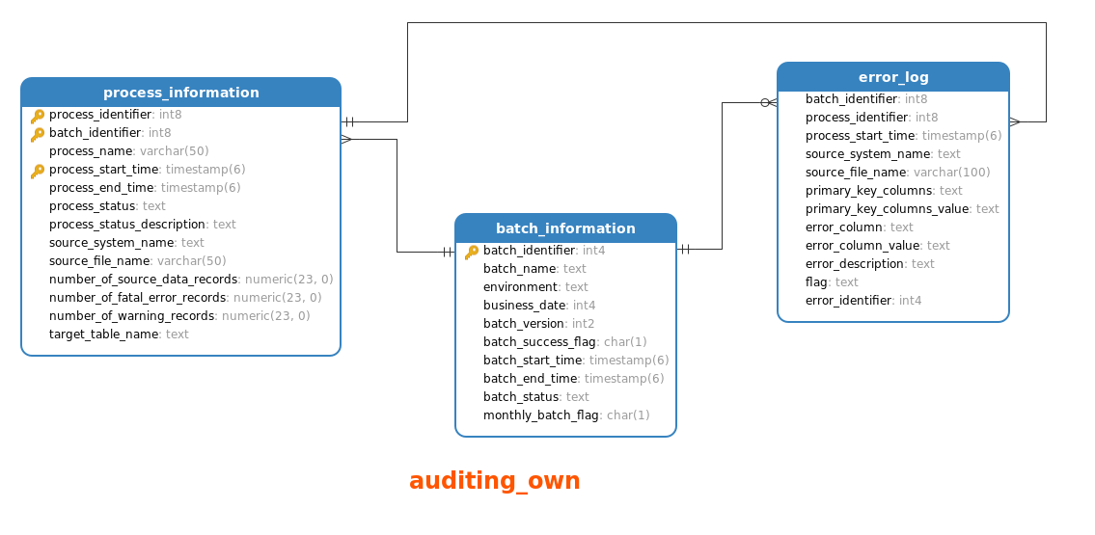
Solution Details : Data Model(Auditing)

Slide 15
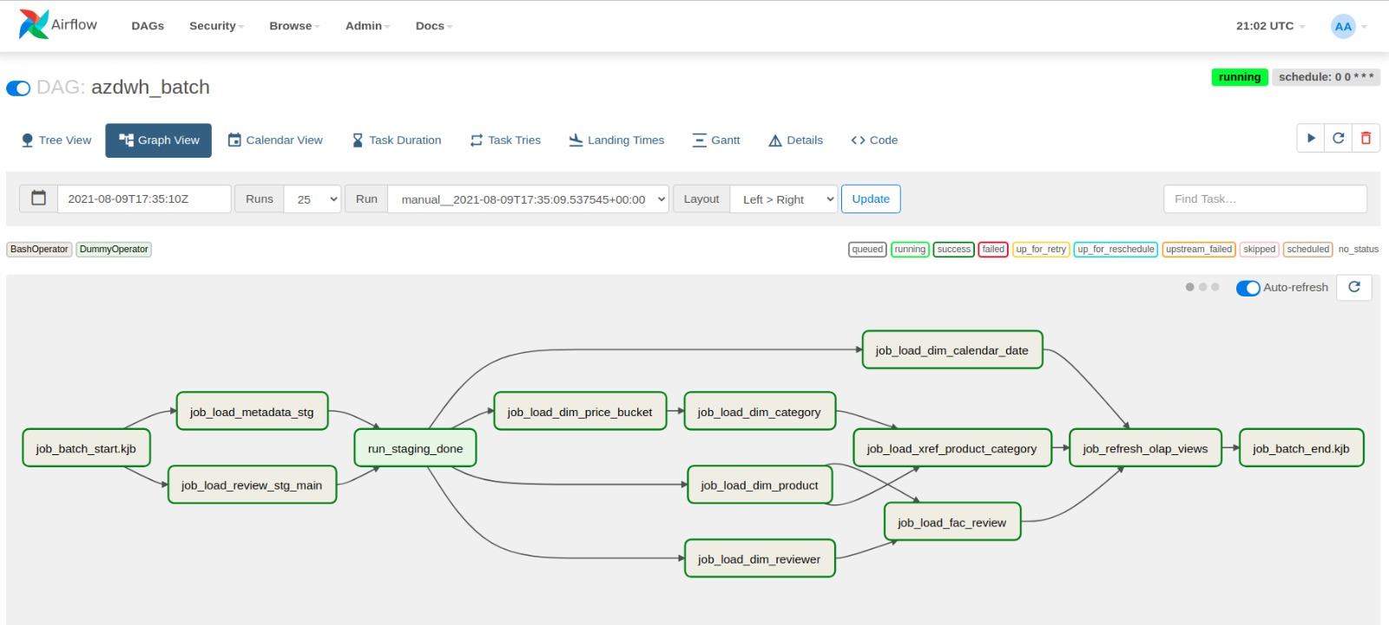
Solution Details : Job Process Model

Slide 16
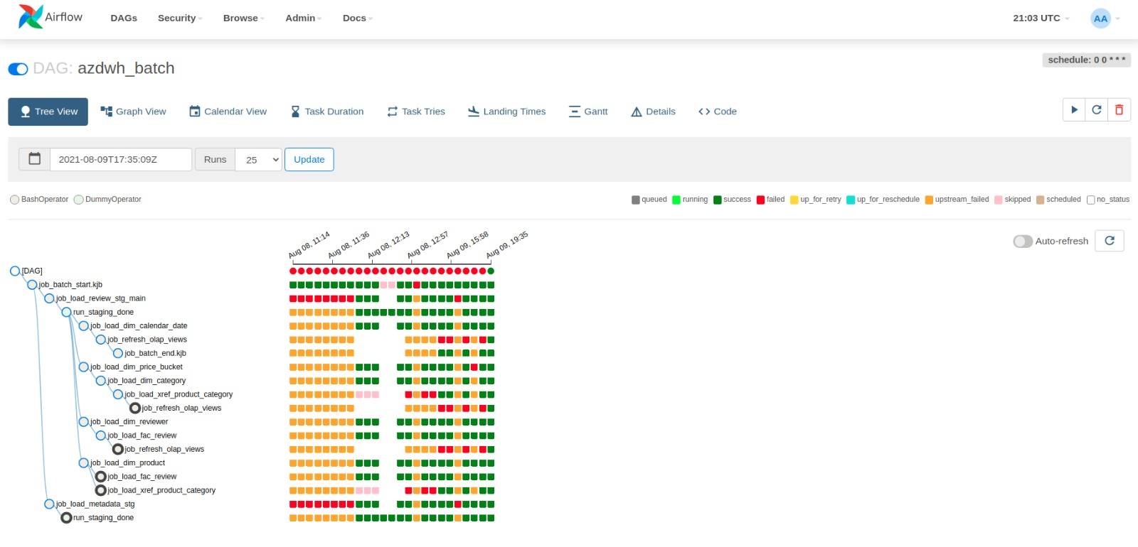
Solution Details : Job Process Model

Slide 17
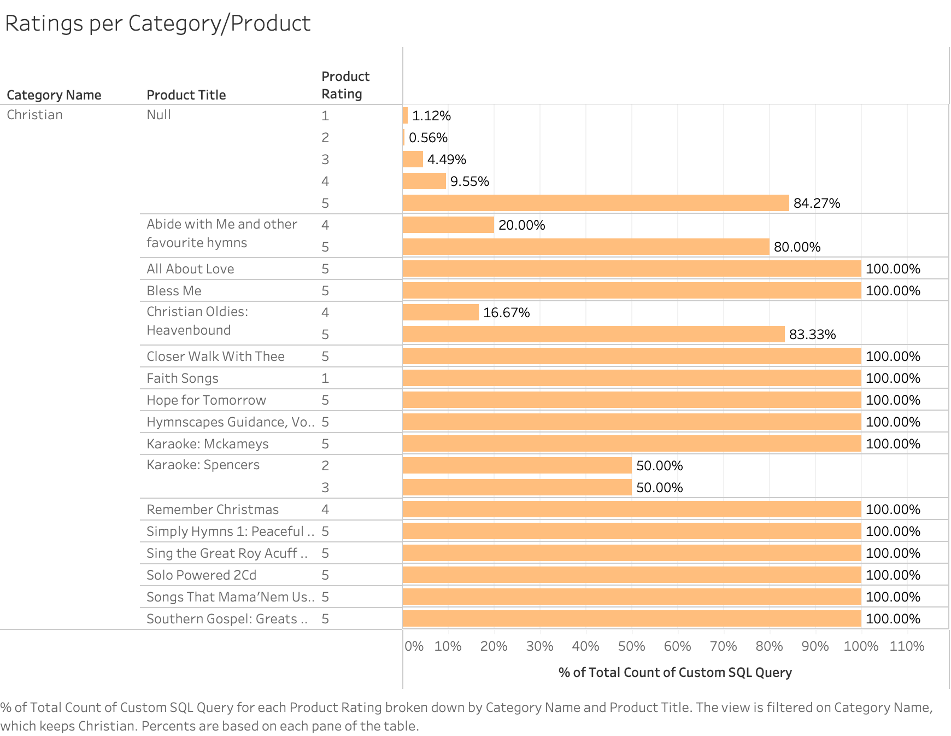
Solution Details : Ratings Histogram

Slide 18
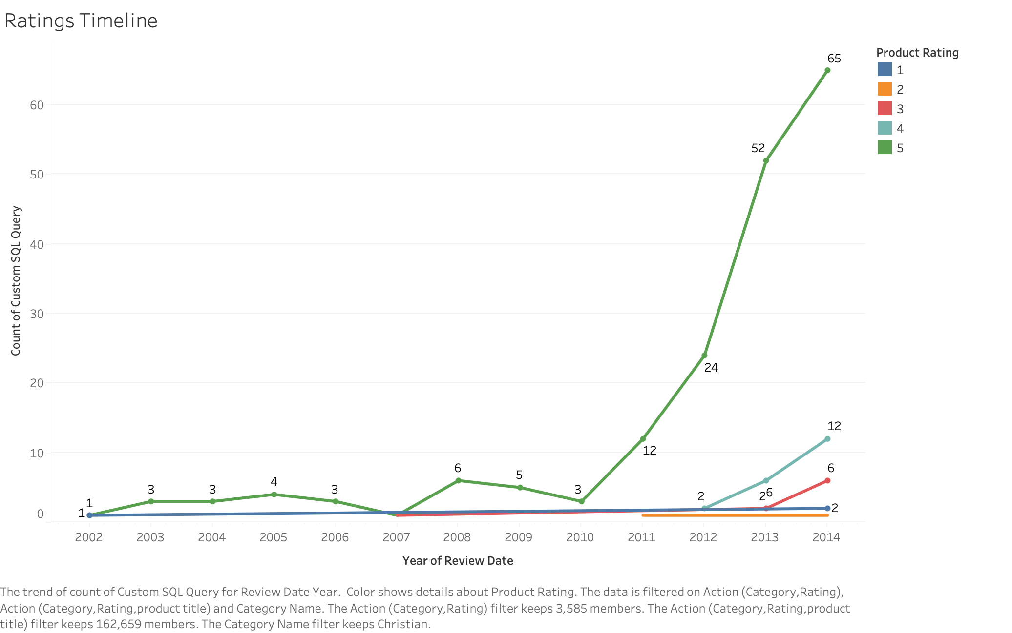
Solution Details : Ratings Timeline

Slide 19
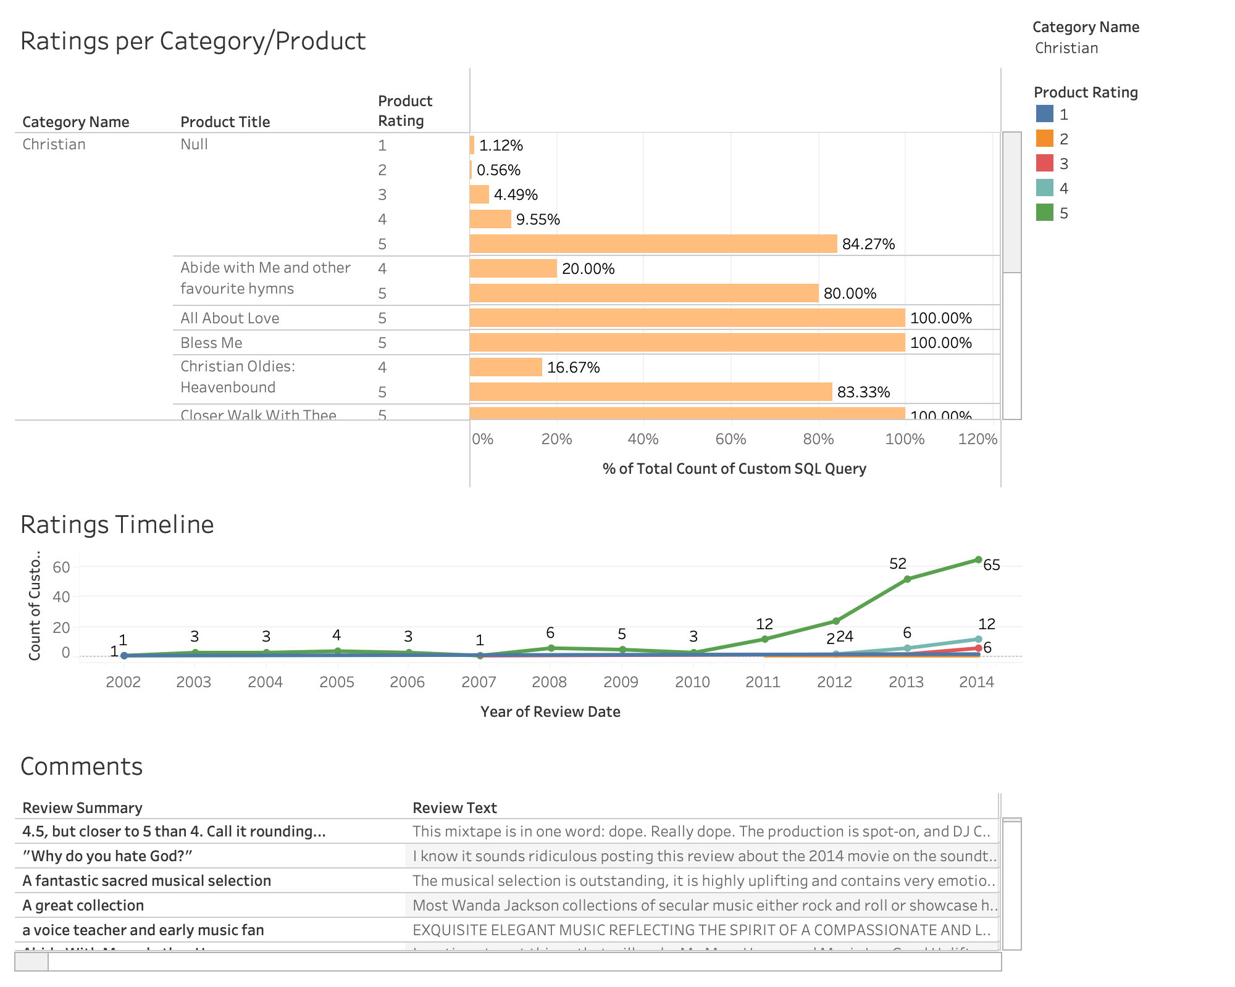
Solution Details : Ratings Dashboard

Slide 20
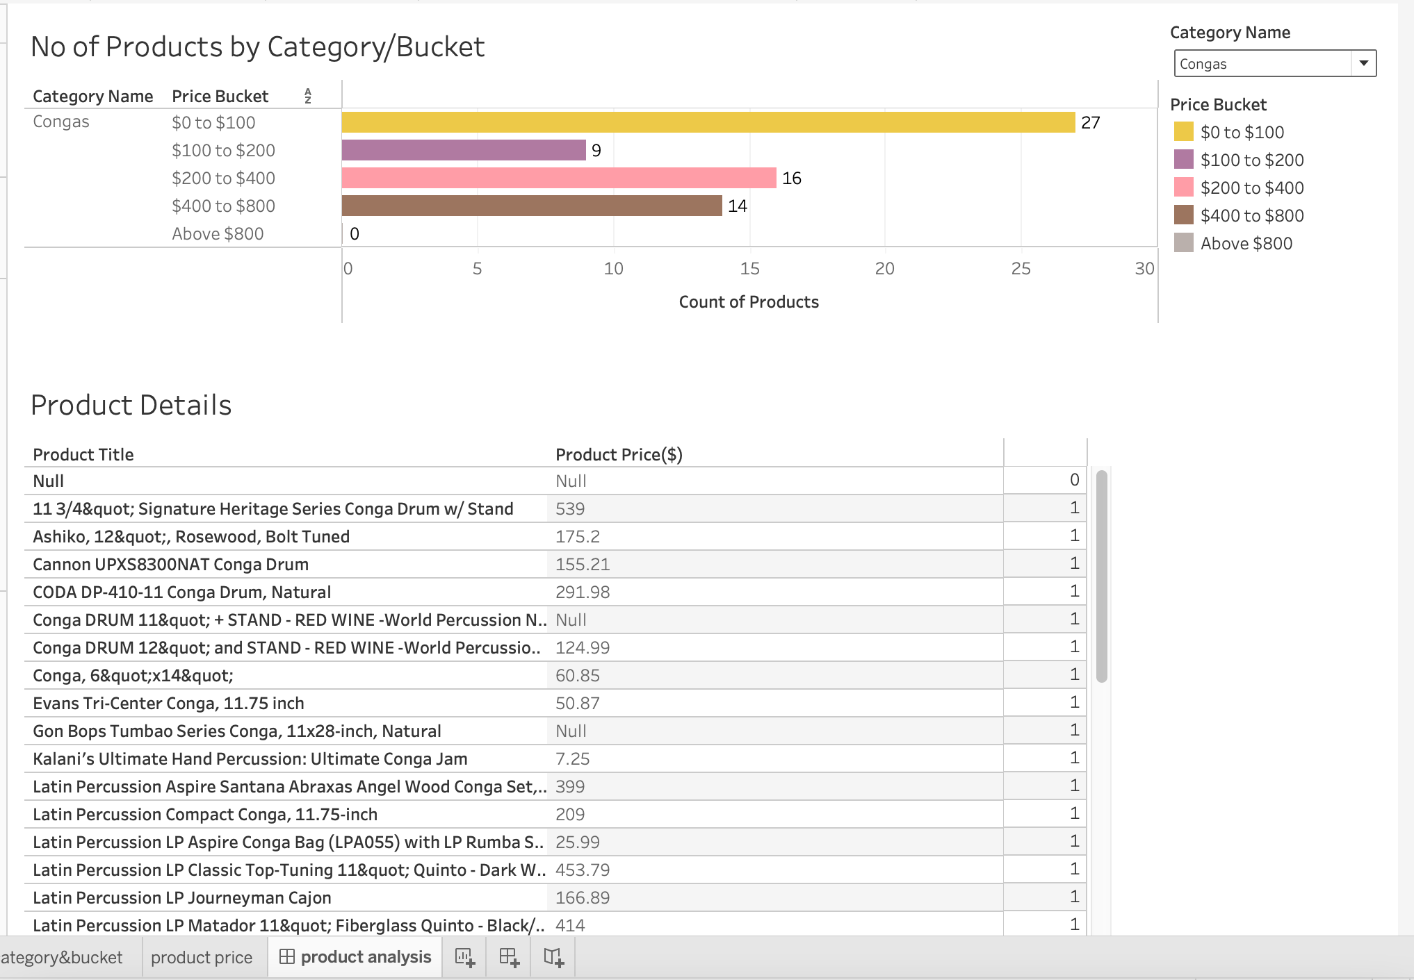
Solution Details : Product Analysis

Slide 21
Demo
Done on a limited set of Data(in the interest of time)
Will be an E2E demo inclusive of:
ETL code walkthrough
Pipeline run using ETL

Slide 22

Questions?

Slide 23
Future Improvements
Event Based Trigger : (Automatic triggering of DWH batch)
We can use REST API call from Pentaho to download the raw .json.gz files to polling location. We can create an airflow dag task to check every 2-5 seconds, if a new file is already present.
We can have an acknowledge file from source/created by us to verify if all files are in polling location. If yes, then start the batch if no batch is open.
Batch Status Mail :
We can create a job which will send (Team) an email confirmation that batch has started, completed staging, completed fact and OLAP etc. In each stage we can get notified.
Staging Area :
As raw data is already in S3 bucket, it is more easy to use cloud based services like Amazon redshift spectrum to directly query on S3 bucket and load.
Parallel processing : If we use Amazon redshift(distributed network) to store whole DWH area, then these huge data can be processed parallel across multiple nodes.

Slide 24
Future Improvements Cont..
DWH Area
Complex validation on each field level to ensure data accuracy.
Range Constraints
Retrieve meaning from review_text field, so that can be used for dash boarding purpose
Create an User Interface screen for price bucket field, so that dynamically some one can add a new bucket.
OLAP :
Based on the review summary, we can create a statistical word cloud dashboard which can highlight if product is overall good/average/bad.
Combine both Product Analysis and Review rating dashboard to crate a tableau story and subscribe it for the whole team, so that every day we can keep track of this dashboard.
Create a Batch monitoring dashboard using auditing_own schema tables, where we can easily monitor the batch status(if not airflow).

Slide 25
Appendix
Assumptions made:
All Categories have been selected for dim_category table. Not considered the highest category only.
Defined 6 different buckets with 5 bucket types each.

Slide 26


