Slide 1
knab Transaction Data Warehouse
- A case study
By : Kulamani Pradhan

Slide 2
Agenda
About Me
The Challenge
High level Solution
Solution Details
Staging Layer
Dimensional Model
Control Model
Job Process Model
DGS Report for DNB
Demo
Questions
Assumptions
Future Improvements
Code base links

Slide 3

About me
Kulamani Pradhan
Native from India
Bachelor of Engineering in Information Technology
Professional experience > 7 years
BI Developer
Hobbies include playing cricket, cooking.

Slide 4

The Challenge
“Design and implement Data Warehouse (DWH) with Extract/Transform/Load (ETL) pipeline for Knab Financial Transaction Data”

Slide 5




High Level Solution : Approach
DWH
Staging Area
Raw Data
Reporting

Slide 6

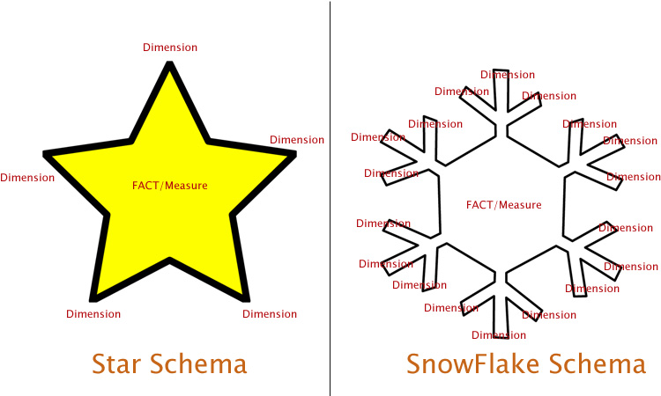

High Level Solution : Approach
Data Validations
Python
Python
SQL
Python
RAW Data
Staging Layer
Warehouse
Reporting

Slide 7
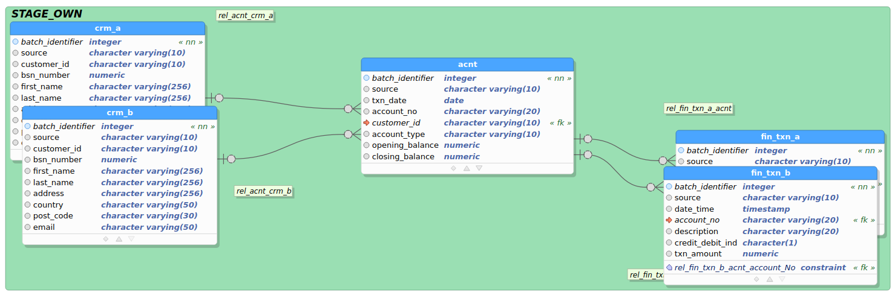
Solution Details : Staging Model
Staging Loading Job :
https://github.com/Kulamanipradhan0/knab_dwh/blob/main/etl_repo/staging/stg_load.py

Slide 8
Solution Details : Data Validations
Data Completeness Validation
knab_dwh_ack.txt file containing (file_name, record_count)
Data Correctness Validation
Mandatory Constraints (customer_id , account_no etc)
Data-Type Constraints (Txn Amount must be Numeric)
Duplicate Record Constraints
Attribute Value level Constraints (customer_id must starts with “CA”)
Date/Time Format Constraints (Ex : yyyy-mm-dd)
Referential Integrity Constraints
Storing bad records in error_log table to monitor and discuss with source systems to fix if required.

Slide 9
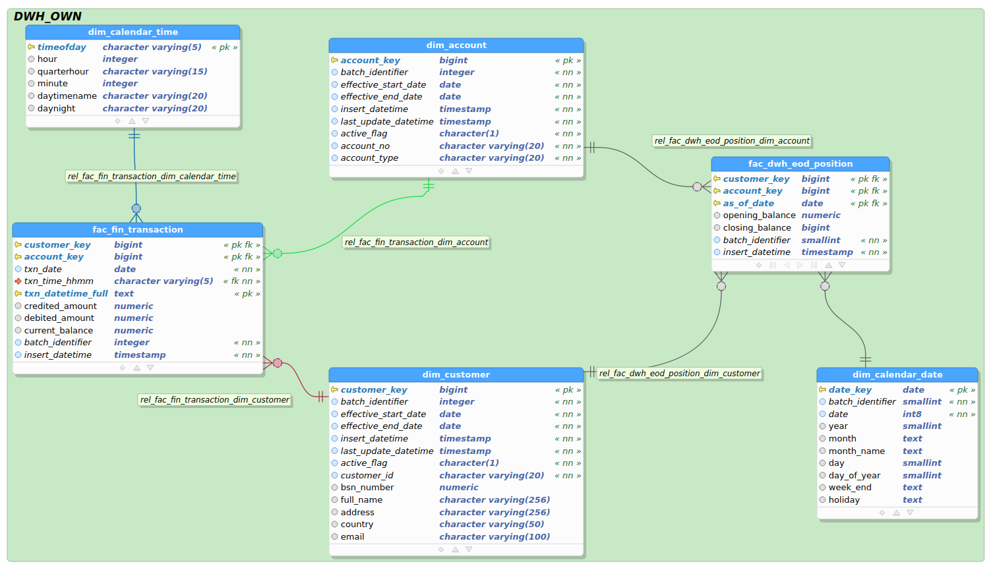
Solution Details :Dimensional Model
Snapshot
Fact Table
Transactional
Fact Table

Slide 10
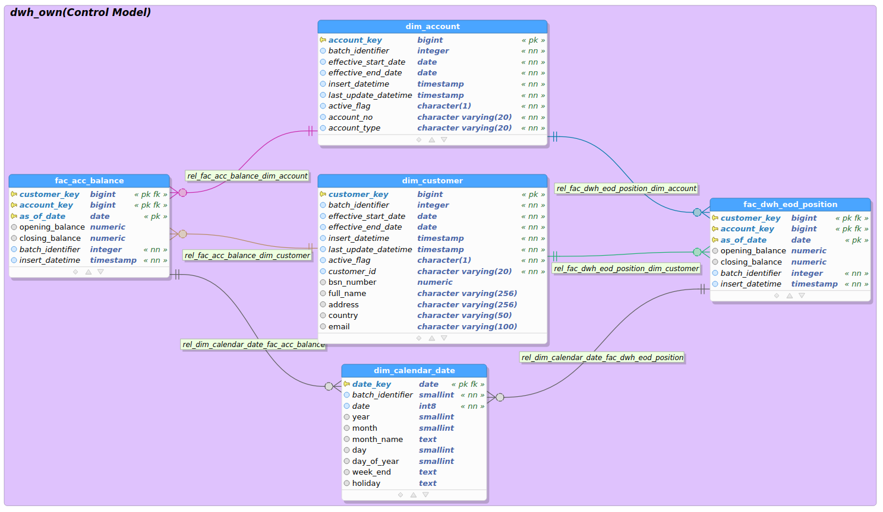
Solution Details :Control Model
From CRM
From Transaction

Slide 11
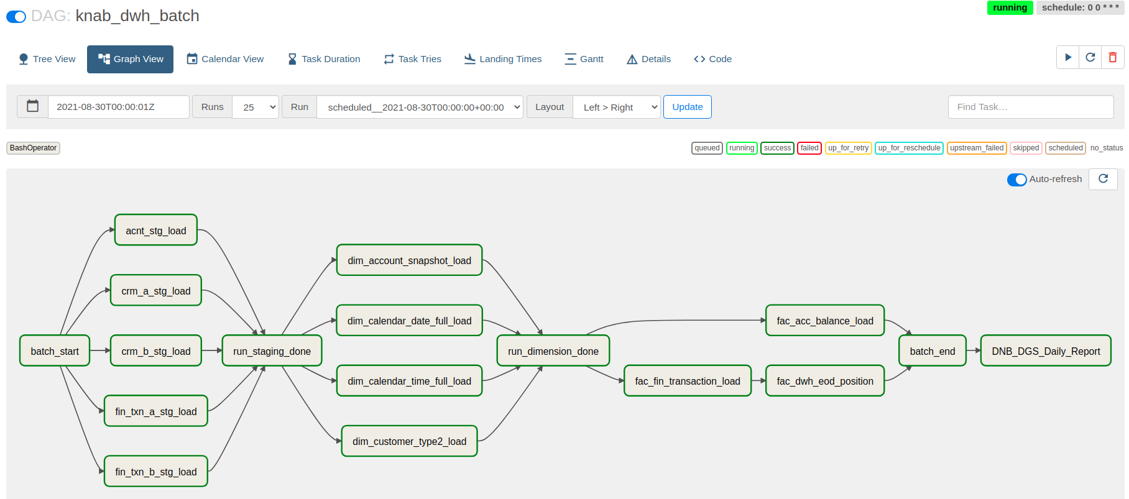
Solution Details : Job Process Model

Slide 12


Containerization :
5432
8080
9000
Docker Host
8080
Container App | Docker File name | Image name(Docker hub)
PostgreSQL | Dockerfile_pg | mekpradhan/knab_dwh:knab_dwh_pg
Airflow | Dockerfile_airflow | mekpradhan/knab_dwh:Knab_dwh_airflow

Slide 13
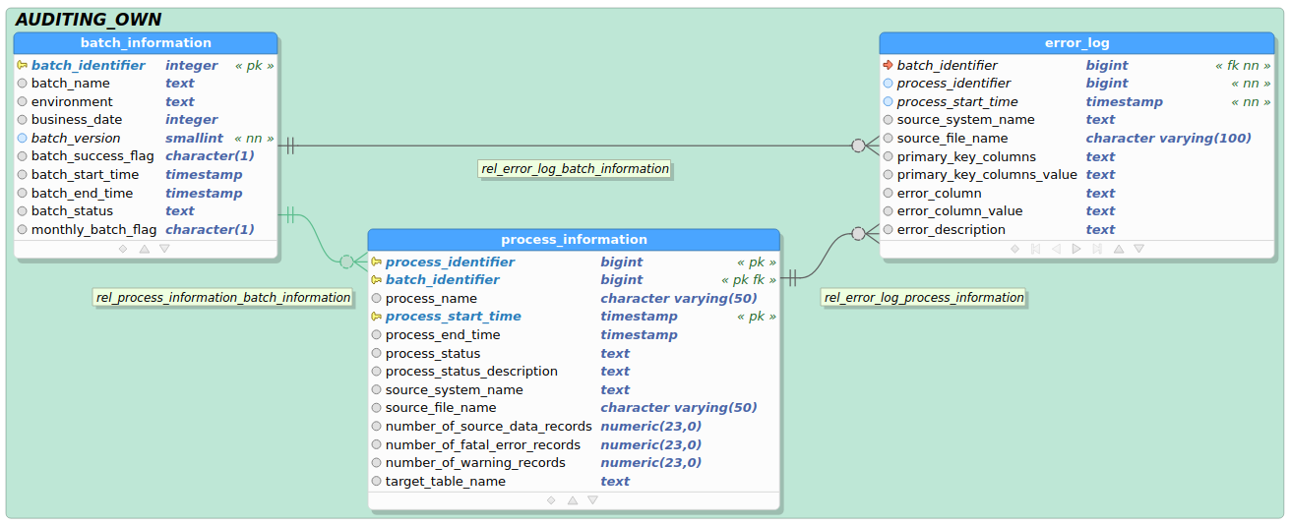
Solution Details : Data Model(Auditing)

Slide 14
Demo
Done on a small set of Data(in the interest of time)
Will be an E2E demo inclusive of:
SQL code walkthrough
Job execution using Airflow

Slide 15

Questions?

Slide 16
Assumptions
CRM system is an internal OLTP system of Knab. If we have external files then approach might change a little bit.
A financial transaction is related to an account and that account must belong to a customer. A customer can have multiple accounts on their name.
Source data completeness Check : Assuming from source we will receive an acknowledgement file with filename & record count in it. We can validate if we have loaded exact amount of data in our domain.
To have a control on our end report, it would be good if we receive an account file with opening balance and closing balance in it on daily basis. Which can be used to reconcile our EOD Position calculated from transaction.
DNB is giving guarantee 100K per customer, doesn’t matter how many accounts that customer has.
All attributes in staging table

Slide 17
Code Base Links :
Docker Images(Airflow + Postgres)
Dockerfiles : https://github.com/Kulamanipradhan0/knab_dwh
Dockerfile_pg
Dockerfile_airflow
Images : https://hub.docker.com/repository/docker/mekpradhan/knab_dwh
DDL Code base : This is used to create all DB objects i.e. schema, users, tables, partitions etc
https://github.com/Kulamanipradhan0/knab_dwh/tree/main/db_scripts
ETL Repository : All code base related to staging, dimension, fact & report loading
https://github.com/Kulamanipradhan0/knab_dwh/tree/main/etl_repo
Sample Source Files : All sample flat files
https://github.com/Kulamanipradhan0/knab_dwh/tree/main/src_files/polling
Airflow Dag file : Used for running the complete DWH batch
https://github.com/Kulamanipradhan0/knab_dwh/tree/main/airflow/dags

Slide 18
Code Base Links :
Loading data from Transaction to EOD Position : (Making sure all active customers are getting loaded everyday )
https://github.com/Kulamanipradhan0/knab_dwh/blob/main/etl_repo/fact/fac_dwh_eod_position.sql
Data Validation Layer(nice to have). Ex:
https://github.com/Kulamanipradhan0/knab_dwh/blob/main/etl_repo/staging/staging_data_validation.sql
ETL Log files : During Job run ETL logs will be created in this directory.
https://github.com/Kulamanipradhan0/knab_dwh/tree/main/log_files
SCD Type 2 Implementation using SQL : (dim_customer)
https://github.com/Kulamanipradhan0/knab_dwh/blob/main/etl_repo/dimension/dim_customer_type2_load.sql
Report Code : (DNB_DGS_Last_Year_Report)
Main Job : https://github.com/Kulamanipradhan0/knab_dwh/blob/main/etl_repo/report/DNB_DGS_Last_Year_Report.py
SQL : https://github.com/Kulamanipradhan0/knab_dwh/blob/main/etl_repo/report/dnb_dgs_report_query.sql

Slide 19
Future Improvements
Event Based Trigger : (Automatic triggering of DWH batch)
We can create an airflow dag task to check every 2-5 seconds, if already all files have been delivered then start the batch. Batch Status Mail :
We can create a job which will send (Team) an email confirmation that batch has started, completed staging, completed fact and OLAP etc. In each stage we can get notified.
Staging Area :
Parallel processing : If we use Amazon redshift(distributed network) to store whole DWH area, then these huge data can be processed parallel across multiple nodes.
Batch Monitoring Dashboard :
Create a Batch monitoring dashboard using auditing_own schema tables, where we can easily monitor the batch status(if not airflow).
Source File Movement :
Once Python processes the source file, the file should be moved to done location. In that way we will not be overriding the files of one date to another.
In case there is a failure we should move the file to working location. In that way it would be clear which one still pending for processing.

Slide 20
Future Improvements
Independent Execution of airflow containers :
In a production environment set up , we should separate airflow scheduler & webserver, so that they should run in two different containers.
Proper networking between containers.
Creating an docker-compose.yml file to start all these containers at once

Slide 21


