Slide 1

Financial Data Warehouse
- A case study
By : Kulamani Pradhan

Slide 2
Agenda
About Me
The Challenge
High level Solution
Solution Details
Assumptions
Staging Layer
Dimensional Model
Control Model
Job Process Model
DGS Report for DNB
Demo
Questions
Future Improvements
Code base links

Slide 3

About me
Kulamani Pradhan
Native from India
Bachelor of Engineering in Information Technology
Professional experience > 7 years
BI Developer
Hobbies include playing cricket, cooking.

Slide 4
Case
Situation
Challenges
Don is the COO at Knab. He is responsible for complying with DNB regulations, one of which is around the DGS (Deposito Garantie Stelsel). The DNB guarantees a maximum amount of € 100K per person in case the bank goes bankrupt.
In order for the DNB to make good on that promise, they want to know exactly how much money they would need to pay out. So Don wants to give them a list of all customers and the amount of money that is guaranteed by the DNB for those customers at the end of last year.
What makes it slightly more interesting, there are multiple source databases with information about customers (CRM) and about financial transactions (let’s call them Fin) and customers can appear in multiple systems at once.
Describe which data you think should be used to answer Don’s question
Draw a dimensional data model describing these data sets
Describe which controls you would implement to ensure the final result is correct.
Write a SQL query that produces the desired result
CRM A
Fin A
CRM B
Fin B

Slide 5





High Level Solution : Approach
DWH
Staging Area
Raw Data
Reporting

Slide 6

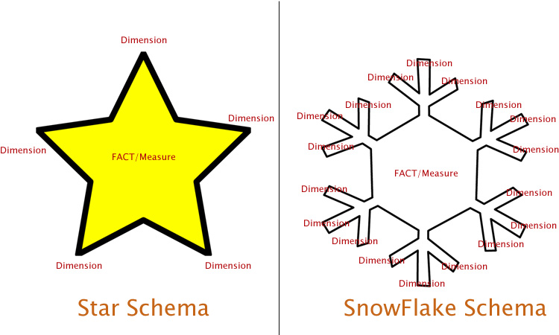

High Level Solution : Approach
Data Validations
Python
Python
SQL
Python
RAW Data
Staging Layer
Warehouse
Reporting

Slide 7
Assumptions
CRM system is an internal OLTP system of Knab. If we have external files then approach will change.
A financial transaction is related to an account and that account must belong to a customer. A customer can have multiple accounts on their name.
We will receive an acknowledgement file with filename & record count of each and every source files.
We will receive an account file with opening balance and closing balance in it on daily basis.
DNB is giving guarantee 100K per customer, doesn’t matter how many accounts that customer has.
All attributes within staging table.
Flat file are in csv format and both crm_a & crm_b has similar structure. Same for fin_txn_a & fin_txn_b.

Slide 8
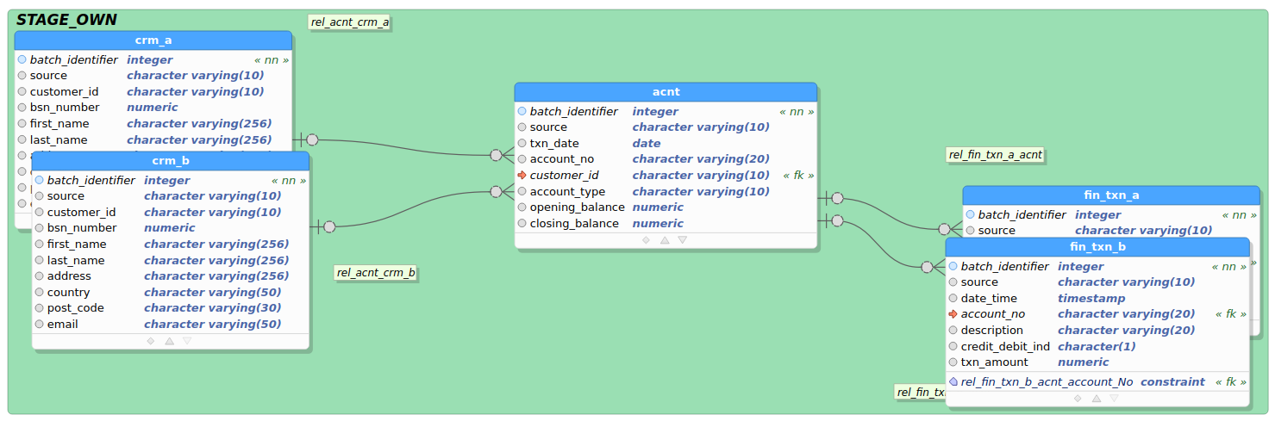
Solution Details : Staging Model
Staging Loading Job :
https://github.com/Kulamanipradhan0/knab_dwh/blob/main/etl_repo/staging/stg_load.py

Slide 9
Solution Details : Data Validations
Data Completeness Validation
knab_dwh_ack.txt file containing (file_name, record_count)
Data Correctness Validation
Mandatory Constraints (customer_id , account_no etc)
Data-Type Constraints (Txn Amount must be Numeric)
Duplicate Record Constraints
Attribute Value level Constraints (customer_id must starts with “CA”)
Date/Time Format Constraints (Ex : yyyy-mm-dd)
Referential Integrity Constraints
Storing bad records in error_log table to monitor and discuss with source systems to fix if required.

Slide 10
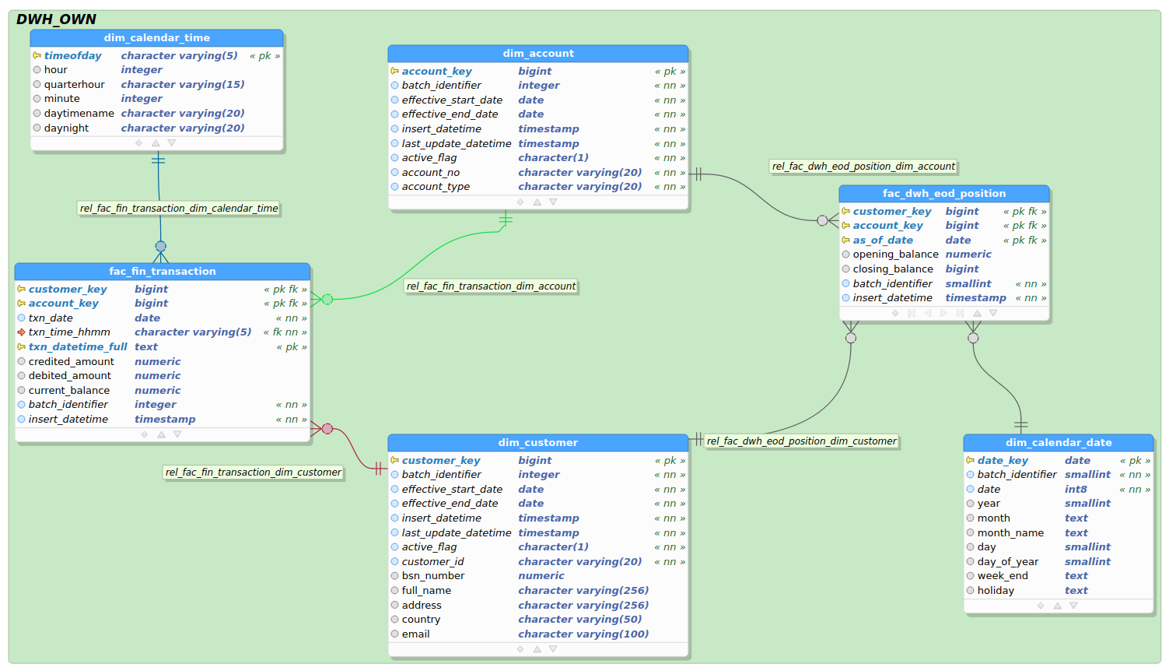
Solution Details :Dimensional Model
Snapshot
Fact Table
Transactional
Fact Table

Slide 11
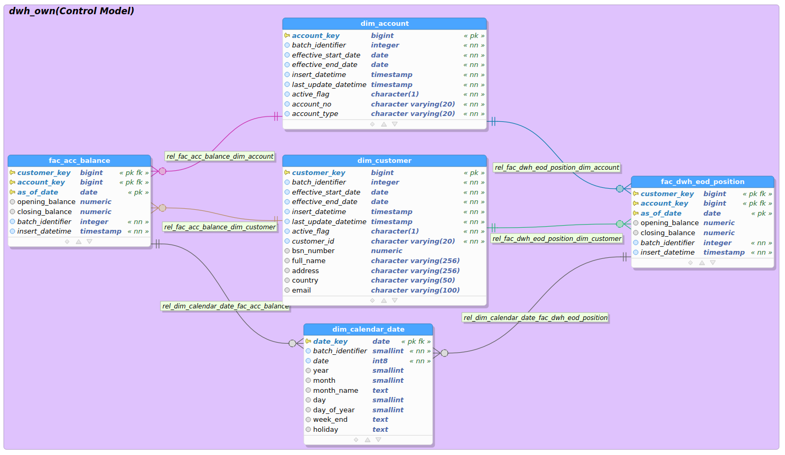
Solution Details :Control Model
From CRM
From Transaction

Slide 12
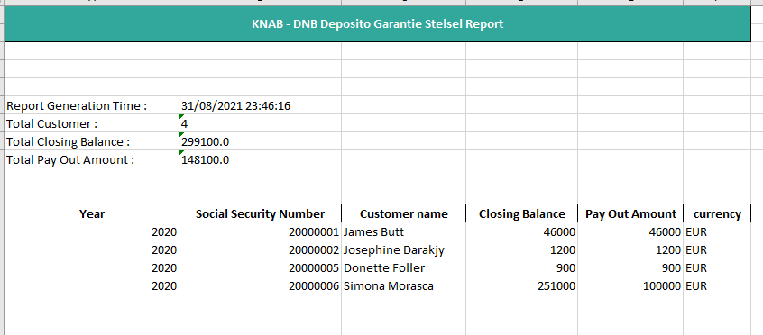
Solution Details : Report

Slide 13
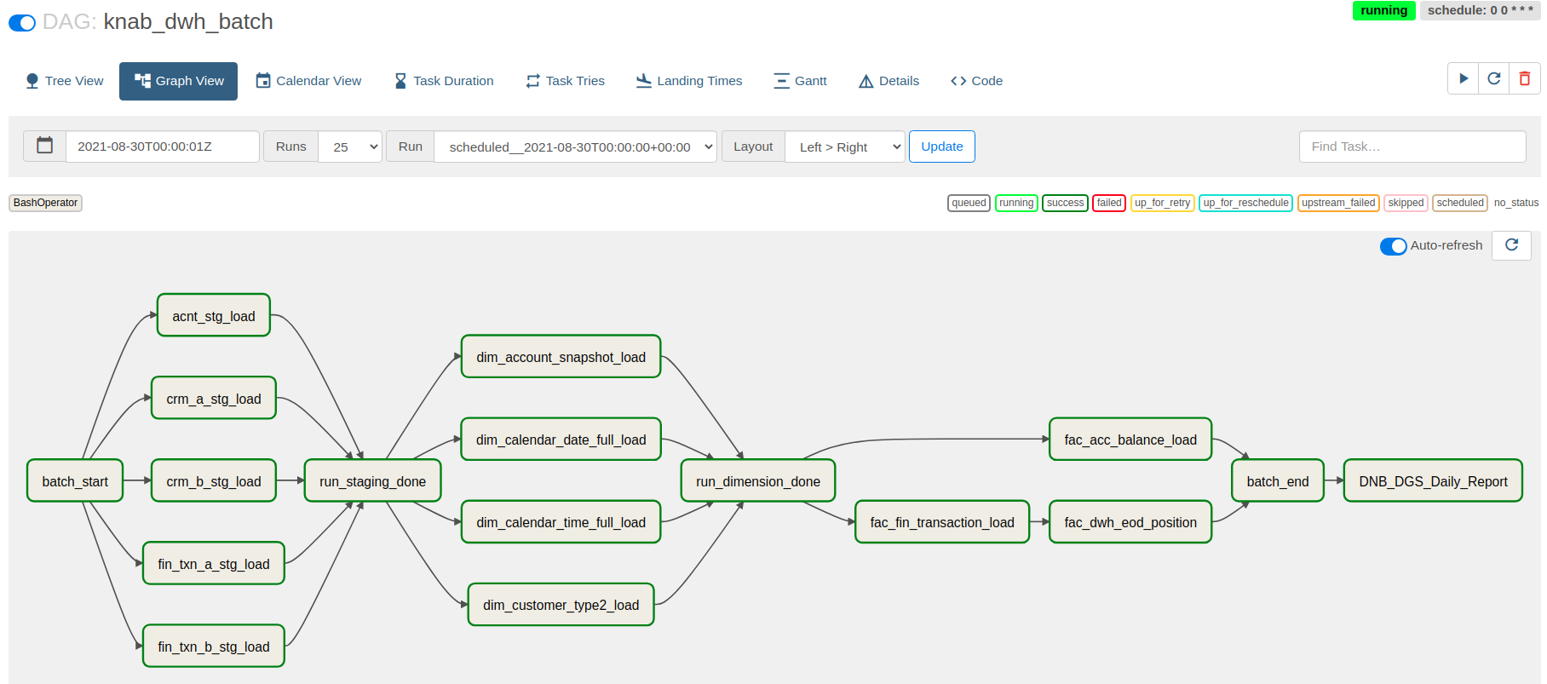
Solution Details : Job Process Model

Slide 14


Containerization :
5432
8080
9000
Docker Host
8080
Container App | Docker File name | Image name(Docker hub)
PostgreSQL | Dockerfile_pg | mekpradhan/knab_dwh:knab_dwh_pg
Airflow | Dockerfile_airflow | mekpradhan/knab_dwh:Knab_dwh_airflow

Slide 15
Demo
Done on a small set of Data(in the interest of time)
Will be an E2E demo inclusive of:
SQL code walkthrough
Job execution using Airflow

Slide 16
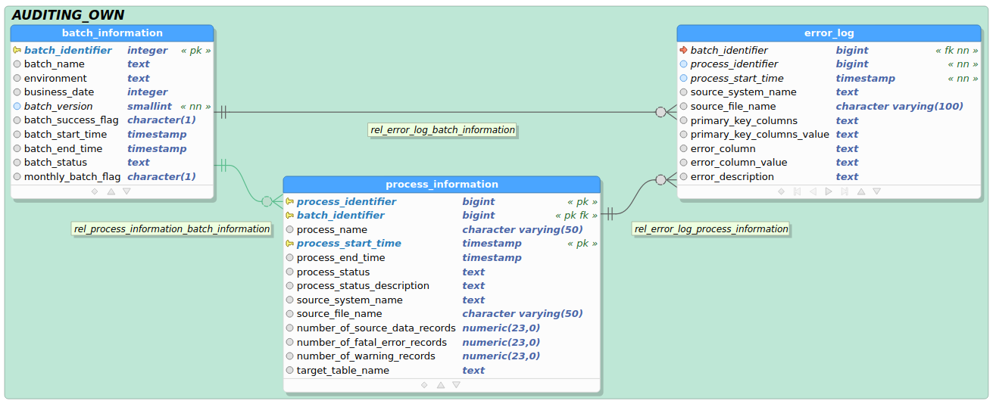
Solution Details : Data Model(Auditing)

Slide 17

Questions?

Slide 18
Future Improvements
Event Based Trigger : (Automatic triggering of DWH batch)
We can create an airflow dag task to check every 2-5 seconds, if already all files have been delivered then start the batch.
Batch Status Mail :
We can create a job which will send (Team) an email confirmation that batch has started, completed staging, completed fact and OLAP etc. In each stage we can get notified.
Staging Area :
Parallel processing : If we use Amazon redshift(distributed network) to store whole DWH area, then these huge data can be processed parallel across multiple nodes.
Batch Monitoring Dashboard :
Create a Batch monitoring dashboard using auditing_own schema tables, where we can easily monitor the batch status(if not airflow).
Source File Movement :
Once Python processes the source file, the file should be moved to done location. In that way we will not be overriding the files of one date to another.
In case there is a failure we should move the file to working location. In that way it would be clear which one is still pending for processing.

Slide 19
Future Improvements
Independent Execution of airflow containers :
In a production environment set up , we should separate airflow scheduler & webserver, so that they should run in two different containers.
Proper networking between containers.
Creating an docker-compose.yml file to start all these containers at once
PDF Report to DNB

Slide 20
Code Base Links :
Docker Images(Airflow + Postgres)
Dockerfiles : https://github.com/Kulamanipradhan0/knab_dwh
Dockerfile_pg
Dockerfile_airflow
Images : https://hub.docker.com/repository/docker/mekpradhan/knab_dwh
DDL Code base : This is used to create all DB objects i.e. schema, users, tables, partitions etc
https://github.com/Kulamanipradhan0/knab_dwh/tree/main/db_scripts
ETL Repository : All code base related to staging, dimension, fact & report loading
https://github.com/Kulamanipradhan0/knab_dwh/tree/main/etl_repo
Sample Source Files : All sample flat files
https://github.com/Kulamanipradhan0/knab_dwh/tree/main/src_files/polling
Airflow Dag file : Used for running the complete DWH batch
https://github.com/Kulamanipradhan0/knab_dwh/tree/main/airflow/dags

Slide 21
Code Base Links :
Loading data from Transaction to EOD Position : (Making sure all active customers are getting loaded everyday )
https://github.com/Kulamanipradhan0/knab_dwh/blob/main/etl_repo/fact/fac_dwh_eod_position.sql
Data Validation Layer(nice to have). Ex:
https://github.com/Kulamanipradhan0/knab_dwh/blob/main/etl_repo/staging/staging_data_validation.sql
ETL Log files : During Job run ETL logs will be created in this directory.
https://github.com/Kulamanipradhan0/knab_dwh/tree/main/log_files
SCD Type 2 Implementation using SQL : (dim_customer)
https://github.com/Kulamanipradhan0/knab_dwh/blob/main/etl_repo/dimension/dim_customer_type2_load.sql
Report Code : (DNB_DGS_Last_Year_Report)
Main Job : https://github.com/Kulamanipradhan0/knab_dwh/blob/main/etl_repo/report/DNB_DGS_Last_Year_Report.py
SQL : https://github.com/Kulamanipradhan0/knab_dwh/blob/main/etl_repo/report/dnb_dgs_report_query.sql

Slide 22


