Slide 1
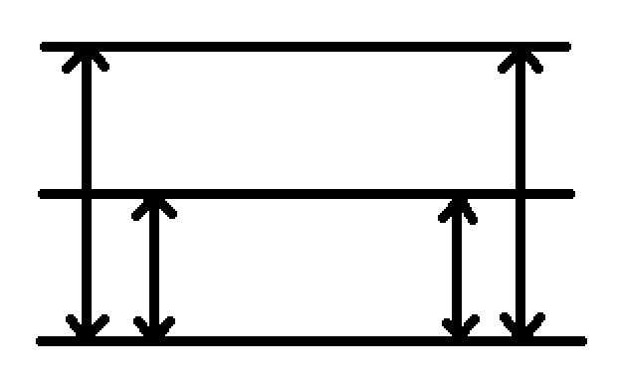
Temperature scale Conversion
100C
212F
Steam Pt
Tc
Tf
Freezing Pt
0C
32F

Slide 2
Closed System Work
P
1
a
b
2
V
1
2
Δx

