Slide 1



Energy Consumption Trend Analysis with Power BI

Slide 2

Learning Objectives
Gain insight into the data points crucial for monitoring energy consumption.
Learn how interactive dashboards in Power BI can reveal valuable patterns in _energy usage (gas, electricity, water).
Understand the connection between data-driven energy analysis and strategic _business improvements.
Appreciate the role of Power BI in facilitating sustainable practices and operational _optimization.
Recognize how Power BI can be utilized to visualize and interpret energy _consumption trends.
GOAL
Source :
www.freepik.com/

Slide 3
Tools and Technology used
This project heavily relied on the following tools and technologies:
Power BI: The core platform for developing the interactive dashboard. Its robust visualization capabilities and __________seamless data connectivity were crucial for analyzing energy consumption trends.
Microsoft Excel: Used for initial data organization and preparation before importing the data into Power BI.
CSV Data Files: The primary format for the energy consumption data, chosen for its straightforward structure _______________and compatibility with Power BI.

Slide 4
Methodology
This project followed a structured methodology to transform raw energy consumption data into actionable insights:
Data Acquisition & Preparation: The process began with the acquisition of energy consumption data (gas, electricity, water) in [CSV]. Initial steps involved data cleaning, handling missing values, and ensuring data integrity for accurate analysis.
Data Modeling in Power BI: The cleaned data was then imported into Power BI. Relationships between relevant data points were established to create a robust and efficient data model, optimizing it for visualization and analysis.
Dashboard Design & Development: An interactive dashboard was designed with a focus on clarity and user experience. Key performance indicators (KPIs) such as total costs, unit consumption, and energy usage patterns were visualized using appropriate charts and graphs (e.g., line charts for trends, bar charts for comparisons, etc.).
Interactive Features & Analysis: The dashboard was enhanced with interactive elements like filters and slicers, allowing users to explore the data from different perspectives and identify specific trends or anomalies.
Iterative Refinement: Throughout the development process, the dashboard underwent iterative refinement based on initial findings and usability considerations to ensure it effectively communicates the intended insights.

Slide 5
Problem Statement:
Effective management of energy resources (gas, electricity, water) is crucial for both financial sustainability and environmental responsibility. However, without a comprehensive and easily understandable view of consumption patterns, organizations often struggle to:
Identify areas of high energy usage and potential waste.
Track the impact of energy-saving initiatives.
Make informed decisions regarding resource allocation and efficiency improvements.

Slide 6
Solution:
An Interactive Power BI Dashboard for Data-Driven Energy Management
To address the challenges of understanding and optimizing energy consumption, this project delivers a comprehensive and interactive Power BI dashboard designed to transform raw energy data (gas, electricity, water) into actionable insights.
Gain a Clear Visual Overview: The dashboard provides intuitive visualizations of key energy consumption metrics, including total costs, unit consumption for each energy type, and historical usage trends.
Identify Areas for Optimization: Through interactive charts and filters, users can drill down into specific time periods, energy types, and potentially even departments or locations to pinpoint areas with high consumption or unusual patterns, highlighting opportunities for efficiency improvements.
Track Progress of Initiatives: The dashboard can be used to monitor the impact of energy-saving initiatives over time, providing visual evidence of their effectiveness and supporting data-driven decisions on future investments.
Facilitate Informed Decision-Making: By presenting energy data in a clear and accessible format, the dashboard equips stakeholders with the information needed to make informed decisions regarding resource allocation, operational adjustments, and long-term energy strategies.
Promote Sustainability and Cost Reduction: Ultimately, this Power BI solution enables organizations to move towards more sustainable practices by providing the insights necessary to reduce energy waste, lower operational costs, and minimize their environmental footprint.

Slide 7
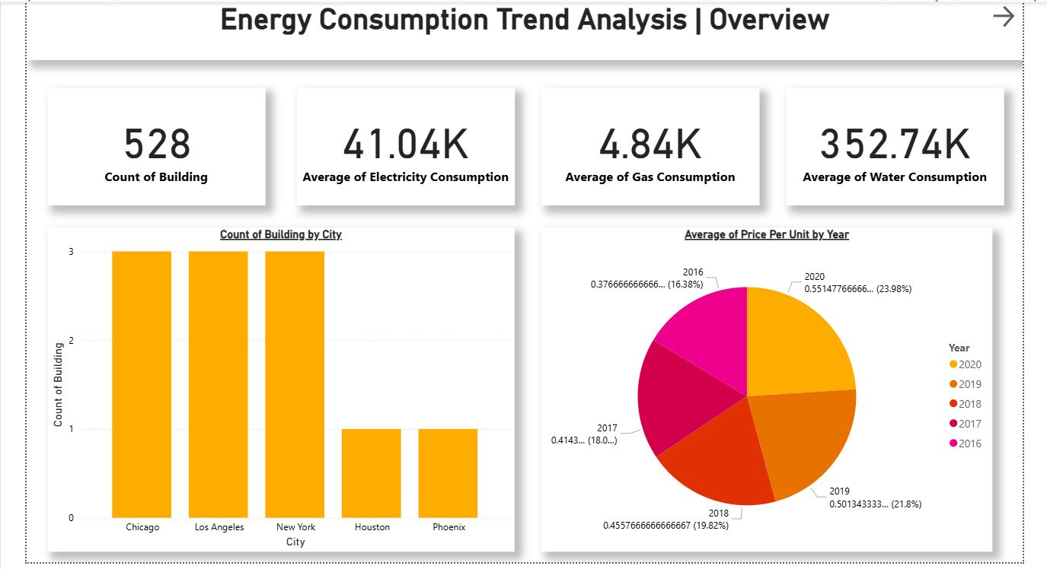
Screenshot of Output:

Slide 8
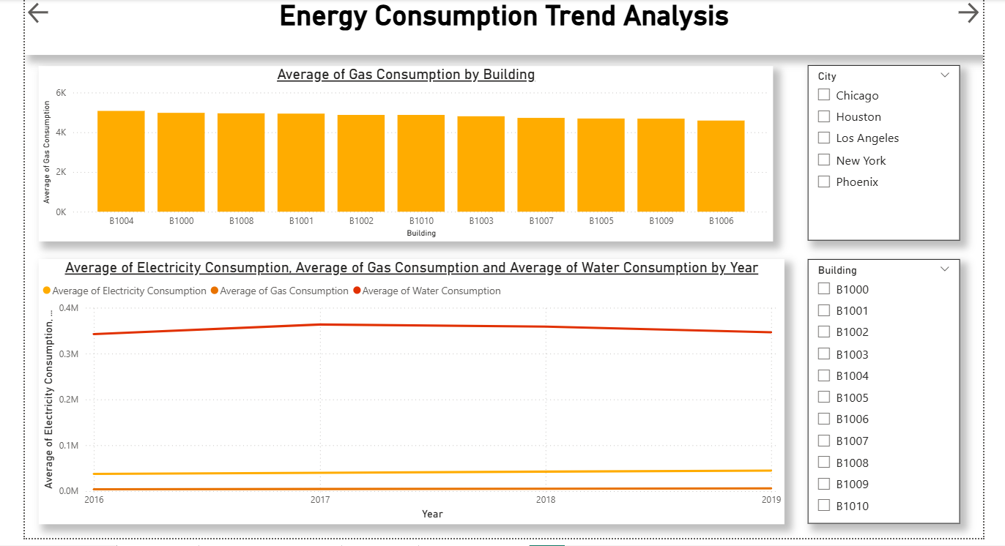

Slide 9
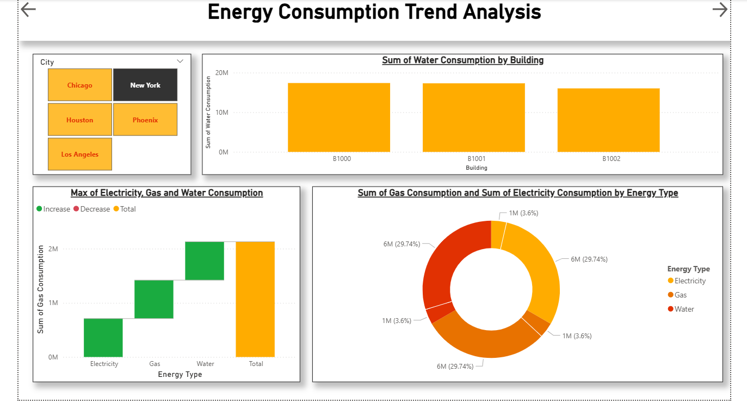

Slide 10
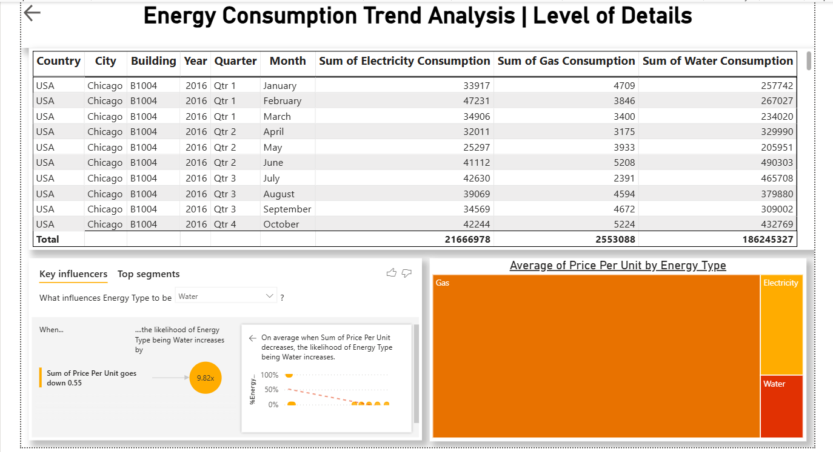

Slide 11
Conclusion:
The Energy Consumption Trend Analysis project leverages Power BI to visualize crucial energy data. This interactive dashboard allows organizations to gain immediate insights into their gas, electricity, and water usage, facilitating the identification of waste, the measurement of savings, and the implementation of more sustainable and efficient practices.
Utilizing Power BI, this project analyzes energy consumption trends (gas, electricity, water) through an intuitive dashboard. This enables businesses to easily understand their energy usage, pinpoint areas for reduction, and track the success of sustainability efforts, leading to better resource management and operational efficiency.

