Slide 1


GLA UNIVERSITY (MATHURA)
Computer Science And Engineering Department
COURSE - JOVAC AWS
SUPERVISOR - Mr. Raushan Kumar Singh
Dr. Ruby Panwar

Slide 2



Create an AutoScaling Group and put Load Balancer,
Test it.
TOPIC :-
Presented By:-
Kuldeep Sharma (2215000956)
Anamika Singh (2215000221)
Tanish Gupta (2215001829)
Vishnu Upadhyay (2215001991)
Sandeep Kumar (2215001573)

Slide 3
STEPS FOR CREATING PROJECT ON AWS.
Create two server/instances.
Create target group & connect server.
Create Load Balancer.
Create Launch template.
Create Autoscaling group.

Slide 4
What is Autoscaling group?
Autoscaling Group helps to create automatically adjusts the number of instances to handle the load if load will decrease then instances will terminate.
Ex:- Web Application, Netflix, Amazon, etc

Slide 5
What is Load Balancer ?
A Load Balancer is a service that automatically distributes incoming network traffic across multiple servers or instances. The goal of a load balancer is to ensure that no single server is overwhelmed by too much traffic, thus improving the availability, reliability, and scalability of your application.

Slide 6
Launch Template:
Define parameters like AMI (Amazon Machine Image), instance type, key pairs, security groups, and more, to reuse across multiple instance launches.

Slide 7
Target group:
In AWS, a Target Group is a configuration resource associated with Elastic Load Balancers (ELB) that defines how traffic should be directed to a specific set of registered instances, containers, or IP address.

Slide 8
Real life Example:
E-Commerce Website (e.g. Flipkart)
Video Streaming Platform (e.g. Netflix)
Financial Applications (e.g. Paytm)
Online Gaming Services (e.g. Call of Duty)

Slide 9
Advantage:
Scalability
High Availability
Improved Performance and User Experience
Simplified Management and Monitoring

Slide 10
Conclusion
The combination of an Auto Scaling Group and a Load Balancer provides a robust, scalable, cost-effective, and highly available architecture for your applications. It ensures that your system can handle varying loads while maintaining consistent performance, security, and availability.

Slide 11
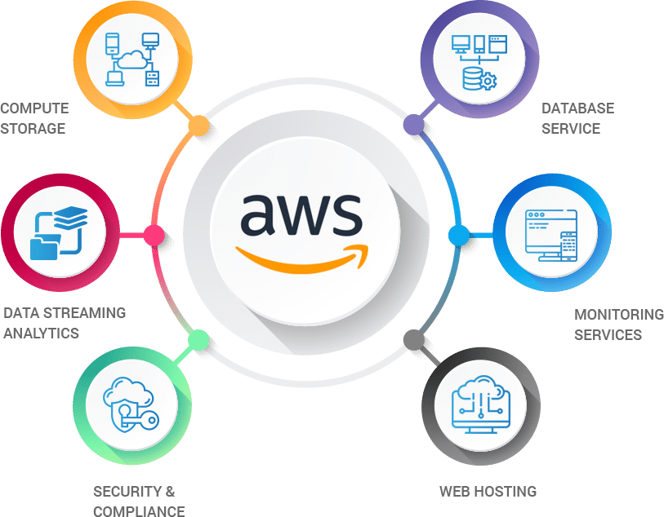
THANK YOU!

