Slide 1


Project Presentation
Project Title:Spotify-Song-Recommendation
Prepared By:
Kuldeep Tapodhan - 92200104033

Slide 2

Project Description
This project builds a content-based recommendation system to suggest Bollywood songs similar to a given input song. The dataset consists of song attributes such as genre, artist, album/movie, and user rating. These attributes are combined into a single tag column, preprocessed (lowercased, spaces removed, ratings normalized), and converted into numerical representations using TF-IDF Vectorization.
The system uses the K-Nearest Neighbors (KNN) algorithm with cosine similarity to find the top 5 most similar songs. The trained model takes the TF-IDF vector of the input song and retrieves the nearest neighbors from the dataset. The final recommendations exclude the input song and return 5 similar songs based on textual and rating similarities

Slide 3
Work-Flow
Dataset:
  Uses a CSV file (Bollywood_songs.csv) containing Bollywood songs with attributes: Song-Name, Artists, Album/Movie, Genre, and User-Rating.
Preprocessing:
  Remove Spaces: Cleans Artists, Album/Movie, and Genre by removing spaces.
  Normalize Text: Converts Artists, Album/Movie, and Genre to lowercase.
  Scale Ratings: Normalizes User-Rating by dividing it by 10.
  Create Tags: Combines Genre, Artists, Album/Movie, and User-Rating into a single tag column.
  Drop Unnecessary Columns: Removes Genre, Artists, Album/Movie, and User-Rating after combining.

Slide 4
Project Description
Feature Extraction
  CountVectorizer: Converts text data (tag) into numerical vectors using the Bag-of-Words model (max 5000 features, stop words removed).
  TF-IDF Vectorizer: Transforms tag into TF-IDF (Term Frequency-Inverse Document Frequency) vectors for better similarity detection.
Model Selection (K-Nearest Neighbors - KNN)
  KNN (k=6, Cosine Similarity): Trains the model using TF-IDF vectors for song similarity.
  Find Nearest Neighbors: Identifies the 5 most similar songs for any given input song.
  Recommendation Function (recommend)
  Locate Song Index: Finds the index of the given song in the dataset.
  Find Nearest Neighbors: Retrieves 6 nearest songs (including the input song).
  Return Top 5 Recommendations: Excludes the input song and returns 5 most similar songs.
  Example Usage
  Call recommend('Badi Dheere Jali') to get the top 5 song recommendations.

Slide 5
Flask Web Page
Frontend: Built using HTML, CSS, and Bootstrap for an interactive UI.
Backend: Flask handles user input, model predictions, and result display.
User Flow:
  User enters a song name.
  Flask processes the request and fetches recommendations.
  Recommended songs are displayed dynamically on the webpage.
Application
Personalized Music Recommendations use machine learning to find Bollywood songs similar to your favorite tracks. It analyzes features like tempo, melody, and mood to suggest songs that match your taste. Whether you love soulful tunes or upbeat beats, it helps you discover new music easily.

Slide 6
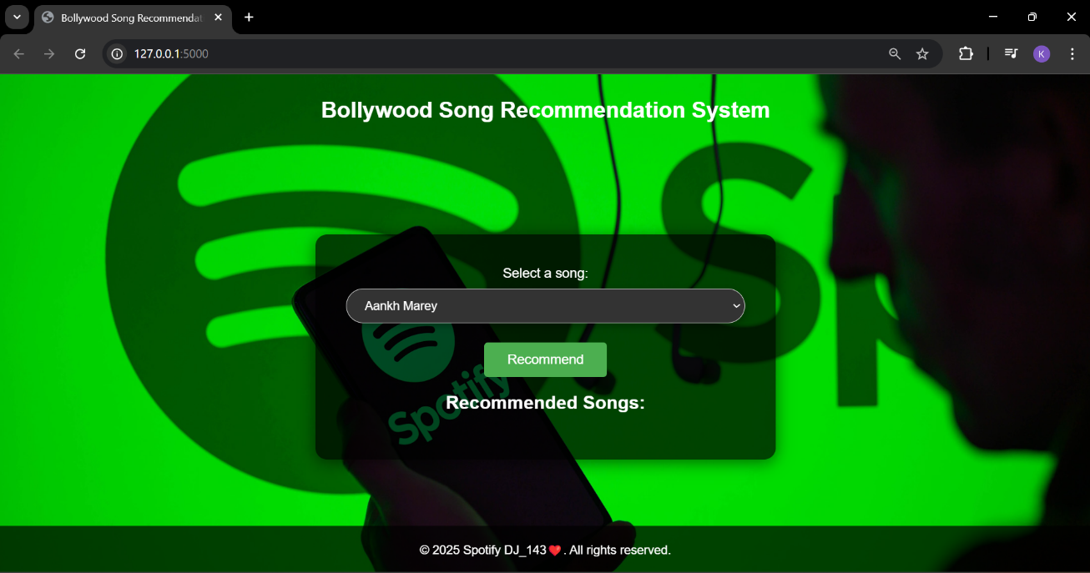
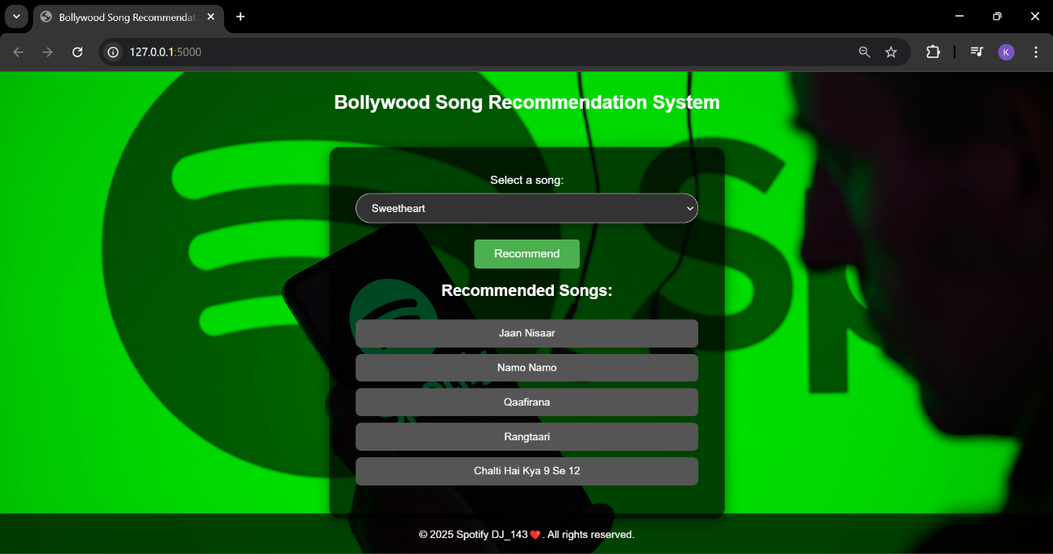
Web Page

