Slide 1


Reconstruction-free Inference on Compressive Measurements
Suhas Lohit, Kuldeep Kulkarni, Pavan Turaga, Jian Wang, Aswin Sankaranarayanan
Arizona State University Carnegie Mellon University

Slide 2
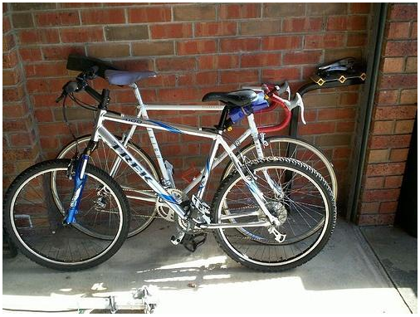
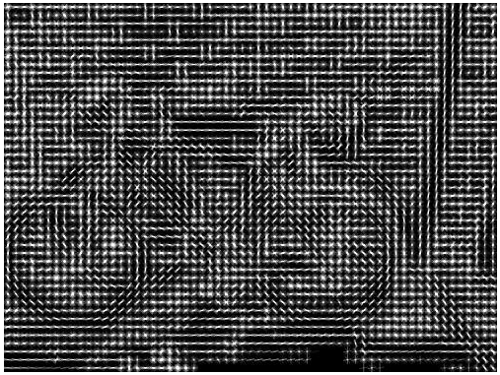

Inference in the Traditional Sensing Framework
Traditional computer vision pipeline
HOG descriptor*
Feature
Extraction
Inference
Camera with a
CCD/CMOS array

Slide 3
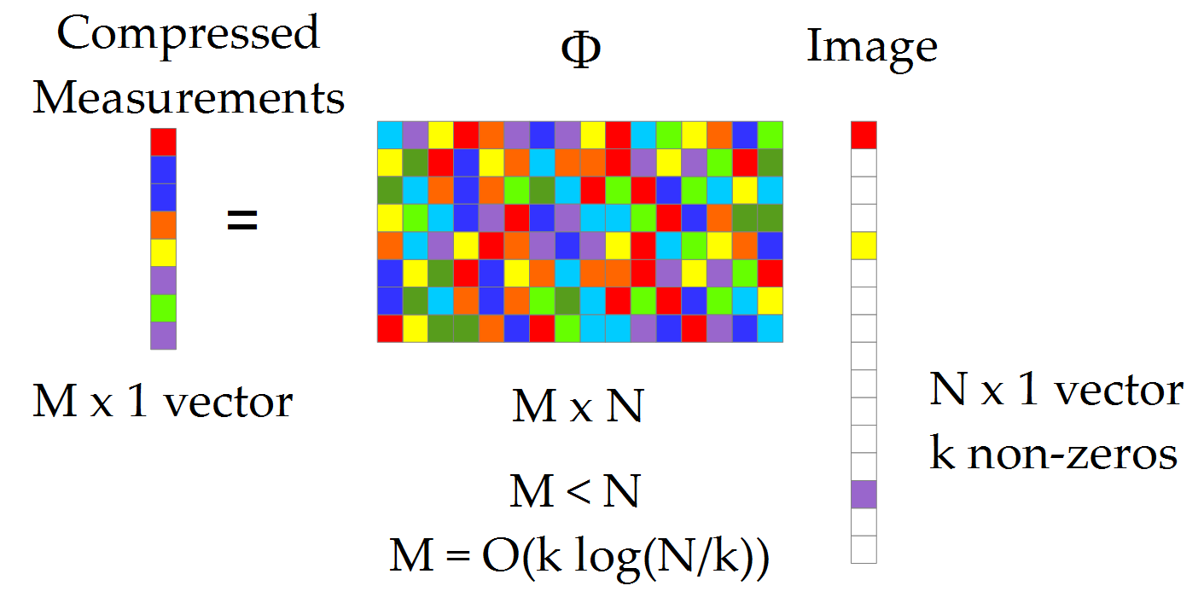
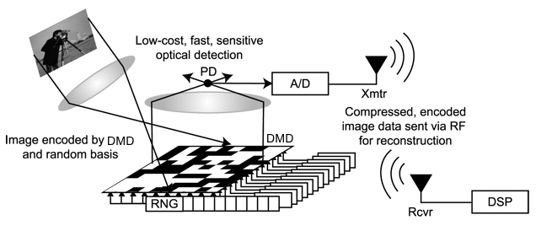
Compressive Imaging – Single Pixel Camera
*

Slide 4

Inference on Compressive Measurements
Reconstruct-then-infer paradigm
Major bottleneck
Reconstruction
Feature
Extraction
Inference
Compressive
Measurements
from SPC

Slide 5
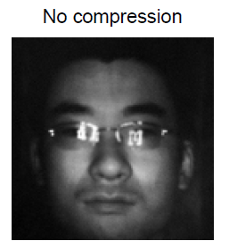
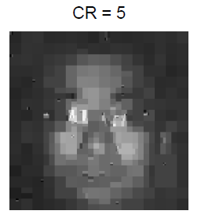
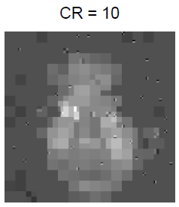
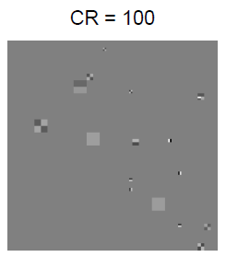
Reconstruction algorithms suffer from drawbacks
Computationally expensive
Do not produce good results at high compression ratios.
Various parameters such as sparsity level and sparsifying basis need to be known a priori.

Slide 6
Is Reconstruction Necessary for Inference?
We posit that one can build effective inference algorithms directly on the compressed bits.
Reconstruction-free compressive inference
Reconstruction
Feature
Extraction
Inference
Compressive
measurements
Bypass reconstruction?

Slide 7
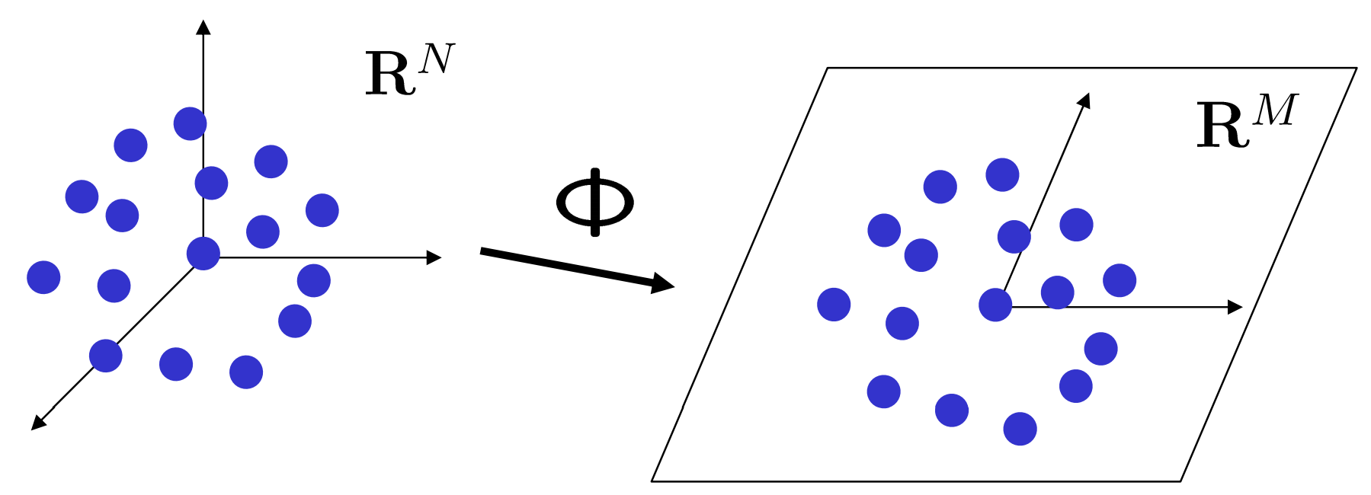

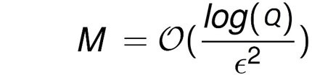

Basis for direct feature extraction
Johnson-Lindenstrauss Lemma [1]
For a given set of Q points in a high dimensional space, certain embeddings exist that nearly preserve distances between points when mapped to a lower dimensional space.
It has been shown that the mapping f can be a random matrix $Φ$ with entries drawn from certain distributions. Such matrices are used in CS.
[2]

Slide 8
Basis for direct feature extraction
This fact is employed in the design of the smashed filter for compressive classification by Davenport et al. (2007) [3].
We extend this idea to construct smashed correlation filters which are more robust to input variations.
As a consequence of the JL lemma, inner products and hence, correlations between vectors are also preserved after mapping to a lower dimension.

Slide 9
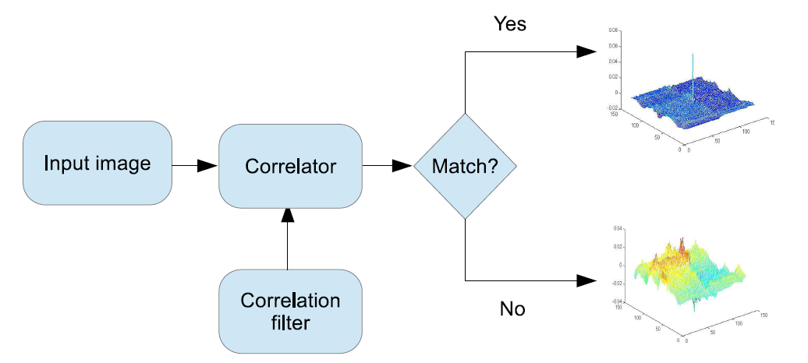
Correlation Filters for Visual Recognition

Slide 10
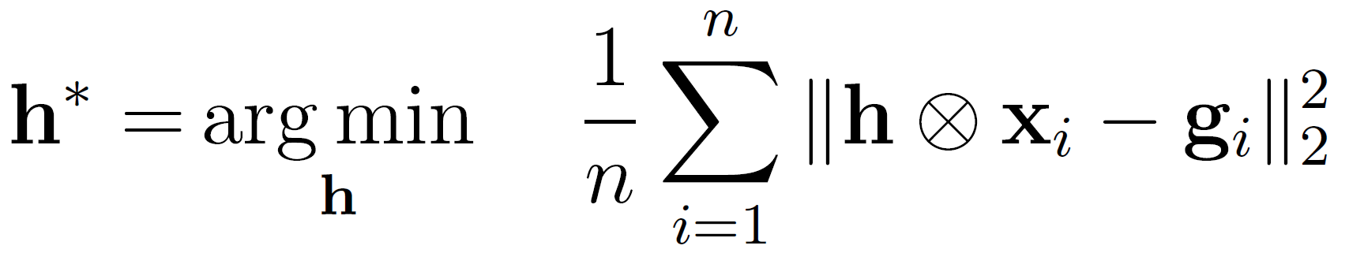
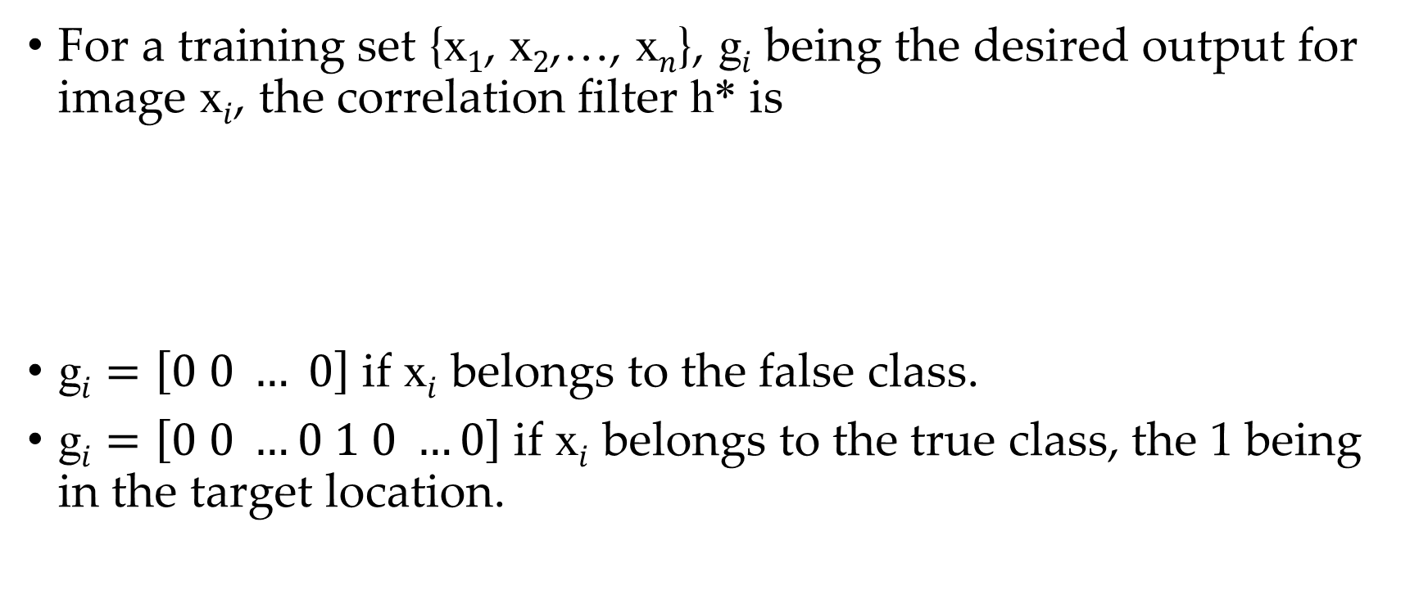
Correlation Filters for Visual Recognition
For a training set {x$1$, x$2$,…, x$n$}, g$i$ being the desired output for image x$i$, the correlation filter h* is
g$i$ $=\left[0 0 … 0\right]$ if x$i$ belongs to the false class.
g$i$ $=\left[0 0 …0 1 0 …0\right]$ if x$i$ belongs to the true class, the 1 being in the target location.

Slide 11
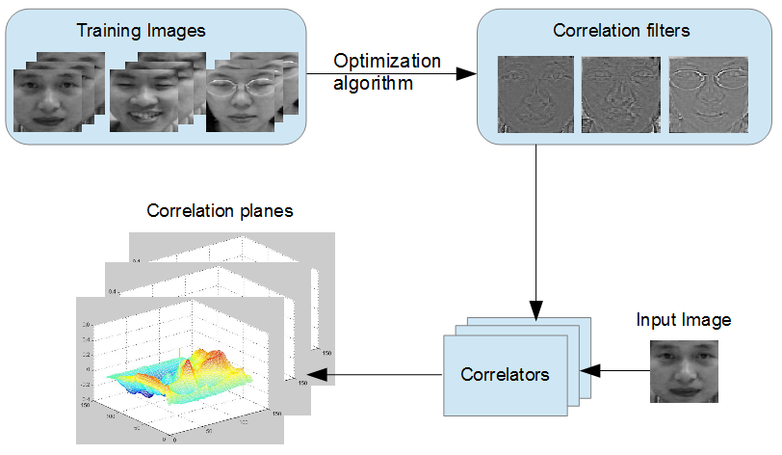



Recognition with Correlation Filters – Oracle Sensing
$$h^{ }$$
SVM
SVM
$$x$$
SVM
Class label
Extracted
Feature
$$c\left(i,j\right)= ⟨x,h^{i,j}⟩$$

Slide 12
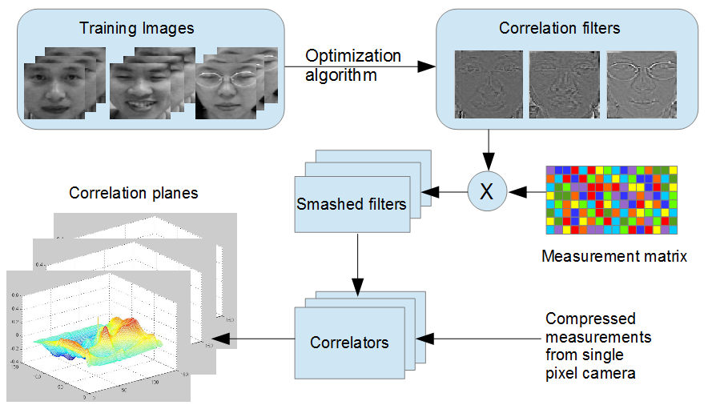





Smashed Correlation Filters for Compressive Recognition
$$h^{ }$$
$$Φh^{i,j}$$
$$Φ$$
SVM
SVM
SVM
Class label
Extracted
Feature
$$Φx$$
$$\left\langle Φx,Φh^{i,j}\right\rangle$$
$$\left\langle Φx,Φh^{i,j}\right\rangle −ϵ≤ c\left(i,j\right)≤\left\langle Φx,Φh^{i,j}\right\rangle +ϵ$$
Using a corollary of the JL lemma, we can write

Slide 13
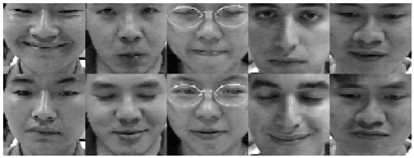
Experiments
Controlled experiments
AMP Database [4]
13 subjects with 75 images per subject.
25 for training, 50 for testing.
64 x 64 images.

Slide 14
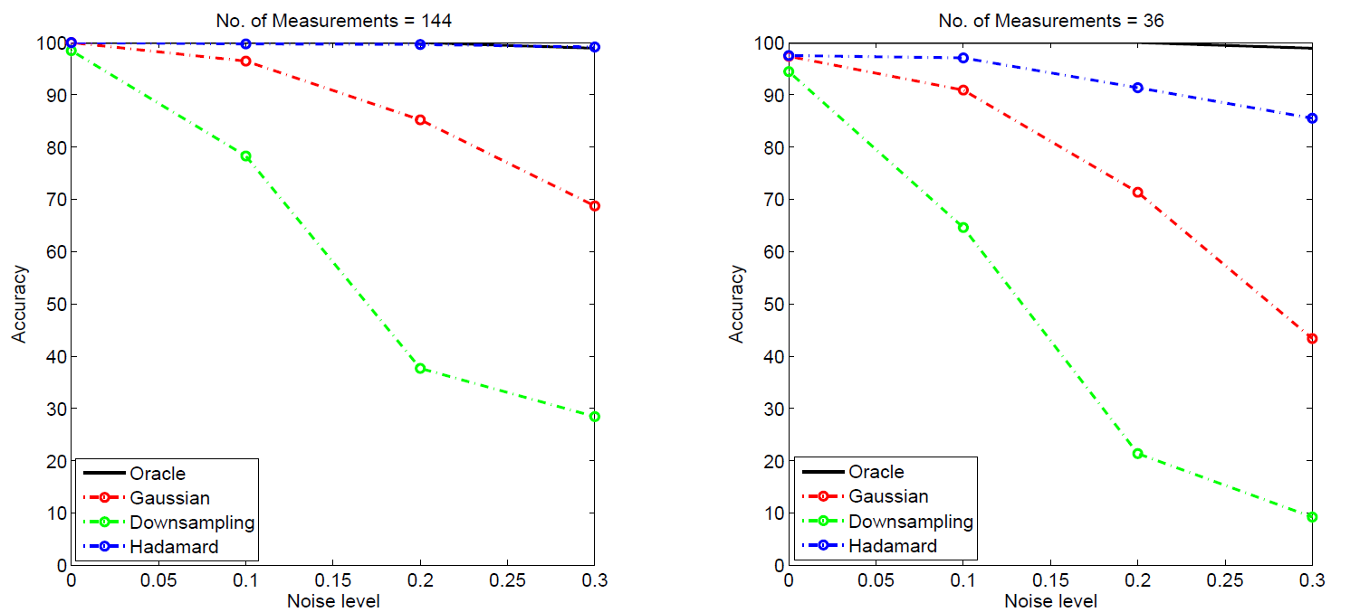
Results on AMP Database (64 x 64 images)
At low noise + high compression ratios; accuracy is comparable to oracle sensing.
Hadamard measurements are more robust to noise.

Slide 15
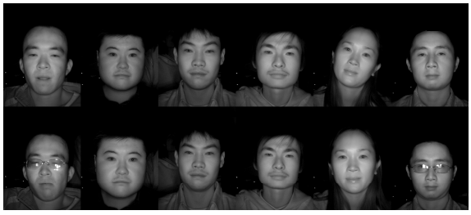
Experiments
Controlled experiments
NIR Database [5]
Near infrared images.
197 subjects with 20 images per subject.
10 for training, 10 for testing.
640 x 480 images resized to 256 x 256.

Slide 16
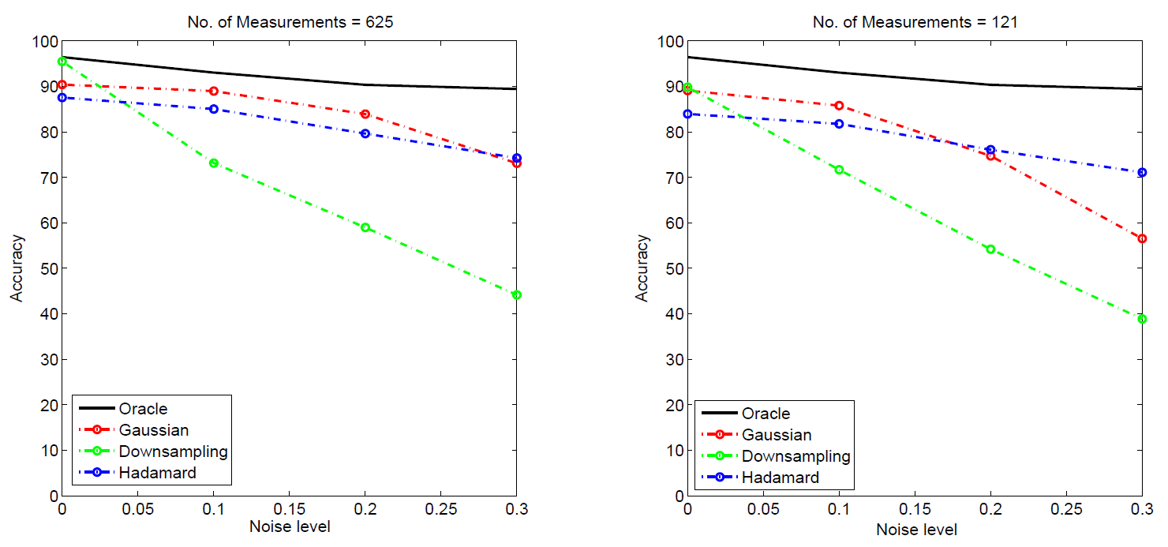
Results on NIR Database (256 x 256 images)
At low noise + high compression ratios; accuracy is comparable to oracle sensing.
Hadamard measurements are more robust to noise at high compression ratio.

Slide 17
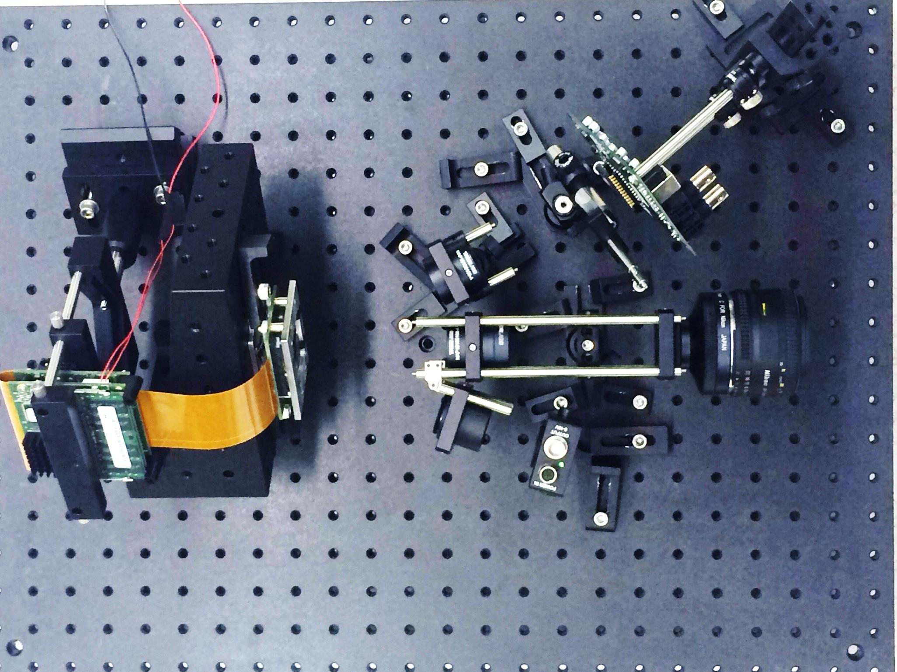
Experiments on Single Pixel Camera
New dataset using the SPC consists of CS measurements of 120 facial images of size 128 x 128.
Images belong to 30 subjects with 4 images per subject.
Images are captured using a DMD with resolution of 1024 x 768 and operating speed of 22,700 measurements per second.
Hadamard matrix was used for sensing.
photodetector
DMD
objective lens
relay lens

Slide 18
Experiments on Single Pixel Camera
Four training-testing splits were created using the database.
Each split containing 3 training images and 1 testing image.
Face recognition accuracy was computed as the average over all the splits.
Face Recognition Results
Compression Ratio | No. of measurements | Recognition Accuracy (%)
1 (Oracle) | 16384 | 60
10 | 1638 | 62.5
50 | 328 | 58.33
100 | 164 | 53.33
200 | 82 | 49.17

Slide 19
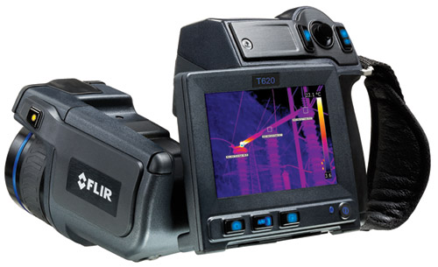
Benefits of compressive acquisition in IR
IR imaging is provides illumination invariance.
Non-visible wavelength sensors are expensive.
Compressive imaging -- e.g. SPC -- provides a cost-effective alternative.
FLIR T620 IR camera
640 x 480 pixels
Price : $ 21,000

Slide 20
Conclusions and Future Work
We have shown that compressive sensing technology can be employed in a practical inference application by extracting features from compressive measurements directly, using smashed correlation filters, thus avoiding reconstruction.
Points to new avenues of research for understanding how to solve high-level computer vision problems from computational imagers in general.

Slide 21
References
W.B. Johnson, and J. Lindenstrauss. "Extensions of Lipschitz mappings into a Hilbert space." Contemporary mathematics 26.189-206 (1984): 1.
J. Romberg, M. Wakin, "Compressed Sensing: A Tutorial", IEEE Statistical Signal Processing Workshop, 2007.
M. A. Davenport, M. F. Duarte, M. B. Wakin, J. N. Laska, D. Takhar, K. F. Kelly,and R. G. Baraniuk. “The smashed filter for compressive classification and target recognition.” Electronic Imaging, pages 64980H–64980H. International Society for Optics and Photonics, 2007.
AMP Database, http://chenlab.ece.cornell.edu/projects/FaceAuthentication
S. Z. Li, R. Chu, S. Liao, and L. Zhang. “Illumination invariant face recognition using near-infrared images.” Pattern Analysis and Machine Intelligence, IEEE Transactions on, 29(4):627–639, 2007.
Thank you

Slide 23
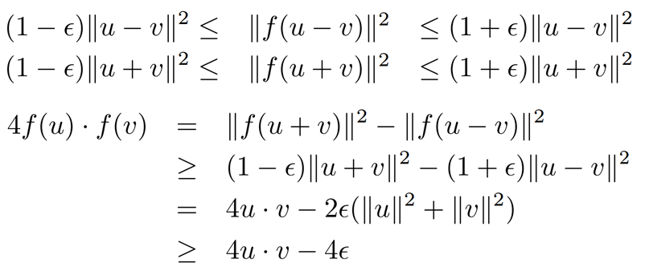
Preserving Inner Products – Proof Sketch
∀ u, v ∈ Q and ∥u∥ = 1, ∥v∥ = 1,
Using JL lemma,
=
Proving the other direction along the same lines gives us the required result.

Slide 24
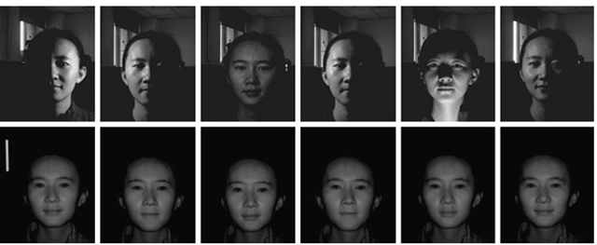
Compressive Sensing for Inference
Benefits of IR imaging for inference – illumination invariance
Color camera
Near-infrared imager

Slide 25
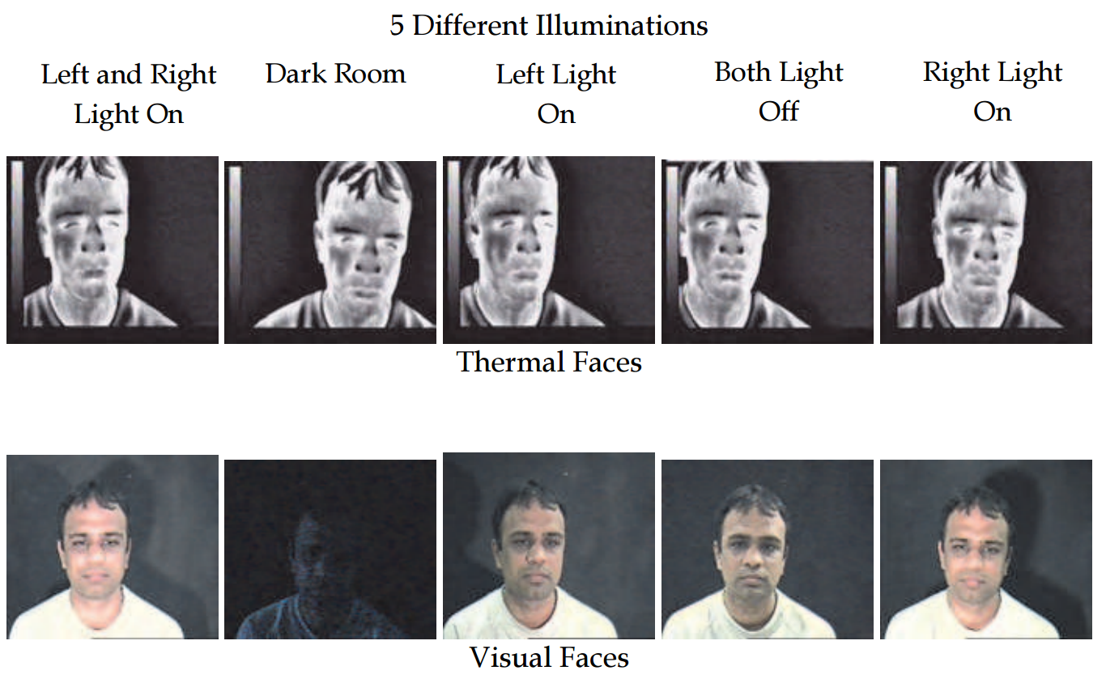
Compressive Sensing for Inference
Benefits of IR imaging for inference – illumination invariance
Long-wave IR imager
Color camera

Slide 26
Acquisition Time Can Be Significantly Reduced
Our SPC senses 22.7 measurements/second
For a 128 x 128 image, sensing time is
Sensing Mechanism | % Measurements Required | Sensing Time
Sensing all measurements | 100% (16384) | 0.72 s
Compressive sensing with recovery | 20% | ~ 0.1 s
Compressive sensing without reconstruction | 1% | ~ 0.001 s

Slide 27
Contributions
We show that simple linear features using smashed correlation filters can be extracted without reconstruction and can be used reliably for high level inference.
It is shown through experiments in face recognition that it is indeed possible to perform compressive inference with these features with only a marginal loss in accuracy compared to traditional (oracle) sensing.
Notes:
1. Face recognition expts in IR domain.

Slide 28
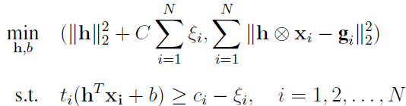
Maximum Margin Correlation Filters
Developed by Rodriguez et al. (2013)
Combines the strengths of correlation filters and SVM.
Optimize for
High peak at target location.
Maximum margin (SVM objective)
Solve optimization problem of the form:
Can be reduced to a single optimization problem that can be solved on any standard SVM solver.

Slide 29
Feature extraction from correlation planes
Each correlation plane is divided into non-overlapping blocks and the PSR and peak values of each block is extracted.
The peak and PSR for the entire correlation plane are also extracted.
All these values are concatenated to form the feature vector that is input to the SVMs.

Slide 30


