Slide 1
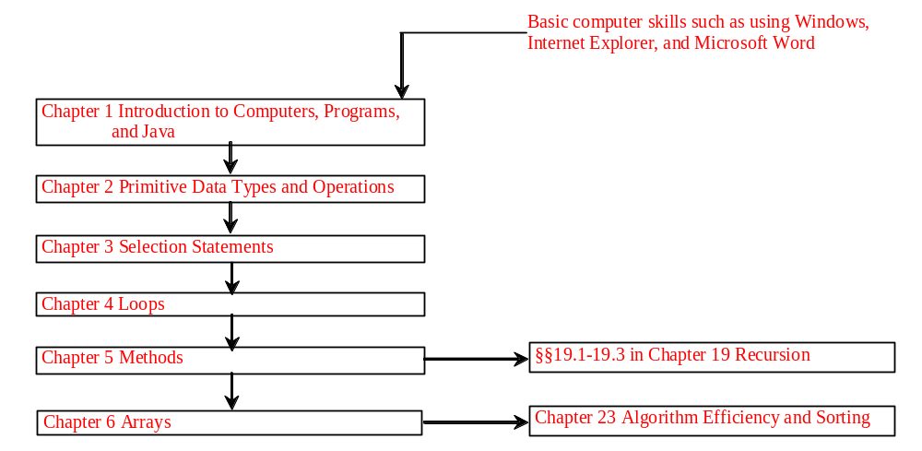
Chapter 6 Arrays

Slide 2
Objectives
To describe why an array is necessary in programming (§6.1).
To learn the steps involved in using arrays: declaring array reference variables and creating arrays (§6.2).
To initialize the values in an array (§6.2).
To simplify programming using JDK 1.5 enhanced for loop (§6.2).
To copy contents from one array to another (§6.3).
To develop and invoke methods with array arguments and ruturn type (§6.4-6.5).
To sort an array using the selection sort algorithm (§6.6).
To search elements using the linear or binary search algorithm (§6.7).
To declare and create multidimensional arrays (§6.8).
To declare and create multidimensional arrays (§6.9 Optional).

Slide 3
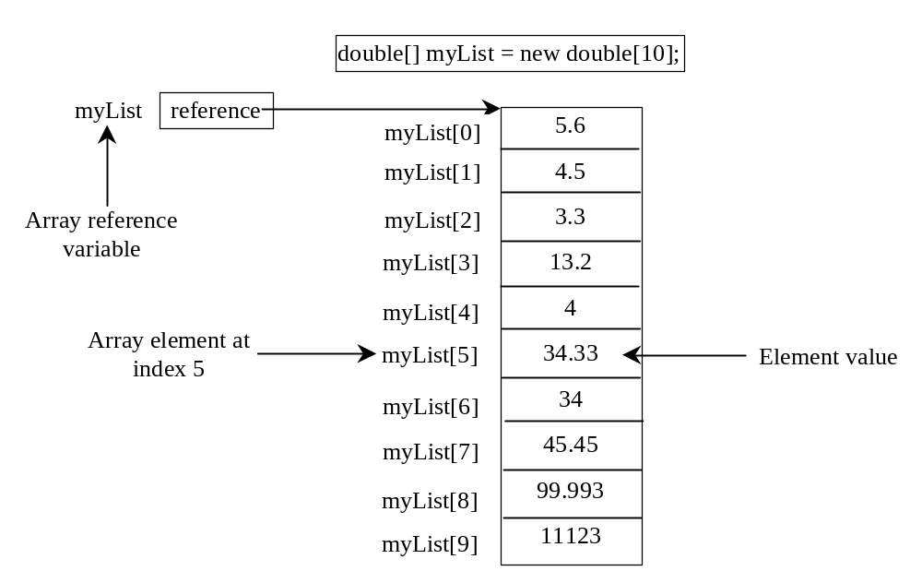
Introducing Arrays
Array is a data structure that represents a collection of the same types of data.

Slide 4
Declaring Array Variables
datatype[] arrayRefVar;
Example:
double[] myList;
datatype arrayRefVar[]; // This style is allowed, but not preferred
Example:
double myList[];

Slide 5
Creating Arrays
arrayRefVar = new datatype[arraySize];
Example:
myList = new double[10];
myList[0] references the first element in the array.
myList[9] references the last element in the array.

Slide 6
Declaring and Creating in One Step
datatype[] arrayRefVar = new
datatype[arraySize];
double[] myList = new double[10];
datatype arrayRefVar[] = new
datatype[arraySize];
double myList[] = new double[10];

Slide 7
The Length of an Array
Once an array is created, its size is fixed. It cannot be changed. You can find its size using
    arrayRefVar.length
For example,
    myList.length returns 10

Slide 8
Default Values
When an array is created, its elements are assigned the default value of
  0 for the numeric primitive data types,
  '\u0000' for char types, and
  false for boolean types.

Slide 9
Indexed Variables
The array elements are accessed through the index. The array indices are 0-based, i.e., it starts from 0 to arrayRefVar.length-1. In the example in Figure 6.1, myList holds ten double values and the indices are from 0 to 9.
Each element in the array is represented using the following syntax, known as an indexed variable:
  arrayRefVar[index];

Slide 10
Using Indexed Variables
After an array is created, an indexed variable can be used in the same way as a regular variable. For example, the following code adds the value in myList[0] and myList[1] to myList[2].
  myList[2] = myList[0] + myList[1];

Slide 11
Array Initializers
Declaring, creating, initializing in one step:
double[] myList = {1.9, 2.9, 3.4, 3.5};
This shorthand syntax must be in one statement.

Slide 12
Declaring, creating, initializing Using the Shorthand Notation
double[] myList = {1.9, 2.9, 3.4, 3.5};
This shorthand notation is equivalent to the following statements:
double[] myList = new double[4];
myList[0] = 1.9;
myList[1] = 2.9;
myList[2] = 3.4;
myList[3] = 3.5;

Slide 13
CAUTION
Using the shorthand notation, you have to declare, create, and initialize the array all in one statement. Splitting it would cause a syntax error. For example, the following is wrong:
  double[] myList;
  myList = {1.9, 2.9, 3.4, 3.5};

Slide 14
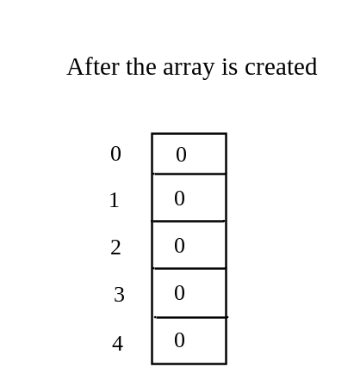
Trace Program with Arrays
animation
Declare array variable values, create an array, and assign its reference to values
public class Test {
public static void main(String[] args) {
int[] values = new int[5];
for (int i = 1; i < 5; i++) {
values[i] = values[i] + values[i-1];
}
values[0] = values[1] + values[4];
}
}

Slide 15
Trace Program with Arrays
animation
i becomes 1
public class Test {
public static void main(String[] args) {
int[] values = new int[5];
for (int i = 1; i < 5; i++) {
values[i] = values[i] + values[i-1];
}
values[0] = values[1] + values[4];
}
}

Slide 16
Trace Program with Arrays
animation
i (=1) is less than 5
public class Test {
public static void main(String[] args) {
int[] values = new int[5];
for (int i = 1; i < 5; i++) {
values[i] = values[i] + values[i-1];
}
values[0] = values[1] + values[4];
}
}

Slide 17
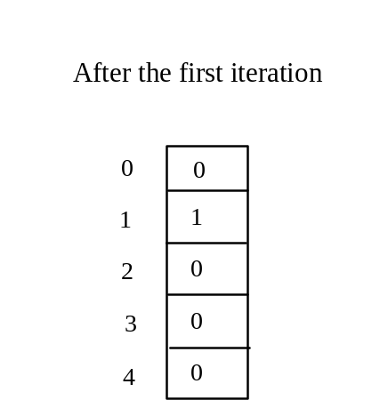
Trace Program with Arrays
animation
After this line is executed, value[1] is 1
public class Test {
public static void main(String[] args) {
int[] values = new int[5];
for (int i = 1; i < 5; i++) {
values[i] = i + values[i-1];
}
values[0] = values[1] + values[4];
}
}

Slide 18
Trace Program with Arrays
animation
After i++, i becomes 2
public class Test {
public static void main(String[] args) {
int[] values = new int[5];
for (int i = 1; i < 5; i++) {
values[i] = values[i] + values[i-1];
}
values[0] = values[1] + values[4];
}
}

Slide 19
Trace Program with Arrays
animation
i (= 2) is less than 5
public class Test {
public static void main(String[] args) {
int[] values = new int[5];
for (int i = 1; i < 5; i++) {
values[i] = values[i] + values[i-1];
}
values[0] = values[1] + values[4];
}
}

Slide 20
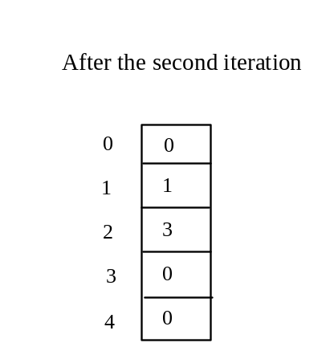
Trace Program with Arrays
animation
After this line is executed,
values[2] is 3 (2 + 1)
public class Test {
public static void main(String[] args) {
int[] values = new int[5];
for (int i = 1; i < 5; i++) {
values[i] = i + values[i-1];
}
values[0] = values[1] + values[4];
}
}

Slide 21
Trace Program with Arrays
animation
After this, i becomes 3.
public class Test {
public static void main(String[] args) {
int[] values = new int[5];
for (int i = 1; i < 5; i++) {
values[i] = i + values[i-1];
}
values[0] = values[1] + values[4];
}
}

Slide 22
Trace Program with Arrays
animation
i (=3) is still less than 5.
public class Test {
public static void main(String[] args) {
int[] values = new int[5];
for (int i = 1; i < 5; i++) {
values[i] = i + values[i-1];
}
values[0] = values[1] + values[4];
}
}

Slide 23
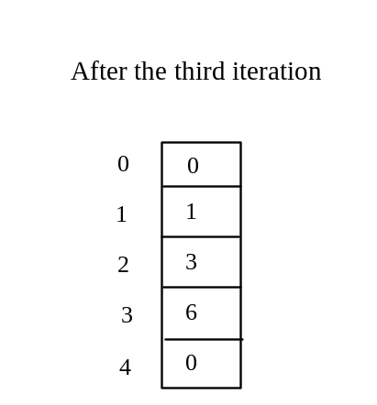
Trace Program with Arrays
animation
After this line, values[3] becomes 6 (3 + 3)
public class Test {
public static void main(String[] args) {
int[] values = new int[5];
for (int i = 1; i < 5; i++) {
values[i] = i + values[i-1];
}
values[0] = values[1] + values[4];
}
}

Slide 24

Trace Program with Arrays
animation
After this, i becomes 4
public class Test {
public static void main(String[] args) {
int[] values = new int[5];
for (int i = 1; i < 5; i++) {
values[i] = i + values[i-1];
}
values[0] = values[1] + values[4];
}
}

Slide 25
Trace Program with Arrays
animation
i (=4) is still less than 5
public class Test {
public static void main(String[] args) {
int[] values = new int[5];
for (int i = 1; i < 5; i++) {
values[i] = i + values[i-1];
}
values[0] = values[1] + values[4];
}
}

Slide 26
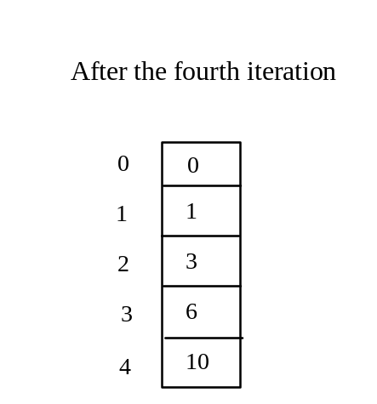
Trace Program with Arrays
animation
After this, values[4] becomes 10 (4 + 6)
public class Test {
public static void main(String[] args) {
int[] values = new int[5];
for (int i = 1; i < 5; i++) {
values[i] = i + values[i-1];
}
values[0] = values[1] + values[4];
}
}

Slide 27
Trace Program with Arrays
animation
After i++, i becomes 5
public class Test {
public static void main(String[] args) {
int[] values = new int[5];
for (int i = 1; i < 5; i++) {
values[i] = i + values[i-1];
}
values[0] = values[1] + values[4];
}
}

Slide 28
Trace Program with Arrays
animation
i ( =5) < 5 is false. Exit the loop
public class Test {
public static void main(String[] args) {
int[] values = new int[5];
for (int i = 1; i < 5; i++) {
values[i] = i + values[i-1];
}
values[0] = values[1] + values[4];
}
}

Slide 29
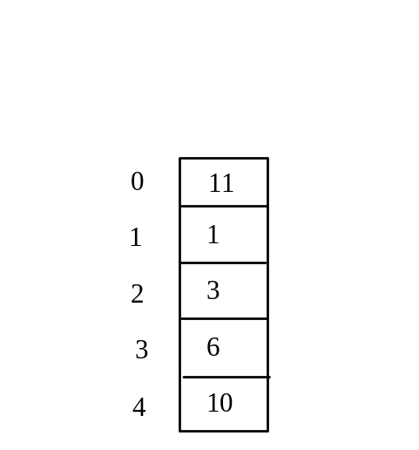
Trace Program with Arrays
animation
After this line, values[0] is 11 (1 + 10)
public class Test {
public static void main(String[] args) {
int[] values = new int[5];
for (int i = 1; i < 5; i++) {
values[i] = i + values[i-1];
}
values[0] = values[1] + values[4];
}
}

Slide 30
Processing Arrays
See the examples in the text.
(Initializing arrays)
(Printing arrays)
(Summing all elements)
(Finding the largest element)
(Finding the smallest index of the largest element)

Slide 31
Enhanced for Loop
JDK 1.5 Feature
JDK 1.5 introduced a new for loop that enables you to traverse the complete array sequentially without using an index variable. For example, the following code displays all elements in the array myList:
  for (double value: myList)
  System.out.println(value);
In general, the syntax is
  for (elementType value: arrayRefVar) {
  // Process the value
  }
You still have to use an index variable if you wish to traverse the array in a different order or change the elements in the array.

Slide 32
Example: Testing Arrays
Objective: The program receives 6 numbers from the user, finds the largest number and counts the occurrence of the largest number entered.
Suppose you entered 3, 5, 2, 5, 5, and 5, the largest number is 5 and its occurrence count is 4.
TestArray
Run

Slide 33
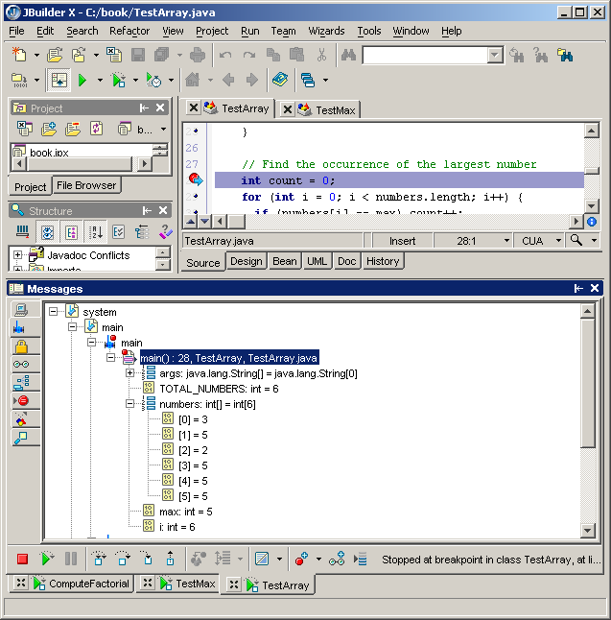
See Arrays in JBuilder Debugger
JBuilder Optional
You can trace the value of array elements in the debugger.
Array

Slide 34
Example: Assigning Grades
Objective: read student scores (int), get the best score, and then assign grades based on the following scheme:
  Grade is A if score is >= best–10;
  Grade is B if score is >= best–20;
  Grade is C if score is >= best–30;
  Grade is D if score is >= best–40;
  Grade is F otherwise.
AssignGrade
Run

Slide 35
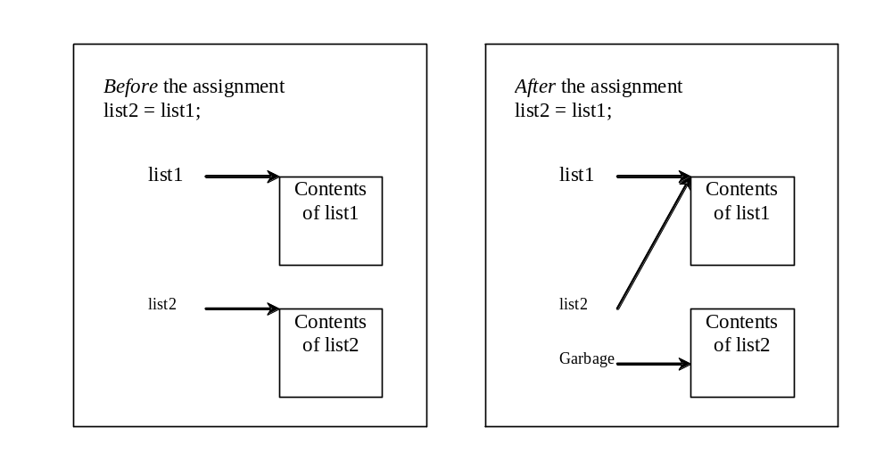
Copying Arrays
Often, in a program, you need to duplicate an array or a part of an array. In such cases you could attempt to use the assignment statement (=), as follows:
list2 = list1;

Slide 36
Copying Arrays
Using a loop:
int[] sourceArray = {2, 3, 1, 5, 10};
int[] targetArray = new int[sourceArray.length];
for (int i = 0; i < sourceArrays.length; i++)
targetArray[i] = sourceArray[i];

Slide 37
The arraycopy Utility
arraycopy(sourceArray, src_pos, targetArray, tar_pos, length);
Example:
System.arraycopy(sourceArray, 0, targetArray, 0, sourceArray.length);

Slide 38
Passing Arrays to Methods
public static void printArray(int[] array) {
for (int i = 0; i < array.length; i++) {
System.out.print(array[i] + " ");
}
}
Invoke the method
int[] list = {3, 1, 2, 6, 4, 2};
printArray(list);
Invoke the method
printArray(new int[]{3, 1, 2, 6, 4, 2});
Anonymous array

Slide 39
Anonymous Array
  The statement
    printArray(new int[]{3, 1, 2, 6, 4, 2});
  creates an array using the following syntax:
    new dataType[]{literal0, literal1, ..., literalk};
  There is no explicit reference variable for the array. Such array is called an anonymous array.

Slide 40
Pass By Value
Java uses pass by value to pass parameters to a method. There are important differences between passing a value of variables of primitive data types and passing arrays.
For a parameter of a primitive type value, the actual value is passed. Changing the value of the local parameter inside the method does not affect the value of the variable outside the method.
For a parameter of an array type, the value of the parameter contains a reference to an array; this reference is passed to the method. Any changes to the array that occur inside the method body will affect the original array that was passed as the argument.

Slide 41
Simple Example
public class Test {
public static void main(String[] args) {
int x = 1; // x represents an int value
int[] y = new int[10]; // y represents an array of int values
m(x, y); // Invoke m with arguments x and y
System.out.println("x is " + x);
System.out.println("y[0] is " + y[0]);
}
public static void m(int number, int[] numbers) {
number = 1001; // Assign a new value to number
numbers[0] = 5555; // Assign a new value to numbers[0]
}
}

Slide 42
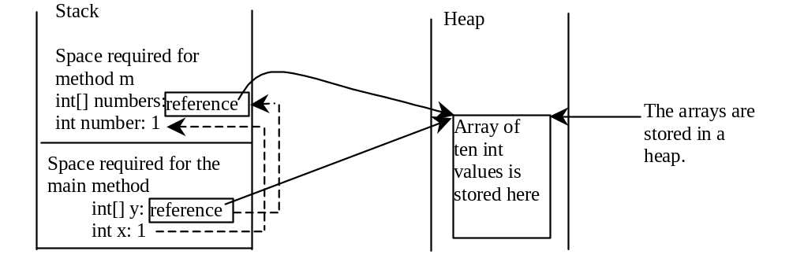
Call Stack
When invoking m(x, y), the values of x and y are passed to number and numbers. Since y contains the reference value to the array, numbers now contains the same reference value to the same array.

Slide 43
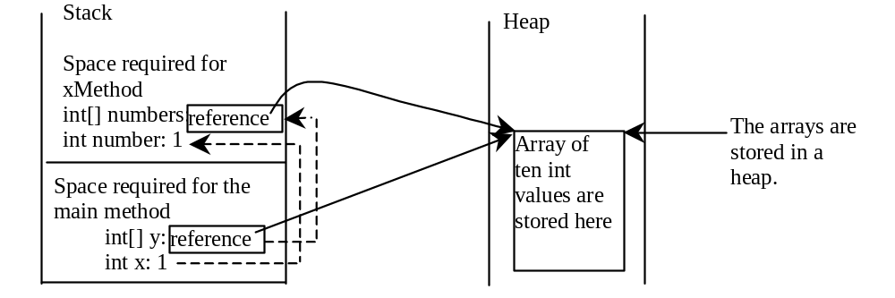
Heap
The JVM stores the array in an area of memory, called heap, which is used for dynamic memory allocation where blocks of memory are allocated and freed in an arbitrary order.

Slide 44
Example:
Passing Arrays as Arguments
Objective: Demonstrate differences of passing primitive data type variables and array variables.
TestPassArray
Run

Slide 45
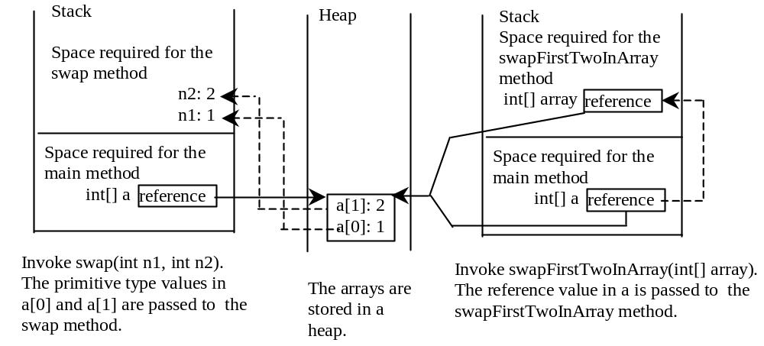
Example, cont.

Slide 46
Returning an Array from a Method
public static int[] reverse(int[] list) {
int[] result = new int[list.length];
for (int i = 0, j = result.length - 1;
i < list.length; i++, j--) {
result[j] = list[i];
}
return result;
}
list
result
int[] list1 = new int[]{1, 2, 3, 4, 5, 6};
int[] list2 = reverse(list1);

Slide 47
Trace the reverse Method
animation
int[] list1 = new int[]{1, 2, 3, 4, 5, 6};
int[] list2 = reverse(list1);
Declare result and create array
public static int[] reverse(int[] list) {
int[] result = new int[list.length];
for (int i = 0, j = result.length - 1;
i < list.length; i++, j--) {
result[j] = list[i];
}
return result;
}
list
1
2
3
4
5
6
result
0
0
0
0
0
0

Slide 48
Trace the reverse Method, cont.
animation
int[] list1 = new int[]{1, 2, 3, 4, 5, 6};
int[] list2 = reverse(list1);
i = 0 and j = 5
public static int[] reverse(int[] list) {
int[] result = new int[list.length];
for (int i = 0, j = result.length - 1;
i < list.length; i++, j--) {
result[j] = list[i];
}
return result;
}
list
1
2
3
4
5
6
result
0
0
0
0
0
0

Slide 49
Trace the reverse Method, cont.
animation
int[] list1 = new int[]{1, 2, 3, 4, 5, 6};
int[] list2 = reverse(list1);
i (= 0) is less than 6
public static int[] reverse(int[] list) {
int[] result = new int[list.length];
for (int i = 0, j = result.length - 1;
i < list.length; i++, j--) {
result[j] = list[i];
}
return result;
}
list
1
2
3
4
5
6
result
0
0
0
0
0
0

Slide 50
Trace the reverse Method, cont.
animation
int[] list1 = new int[]{1, 2, 3, 4, 5, 6};
int[] list2 = reverse(list1);
i = 0 and j = 5
Assign list[0] to result[5]
public static int[] reverse(int[] list) {
int[] result = new int[list.length];
for (int i = 0, j = result.length - 1;
i < list.length; i++, j--) {
result[j] = list[i];
}
return result;
}
list
1
2
3
4
5
6
result
0
0
0
0
0
1

Slide 51
Trace the reverse Method, cont.
animation
int[] list1 = new int[]{1, 2, 3, 4, 5, 6};
int[] list2 = reverse(list1);
After this, i becomes 1 and j becomes 4
public static int[] reverse(int[] list) {
int[] result = new int[list.length];
for (int i = 0, j = result.length - 1;
i < list.length; i++, j--) {
result[j] = list[i];
}
return result;
}
list
1
2
3
4
5
6
result
0
0
0
0
0
1

Slide 52
Trace the reverse Method, cont.
animation
int[] list1 = new int[]{1, 2, 3, 4, 5, 6};
int[] list2 = reverse(list1);
i (=1) is less than 6
public static int[] reverse(int[] list) {
int[] result = new int[list.length];
for (int i = 0, j = result.length - 1;
i < list.length; i++, j--) {
result[j] = list[i];
}
return result;
}
list
1
2
3
4
5
6
result
0
0
0
0
0
1

Slide 53
Trace the reverse Method, cont.
animation
int[] list1 = new int[]{1, 2, 3, 4, 5, 6};
int[] list2 = reverse(list1);
i = 1 and j = 4
Assign list[1] to result[4]
public static int[] reverse(int[] list) {
int[] result = new int[list.length];
for (int i = 0, j = result.length - 1;
i < list.length; i++, j--) {
result[j] = list[i];
}
return result;
}
list
1
2
3
4
5
6
result
0
0
0
0
2
1

Slide 54
Trace the reverse Method, cont.
animation
int[] list1 = new int[]{1, 2, 3, 4, 5, 6};
int[] list2 = reverse(list1);
After this, i becomes 2 and j becomes 3
public static int[] reverse(int[] list) {
int[] result = new int[list.length];
for (int i = 0, j = result.length - 1;
i < list.length; i++, j--) {
result[j] = list[i];
}
return result;
}
list
1
2
3
4
5
6
result
0
0
0
0
2
1

Slide 55
Trace the reverse Method, cont.
animation
int[] list1 = new int[]{1, 2, 3, 4, 5, 6};
int[] list2 = reverse(list1);
i (=2) is still less than 6
public static int[] reverse(int[] list) {
int[] result = new int[list.length];
for (int i = 0, j = result.length - 1;
i < list.length; i++, j--) {
result[j] = list[i];
}
return result;
}
list
1
2
3
4
5
6
result
0
0
0
0
2
1

Slide 56
Trace the reverse Method, cont.
animation
int[] list1 = new int[]{1, 2, 3, 4, 5, 6};
int[] list2 = reverse(list1);
i = 2 and j = 3
Assign list[i] to result[j]
public static int[] reverse(int[] list) {
int[] result = new int[list.length];
for (int i = 0, j = result.length - 1;
i < list.length; i++, j--) {
result[j] = list[i];
}
return result;
}
list
1
2
3
4
5
6
result
0
0
0
3
2
1

Slide 57
Trace the reverse Method, cont.
animation
int[] list1 = new int[]{1, 2, 3, 4, 5, 6};
int[] list2 = reverse(list1);
After this, i becomes 3 and j becomes 2
public static int[] reverse(int[] list) {
int[] result = new int[list.length];
for (int i = 0, j = result.length - 1;
i < list.length; i++, j--) {
result[j] = list[i];
}
return result;
}
list
1
2
3
4
5
6
result
0
0
0
3
2
1

Slide 58
Trace the reverse Method, cont.
animation
int[] list1 = new int[]{1, 2, 3, 4, 5, 6};
int[] list2 = reverse(list1);
i (=3) is still less than 6
public static int[] reverse(int[] list) {
int[] result = new int[list.length];
for (int i = 0, j = result.length - 1;
i < list.length; i++, j--) {
result[j] = list[i];
}
return result;
}
list
1
2
3
4
5
6
result
0
0
0
3
2
1

Slide 59
Trace the reverse Method, cont.
animation
int[] list1 = new int[]{1, 2, 3, 4, 5, 6};
int[] list2 = reverse(list1);
i = 3 and j = 2
Assign list[i] to result[j]
public static int[] reverse(int[] list) {
int[] result = new int[list.length];
for (int i = 0, j = result.length - 1;
i < list.length; i++, j--) {
result[j] = list[i];
}
return result;
}
list
1
2
3
4
5
6
result
0
0
4
3
2
1

Slide 60
Trace the reverse Method, cont.
animation
int[] list1 = new int[]{1, 2, 3, 4, 5, 6};
int[] list2 = reverse(list1);
After this, i becomes 4 and j becomes 1
public static int[] reverse(int[] list) {
int[] result = new int[list.length];
for (int i = 0, j = result.length - 1;
i < list.length; i++, j--) {
result[j] = list[i];
}
return result;
}
list
1
2
3
4
5
6
result
0
0
4
3
2
1

Slide 61
Trace the reverse Method, cont.
animation
int[] list1 = new int[]{1, 2, 3, 4, 5, 6};
int[] list2 = reverse(list1);
i (=4) is still less than 6
public static int[] reverse(int[] list) {
int[] result = new int[list.length];
for (int i = 0, j = result.length - 1;
i < list.length; i++, j--) {
result[j] = list[i];
}
return result;
}
list
1
2
3
4
5
6
result
0
0
4
3
2
1

Slide 62
Trace the reverse Method, cont.
animation
int[] list1 = new int[]{1, 2, 3, 4, 5, 6};
int[] list2 = reverse(list1);
i = 4 and j = 1
Assign list[i] to result[j]
public static int[] reverse(int[] list) {
int[] result = new int[list.length];
for (int i = 0, j = result.length - 1;
i < list.length; i++, j--) {
result[j] = list[i];
}
return result;
}
list
1
2
3
4
5
6
result
0
5
4
3
2
1

Slide 63
Trace the reverse Method, cont.
animation
int[] list1 = new int[]{1, 2, 3, 4, 5, 6};
int[] list2 = reverse(list1);
After this, i becomes 5 and j becomes 0
public static int[] reverse(int[] list) {
int[] result = new int[list.length];
for (int i = 0, j = result.length - 1;
i < list.length; i++, j--) {
result[j] = list[i];
}
return result;
}
list
1
2
3
4
5
6
result
0
5
4
3
2
1

Slide 64
Trace the reverse Method, cont.
animation
int[] list1 = new int[]{1, 2, 3, 4, 5, 6};
int[] list2 = reverse(list1);
i (=5) is still less than 6
public static int[] reverse(int[] list) {
int[] result = new int[list.length];
for (int i = 0, j = result.length - 1;
i < list.length; i++, j--) {
result[j] = list[i];
}
return result;
}
list
1
2
3
4
5
6
result
0
5
4
3
2
1

Slide 65
Trace the reverse Method, cont.
animation
int[] list1 = new int[]{1, 2, 3, 4, 5, 6};
int[] list2 = reverse(list1);
i = 5 and j = 0
Assign list[i] to result[j]
public static int[] reverse(int[] list) {
int[] result = new int[list.length];
for (int i = 0, j = result.length - 1;
i < list.length; i++, j--) {
result[j] = list[i];
}
return result;
}
list
1
2
3
4
5
6
result
6
5
4
3
2
1

Slide 66
Trace the reverse Method, cont.
animation
int[] list1 = new int[]{1, 2, 3, 4, 5, 6};
int[] list2 = reverse(list1);
After this, i becomes 6 and j becomes -1
public static int[] reverse(int[] list) {
int[] result = new int[list.length];
for (int i = 0, j = result.length - 1;
i < list.length; i++, j--) {
result[j] = list[i];
}
return result;
}
list
1
2
3
4
5
6
result
6
5
4
3
2
1

Slide 67
Trace the reverse Method, cont.
animation
int[] list1 = new int[]{1, 2, 3, 4, 5, 6};
int[] list2 = reverse(list1);
i (=6) < 6 is false. So exit the loop.
public static int[] reverse(int[] list) {
int[] result = new int[list.length];
for (int i = 0, j = result.length - 1;
i < list.length; i++, j--) {
result[j] = list[i];
}
return result;
}
list
1
2
3
4
5
6
result
6
5
4
3
2
1

Slide 68
Trace the reverse Method, cont.
animation
int[] list1 = new int[]{1, 2, 3, 4, 5, 6};
int[] list2 = reverse(list1);
Return result
public static int[] reverse(int[] list) {
int[] result = new int[list.length];
for (int i = 0, j = result.length - 1;
i < list.length; i++, j--) {
result[j] = list[i];
}
return result;
}
list
1
2
3
4
5
6
list2
result
6
5
4
3
2
1

Slide 69
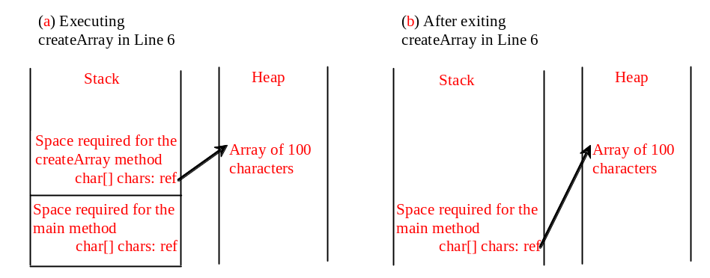
Example: Counting Occurrence of Each Letter
Generate 100 lowercase letters randomly and assign to an array of characters.
Count the occurrence of each letter in the array.
CountLettersInArray
Run

Slide 70
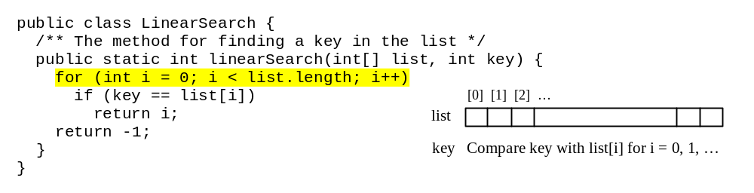
Searching Arrays
Searching is the process of looking for a specific element in an array; for example, discovering whether a certain score is included in a list of scores. Searching is a common task in computer programming. There are many algorithms and data structures devoted to searching. In this section, two commonly used approaches are discussed, linear search and binary search.

Slide 71
Linear Search
The linear search approach compares the key element, key, sequentially with each element in the array list. The method continues to do so until the key matches an element in the list or the list is exhausted without a match being found. If a match is made, the linear search returns the index of the element in the array that matches the key. If no match is found, the search returns -1.

Slide 72
Linear Search Animation
animation
Key
List
3
6 | 4 | 1 | 9 | 7 | 3 | 2 | 8
3
6 | 4 | 1 | 9 | 7 | 3 | 2 | 8
3
6 | 4 | 1 | 9 | 7 | 3 | 2 | 8
3
6 | 4 | 1 | 9 | 7 | 3 | 2 | 8
3
6 | 4 | 1 | 9 | 7 | 3 | 2 | 8
3
6 | 4 | 1 | 9 | 7 | 3 | 2 | 8

Slide 73
From Idea to Solution
/** The method for finding a key in the list */
public static int linearSearch(int[] list, int key) {
for (int i = 0; i < list.length; i++)
if (key == list[i])
return i;
return -1;
}
Trace the method
int[] list = {1, 4, 4, 2, 5, -3, 6, 2};
int i = linearSearch(list, 4); // returns 1
int j = linearSearch(list, -4); // returns -1
int k = linearSearch(list, -3); // returns 5

Slide 74
Linear Search Applet
An applet was developed by a student to visualize the steps for linear search
Linear Search Applet
Linear Search source code
LinearSearch

Slide 75
Binary Search
For binary search to work, the elements in the array must already be ordered. Without loss of generality, assume that the array is in ascending order.
  e.g., 2 4 7 10 11 45 50 59 60 66 69 70 79
The binary search first compares the key with the element in the middle of the array.

Slide 76
Binary Search, cont.
Consider the following three cases:
If the key is less than the middle element, you only need to search the key in the first half of the array.
If the key is equal to the middle element, the search ends with a match.
If the key is greater than the middle element, you only need to search the key in the second half of the array.

Slide 77
Binary Search
animation
Key
List
8
1 | 2 | 3 | 4 | 6 | 7 | 8 | 9
8
1 | 2 | 3 | 4 | 6 | 7 | 8 | 9
8
1 | 2 | 3 | 4 | 6 | 7 | 8 | 9

Slide 78
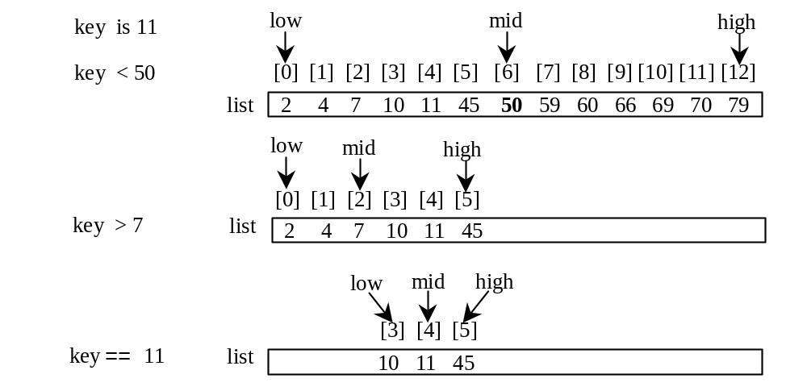
Binary Search, cont.

Slide 79
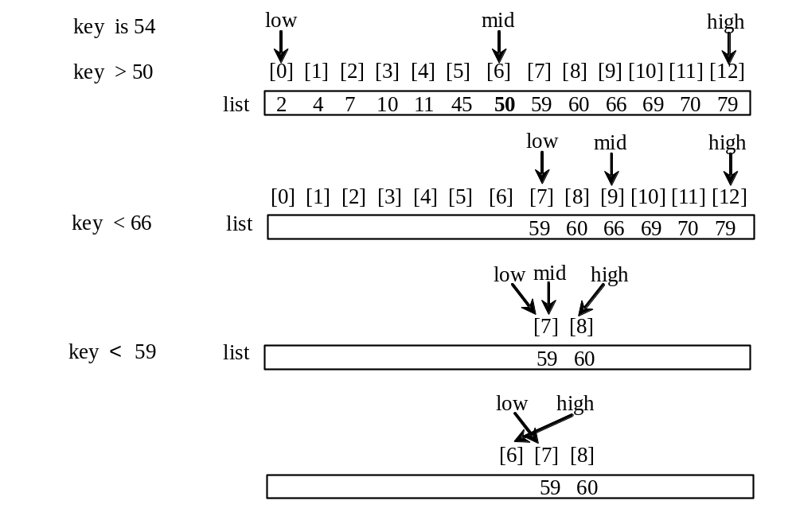
Binary Search, cont.

Slide 80
Binary Search, cont.
The binarySearch method returns the index of the search key if it is contained in the list. Otherwise, it returns –insertion point - 1. The insertion point is the point at which the key would be inserted into the list.

Slide 81
From Idea to Soluton
/** Use binary search to find the key in the list */
public static int binarySearch(int[] list, int key) {
int low = 0;
int high = list.length - 1;
while (high >= low) {
int mid = (low + high) / 2;
if (key < list[mid])
high = mid - 1;
else if (key == list[mid])
return mid;
else
low = mid + 1;
}
return -1 - low;
}

Slide 82
Binary Search Applet
An applet was developed by a student to visualize the steps for binary search
Binary Search Applet
Binary Search source code
BinarySearch

Slide 83
The Arrays.binarySearch Method
Since binary search is frequently used in programming, Java provides several overloaded binarySearch methods for searching a key in an array of int, double, char, short, long, and float in the java.util.Arrays class. For example, the following code searches the keys in an array of numbers and an array of characters.
  int[] list = {2, 4, 7, 10, 11, 45, 50, 59, 60, 66, 69, 70, 79};
  System.out.println("Index is " +
  java.util.Arrays.binarySearch(list, 11));
  char[] chars = {'a', 'c', 'g', 'x', 'y', 'z'};
  System.out.println("Index is " +
  java.util.Arrays.binarySearch(chars, 't'));
For the binarySearch method to work, the array must be pre-sorted in increasing order.
Return is 4
Return is –4 (insertion point is 3, so return is -3-1)

Slide 84
Sorting Arrays
Sorting, like searching, is also a common task in computer programming. It would be used, for instance, if you wanted to display the grades from Listing 6.2, “Assigning Grades,” in alphabetical order. Many different algorithms have been developed for sorting. This section introduces two simple, intuitive sorting algorithms: selection sort and insertion sort.

Slide 85
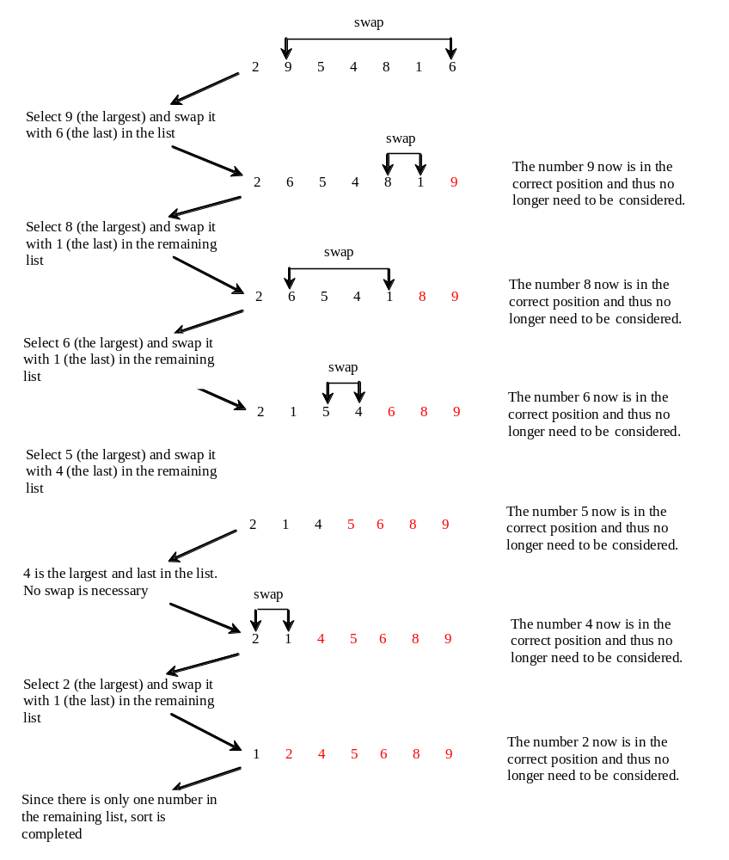
Selection Sort
Selection sort finds the largest number in the list and places it last. It then finds the largest number remaining and places it next to last, and so on until the list contains only a single number. Figure 6.17 shows how to sort the list {2, 9, 5, 4, 8, 1, 6} using selection sort.

Slide 86
Selection Sort
animation
int[] myList = {2, 9, 5, 4, 8, 1, 6}; // Unsorted
2 | 9 | 5 | 4 | 8 | 1 | 6
2 | 6 | 5 | 4 | 8 | 1 | 9
2 | 6 | 5 | 4 | 1 | 8 | 9
2 | 1 | 5 | 4 | 6 | 8 | 9
2 | 1 | 4 | 5 | 6 | 8 | 9
2 | 1 | 4 | 5 | 6 | 8 | 9
1 | 2 | 4 | 5 | 6 | 8 | 9

Slide 87
From Idea to Solution
for (int i = list.length - 1; i >= 1; i--) {
select the largest element in list[0..i];
swap the largest with list[i], if necessary;
// list[i] is in place. The next iteration applies on list[0..i-1]
}
list[0] list[1] list[2] list[3] ... list[10]
list[0] list[1] list[2] list[3] ... list[9]
list[0] list[1] list[2] list[3] ... list[8]
list[0] list[1] list[2] list[3] ... list[7]
...
list[0]

Slide 88
Expand
for (int i = list.length - 1; i >= 1; i--) {
select the largest element in list[0..i];
swap the largest with list[i], if necessary;
// list[i] is in place. The next iteration applies on list[0..i-1]
}
// Find the maximum in the list[0..i]
double currentMax = list[0];
int currentMaxIndex = 0;
for (int j = 1; j <= i; j++) {
if (currentMax < list[j]) {
currentMax = list[j];
currentMaxIndex = j;
}
}

Slide 89
Expand
for (int i = list.length - 1; i >= 1; i--) {
select the largest element in list[0..i];
swap the largest with list[i], if necessary;
// list[i] is in place. The next iteration applies on list[0..i-1]
}
// Find the maximum in the list[0..i]
double currentMax = list[0];
int currentMaxIndex = 0;
for (int j = 1; j <= i; j++) {
if (currentMax < list[j]) {
currentMax = list[j];
currentMaxIndex = j;
}
}

Slide 90
Expand
for (int i = list.length - 1; i >= 1; i--) {
select the largest element in list[0..i];
swap the largest with list[i], if necessary;
// list[i] is in place. The next iteration applies on list[0..i-1]
}
// Swap list[i] with list[currentMaxIndex] if necessary;
if (currentMaxIndex != i) {
list[currentMaxIndex] = list[i];
list[i] = currentMax;
}

Slide 91
Wrap it in a Method
/** The method for sorting the numbers */
public static void selectionSort(double[] list) {
for (int i = list.length - 1; i >= 1; i--) {
// Find the maximum in the list[0..i]
double currentMax = list[0];
int currentMaxIndex = 0;
for (int j = 1; j <= i; j++) {
if (currentMax < list[j]) {
currentMax = list[j];
currentMaxIndex = j;
}
}
// Swap list[i] with list[currentMaxIndex] if necessary;
if (currentMaxIndex != i) {
list[currentMaxIndex] = list[i];
list[i] = currentMax;
}
}
}
Invoke it
selectionSort(yourList)

Slide 92
Selection Sort Applet
An applet was developed by a student to visualize the steps for selection sort
Selection Sort Applet
Selection Sort source code
SelectionSort

Slide 93
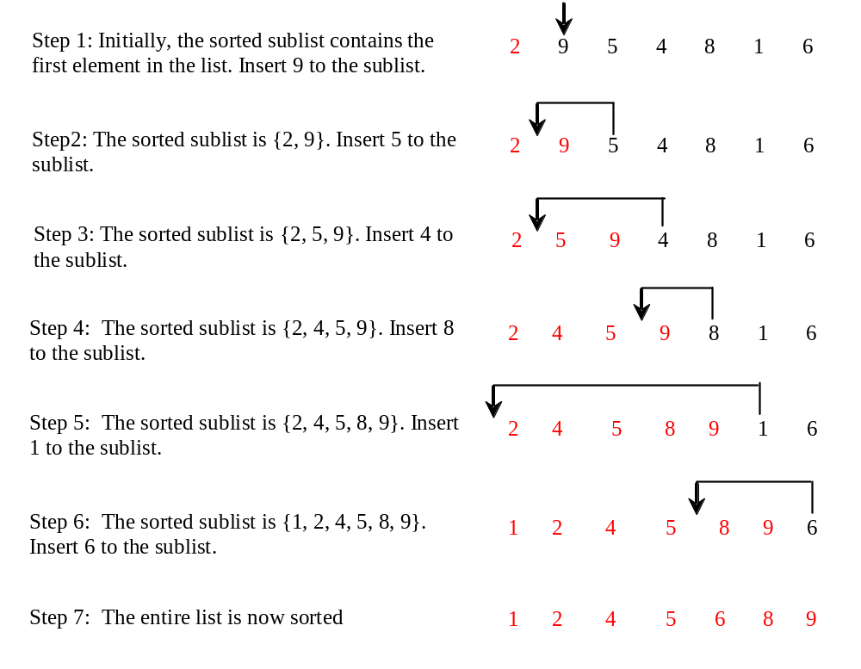
Insertion Sort
Optional
int[] myList = {2, 9, 5, 4, 8, 1, 6}; // Unsorted
The insertion sort algorithm sorts a list of values by repeatedly inserting an unsorted element into a sorted sublist until the whole list is sorted.

Slide 94
Insertion Sort
animation
int[] myList = {2, 9, 5, 4, 8, 1, 6}; // Unsorted
2 | 9 | 5 | 4 | 8 | 1 | 6
2 | 9 | 5 | 4 | 8 | 1 | 6
2 | 5 | 9 | 4 | 8 | 1 | 6
2 | 4 | 5 | 9 | 8 | 1 | 6
2 | 4 | 5 | 8 | 9 | 1 | 6
1 | 2 | 4 | 5 | 8 | 9 | 6
1 | 2 | 4 | 5 | 6 | 8 | 9

Slide 95
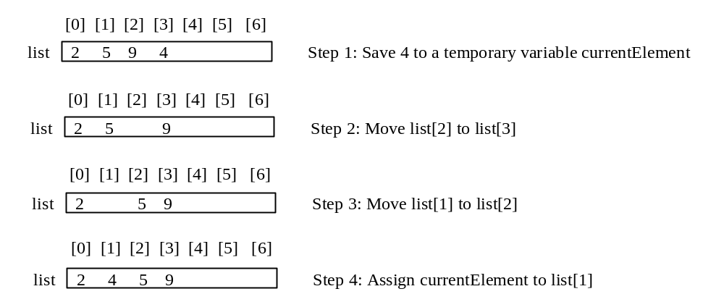
How to Insert?
Optional
The insertion sort algorithm sorts a list of values by repeatedly inserting an unsorted element into a sorted sublist until the whole list is sorted.

Slide 96
Insertion Sort Applet
Optional
An applet was developed by a student to visualize the steps for selection sort
Insertion Sort Applet
Selection Sort source code
InsertionSort

Slide 97
The Arrays.sort Method
Since sorting is frequently used in programming, Java provides several overloaded sort methods for sorting an array of int, double, char, short, long, and float in the java.util.Arrays class. For example, the following code sorts an array of numbers and an array of characters.
  double[] numbers = {6.0, 4.4, 1.9, 2.9, 3.4, 3.5};
  java.util.Arrays.sort(numbers);
  char[] chars = {'a', 'A', '4', 'F', 'D', 'P'};
  java.util.Arrays.sort(chars);

Slide 98
Exercise 6.14 Bubble Sort
Optional
int[] myList = {2, 9, 5, 4, 8, 1, 6}; // Unsorted
The bubble-sort algorithm makes several iterations through the array. On each iteration, successive neighboring pairs are compared. If a pair is in decreasing order, its values are swapped; otherwise, the values remain unchanged. The technique is called a bubble sort or sinking sort because the smaller values gradually "bubble" their way to the top and the larger values sink to the bottom.
Iteration 1: 2, 5, 4, 8, 1, 6, 9
Iteration 2: 2, 4, 5, 1, 6, 8, 9
Iteration 3: 2, 4, 1, 5, 6, 8, 9
Iteration 4: 2, 1, 4, 5, 6, 8, 9
Iteration 5: 1, 2, 4, 5, 6, 8, 9
Iteration 6: 1, 2, 4, 5, 6, 8, 9

Slide 99
Two-dimensional Arrays
// Declare array ref var
dataType[][] refVar;
// Create array and assign its reference to variable
refVar = new dataType[10][10];
// Combine declaration and creation in one statement
dataType[][] refVar = new dataType[10][10];
// Alternative syntax
dataType refVar[][] = new dataType[10][10];

Slide 100
Declaring Variables of Two-dimensional Arrays and Creating Two-dimensional Arrays
int[][] matrix = new int[10][10];
or
int matrix[][] = new int[10][10];
matrix[0][0] = 3;
for (int i = 0; i < matrix.length; i++)
for (int j = 0; j < matrix[i].length; j++)
matrix[i][j] = (int)(Math.random() * 1000);
double[][] x;

Slide 101
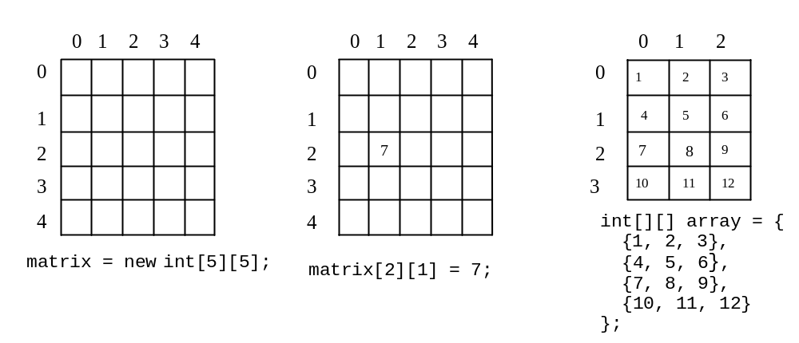
Two-dimensional Array Illustration
matrix.length? 5
matrix[0].length? 5
array.length? 4
array[0].length? 3

Slide 102
Declaring, Creating, and Initializing Using Shorthand Notations
You can also use an array initializer to declare, create and initialize a two-dimensional array. For example,
int[][] array = {
{1, 2, 3},
{4, 5, 6},
{7, 8, 9},
{10, 11, 12}
};
int[][] array = new int[4][3];
array[0][0] = 1; array[0][1] = 2; array[0][2] = 3;
array[1][0] = 4; array[1][1] = 5; array[1][2] = 6;
array[2][0] = 7; array[2][1] = 8; array[2][2] = 9;
array[3][0] = 10; array[3][1] = 11; array[3][2] = 12;
Same as

Slide 103
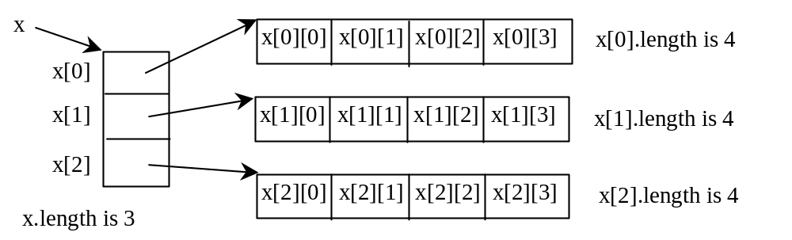
Lengths of Two-dimensional Arrays
int[][] x = new int[3][4];

Slide 104
Lengths of Two-dimensional Arrays, cont.
int[][] array = {
{1, 2, 3},
{4, 5, 6},
{7, 8, 9},
{10, 11, 12}
};
array.length
array[0].length
array[1].length
array[2].length
array[3].length
array[4].length ArrayIndexOutOfBoundsException

Slide 105
Ragged Arrays
Each row in a two-dimensional array is itself an array. So, the rows can have different lengths. Such an array is known as a ragged array. For example,
int[][] matrix = {
{1, 2, 3, 4, 5},
{2, 3, 4, 5},
{3, 4, 5},
{4, 5},
{5}
};
matrix.length is 5
matrix[0].length is 5
matrix[1].length is 4
matrix[2].length is 3
matrix[3].length is 2
matrix[4].length is 1

Slide 106
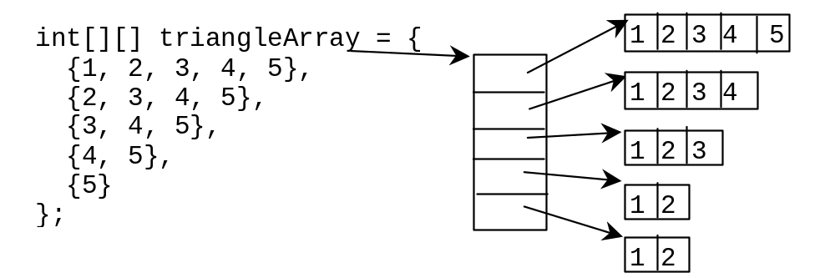
Ragged Arrays, cont.

Slide 107
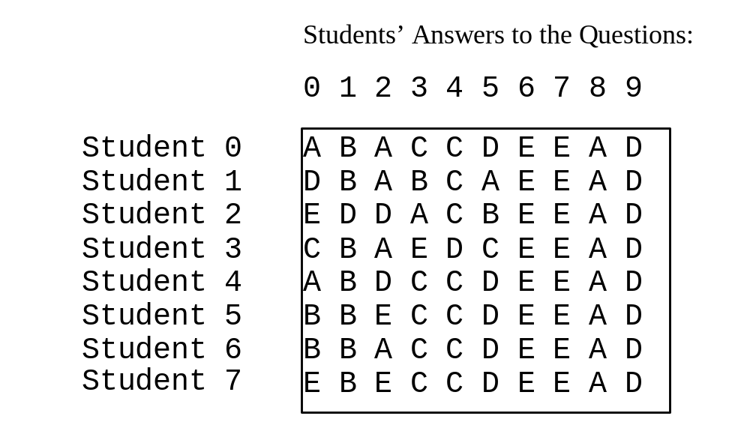
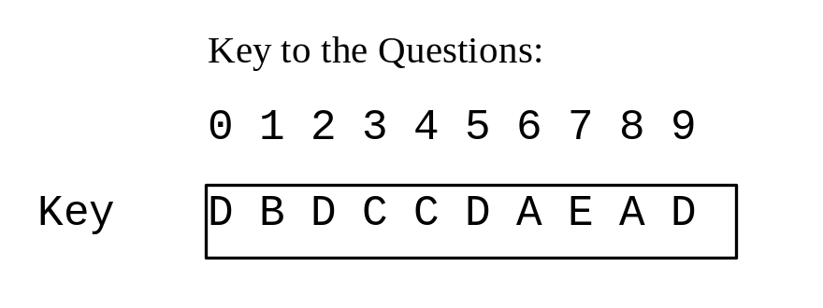
Example: Grading Multiple-Choice Test
Objective: write a program that grades multiple-choice test.
GradeExam
Run

Slide 108
Example: Computing Taxes Using Arrays
Liting 5.4, “Computing Taxes with Methods,” simplified Listing 3.4, “Computing Taxes.” Listing 5.4 can be further improved using arrays. Rewrite Listing 3.1 using arrays to store tax rates and brackets.
ComputeTax
Run

Slide 109
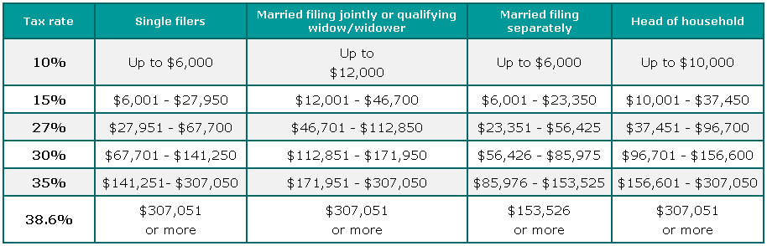
Refine the table
10%
15%
27%
30%
35%
38.6%
6000 | 12000 | 6000 | 10000
27950 | 46700 | 23350 | 37450
67700 | 112850 | 56425 | 96745
141250 | 171950 | 85975 | 156600
307050 | 307050 | 153525 | 307050

Slide 110
Reorganize the table
6000 | 12000 | 6000 | 10000
27950 | 46700 | 23350 | 37450
67700 | 112850 | 56425 | 96745
141250 | 171950 | 85975 | 156600
307050 | 307050 | 153525 | 307050
Rotate
6000 | 27950 | 67700 | 141250 | 307050
12000 | 46700 | 112850 | 171950 | 307050
6000 | 23350 | 56425 | 85975 | 153525
10000 | 37450 | 96745 | 156600 | 307050
Single filer
Married jointly
Married separately
Head of household

Slide 111
Declare Two Arrays
6000 | 27950 | 67700 | 141250 | 307050
12000 | 46700 | 112850 | 171950 | 307050
6000 | 23350 | 56425 | 85975 | 153525
10000 | 37450 | 96745 | 156600 | 307050
Single filer
Married jointly
Married separately
Head of household
10%
15%
27%
30%
35%
38.6%
int[][] brackets = {
{6000, 27950, 67700, 141250, 307050}, // Single filer
{12000, 46700, 112850, 171950, 307050}, // Married jointly
{6000, 23350, 56425, 85975, 153525}, // Married separately
{10000, 37450, 96700, 156600, 307050} // Head of household
};
double[] rates = {0.10, 0.15, 0.27, 0.30, 0.35, 0.386};

Slide 112
Multidimensional Arrays
Occasionally, you will need to represent n-dimensional data structures. In Java, you can create n-dimensional arrays for any integer n.
The way to declare two-dimensional array variables and create two-dimensional arrays can be generalized to declare n-dimensional array variables and create n-dimensional arrays for n >= 3. For example, the following syntax declares a three-dimensional array variable scores, creates an array, and assigns its reference to scores.
  double[][][] scores = new double[10][5][2];

Slide 113
Example: Calculating Total Scores
Objective: write a program that calculates the total score for students in a class. Suppose the scores are stored in a three-dimensional array named scores. The first index in scores refers to a student, the second refers to an exam, and the third refers to the part of the exam. Suppose there are 7 students, 5 exams, and each exam has two parts--the multiple-choice part and the programming part. So, scores[i][j][0] represents the score on the multiple-choice part for the i’s student on the j’s exam. Your program displays the total score for each student.
TotalScore
Run

