Slide 1
‘AI In
HealthCare’
“Revolutionizing the Future of Medicine “

Slide 2
Introduction:
What is AI?
AI refers to computer systems that can perform tasks normally requiring human intelligence, such
as learning, reasoning, and decision-making.
Why is AI important in healthcare?
AI is transforming healthcare by improving diagnostics, personalizing treatments, reducing errors,
and enhancing patient care.
Objectives of the Presentation:
1.Explore how AI is used in healthcare.
2.Highlight key areas where AI is making an impact.
3.Discuss challenges and the future potential of AI in healthcare.

Slide 3
History and Evolution of AI in Healthcare
The Early Days (1960s-1990s) :
The journey of AI in healthcare began with the development of expert systems, such as MYCIN, which helped in diagnosing infections. However, these systems were limited by the technology of the time, including computational power and the availability of data.
Rapid Growth in the 21st Century
In the 2000s, we saw a shift toward machine learning techniques that allowed for improved diagnostic accuracy.
The 2010s brought the deep learning revolution, enabling computers to recognize images and understand natural language, opening new doors in medical applications.
Today, AI is integrated into various clinical settings, assisting in everything from diagnostics to personalized medicine.

Slide 4
Current Applications of AI in Healthcare
AI for Diagnostics
AI algorithms analyze medical images (like X-rays and MRIs) with high accuracy, helping
radiologists detect diseases such as cancer earlier than traditional methods.
Example: AI tools like Zebra Medical Vision can identify abnormalities in imaging
data, leading to faster diagnosis.
Robotic Surgery
AI-powered robotic systems assist surgeons by providing enhanced precision and control
during complex procedures, leading to better patient outcomes.
Example: The da Vinci Surgical System allows surgeons to perform minimally
invasive surgeries with greater accuracy.

Slide 5
Current Applications of AI in Healthcare
Personalized Medicine
AI analyzes patient data to tailor treatment plans based on individual needs, making
healthcare more effective and targeted.
Example: Genetic data analysis through AI can help predict how patients will
respond to specific treatments.
Predictive Analytics
AI algorithms can predict patient outcomes and disease progression by analyzing historical
patient data and trends.
Example: Hospitals use predictive models to identify patients at risk of readmission.
Virtual Health Assistants , Drug Discovery , etc...

Slide 6


AI in Medical Imaging

Slide 7
Enhancing Diagnostic Accuracy
AI algorithms analyze medical images (like X-rays, CT scans, and MRIs) with high precision, significantly reducing human error and enhancing diagnostic accuracy.
AI in Medical Imaging
Case Studies of Success
1. Google Health's Mammography Study: AI outperformed radiologists in identifying breast cancer in mammograms, demonstrating the potential for reducing false positives and negatives.
2.Aidoc: This AI platform provides real-time analysis of medical images, alerting radiologists to critical findings, thereby accelerating the decision-making process.
Streamlining Workflow
AI can automate routine tasks, such as sorting and tagging medical images, freeing up radiologists to focus on more complex cases.

Slide 8
AI IN DRUG DISCOVERY
Accelerating Drug Development
AI can analyze vast datasets, identifying patterns and predicting which compounds are most likely to succeed in drug trials. This reduces the time and cost involved in developing new medications.
Impact: Traditional drug discovery can take years, but AI helps reduce this time by quickly filtering through millions of compounds.
Examples of AI in Drug Discovery
Atomwise: Uses AI to predict molecular interactions, speeding up the discovery of new drugs.
Insilico Medicine: Developed an AI platform that identifies new drug molecules for treating various diseases, reducing R&D timelines.

Slide 9
AI IN DRUG DISCOVERY
AI’s Role in COVID-19
During the pandemic, AI helped researchers identify potential drug candidates and repurpose existing drugs to treat COVID-19.eed in drug trials. This reduces the time and cost involved in developing new medications.
Advantages of AI in Drug Discovery
Speed: Faster identification of drug candidates.
Cost: Reduces the high costs of clinical trials and R&D.
Precision: AI can target specific proteins or genetic markers to develop personalized treatments.
Challenges and Limitations
Data quality and availability can be a barrier.
Regulatory hurdles still need to be addressed for AI-driven drugs to reach the market quickly.

Slide 10
Predicting Patient Outcomes
AI uses historical patient data and algorithms to predict disease progression, helping doctors make more informed decisions.
Early Detection of Diseases
By analyzing patterns in health records, AI can detect early signs of chronic conditions, allowing for preventative care.
Managing Population Health
AI helps healthcare providers analyze population data to identify trends and risks, allowing for targeted health interventions at a community level.
Personalized Treatment Plans
AI can analyze genetic and clinical data to predict the best treatment options for individual patients, improving success rates.
AI in Predictive Analytics

Slide 11
AI IN PRECISION MEDICINE
Personalized Treatment
AI helps doctors create treatment plans tailored to each patient by analyzing genetic, environmental, and lifestyle factors.
Data-Driven Insights
AI predicts how patients will respond to treatments, optimizing outcomes.
AI in Genomics
AI decodes genomic data, linking genes to diseases for personalized therapies.
Real-World Applications
Especially effective in cancer treatment, cardiovascular diseases, and rare genetic disorders.

Slide 12
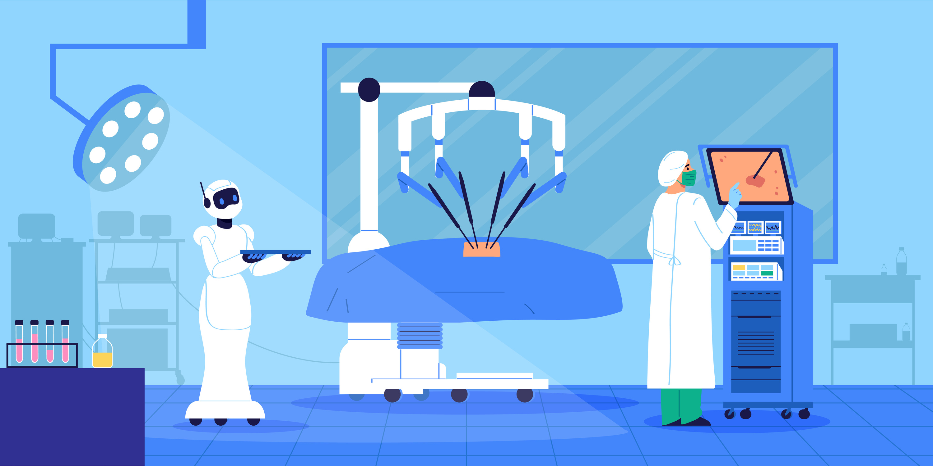
AI in Robotic Surgery

Slide 13

Increased Precision
AI-powered robotic systems provide surgeons with enhanced precision, minimizing human error during complex surgeries.
Minimally Invasive Procedures
Robotic surgery allows for smaller incisions, leading to quicker recovery times, less pain, and reduced risk of infection.
Improved Outcomes
AI helps surgeons plan procedures with greater accuracy, resulting in better patient outcomes, especially in areas like orthopedics and neurosurgery.
Real-Time Assistance
AI offers real-time guidance and feedback during surgeries, improving decision-making and reducing complications.
AI in Robotic Surgery

Slide 14
AI in Virtual Health Assistants
24/7 Patient Support
AI-powered virtual assistants provide round-the-clock healthcare support, answering patient questions and helping manage appointments.
Improved Patient Engagement
Virtual assistants keep patients engaged in their healthcare by offering reminders for medication, follow-up appointments, and general health advice.
Reducing the Workload for Healthcare Providers
AI assistants can handle routine tasks such as answering common medical questions, freeing up healthcare professionals to focus on more complex issues.
Telemedicine Integration
AI assistants often integrate with telemedicine platforms, allowing patients to access healthcare remotely with personalized responses based on their health history.

Slide 15
AI IN MANAGING HEALTHCARE DATA
Efficient Data Handling
AI automates the collection, sorting, and analysis of vast amounts of healthcare data, making it easier to manage patient records and medical research.
Data-Driven Decision Making
AI helps healthcare providers make informed decisions by analyzing patient data for trends, predicting outcomes, and suggesting treatment options.
Improving Patient Care
With AI processing data in real-time, healthcare providers can deliver more accurate and timely care, improving patient outcomes and reducing medical errors.
Data Privacy and Security
While AI manages data effectively, ensuring data privacy and security remains a challenge, especially with sensitive patient information

Slide 16
AI in Patient Monitoring and Wearables
Continuous Health Monitoring
AI-powered wearables, such as smartwatches and fitness trackers, continuously monitor vital signs like heart rate, blood pressure, and activity levels, providing real-time health insights.
Early Detection of Health Issues
AI algorithms analyze data from wearables to detect potential health problems early, alerting users or healthcare providers before symptoms worsen.
Example: Wearables can detect irregular heartbeats (arrhythmia) and notify users to seek medical attention.

Slide 17
AI in Patient Monitoring and Wearables
Remote Patient Monitoring
AI enables doctors to monitor patients remotely, especially those with chronic illnesses, allowing for timely intervention and reducing hospital visits.
Empowering Patients
With AI and wearables, patients can track their health metrics, stay informed about their well-being, and take proactive steps toward healthier lifestyles.
Chronic Disease Management
AI wearables help manage chronic conditions like diabetes by continuously tracking glucose levels and providing real-time alerts.

Slide 18

Data Privacy and Security
AI systems handle sensitive patient data, which poses challenges in ensuring privacy and preventing data breaches.
Bias in AI Algorithms
AI models can be biased if trained on incomplete or non-representative data, leading to unequal treatment or misdiagnosis in certain patient populations.
Regulatory and Ethical Issues
The adoption of AI in healthcare is hindered by regulatory frameworks and ethical concerns, especially regarding patient consent and transparency.
Integration with Existing Systems
Integrating AI tools into existing healthcare systems can be difficult due to technical incompatibilities and resistance to change.
Cost and Accessibility
High costs associated with AI implementation may limit its accessibility, particularly in low-resource settings.
Challenges and Limitations of AI in Healthcare

Slide 19
Future of AI in Healthcare
Enhanced Collaboration
Future AI systems will facilitate better collaboration between healthcare professionals by providing shared insights and real-time data.
Increased Personalization
As AI continues to evolve, treatments will become even more personalized, taking into account genetic, environmental, and lifestyle factors.
Expansion of Telemedicine
AI will enhance telemedicine services, providing real-time diagnostics and virtual health assistance, making healthcare more accessible.
Continuous Learning Systems
Future AI systems will adapt and learn continuously from new data, improving their accuracy and effectiveness over time.

Slide 20
CONCLUSION
Transformative Impact
AI is revolutionizing healthcare, improving diagnostics, treatment personalization, and patient engagement.
Ongoing Innovation
Continued advancements in AI technology promise to enhance healthcare delivery and outcomes in the coming years.
Collaboration Needed
Successful implementation of AI requires collaboration between healthcare professionals, data scientists, and policymakers to address challenges and maximize benefits.
Future Outlook
As AI evolves, it holds the potential to create a more efficient, accessible, and effective healthcare system for everyone.

Slide 21

Thank
You
Kuldeep Rathod
21002170110155

