Slide 1

MODULE 7 — INFOCOM PROJECT
Project name
Content
Saathi
Making daily content creation simple and smart.
AI-Powered Content Assistant for Small Businesses
Submitted by
Kuldeep Sanodiya
Paras Mehra
Anil Kumar
Gaurav Yadav
Submitted to
Mr. Siddharth Singh Sir
Branch
Advanced Networking and System Administration

Slide 2
02 — INTRODUCTION
Meet Content Saathi
A Python-based AI application designed to help small business owners create promotional content easily.
MAIN GOAL
To make content creation faster, easier and more accessible for small businesses.
It uses Google Gemini AI to generate content from shop details and user requests. Through a Telegram bot, users can generate posts, ask questions and receive AI responses. Content is stored in a database, with options to regenerate, approve or reject drafts.

Slide 3
THE PROBLEM
PROPOSED SOLUTION
Small businesses need regular promotion, but daily content is hard.
Content Saathi uses AI to generate promotional content.
Creating daily posts takes time
Not everyone writes well
Professional writers can be expensive
Regular promotion is hard to maintain
Tracking content manually is difficult
A simple Telegram-based system makes managing that content easy.

Slide 4
04 — OBJECTIVES
What the project sets out to do
01
Generate promotional content using AI
02
Allow content requests through Telegram
03
Provide AI-powered responses to queries
04
Support Telegram, Instagram and Google Business formats
05
Allow content regeneration when needed
06
Store generated posts in SQLite
07
Provide draft approval and rejection
08
Support scheduled content generation

Slide 5
05 — KEY FEATURES
Eight features, one workflow
1. AI Content Generation
5. Draft Management
Posts from shop information and user instructions.
Review, approve and reject generated posts.
2. Telegram Bot Integration
6. Database Storage
Interact with the application through Telegram.
Posts and statuses saved in SQLite.
3. AI Query Responses
7. Scheduled Generation
Configured Gemini model answers questions.
Automatic generation at configured times.
4. Regenerate Content
8. Festival-Based Content
A new version when a draft is not satisfactory.
Festival posts using verified dates.

Slide 6
06 — TECHNOLOGIES USED
The tools behind it
Technology | Purpose
Python | Main programming language
Google Gemini AI | Content generation and AI responses
FastAPI | Backend API development
SQLite | Storing generated posts
Telegram Bot API | User communication
JSON | Storing shop information and configuration
Python Scheduler | Scheduling content-generation tasks
Uvicorn | Running the FastAPI server
Python-dotenv | Managing environment variables

Slide 7
07 — SYSTEM ARCHITECTURE
How the system works
User
Telegram Bot
Python / FastAPI
Gemini AI
SQLite DB
Response
1
User — sends a request through Telegram
5
FastAPI — handles the relevant API operations
2
Telegram Bot — receives the command or query
6
SQLite Database — stores posts and their status
3
Python Backend — processes the request, prepares input
7
Telegram Bot — returns the result to the user
4
Gemini AI — generates the content or response

Slide 8
08 — WORKING PROCESS & DATABASE
From request to approved post
1
The user sends a command or query through Telegram
SQLITE • LOCAL STORAGE
database/content_saathi.db
2
The application processes the request
Maintains generated post records and status information.
3
Gemini AI generates a response or promotional post
4
The generated post is saved in the database
DRAFT
Waiting for review
5
The user reviews the draft, regenerates if required
APPROVED
Content approved
6
The user approves or rejects the draft
REJECTED
Content rejected

Slide 9
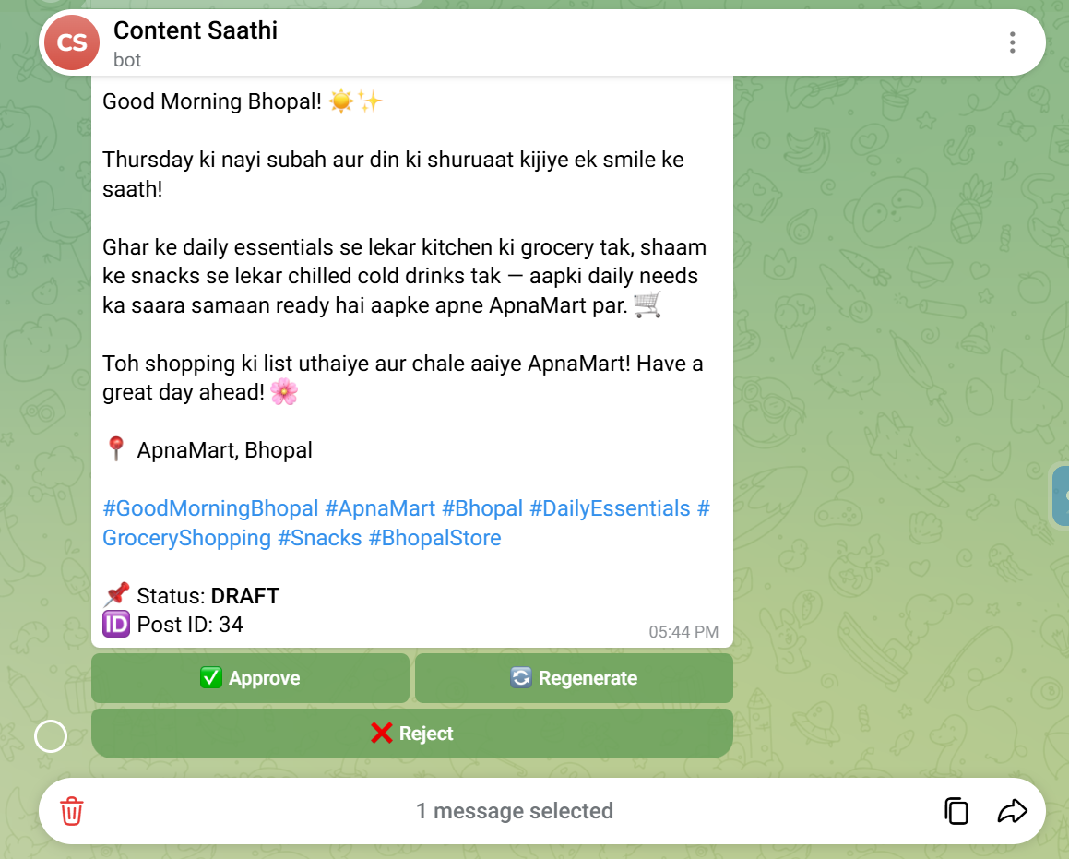
09 — TELEGRAM BOT OUTPUT
A generated draft, ready for review
01
AI-written draft
Hinglish promotional post for ApnaMart, Bhopal, with location and hashtags.
02
Status and Post ID
Each post is saved as DRAFT with a Post ID for tracking.
03
Review in one tap
Approve, Regenerate and Reject buttons appear below the post.

Slide 10
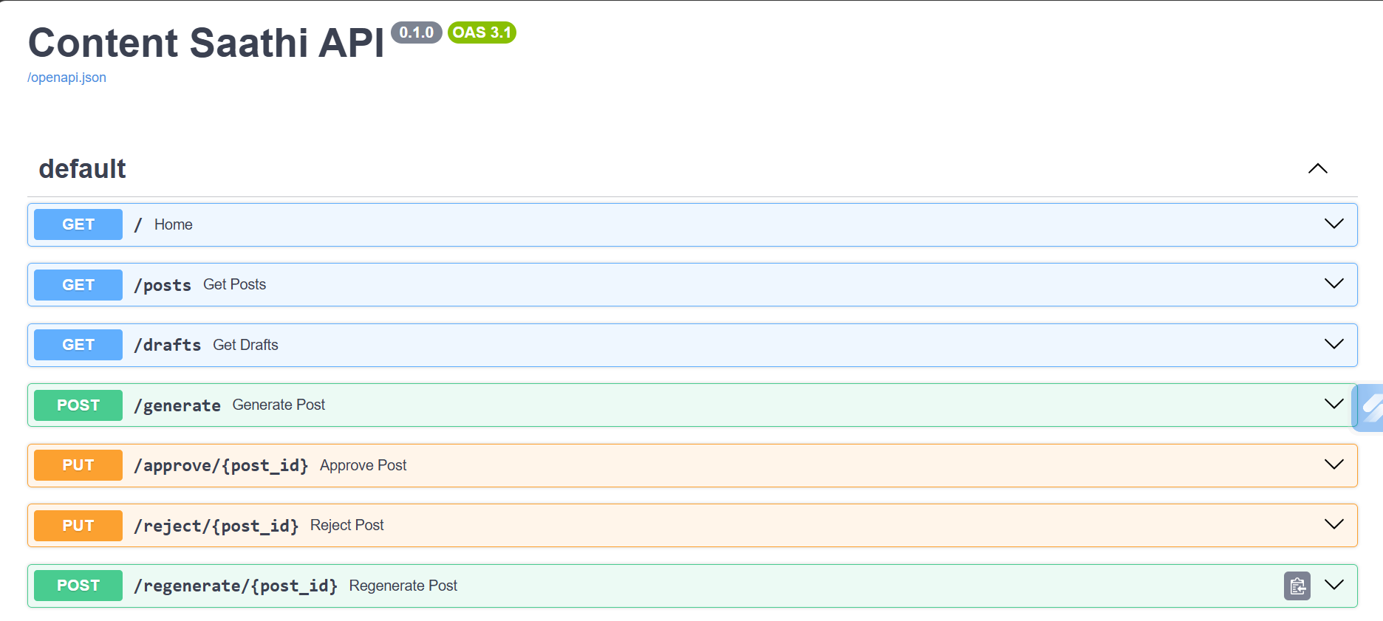
10 — API ENDPOINTS
FastAPI backend shown in Swagger UI

Slide 11
11 — BENEFITS & FUTURE SCOPE
Value today, growth tomorrow
Benefits
Future Scope
Saves time and effort in content creation
Makes AI accessible to small businesses
Easy interaction through Telegram
Helps maintain regular promotion
Stores posts for convenient tracking
Keeps the owner involved in approval
Web dashboard for content management
More language and tone options
Improved festival calendar verification
Generation and approval analytics
Authorized social media publishing
Multiple shops and business accounts

Slide 12
CONCLUSION
An AI-powered application that simplifies promotional content creation for small businesses.
It combines Python, Gemini AI, FastAPI, SQLite and Telegram to generate content, answer queries, store drafts and support review.

Slide 13
Thank You

