Slide 1
MAJOR PROJECT PRESENTATION ON
JAGAH — AI Event Planner
An intelligent web application for event coordination, budget tracking, and custom recommendations powered by LLM Orchestration.
SUBMITTED BY:
Mangal Singh Chouhan
Major Project Submission (BCA)
1 / 18

Slide 2
Table of Contents
JAGAH — AI EVENT PLANNER
PROJECT OVERVIEW
01
SYSTEM ARCHITECTURE
02
DATABASE & WORKFLOWS
03
• Introduction
• Technology Stack
• Database Design (MySQL)
• Project Objectives
• Software Requirements
• User & Admin Workflows
• System Functionalities
• Hardware Requirements
SYSTEM SNAPSHOTS
04
SUMMARY
05
• Desktop Homepage & Entry
• Conclusion & Achievements
• Dashboard & Event Details
• Future Scope & Roadmap
• AI Recommendations & Admin
• Q&A Session
• Mobile Responsive Design
2 / 18

Slide 3
Introduction
JAGAH — AI EVENT PLANNER
Unified Management Dashboard
JAGAH is an AI-orchestrated event management application designed to centralize event planning and offer intelligent automation while maintaining database high availability.
Consolidates RSVP tracking, guest lists, task checklists, vendors, and expenses in one single real-time portal.
Multi-LLM Suggestion Engine
Integrates Google Gemini, Groq, and Grok APIs to generate customized themes, menus, and timelines instantly.
Resilient Dual-Mode Storage
Features a fallback SQL emulator that dynamically activates when MySQL is offline, enabling zero-config execution.
3 / 18

Slide 4
Project Objectives
JAGAH — AI EVENT PLANNER
01
Centralized CRUD
02
AI Suggestions
03
Interactive AI Chat
Enable full management of guest RSVPs, budgets, schedules, checklist deadlines, and vendor directories in a single database.
Employ advanced LLM models (Gemini, Groq, Grok) to auto-generate personalized themes, menus, vendor types, and timelines.
Embed a contextual chat assistant in the frontend that answers queries and updates planning components interactively.
04
JWT & OAuth Security
05
SQL Mock Fallback
06
Moderation Controls
Protect user accounts using stateless JSON Web Tokens (JWT), bcrypt password hashing, and Google OAuth 2.0 logins.
Build an active database driver fallback that mimics SQL queries in memory, allowing instant local developer setup.
Provide admins with a comprehensive panel to monitor platform stats, toggle user status, alter roles, and audit events.
4 / 18

Slide 5
Technology Stack
JAGAH — AI EVENT PLANNER
FRONTEND & STYLING
BACKEND API
DATA STORAGE
INTELLIGENCE & AUTH
Next.js (React)
Node.js Runtime
MySQL 8.0 Database
LLM Orchestration
Client-side SPA architecture with Pages Router.
Asynchronous, event-driven JavaScript environment.
Primary relational storage with transactional support.
Calls Google Gemini, Groq, and Grok APIs.
Tailwind CSS v4
Express.js Framework
In-Memory SQL Mock
JWT Sessions
Utility-first modern layout, variables, dark/light toggle.
Minimalist server, router, and middleware controller.
Local database simulation, no system config required.
Secure token-based logins stored locally on client.
Axios
CORS & dotenv
InnoDB Engine
bcryptjs
Promise-based HTTP client for calling backend endpoints.
Cross-origin resource sharing and environment management.
Enforces strict ACID properties and foreign key safety.
High-entropy salt hashing for storing secure passwords.
5 / 18

Slide 6
System Functionalities
JAGAH — AI EVENT PLANNER
USER CAPABILITIES
ADMINISTRATION PORTAL
✓
Local & Google OAuth Signup / Authentication
⚙
Centralized Control Panel for checking application health
✓
Interactive Planning Dashboard for managing multiple events
⚙
User account audits & real-time activity tracking
✓
Real-time guest RSVP tracking (Going / Pending / Not Going)
⚙
Block / Unblock moderation controls for user credentials
✓
Expense ledger logs with automatic budget recalculation
⚙
User role alteration (elevating users to administrators)
✓
Task checklists with priority levels and deadline reminders
⚙
Global event supervision and metadata statistics
✓
On-demand AI recommendations for themes, menus, and venues
⚙
Direct database row deletion and record management
✓
Contextual chatbot assistant for planning guidance
6 / 18

Slide 7
Software Requirements
JAGAH — AI EVENT PLANNER
💻
Operating System
📦
Runtime Environment
🗄️
Database Systems
Windows 10/11, macOS Big Sur+, or Linux (Ubuntu 20.04 LTS+)
Node.js (v18.0.0+ LTS recommended) and NPM (v9.0.0+)
MySQL Community Server 8.0+ or MariaDB 10.5+ equivalent
📝
IDE & Editors
🧪
API Testing Suite
🌐
Web Browsers
Visual Studio Code with ESLint and Prettier formatting plugins
Postman Desktop Client or VS Code Thunder Client extension
Chrome 100+, Firefox 98+, or Edge (modern Chromium rendering)
7 / 18

Slide 8
Hardware Requirements
JAGAH — AI EVENT PLANNER
DEVELOPMENT WORKSTATION
PRODUCTION CLOUD SERVER (VPS)
PROCESSOR
PROCESSOR
Intel Core i5 / AMD Ryzen 5 or higher (minimum 4 physical cores)
1 Virtual CPU (vCPU) on standard cloud architectures (AWS EC2, DigitalOcean)
MEMORY (RAM)
MEMORY (RAM)
8 GB DDR4 RAM (16 GB recommended for concurrent docker/ide execution)
1 GB RAM (2 GB recommended if hosting MySQL locally on the instance)
STORAGE
STORAGE
10 GB of available SSD storage space for node_modules and DB instances
20 GB Solid State Drive (SSD) for operating system files and backups
NETWORK
NETWORK
Standard network adapter for localhost binding and API orchestration
High-speed broadband network interface with a static public IPv4 address
8 / 18

Slide 9
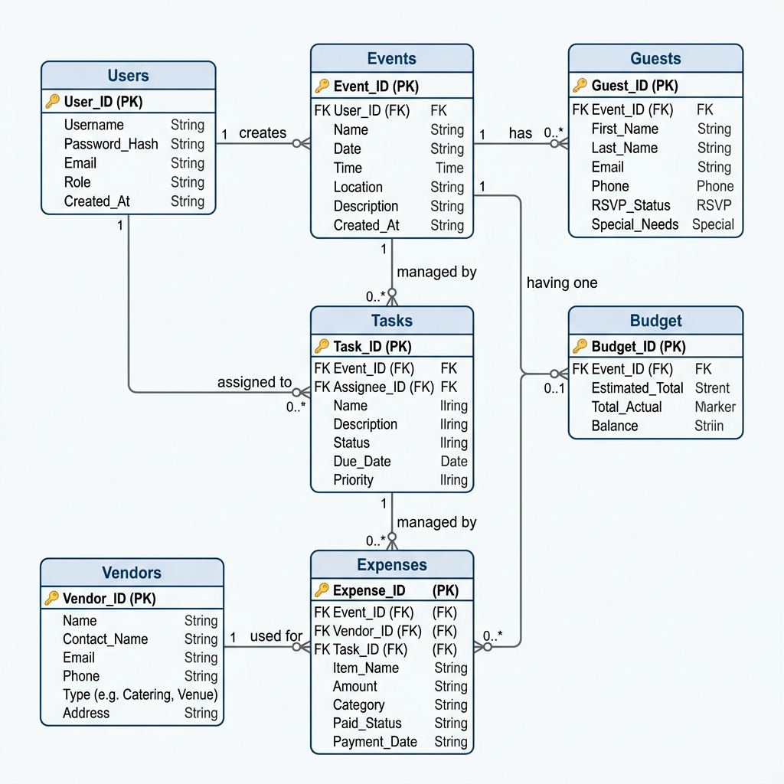
Database Schema Design
JAGAH — AI EVENT PLANNER
9 RELATIONAL TABLES (MYSQL)
https://jagah-event-planner.local/entity-relationship-er-diagram
users
events
guests
budget
expenses
tasks
vendors
notifications
feedback
📷 [ Screen Snapshot Placeholder ]
KEY RELATIONSHIPS & CONSTRAINTS
•
Users ➔ Events (1 : N relation via user_id)
Drop 'Entity Relationship (ER) Diagram' Desktop screenshot here
•
Events ➔ Budget (1 : 1 relation via event_id)
•
Events ➔ Guests, Expenses, Tasks, Vendors (1 : N)
•
Referential Integrity: ON DELETE CASCADE constraints
•
Normalization: Structured up to 3NF for zero redundancy
9 / 18

Slide 10
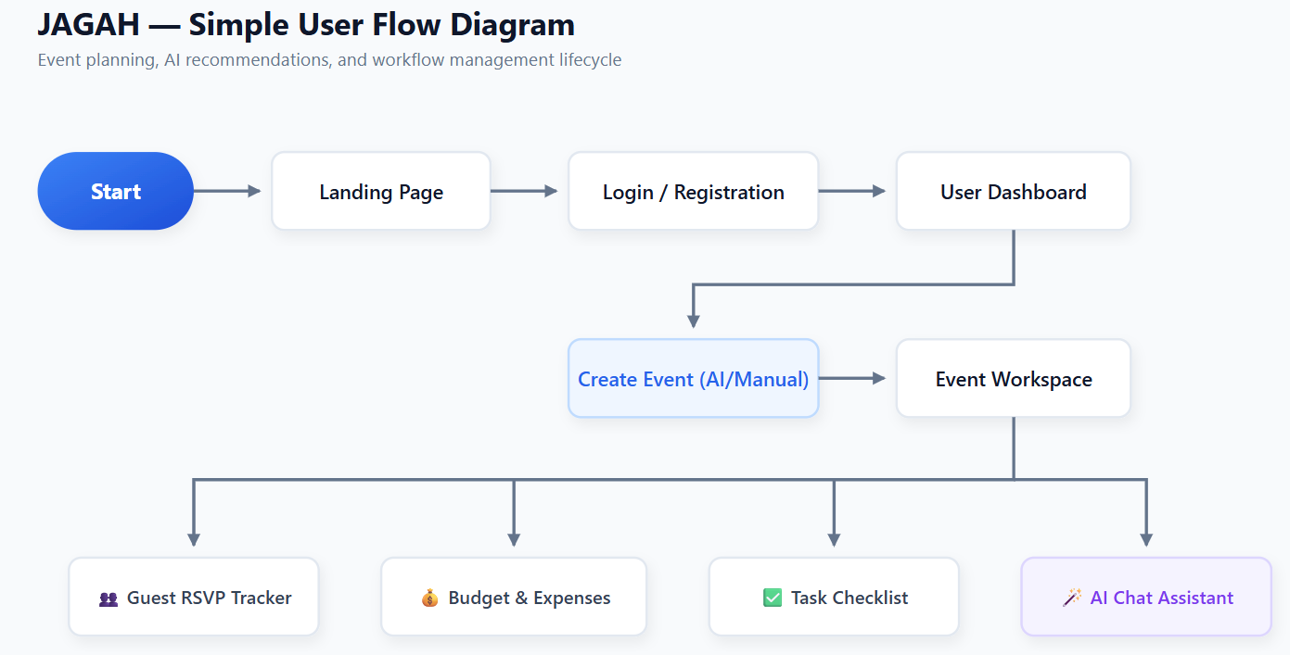
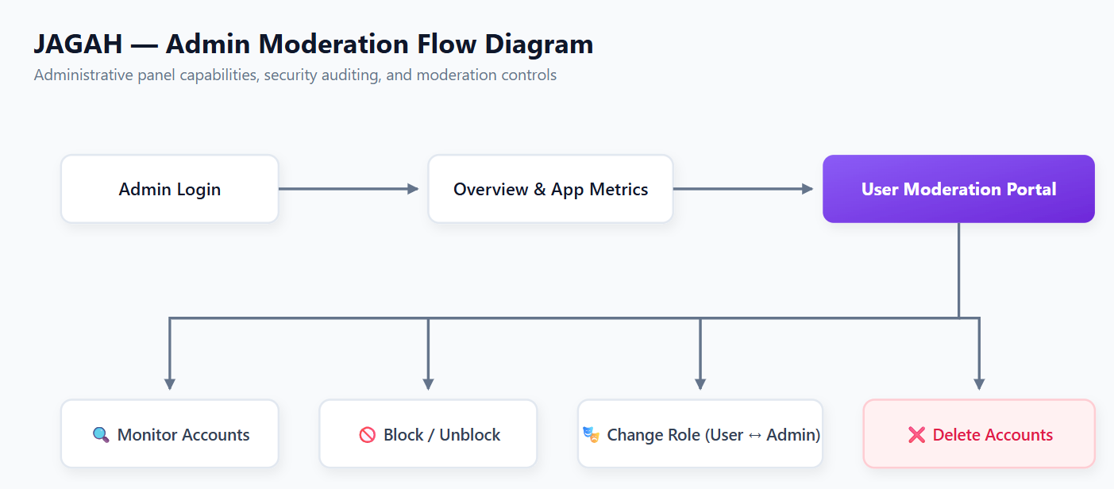
System Workflows
JAGAH — AI EVENT PLANNER
https://jagah-event-planner.local/user-flow-diagram
https://jagah-event-planner.local/admin-moderation-flow-diagram
📷 [ Screen Snapshot Placeholder ]
📷 [ Screen Snapshot Placeholder ]
Drop 'User Flow Diagram' Desktop screenshot here
Drop 'Admin Moderation Flow Diagram' Desktop screenshot here
10 / 18

Slide 11
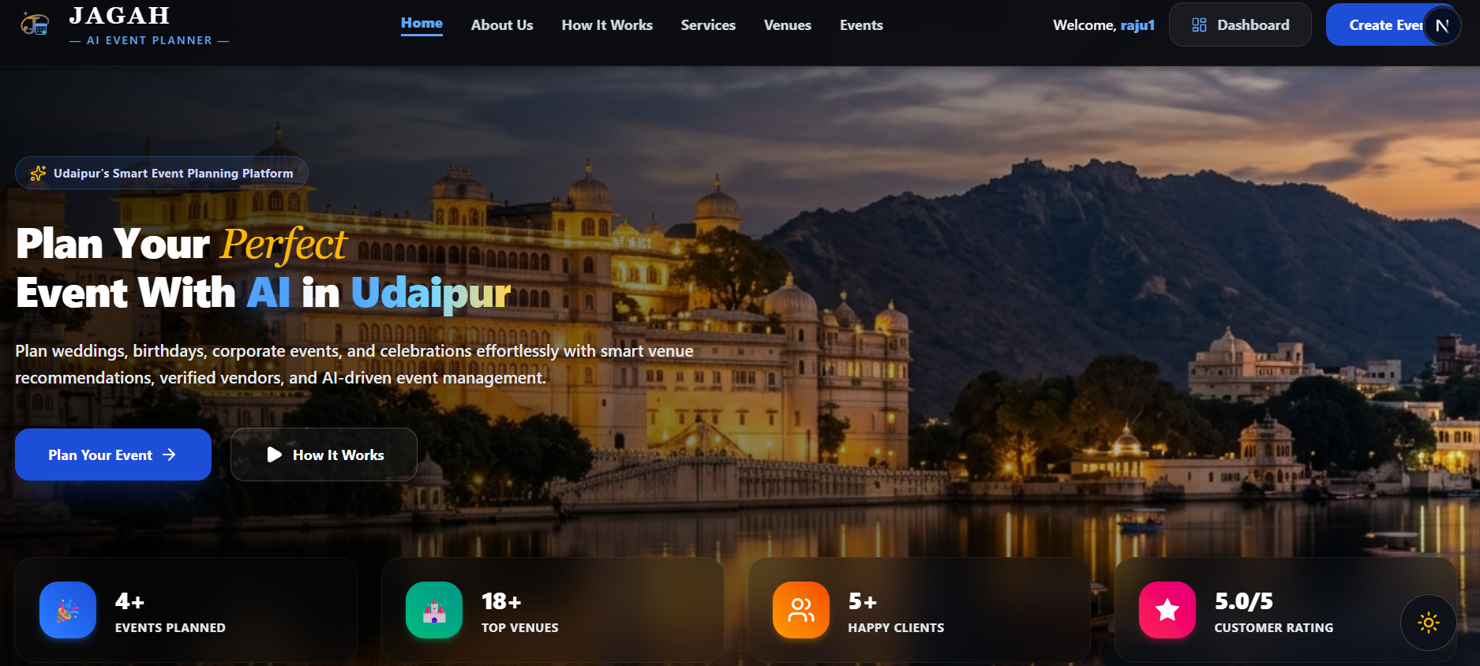
Snapshots — Homepage
JAGAH — AI EVENT PLANNER
https://jagah-event-planner.local/desktop-homepage-features
📷 [ Screen Snapshot Placeholder ]
Drop 'Desktop Homepage & Features' Desktop screenshot here
11 / 18

Slide 12
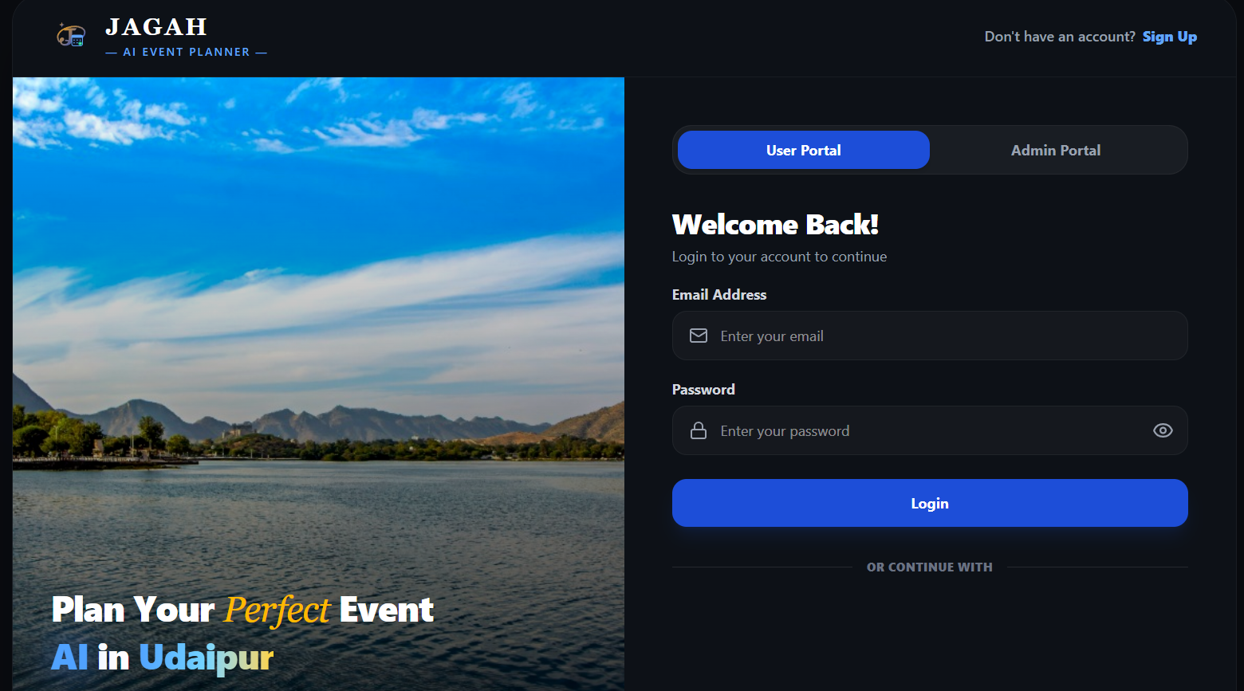
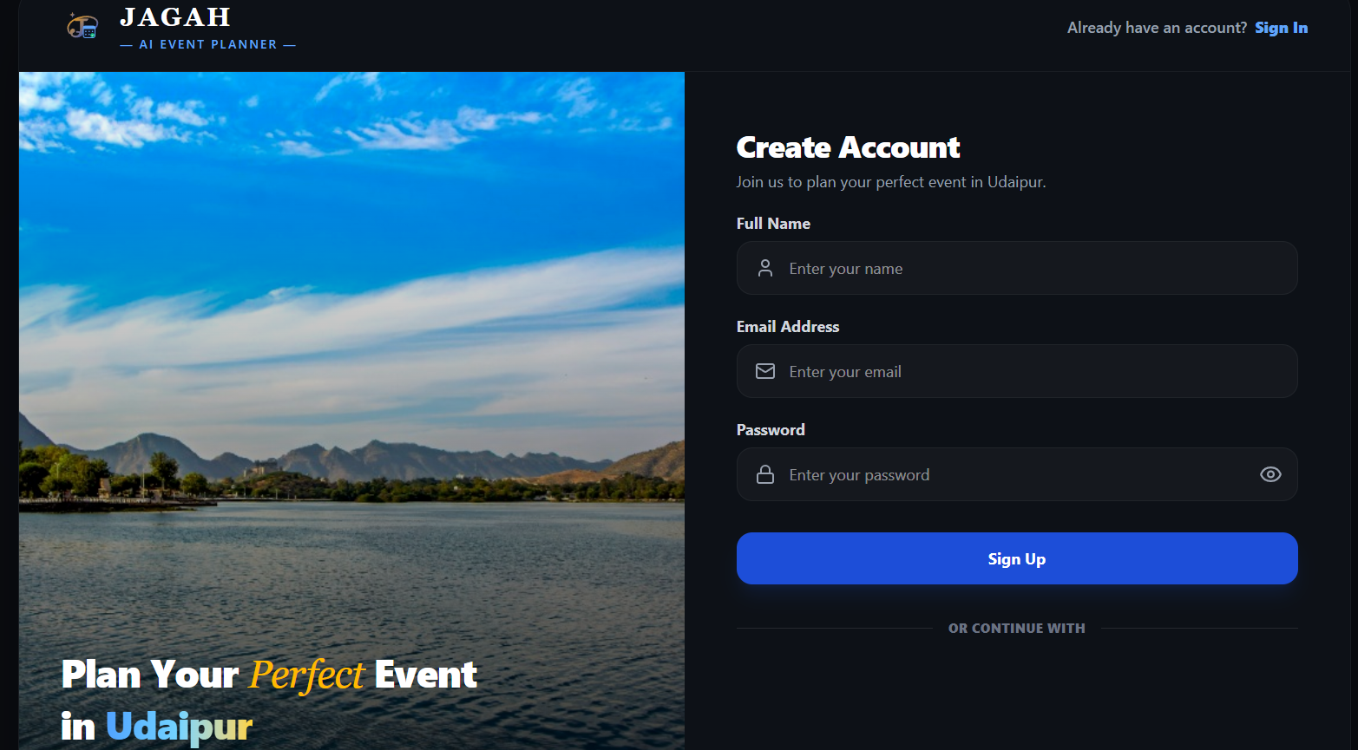
Snapshots — Login & Registration
JAGAH — AI EVENT PLANNER
📷 [ Screen Snapshot Placeholder ]
📷 [ Screen Snapshot Placeholder ]
Drop 'Secure User Login Page' Desktop screenshot here
Drop 'New Account Registration Page' Desktop screenshot here
12 / 18

Slide 13
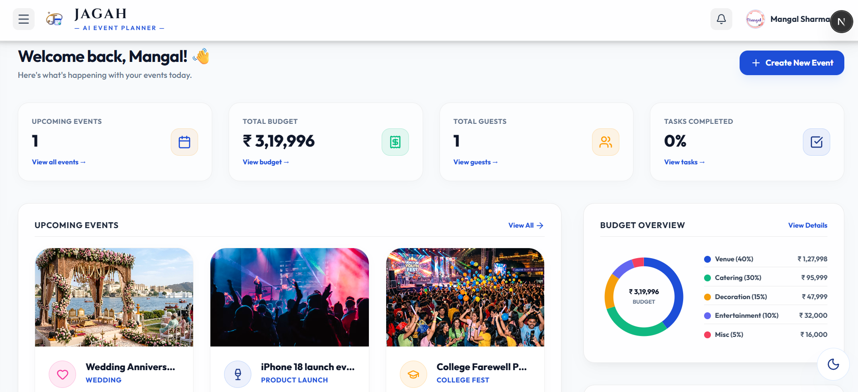
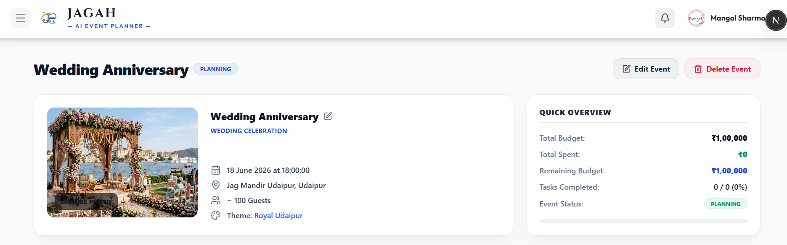
Snapshots — Dashboard & Events
JAGAH — AI EVENT PLANNER
📷 [ Screen Snapshot Placeholder ]
📷 [ Screen Snapshot Placeholder ]
Drop 'User Dashboard with Stats & Checklists' Desktop screenshot here
Drop 'Detailed Event View (Guests& Budget)' Desktop screenshot here
13 / 18

Slide 14
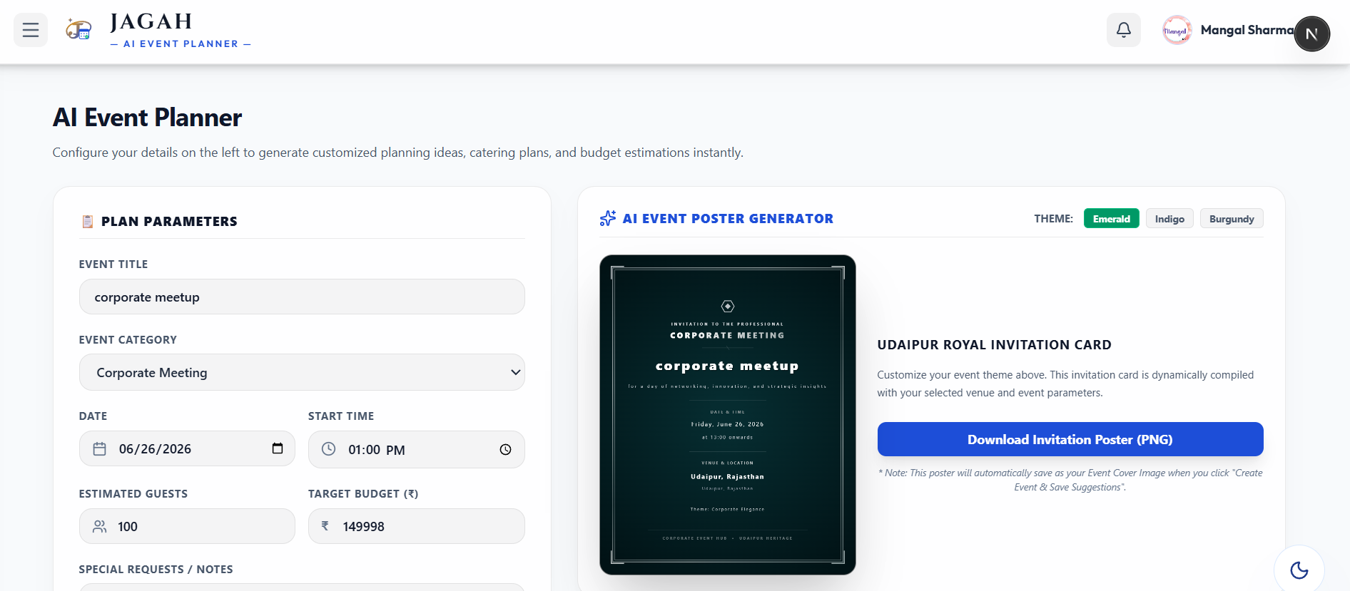
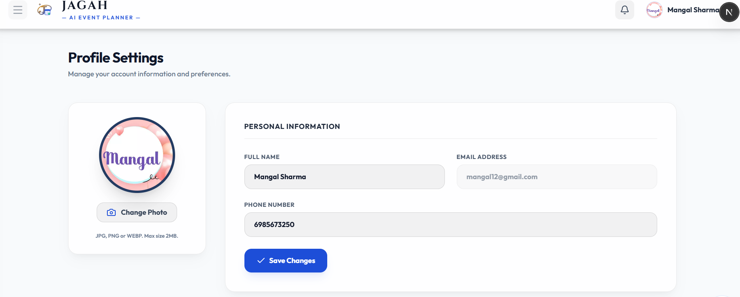
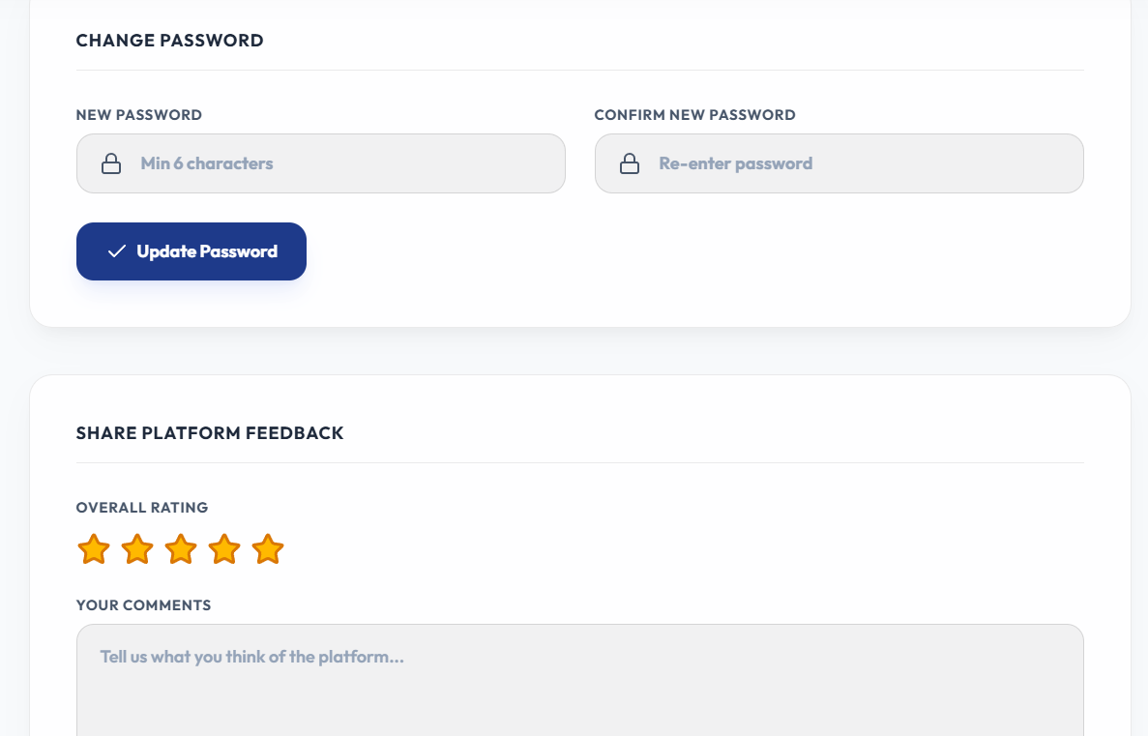
Snapshots — AI Recommendations & Profile
JAGAH — AI EVENT PLANNER
📷 [ Screen Snapshot Placeholder ]
14 / 18

Slide 15
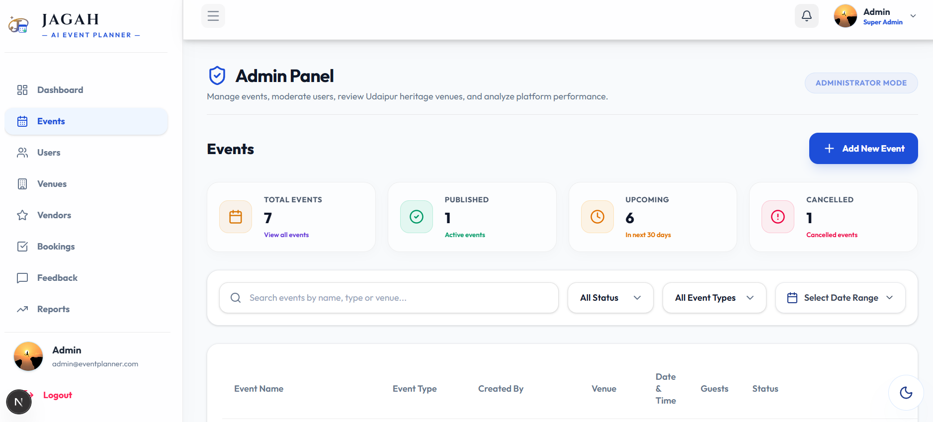
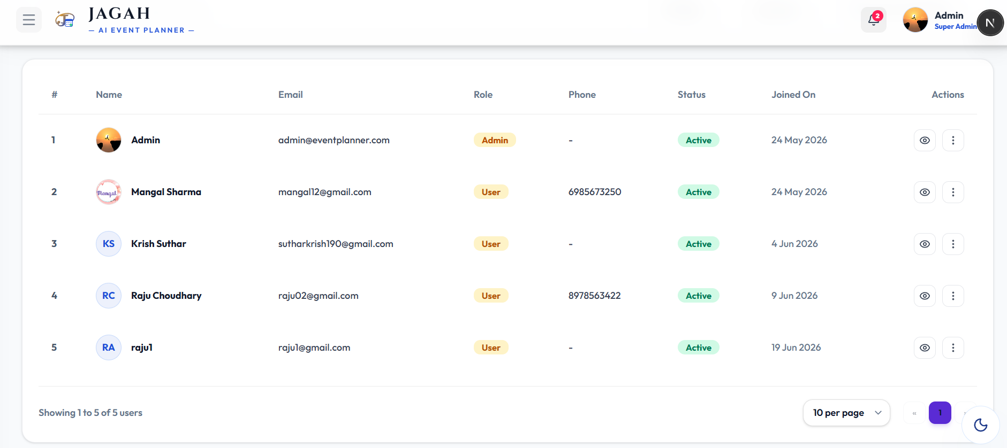
Snapshots — Admin Moderation Panel
JAGAH — AI EVENT PLANNER
📷 [ Screen Snapshot Placeholder ]
Drop 'Admin Control Panel & System Metrics' Desktop screenshot here
15 / 18

Slide 16
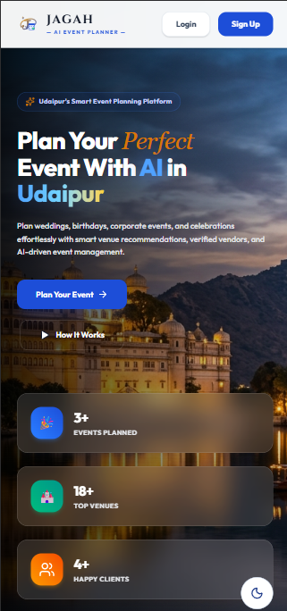
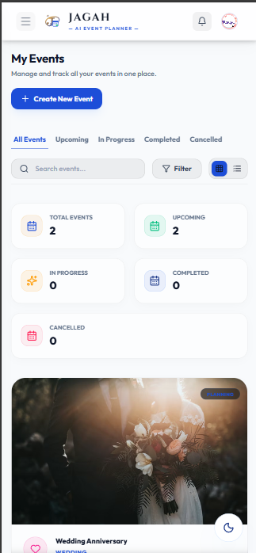
Snapshots — Mobile Responsive Views
JAGAH — AI EVENT PLANNER
📱 Mobile Screenshot
[ Mobile Home & Navigation View ]
[ Mobile Dashboard & Planner View ]
16 / 18

Slide 17
Conclusion & Future Scope
JAGAH — AI EVENT PLANNER
KEY ACHIEVEMENTS
FUTURE ROADMAP
⭐
Developed a fully-functional full-stack web application using Next.js, Node.js, Express.js, and MySQL.
🚀
Payment gateway integration (Stripe / Razorpay) for direct vendor booking and ticket purchases.
⭐
Successfully implemented multi-model AI Orchestration calling Gemini, Groq, and Grok APIs.
🚀
Automated digital invitation dispatch via Email, SMS, and WhatsApp using Twilio API suite.
⭐
Engineered a resilient active-fallback SQL mock driver for zero-config database execution during testing.
🚀
Real-time cooperative planning workspaces using WebSockets for concurrent editing by co-hosts.
⭐
Achieved clean JWT credentials authorization with Google OAuth 2.0 single sign-on integration.
🚀
Localized vendor marketplace module with reviews, ratings, portfolios, and direct quote messaging.
⭐
Validated application reliability through comprehensive testing of authentication, database, and API logic.
🚀
Cross-platform mobile application development utilizing the React Native core framework.
17 / 18

Slide 18
THANK YOU
Questions & Answers Session
PROJECT: JAGAH — AI Event Planner
Candidate Name: Mangal Sharma • Major Project Submission
18 / 18

