Slide 1
Agenda
Business Problem Statement
Objective
Dataset
Data clean up and Preparation
Data Insights
Data Visualization
Overcoming Challenges
Approach
Evaluation
Conclusion

Slide 2
Business Problem Statement
Assume you are working with MyBank. The Bank executed a campaign to cross-sell Personal Loans. As part of their Pilot Campaign, 20000 customers were sent campaigns through email, sms, and direct mail. They were given an offer of Personal Loan at an attractive interest rate of 12% and processing fee waived off if they respond within 1 Month.
2512 customer expressed their interest and are marked as column name “TARGET” = 1
Many Demographics and Behavioral variables provided.
You have to build a Model to find profitable segments to target for cross-selling personal loans. Make necessary assumptions where required.
Data File: MyBank_DATA.csv
Metadata File: MyBank_METADATA.xlsx
NOTE: Datasets are attached in the same zip file

Slide 3
Submission Guidelines
Submission should be done only in PPT format. Continue in this PPT, no additional format required.
Solution should be given only using Python
While submitting both code and PPT should be submitted

Slide 4
Objective
Apply supervised machine learning techniques on MyBank personal loan campaign dataset. And develop machine Learning Algorithm models to predict the potential list of bank customers who require Personal Loan.

Slide 5
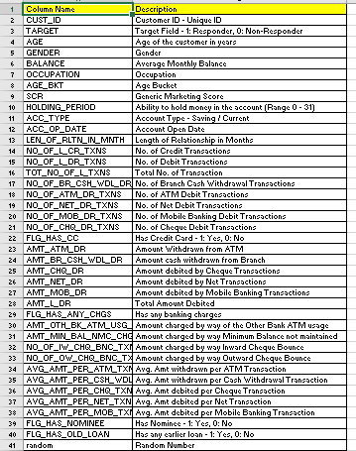
Dataset
Total observations 20,000
TARGET to be predicted from 40 features

Slide 6
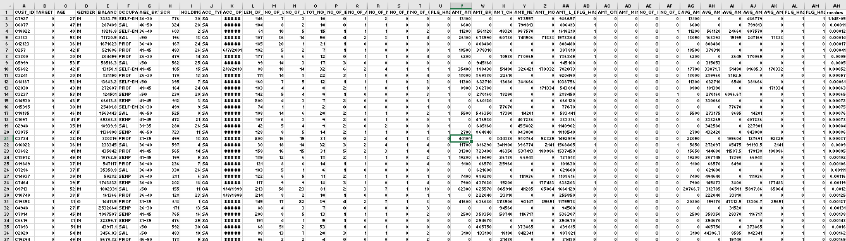
MyBank Dataset

Slide 7
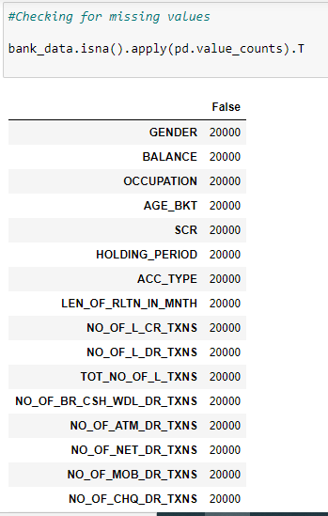
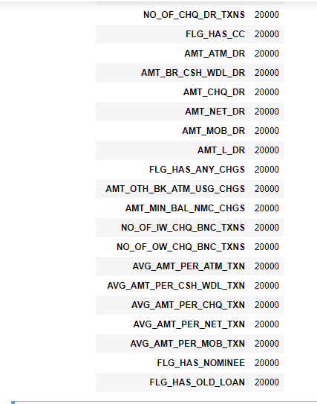
Data Clean-up and Preparation
Challenges:
Dataset have a mix of numeric, and categorical variables.
Imbalance dataset.
Feature Extraction.
Data is not normalized.
Observation from Dataset:
We observed that there are no missing values.
We must remove unwanted data like –
1. The CUST_ID , ACC_OP_DATE and “random” are not required so we drop them.
2. There are some variables which represents the same data so we
drop AGE because AGE and AGE_BKT represent same data.

Slide 8
Data Insights
Here, are some data Insights which are attached below:
Click Here

Slide 9
Data Visualization
We used SweetViz library to visualize column relations and correlation relations.
Here is the report.

Slide 10
Overcoming Challenges
1.Categorical Variables :
For converting Categorical to numerical we used Label Encoder.
2. Feature Extraction:
Features are extracted by using VIF factor which checks the collinearity between features, and we removed 15 features on the basis of that.
3.Imbalance Data:
We used cross-validation.
4.Normalizing Data:
We used standard scalar .

Slide 11
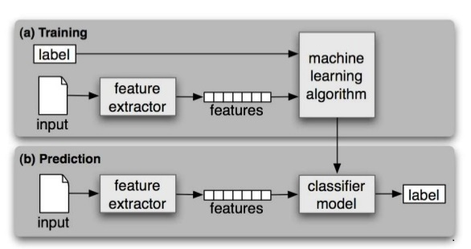
Approach
Based on above Approach we created 5 models.

Slide 12
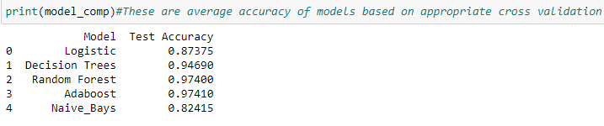
Model
Naïve Bayes
Logistic Regression
Decision Tree
Random Forest Classifier
AdaBoost

Slide 13
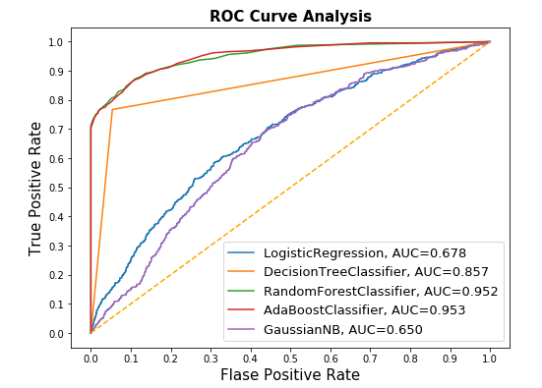

Evaluation

Slide 14
Conclusion
Based on supervised machine learning techniques-Random Forest, Logistic Regression, Adaboost, Naive Bayes, Decision Tree, we can conclude that out of 5 machine learning techniques, random Forest is best fit for personal loan campaign dataset.
Random Forest predicted best amount of True positives.
Hence, we recommend MyBank to perform Random Forest Model on customer dataset to identify potential buyers of loan.

Slide 15
References
https://en.wikipedia.org/wiki/Machine_learning
https://en.wikipedia.org/wiki/Data_science
https://www.javatpoint.com/data-science
https://numpy.org/
https://pandas.pydata.org/
https://www.geeksforgeeks.org/supervised-unsupervised-learning/
https://lex.infosysapps.com/

