Slide 1
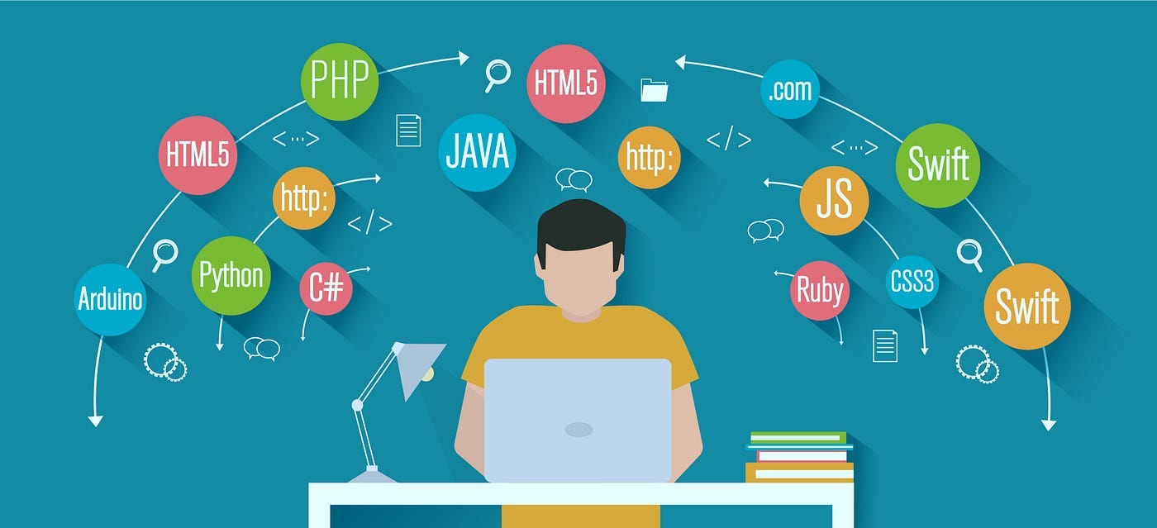






The Present and Future of Programming
- Mr. Kuldip Ranavaya
2024-06-20

Slide 2



OUTLINE
Executive Summary
Introduction
Methodology
Results
Visualization – Charts
Dashboard
Discussion
Findings & Implications
Conclusion
Appendix

Slide 3

EXECUTIVE SUMMARY
Collecting Data of Various Jobs from Different Platforms
Analyzing the Data and Identifying the current and future trends
Top 10 Programming Languages
Top 10 Databases
Popular IDE platforms
Representing extracted information using Dashboards showing Current Skills, Future Skills and Demography

Slide 4

INTRODUCTION
Keeping up the pace with ever-changing technology is significant to expertise in Programming
The Focus of the report is
What are the current trend of programming languages and database in different regions?
Predicting the future of programming languages and databases for different regions.

Slide 5

METHODOLOGY
Data Collection
Data Wrangling
Data Analysis
Data Visualization
Presentation of Findings
Data Sources : Job Posting, Training Portals and Surveys
https://www.kaggle.com/datasets/promptcloud/jobs-on-naukricom
https://cf-courses-data.s3.us.cloud-object-storage.appdomain.cloud/IBM-DA0321EN-SkillsNetwork/labs/datasets/Programming_Languages.html
https://cf-courses-data.s3.us.cloud-object-storage.appdomain.cloud/IBM-DA0321EN-SkillsNetwork/LargeData/m1_survey_data.csv

Slide 6
RESULTS
The Collected Data is now transferred for cleaning and then different statistical methods are applied to analyze data. After that, the final report is concluded.

Slide 7
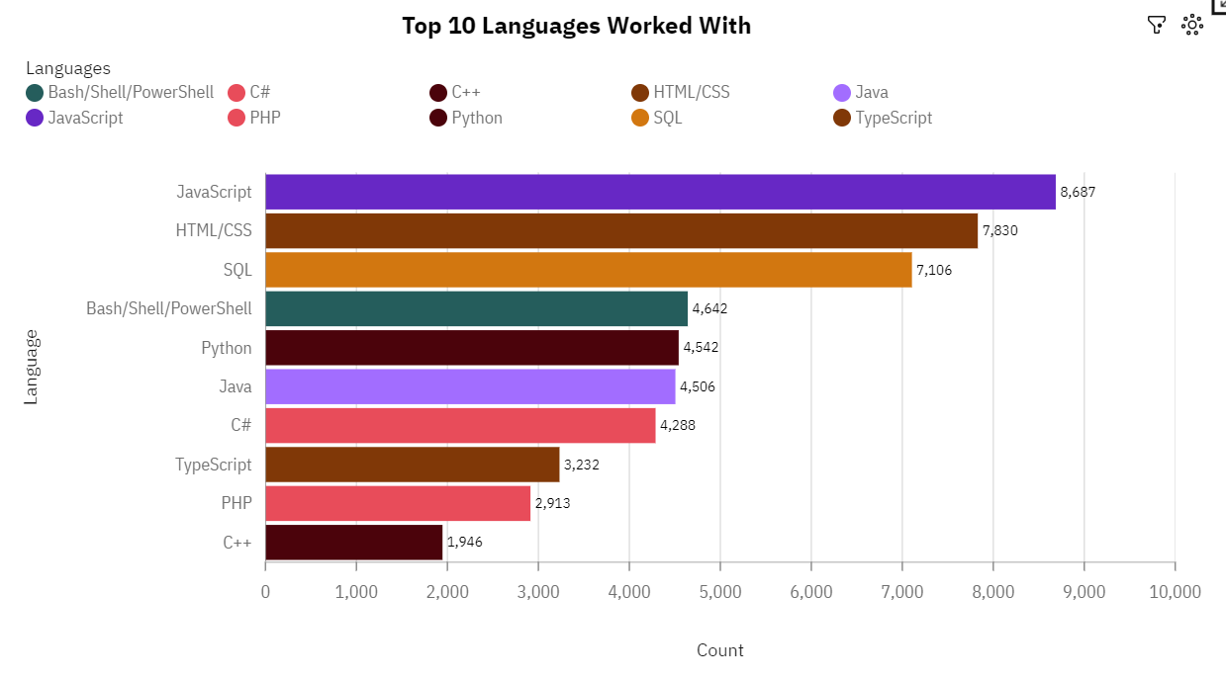
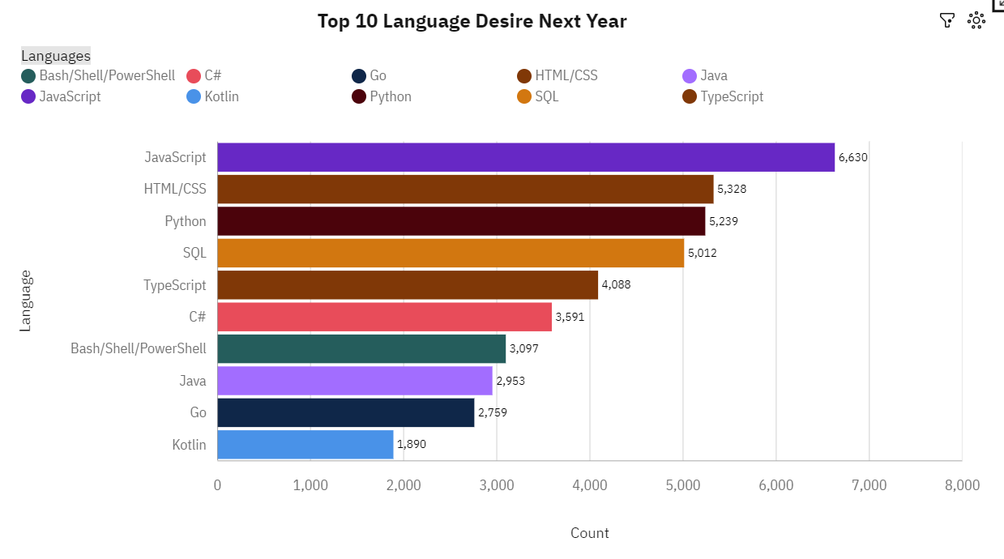
PROGRAMMING LANGUAGE TRENDS
Current Year
Next Year

Slide 8
PROGRAMMING LANGUAGE TRENDS - FINDINGS & IMPLICATIONS
Findings
JavaScript (17.5 %), is the most frequently used Language followed by HTML/CSS(15.8 %).
SQL(14.3 %) is currently at third place but will be replaced by python in future.
Bash/Shell/PowerShell is in Top 5 but will see the downfall
Implications
JavaScript and HTML/CSS will be most desired Languages in future as well.
Python will take third place in future, but SQL will still be in the trends
TypeScript will be more popular in the future

Slide 9
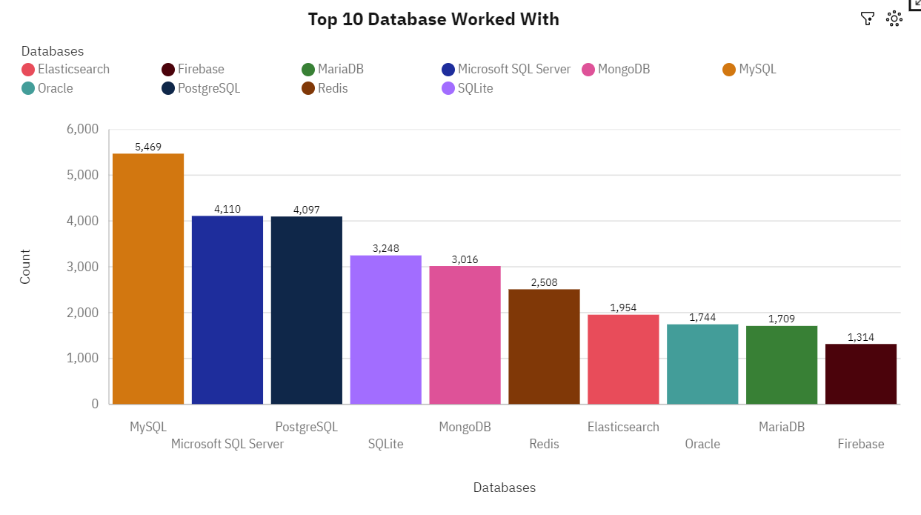
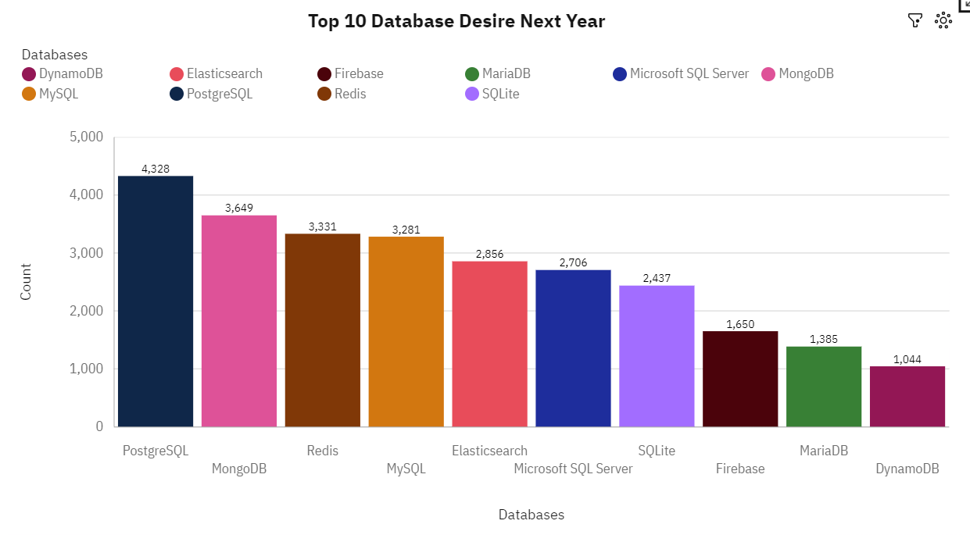
DATABASE TRENDS
Current Year
Next Year

Slide 10
DATABASE TRENDS - FINDINGS & IMPLICATIONS
Findings
MySQL(18.7 %) is the most frequently used database followed by Microsoft SQL server.
PostgreSQL will see the rise in the user and will be the most used language in the future
Implications
In the Future MySQL will lose its top place to 4th place.
MongoDB and Redis will be 2nd and 3rd place respectively replacing sqllite and Microsoft SQL server
Elasticsearch will be in the top 5 in future.

Slide 11

DASHBOARD
The GitHub Link for Cognos Dashboard

Slide 12
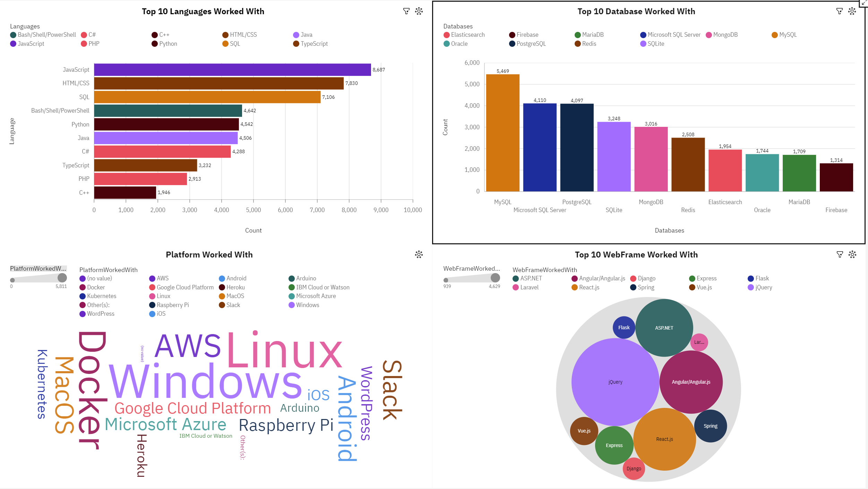
Screenshot of dashboard tab 1 goes here

Slide 13
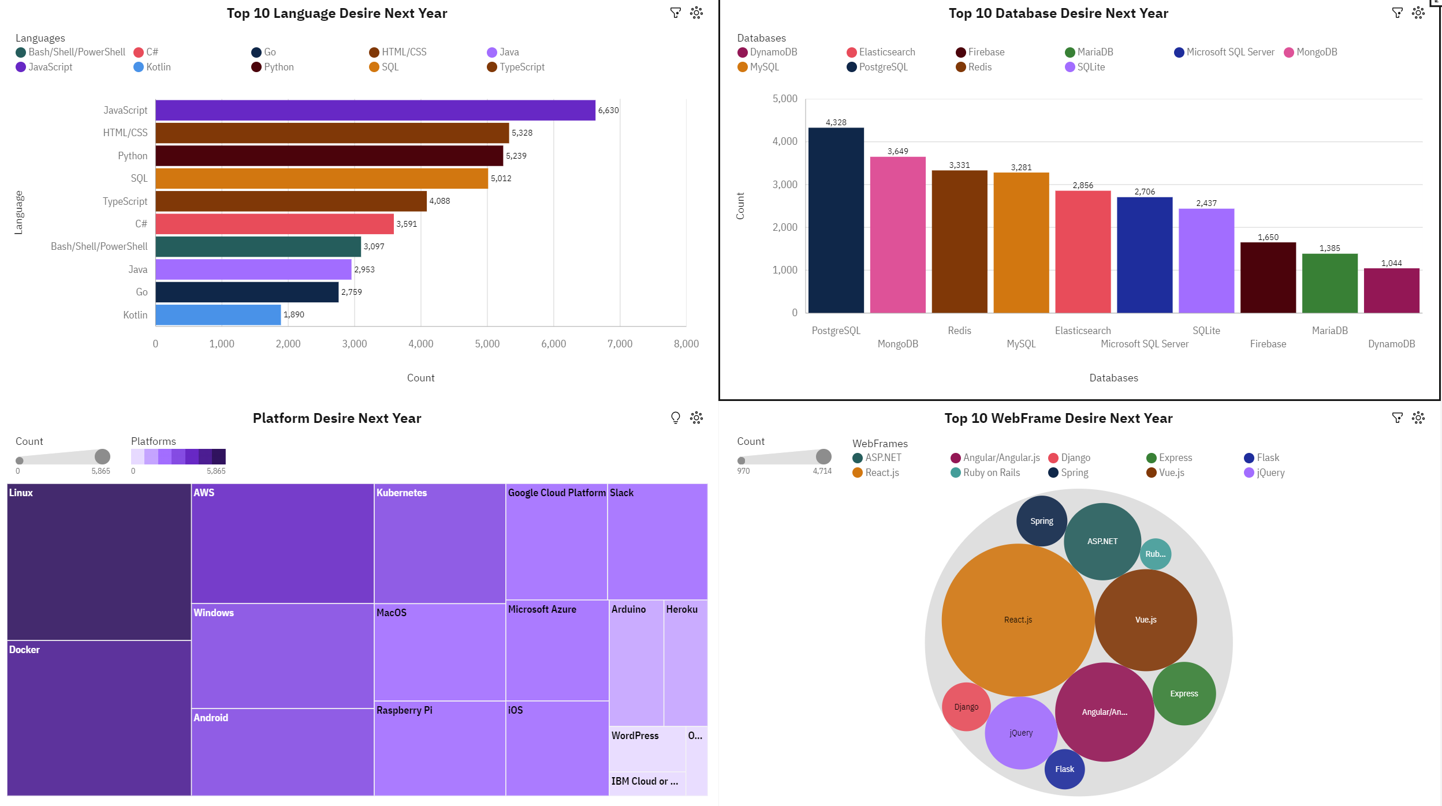
DASHBOARD TAB 2

Slide 14
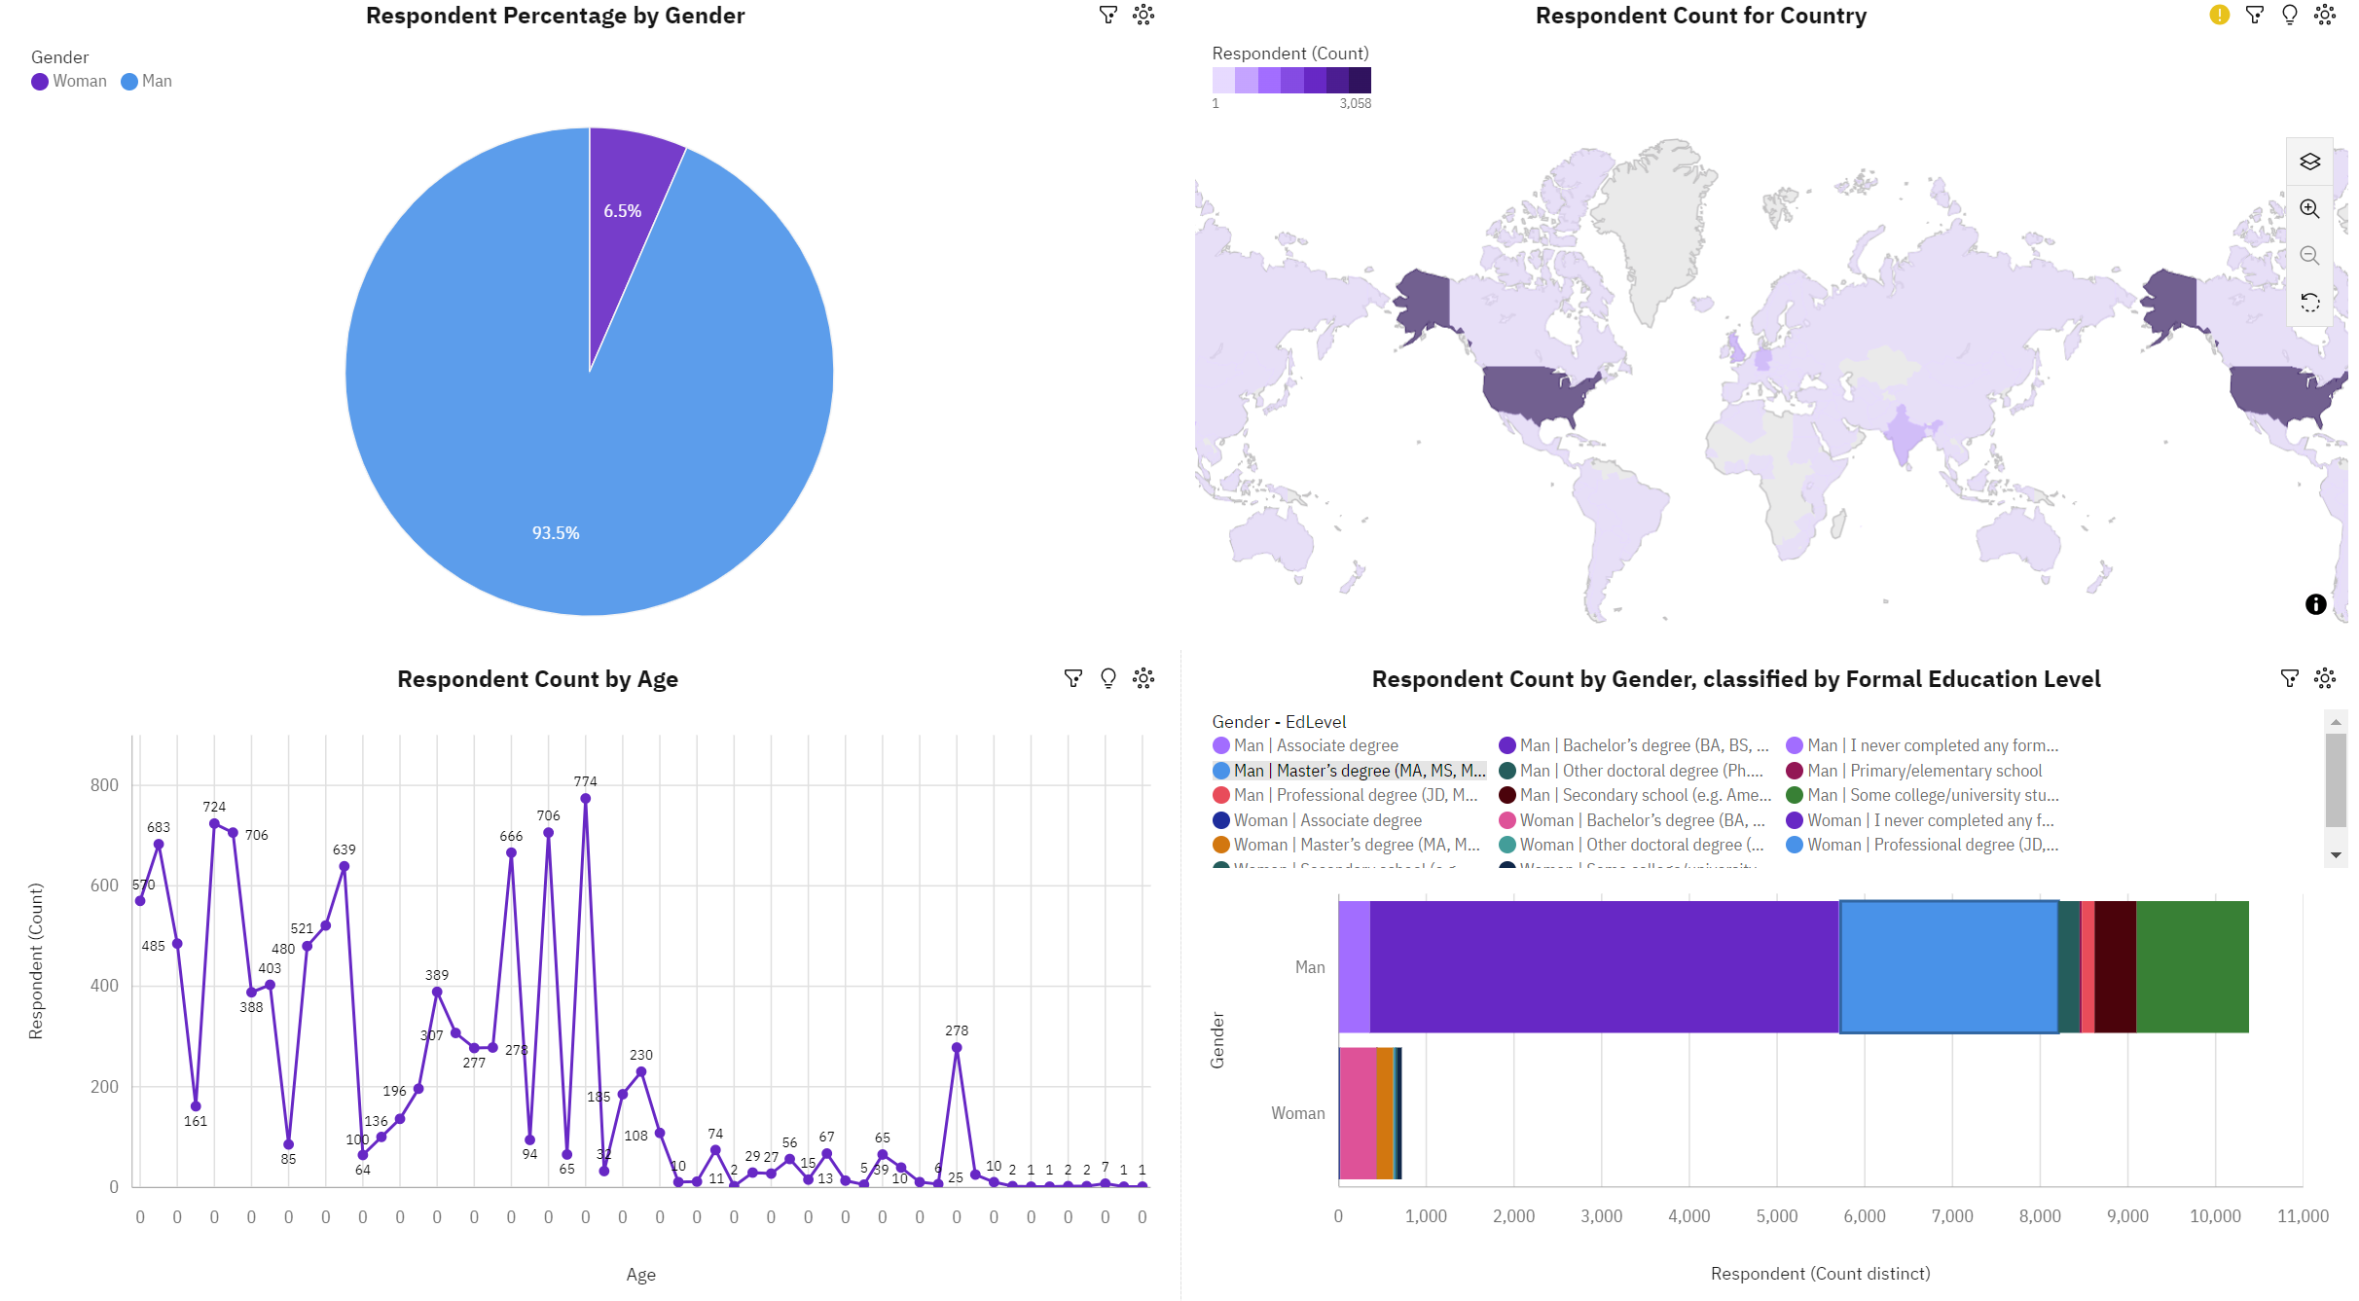
DASHBOARD TAB 3

Slide 15
DISCUSSION
Women ration compared to Man in IT
What are the key points that makes JavaScript so much popular?
Reason for downfall in popularity of Bash/shell/PowerShell and Microsoft SQL Server
Rising Popularity of MongoDB

Slide 16
OVERALL FINDINGS & IMPLICATIONS
Findings
JavaScript and HTML/CSS is and will be the most popular languages in future.
SQL will be surpassed by Python in future.
PostgreSQL is presented to be 1st instead of MySQL.
Microsoft SQL Server and SQLite is losing popularity
Linux platform is top, but Windows will be replaced by Docker in future
ReactJs is predicted highest used web frame replacing jQuery
Respondent ration of Men are very high compared to Women and area of study is Bachelor's degree
Implications
JavaScript and HTML/CSS is and will be the 1st and 2nd desired languages in future.
Python is gaining popularity in the future
MySQL will be required but PostgreSQL will be more popular
Linux platform and Docker has almost similar ration of users.
The Demand of jQuery is decreasing
It is assumed that large number of Russian men who have bachelor’s degree is interested in Respondent

Slide 17

CONCLUSION
Men are interested more in IT than Women
JavaScript and HTML/CSS is and will stay popular in future as well
PostgreSQL will be more in demand database
Linux platform will be used same n will hold the first place
The most percentage of web frames will be acquired by ReactJs

Slide 18

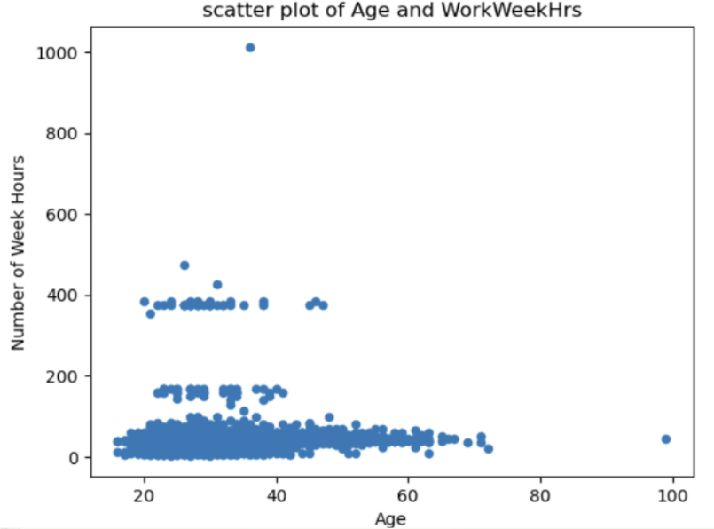
APPENDIX

Slide 19
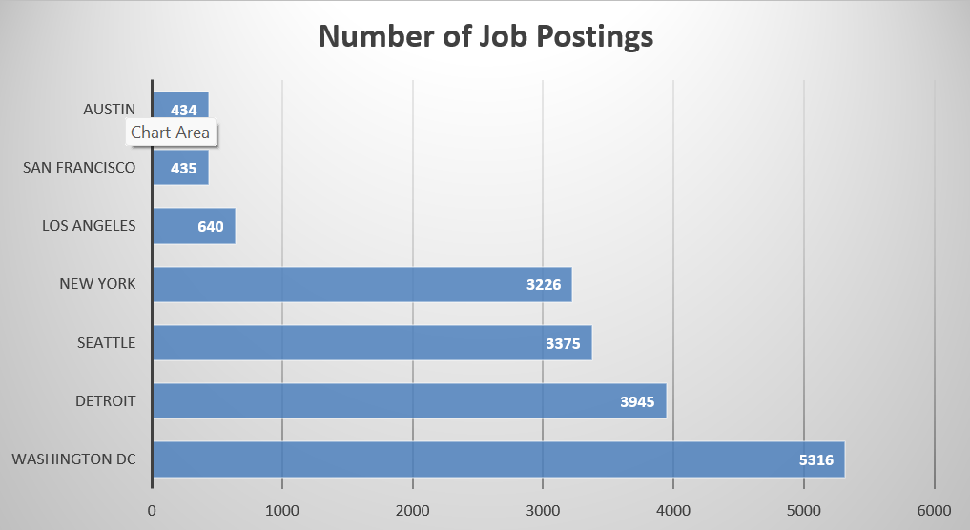
JOB POSTINGS

Slide 20
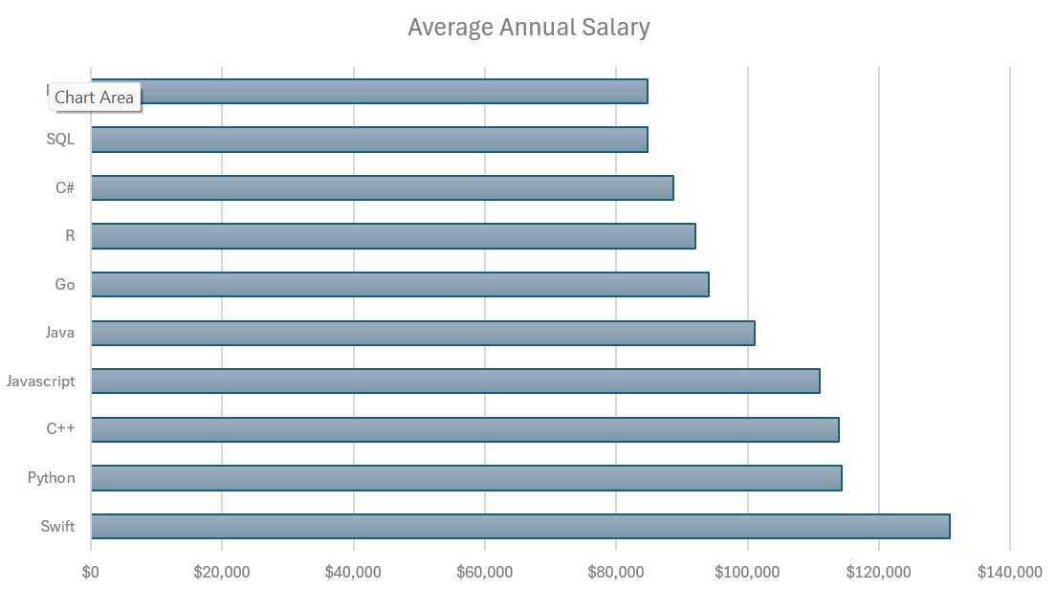
POPULAR LANGUAGES

