Slide 1
Parody Pumper

Slide 2

Have you….
ever wondered how your favourite song would sound with different words
Ever felt the words of a song just needed a little tweak?
Ever wanted to test someone's knowledge of a song

Slide 3

Parody Pumper
Now you Can with…

Slide 4
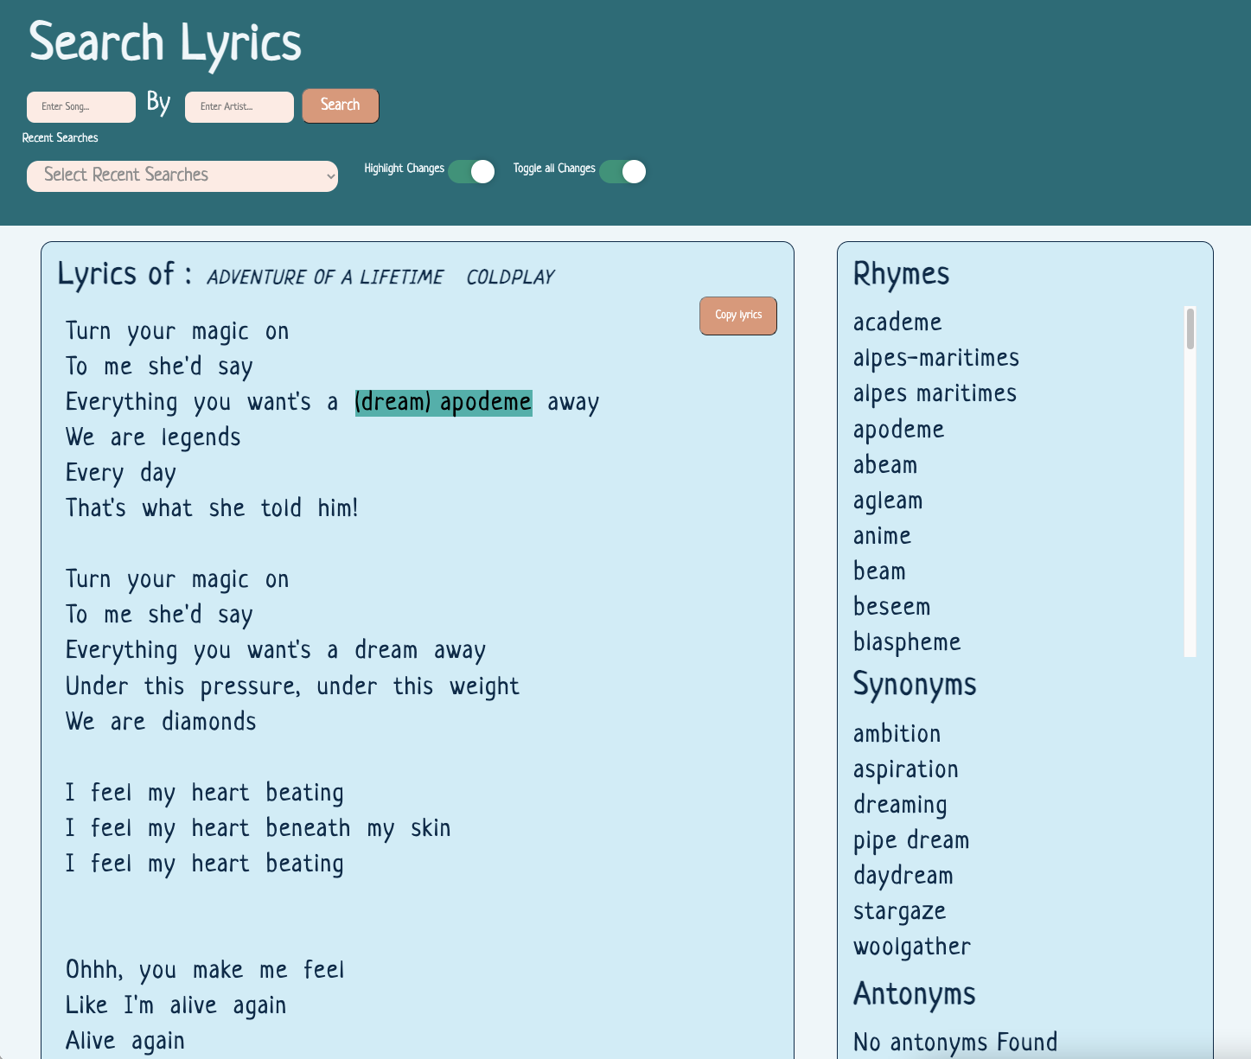
Remaster the lyrics of your favourite song
Change each word in a song lyric with a selection of
Rhymes
Synonyms
Antonyms
Display or hide your choices

Slide 5
Meet our team
Kuleena Binoy
Amelia Hooper
Doss Anania
Stuart Simmons

Slide 6
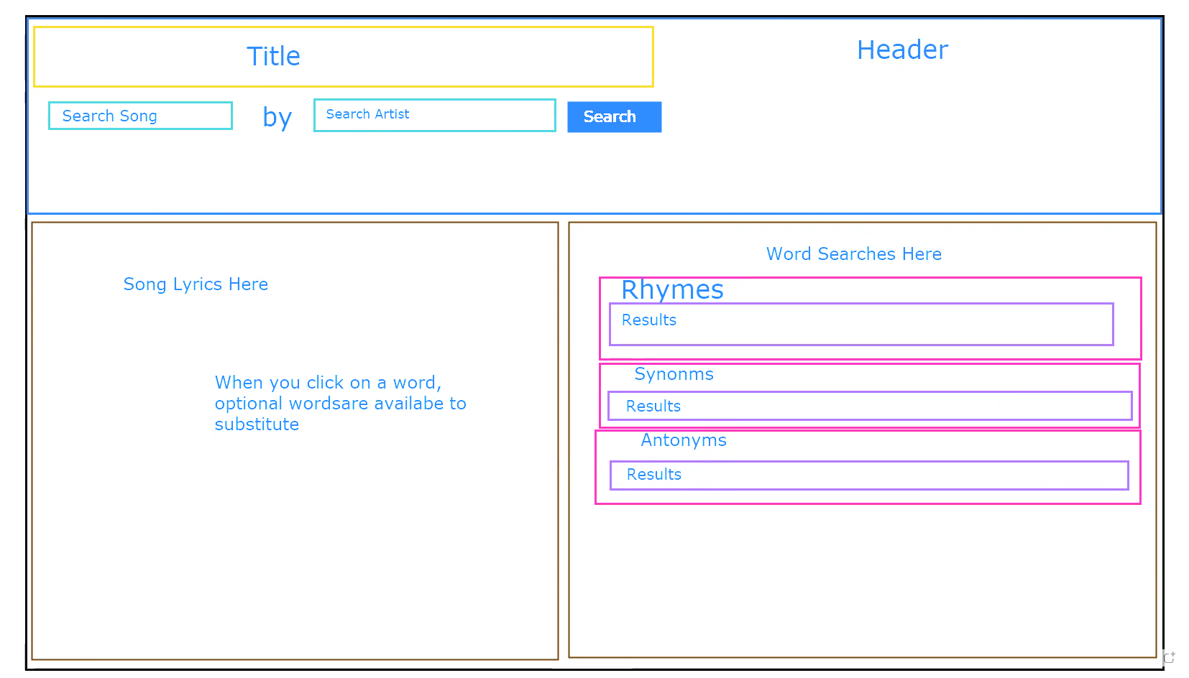
From a simple concept
Or decision to create this app was based around the availability of API’s and having a unique concept.
This is our original wireframe concept

Slide 7
Project delegation
We broke the project into some key elements:
Research the API for music lyrics
Kuleena and Doss
Research the API for words / rhymes
Stuart and Amelia
Basic layout
Amelia and Kuleena

Slide 8
Tragedy
NoCORS
We discovered the API for the music lyric was not available. Several hours of research from the whole team, led us to a position of not having a usable API for the lyrics.
Bring on our wonderful class instructor!
Within a short space of time our problem was resolved and we were on our way again.

Slide 9
Getting on with it!
Stuart
Displaying and highlighting text from the lyric
Getting words API from a word click and substituting words in the lyric
Kuleena
Search function
Lyric API
Onscreen modals for errors
Screen layout
Doss
Error management
Onscreen modals for errors
Amelia
Screen layout
CSS and usability

Slide 10
Lesson learnt
Nonresponsive API
After a day of testing the lyric API we found it to be no longer responsive. This was probably due to ‘overuse’.
On to another API and a hard coded testing lyric to save any overuse of the API… All fingers crossed it works tonight!!

Slide 11
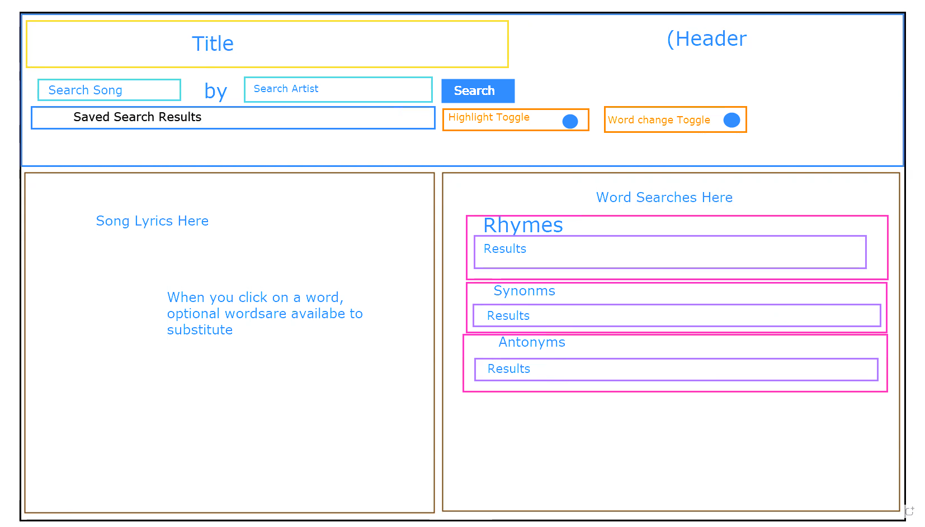
From skateboard to car
Additional Features
Recall recent searches from Local Storage
Toggle Highlights on / off
Toggle word substitute on / off

Slide 12
Getting on with it!
Live DEMO

Slide 13
To the future
What we would like to add
Dropdown / autocomplete list for song and artist choice
Better mobile functionality (shrinking menu)
Footer with a Spotify link to play the song

