Slide 1

ÓSZC Bródy Imre Technical School Information Technology and Telecommunication sector FINAL EXAM Group 4
Created by:
Kulin István Dominik
Csatári Dominik
Kiss Károly Alex

Slide 2
Introduction
Objective: Design and implementation of the network infrastructure for three sites
Key Considerations: stability, security, scalability
Implementation: addressing plan, configuring devices, security solutions
Testing: verifying functionality, troubleshooting

Slide 3
Project planning
Task distribution:
Network
Documentation
Prezentation
Video
Programs/Softwares:
Cisco Packet Tracer
Github
Powerpoint
Word
Virtualbox
AWS Academy

Slide 4
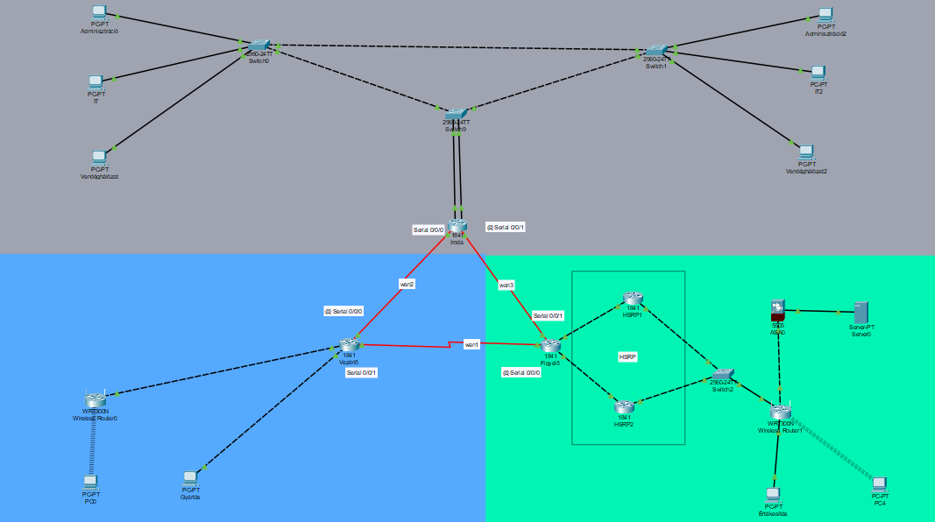
Network topology
The company’s three locations:
Main Office – Data Center and Management
Controller – Manufacturing and Logistics
Observer – Costumer Service and Sales
The network connection between the locations is provided by an MPLS-based link (low latency, reliable data transmission)
Ipsec VPN Backup connection (communication)
Redundant connections (to enhance network stability)

Slide 5
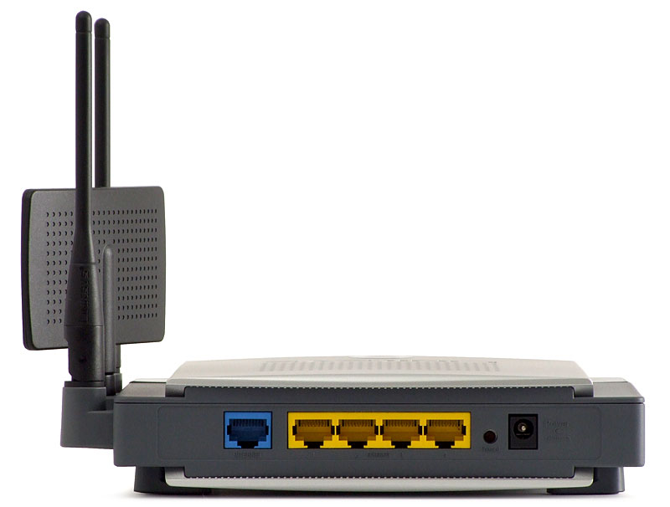
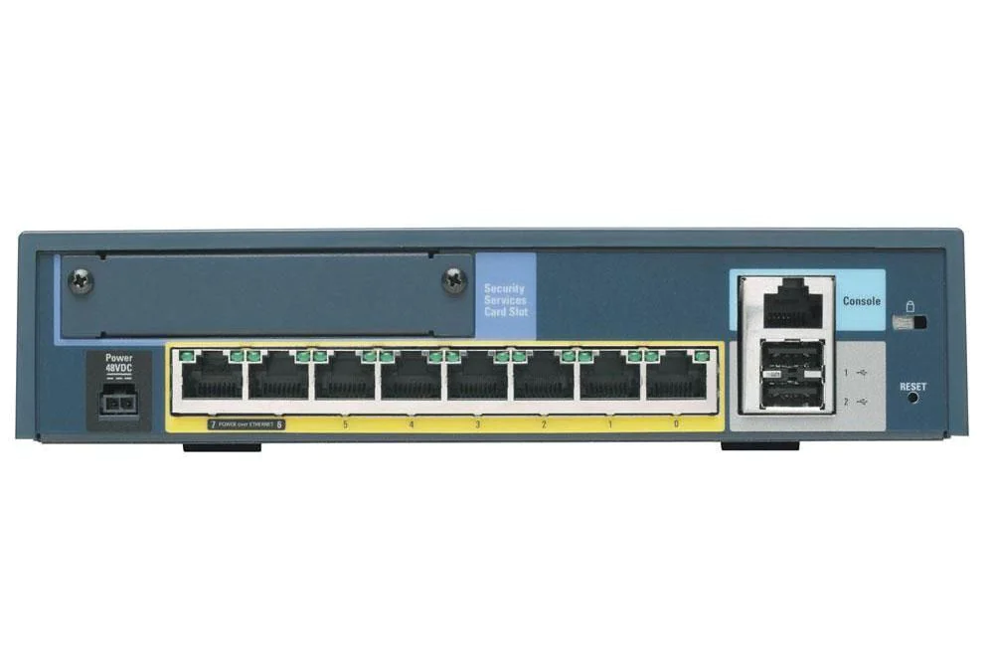
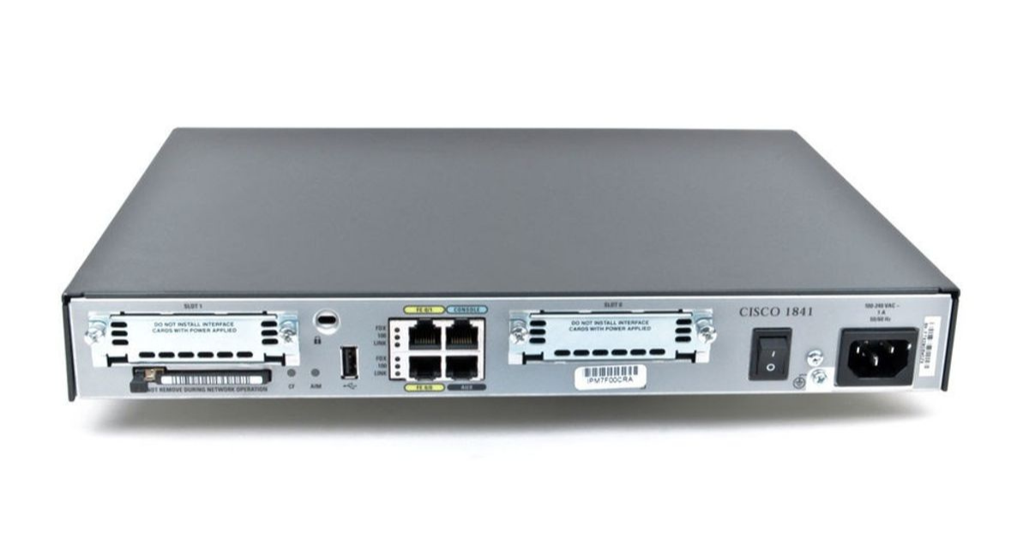
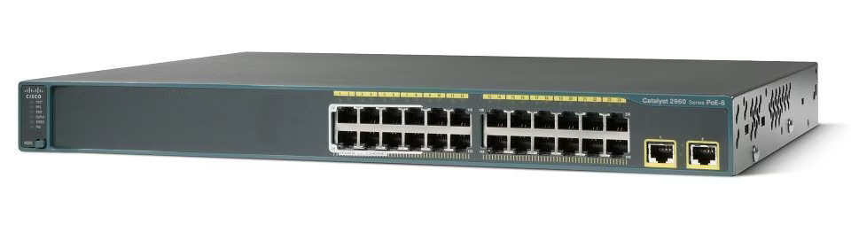
Devices
Routers (Cisco 1841) – at the three main nodes, with redundant connections
Switches (Cisco 2960-24TT) – for managing the local networks at the office and controller sites
ASA Firewall – at the observer site to protect servers and external connections
Wireless Routers (WRT300N) – to support wireless devices

Slide 6
Locations
Main Office
VLAN-configuration:
- VLAN 11: Administration
- VLAN 21: IT
- VLAN 31: Guest Network
WLAN access provided with 802.1X authentication
IPv4/IPv6 support, with static and dynamic addressing
Redundant network connections between segments to ensure high availability
Controller
Manufacturing VLAN to isolate control systems and industrial devices
VPN connection with the office headquarters, enabling secure data transmission
Local DHCP and DNS services with redundancy, ensuring the independence operation of the local network even in the event of network issues
Redundant connection to the central office, minimizing the impact of network outages
Observer
Sales VLAN to isolate customer data and business applications
WLAN access for both guests and employees
NAT/PAT solutions for efficient management of the internet connection
Redundant connection to the controller site, ensuring business permanence in case of failure

Slide 7
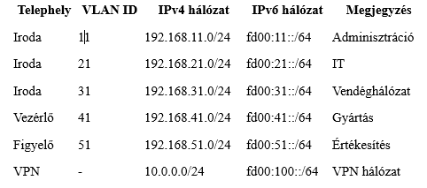
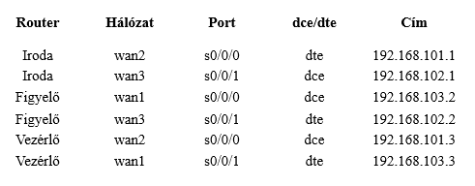
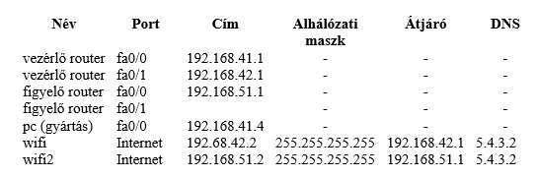
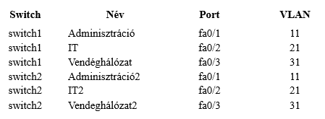
Network addressing plan

Slide 8
Configuration of network devices
VLAN configuration
HSRP/VRRP redundancy
WLAN security: WPA2
Routing protokoll: OSPFv2
NAT/PAT solutions

Slide 9
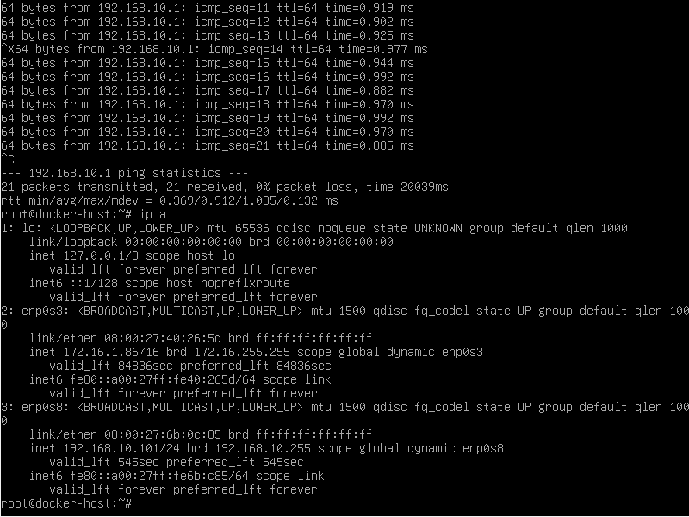
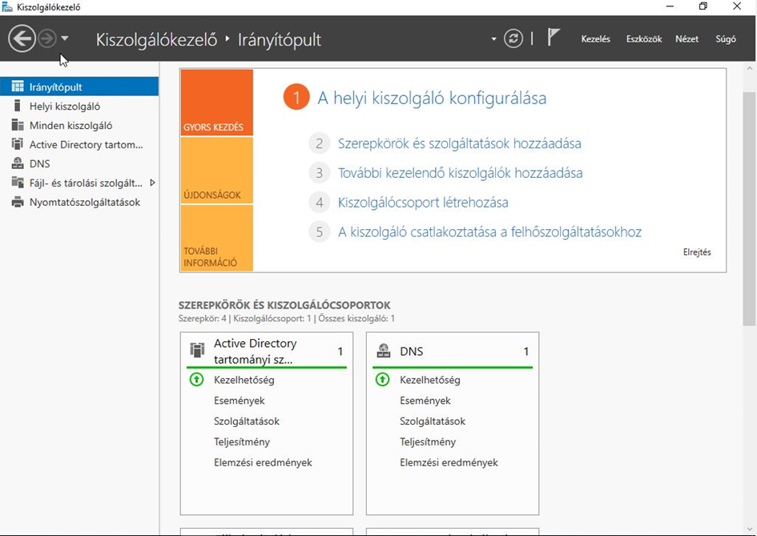
Services Configuration
Linux server configuration:
DNS server: Ensuring name resolution
DHCP server: Automatic IP address assignment
HTTP/HTTP server: Running web services
Windows server configuration:
Active Directory: Central management of users and devices
File Server and Printer Sharing: Central management and sharing of documents and printers
Group Policies (GPOs): Enforcing corporate security and operational rules

Slide 10
Security Solutions
ACLs (Access Lists): Limiting unauthorized access, protecting sensitive data
Firewall Solutions: Filtering inbound and outbound traffic
VPN Configuration: Ensuring secure communication between sites

Slide 11
Testing and Documentation
Ping and Traceroute Tests: Checking availability and network routes
Testing ACLs and VLANs: Verifying the functionality of security and segmentation settings
Redundancy Testing: Simulating the proper operation of HSRP/VRRP and other redundant solutions by modeling failure scenarios

Slide 12
THANK YOU FOR YOUR ATTENTION!

