Slide 1

RETAIL SALES & CUSTOMER PERFORMANCE ANALYSIS
Final Project Presentation
Presented by: Sakshi Kulkarni
Internship Organization: StarCentauri Technologies Pvt. Ltd.
Internship Role: Data Analytics & Data Science Intern
Tools & Technologies: Python | SQL | Excel | Power BI
Submission: Day 15 — Final Project
Date: 21 October 2026

Slide 2
Business Problem & Project Objectives
Business Problem
Retail businesses generate large amounts of sales and customer data.
Without proper analysis, identifying sales trends, profitable products, and customer purchasing patterns can be difficult.
Businesses need data-driven insights to understand performance and identify improvement opportunities.
Project Objectives
Analyze overall sales and profit performance.
Identify top-performing and low-performing products and categories.
Evaluate customer purchasing behavior and spending patterns.
Analyze sales performance across regions and time periods.
Develop an interactive Power BI dashboard to communicate key business insights.

Slide 3
Dataset Overview
Dataset Information
Dataset Name: Retail Sales Dataset
Dataset Source: Kaggle — Superstore Dataset
Total Records: 9,994 rows
Original Columns: 21
Transformed Columns: 33
Key Data Fields
Order Date and Ship Date
Customer Name and Customer Segment
Product Name, Category, and Sub-Category
Sales, Quantity, Discount, and Profit
Region, State, and City
Purpose of the Dataset
The dataset contains retail transaction, customer, product, sales, and profit information. It was used to analyze business performance, identify product trends, and understand customer purchasing behavior.

Slide 4
Data Cleaning & EDA
Inspected the dataset structure and data types.
Checked for missing values and duplicate records
Verified column names and corrected data types where required.
Data Cleaning
Created additional analytical features, including Year, Month, Month Name, and Quarter
Prepared the transformed dataset for further analysis.
Analyzed sales and profit performance across product categories.
Examined monthly sales trends.
Evaluated profit margins across product categories to identify areas for profitability improvement.
Exploratory Data Analysis (EDA)
Compared sales performance across regions.
Identified top-performing customers and products.
Key Tools
Python | Pandas | NumPy | Matplotlib

Slide 5
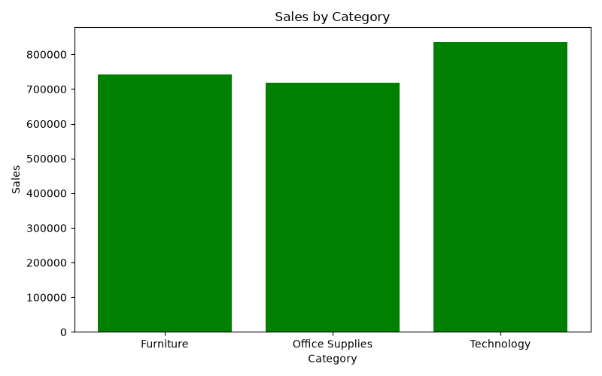
KPIs & VISUALIZATIONS
Total Sales
Total Profit
Total Orders
Unique Customers
5,009
793
Key Analytical Areas
2.30M
286.40K
Sales and Profit by Product Category
Monthly Sales Trends
Regional Sales Performance
Top-Performing Products and Customers

Slide 6
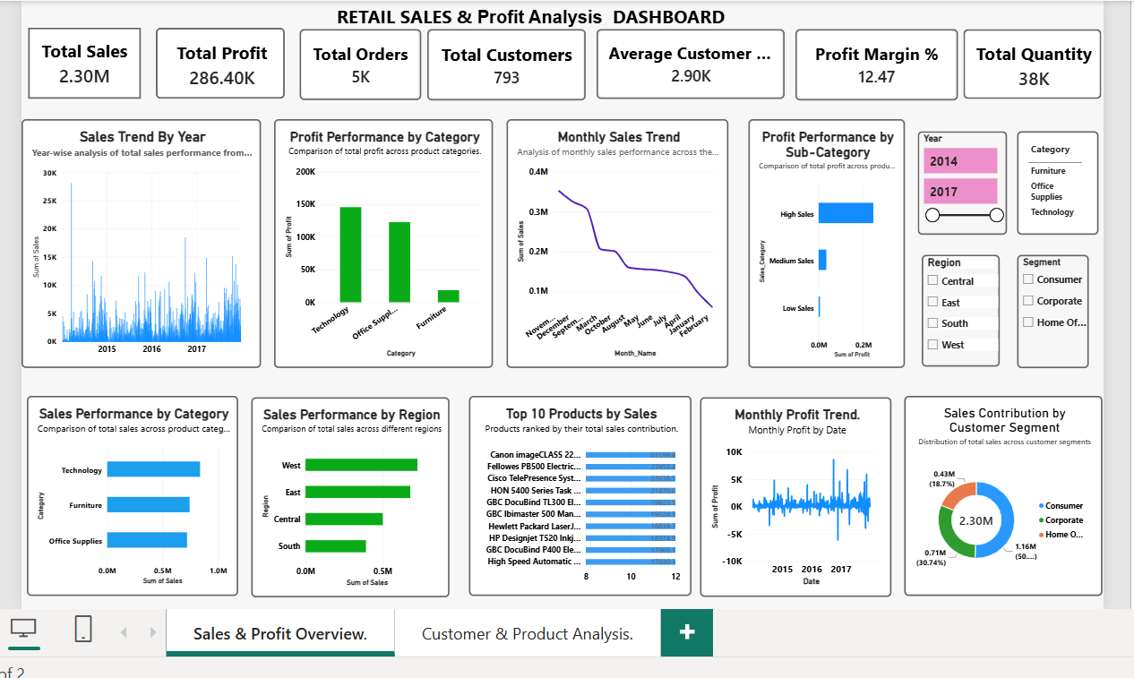
Power BI Dashboard & Key Insights
Power BI Dashboard

Slide 7
Key Business Insights
1.Overall Sales Performance
Total sales reached approximately 2.30 million.
2. Overall Profitability
The business generated approximately 286.40K in total profit.
5. Category Sales Performance
Technology recorded the highest sales among the three product categories, generating approximately 836.15K.
4. Customer Base
The analysis identified 793 unique customers.
3.Order Performance
The dataset contained 5,009 unique orders.

Slide 8
Additional Business Insights
6. Technology Profit Performance
Technology generated approximately 145.45K in profit
7. Office Supplies Profit Performance
Office Supplies generated approximately 122.49K in profit.
8. Furniture Profit Performance
Furniture generated approximately 18.45K in profit, considerably less than the other two categories.
9. Monthly Sales Performance
November recorded the highest monthly sales, at approximately 352.46K.
10. Revenue Growth
Revenue increased by approximately 20.36% from 2016 to 2017.

Slide 9
Conclusion & Future Scope
Conclusion
Analyzed retail sales, profit, and customer performance using Python, SQL, and Power BI.
Identified sales patterns across product categories, regions, and time periods.
Evaluated customer purchasing behaviour and product performance.
Developed an interactive dashboard to present key business metrics and findings.
Future Scope
Develop sales forecasting models using historical sales data.
Conduct deeper customer segmentation and retention analysis.
Investigate opportunities to improve product profitability.
Enhance the dashboard with additional KPIs and predictive analytics.

