Slide 1

Clustering Techniques - K-Means
Prof. H.P.Channe

Slide 2
Overview
K-Means Clustering
Determining number of clusters-WSS
Applications

Slide 3

Distance Based Algorithms
Distance-based methods are popular because they can be used with almost any data type, as long as an appropriate distance function is created for that data type.

Slide 4
Distance
1. Euclidean Distance
2. Manhattan Distance- |x1-x2| + |y1-y2|
3. Chebyshev Distance-
PQ chebyshev = Max(|x 1 − x2|, |y1 − y2|)
4. Minkowski Distance- Minkowski distance is one of the generalized distance measures, which means that by manipulating the formula different distances measures can be obtained. Above stated distance measures are the special case of Minkowski distance.

Slide 5
K-means Clustering
It is one of the simplest and most efficient clustering algorithms in data clustering.
It starts by choosing K representative points as the initial centroids.
Each point is then assigned to the closest centroid based on a particular proximity measure chosen.
Once the clusters are formed, the centroids for each cluster are updated.
The algorithm then iteratively repeats these two steps until the centroids do not change or any other alternative relaxed convergence criterion is met.
K-means clustering is a greedy algorithm which is guaranteed to converge to a local minimum but the minimization of its score function is known to be NP-Hard.
Typically, the convergence condition is relaxed and a weaker condition may be used.
In practice, it follows the rule that the iterative procedure must be continued until 1% of the points change their cluster memberships.

Slide 6
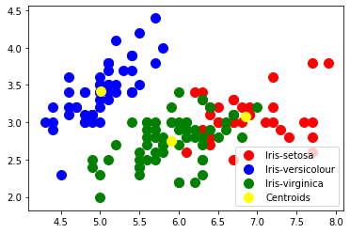

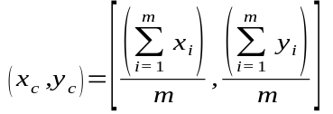
K-Means Clustering Algorithm
K-means algorithm to find k clusters:
1. Choose the value of k and the k initial guesses for the centroid.
2. Compute the distance from each data point (X_{i},Y_{i}) to each centroid. Assign each point to the closest centroid. This association defines the first k clusters.
In two dimensions, the distance, d, between any two points, ( x₁ , y₁ ) and ( x₂ , y₂ ) , in the Cartesian plane is typically expressed by using the Euclidean distance measure with eq^{n}:
3. Compute the centroid, the center of mass, of each newly defined cluster from step 2. In two dimensions, the centroid ( x C , y C ) of the m points in a k-means cluster is calcu-
lated as in eqn:
4. repeat step 2 and 3 until the algorithm converges to an answer.
a. Assign each point to the closest centroid computed in step 3.
b. Compute the centroid of newly defined clusters.
c. Repeat until the algorithm reaches the final answer.
Figure k-Means applied on Iris Dataset with
Three types of species creating 3 clusters
Convergence is reached when the
computed centroids do not change or
the centroids and the assigned points oscillate back and forth from one iteration to the next.
The latter case can occur when there are one or more points that are equal distances from the computed centroid.

Slide 7
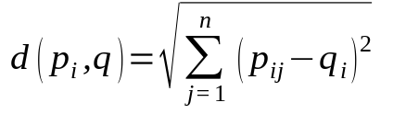
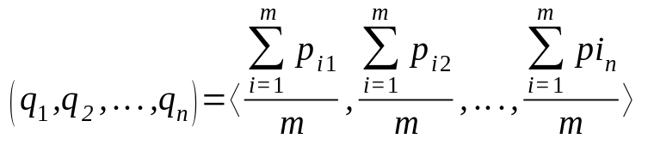
Generalized to n-dimensions
Suppose there are M objects, where each object is described by n attributes or property values ( p₁ , p₂ , ... p_{n} ) .
Then object i is described by ( p_{i1} , p_{i2} , ... p_{in} ) for i = 1,2,..., M.
There is a matrix with M rows corresponding to the M objects and n columns to store the attribute values.
To find the k clusters from two dimensions to n dimensions, the following equations provide the formulas for calculating the distances and the locations of the centroids for n ≥ 1.
For a given point, p_{i} , at ( p_{i1} , p_{i2} , ... p_{in} ) and a centroid, q, located at ( q₁ , q₂ , ... q_{n} ) , the distance, d, between p_{i} and q, is expressed as shown in Eq^{n}
The centroid, q, of a cluster of m points,
( p_{i1} , p_{i2} , ... p_{in} ) , is calculated as in
Eqn:

Slide 8
Factors Affecting K-Means
The major factors that can impact the performance of the K-means algorithm are the following:
1. Choosing the initial centroids.
2. Estimating the number of clusters K.

Slide 9
Determining the Number of Clusters
k clusters can be identified in a given dataset, but what value of k should be selected?
The value of k can be chosen based on a reasonable guess or some predefined requirement.
Even then, it would be good to know how much better or worse having k clusters versus k – 1 or k + 1 clusters would be in explaining the structure of the data.
The problem of estimating the correct number of clusters (K) is one of the major challenges for the K-means clustering. Several researchers have proposed new methods for addressing this challenge in the literature.

Slide 10
Determining the Number of Clusters: Methods
1. Elbow method
2. Calinski–Harabasz Index
3. Gap Statistic
4. Bayesian Information Criterion (BIC)
5. Silhouette Coefficient

Slide 11
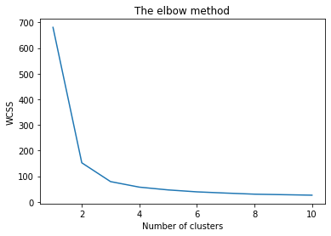
Elbow Method
The basic idea behind partitioning methods, such as k-means clustering, is to define clusters such that the total intra-cluster variation [or total within-cluster sum of square (WSS)] is minimized.
The total WSS measures the compactness of the clustering and we want it to be as small as possible.
The Elbow method looks at the total WSS as a function of the number of clusters: One should choose a number of clusters so that adding another cluster doesn’t improve much better the total WSS.
Figure Elbow method applied on Iris
Dataset from k=1 to 10 shows k = 3 as the
optimim value as number of clusters

Slide 12
Elbow Method
The optimal number of clusters can be defined as follow:
Compute clustering algorithm (e.g., k-means clustering) for different values of k. For instance, by varying k from 1 to 10 clusters.
For each k, calculate the total within-cluster sum of square (wss or wcss).
Plot the curve of wss according to the number of clusters k.
The location of a bend (knee) in the plot is generally considered as an indicator of the appropriate number of clusters.
Figure Elbow method applied on Iris
Dataset from k=1 to 10 shows k = 3 as the
optimim value as number of clusters

Slide 13
Average silhouette method
The silhouette value measures how similar a point is to its own cluster (cohesion) compared to other clusters (separation).
A high average silhouette width indicates a good clustering.
Average silhouette method computes the average silhouette of observations for different values of k.
The optimal number of clusters k is the one that maximize the average silhouette over a range of possible values for k.
The algorithm is similar to the elbow method and can be computed as follow:
Compute clustering algorithm (e.g., k-means clustering) for different values of k. For instance, by varying k from 1 to 10 clusters.
For each k, calculate the average silhouette of observations (avg.sil).
Plot the curve of avg.sil according to the number of clusters k.
The location of the maximum is considered as the appropriate number of clusters.

Slide 14
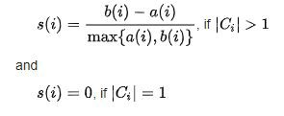


Average silhouette method
The range of the Silhouette value is between +1 and -1.
A high value is desirable and indicates that the point is placed in the correct cluster.
If many points have a negative Silhouette value, it may indicate that we have created too many or too few clusters.
Here, a(i) is the measure of similarity of the point i to its own cluster.
It is measured as the average distance of i from other points in the cluster.
Similarly, b(i) is the measure of dissimilarity of i from points in other clusters.

Slide 15
Applications of Clustering
Intermediate Step for other fundamental data mining problems:
  A clustering can be considered a form of data summarization
  Serves as a key intermediate step for many fundamental data mining problems such as classification or outlier analysis.
Collaborative Filtering:
  In collaborative filtering methods, the clustering provides a summarization of like-minded users.
  The ratings provided by the different users for each other are used in order to perform the collaborative filtering.
  This can be used to provide recommendations in a variety of applications.
Customer Segmentation:
  Quite similar to collaborative filtering as it creates groups of similar customers in the data.
  Instead of using rating information, arbitrary attributes about the objects may be used for clustering purposes.

Slide 16
Applications of Clustering
Data Summarization:
  Many clustering methods are closely related to dimensionality reduction methods and can be considered a form of data summarization.
  Data summarization can be helpful in creating compact data representations, which are easier to process and interpret in a wide variety of applications.
Dynamic Trend Detection:
  To perform trend detection in a wide variety of social networking applications.
  The data is dynamically clustered in a streaming fashion and can be used in order to determine important patterns of changes.
  Examples of such streaming data could be multidimensional data, text streams, streaming time-series data, and trajectory data.
  Key trends and events in the data can be discovered with the use of clustering methods.

Slide 17
Applications of Clustering
Multimedia Data Analysis:
  Documents such as images, audio or video.
  The determination of similar snippets of music or similar photographs.
Biological Data Analysis:
  Biological data is usually structured either as sequences or as networks.
  Clustering algorithms provide good ideas of the key trends in the data, as well as the unusual sequences.
Social Network Analysis:
  The structure of a social network is used in order to determine the important communities in the underlying network.
  Community detection has important applications in social network analysis, because it provides an important understanding of the community structure in the network.

Slide 18
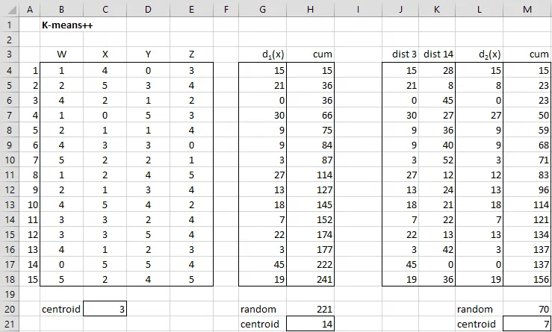
K-means example

Slide 19
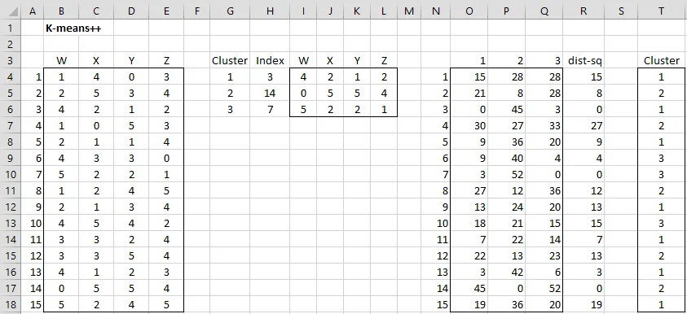

Slide 20
Initializing clusters via k-means++ algorithm
There are many ways of choosing the initial centroids in step 2 of the k-means cluster analysis algorithm, a poor choice may result in a sub-optimal minimization of SSE.
One approach is to simply choose the initial centroids randomly from among the elements in S (or to randomly assign data elements to clusters if you are using the second version of the algorithm).
Another approach is to choose one centroid randomly and then choose the others so as to try to spread the centroids out so that they are as far apart from each other as possible.

Slide 21
K-means++ algorithm
The K-means++ algorithm is defined as follows:
Step 1: Choose one of the data elements in S at random as centroid c1
Step 2: For each data element x in S calculate the minimum squared distance between x and the centroids that have already been defined. Thus if centroids c1 ,…, cm have already been chosen define dm(x) = (dist)^2(x, cj) where j = that h, 1 ≤ h ≤ m, for which (dist)^2(x, ch) has the minimum value.
Step 3: Choose one of the data elements in S − {c1 ,…, cm} at random as centroid cm+1 where the probability of any data element x being chosen is proportional to dm(x). Thus the probability that x is chosen is equal to dm(x) / ∑z_{εs}dm(z).
Step 4: Repeat Step 2 until k centroids have been chosen

Slide 22
References
1. David Dietrich, Barry Hiller, “Data Science & Big Data Analytics”, EMC education services, Wiley publications, 2012, ISBN0-07-120413-X
2.https://www.mastersindatascience.org/
3.https://towardsdatascience.com
4.Charu C. Aggarwal, Chandan K. Reddy, ”Data Clustering Algorithms and Applications”, CRC Press.

