Slide 1
USART :8251
8251 is universal synchronous asynchronous receiver transmitter (USART).
It takes data serially from peripheral (outside devices) and converts into parallel data. After converting the data into parallel form, it transmits it to the CPU.
Similarly, it receives parallel data from microprocessor and converts it into serial form. After converting data into serial form, it transmits it to outside device (peripheral).
HEMANT SINGH POKHARIYA, A.P. CSE DEPT.GRAPHIC ERA DEEMEED TO BE UNIVERSITY DEHRADUN

Slide 2
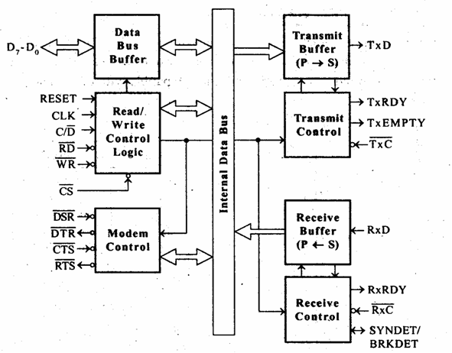
Block Diagram of 8251

Slide 3
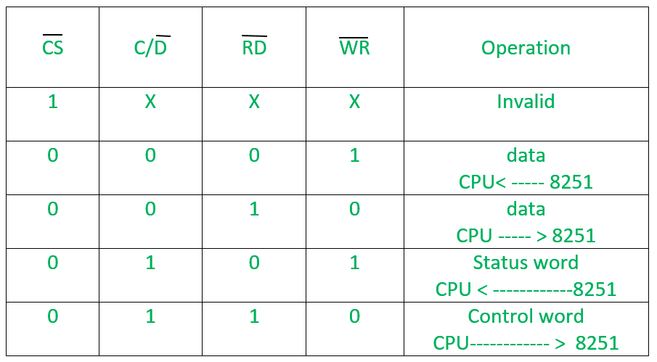
Read/Write control logic of 8251

Slide 4
MODEM Control Signals of 8251
DSR: Data Set Ready signal is an input signal.
DTR: Data terminal Ready is an output signal.
CTS: It is an input signal which controls the data transmit circuit. RTS: It is an output signal which is used to set the status RTS.
HEMANT SINGH POKHARIYA, Assistant Proffesor CSE DEPT
GRAPHIC ERA DEMEED TO BE UNIVERSITY DEHADUN

Slide 5
Transmit buffer and control signals
TXD: It is an output signal, if its value is one, means transmitter will transmit the data.
TXRDY: It means transmitter is ready to transmit data character.
TXEMPTY: An output signal which indicates that TXEMPTY pin has transmitted all the data characters and transmitter is empty now.
TXC: An active-low input pin which controls the data transmission rate of transmitted data.
10010010

Slide 6
Receive buffer and control signals
RXD: An input signal which receives the data.
RXRDY: An input signal indicates that it is ready to receive the data.
RXC: An active-low input signal which controls the data transmission rate of received data.
SYNDET/BD: An input or output terminal. External synchronous mode-input terminal and asynchronous mode-output terminal.

Slide 7
Thanks For Watching

