Slide 1
8259-Programmable Interrupt Controller
8 levels of interrupts.
Can be cascaded in master-slave configuration to handle 64 levels of interrupts.
It has fixed priority mode and rotating priority mode.
Individually maskable interrupts.
Modes and masks can be changed dynamically.
Accepts IRQ, determines priority, checks whether incoming priority current level being serviced, issues interrupt signal.
In 8085 mode, provides 3 byte CALL instruction. In 8086 mode, provides 8 bit vector number.
Starting address of ISR or vector number is programmable.
No clock required.
HEMANT SINGH POKHARIYA, A.P. CSE DEPT.GRAPHIC ERA DEEMEED TO BE UNIVERSITY DEHRADUN

Slide 2
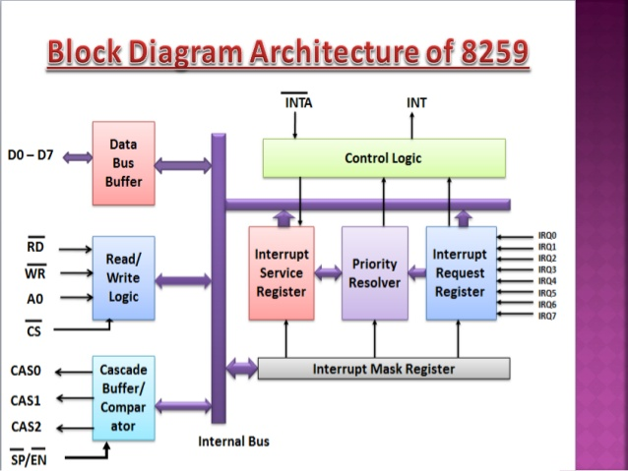

Slide 3
Data bus buffer
This Block is used as a mediator between 8259 and 8085/8086 microprocessor by acting as a buffer. It takes the control word from the 8085 (let say) microprocessor and transfer it to the control logic of 8259 microprocessor. Also, after selection of Interrupt by 8259 microprocessor, it transfer the opcode of the selected Interrupt and address of the Interrupt service sub routine to the other connected microprocessor. The data bus buffer consists of 8 bits represented as D0-D7 in the block diagram. Thus, shows that a maximum of 8 bits data can be transferred at a time.

Slide 4
Read/Write and Control logic
Read/Write logic This block works only when the value of pin CS is low (as this pin is active low). This block is responsible for the flow of data depending upon the inputs of RD and WR. These two pins are active low pins used for read and write operations.
Control logic It is the centre of the microprocessor and controls the functioning of every block. It has pin INTR which is connected with other microprocessor for taking interrupt request and pin INT for giving the output.
HEMANT SINGH POKHARIYA, Assistant Professor CSE DEPT
GRAPHIC ERA DEMEED TO BE UNIVERSITY DEHADUN

Slide 5
Registers of 8259
Interrupt request register (IRR) It stores all the interrupt level which are requesting for Interrupt services.
Interrupt service register (ISR) It stores the interrupt level which are currently being executed.
Interrupt mask register (IMR) It stores the interrupt level which have to be masked by storing the masking bits of the interrupt level.

Slide 6
Priority resolver
It examines all the three registers and set the priority of interrupts and according to the priority of the interrupts, interrupt with highest priority is set in ISR register. Also, it reset the interrupt level which is already been serviced in IRR.

Slide 7
Cascade buffer
To increase the Interrupt handling capability, we can further cascade more number of pins by using cascade buffer. So, during increment of interrupt capability, CSA lines are used to control multiple interrupt structure.
SP/EN (Slave program/Enable buffer) pin is when set to high, works in master mode else in slave mode. In Non Buffered mode, SP/EN pin is used to specify whether 8259 work as master or slave and in Buffered mode, SP/EN pin is used as an output to enable data bus.

Slide 8
Thanks For Watching

