Slide 1
Recurrence Relation

Slide 2
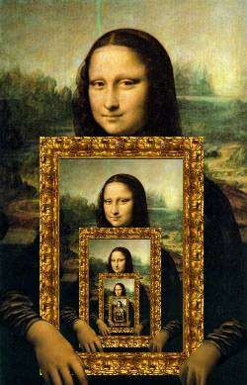
Recursive Algorithm
A recursive algorithm is an algorithm which calls itself with smaller (or simpler) input values.

Slide 3
Recurrence Relations
The running time for a recursive algorithm is most easily expressed by a recursive expression because the total time for the recursive algorithm includes the time to run the recursive call(s).
A recurrence relation defines a function by means of an expression that includes one or more (smaller) instances of itself.
To solve a Recurrence Relation means to obtain a function defined on the natural numbers that satisfy the recurrence.

Slide 4
Example of Linear Search
Input: Array A, an element x
Question: Is x ∈ A
A recursive approach to linear search first searches the given element in the first location, and if not found it recursively calls the linear search with the modified array without the first element. i.e., the problem size reduces by one in the subsequent calls.
Let T(n) be the number of comparisons (time) required for linear search on an array of size n.
So, Recurrence Relation is:
T(n) = T(n − 1) +1
T(1)=1

Slide 5
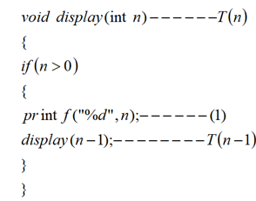
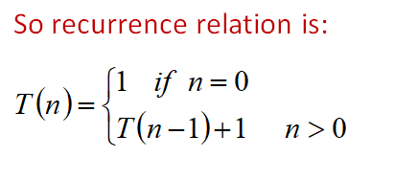
Example 2

Slide 6
Solving Recurrence Relations
Following methods are used to solve recurrence relations:
Substitution method
Recursion tree method
Master theorem

Slide 7
Substitution method
The substitution method for solving recurrences comprises two steps:
1. Guess the form of the solution.
2. Use mathematical induction to find the constants and show that the solution works.
We substitute the guessed solution for the function when applying the inductive hypothesis to smaller values; hence the name “substitution method.”

Slide 8
Example 1
Determine an upper bound on the recurrence T(n)=2T(n/2)+ n
T(1)=1
Answer is O(n log n)

Slide 9
Example 2
Determine an upper bound on the recurrence T(n)=T(n-1)+ n
T(1)=1
Answer is O(n²)

Slide 10
Recursion Tree method
A recursion tree is a tree where each node represents the cost of a certain recursive subproblem.
After that, sum up the numbers in each node to get the cost of the entire algorithm

Slide 11
Example 1

Slide 13
Example 2
T(n)=T(n/3)+T(2n/3)+O(n)

Slide 15
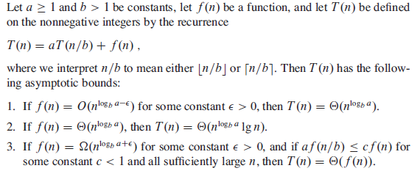
Master Theorem

Slide 16
Example 1
T(n)=9T(n/3)+n

Slide 17
Example 2
T(n)=T(2n/3)+1

Slide 18
Example 3
T(n)=3T(n/4)+nlogn

Slide 19
Master Theorem for Decreasing Functions :
General form for decreasing functions will be
T(n) = aT(n-b) + f(n), where a and b are the constants. a>0, b>0 and f(n)=O(n^k) where k≥0.
a = Number of subproblems and b = The cost of dividing and merging the subproblems.
To solve this type of recurrence relation there are 3 cases :
Case : 1
If a<1 then T(n) = O(n^k) or simply T(n) = O(f(n)).
Case : 2
If a = 1 then T(n) = O(n^(k+1)) or simply T(n) = O(n*f(n)).
Case : 3
If a>1 then T(n) = O(a^(n/b) * f(n)).

