Slide 1
Graphs

Slide 2
Definition
A graph G = (V ,E) consists of V , a nonempty set of vertices (or nodes) and E, a set of edges. Each edge has either one or two vertices associated with it, called its endpoints.
An edge is said to connect its endpoints.
Finite Graph
Infinite Graph

Slide 3
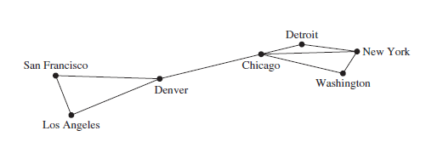
Simple Graph
A graph in which each edge connects two different vertices and where no two edges connect the same pair of vertices is called a simple graph.
When there is an edge of a simple graph associated to {u, v},we can also say, without possible confusion, that {u, v} is an edge of the graph.

Slide 4
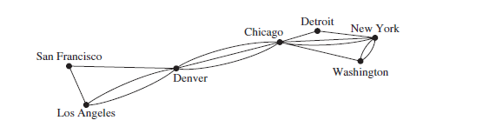
Multigraphs
A computer network may contain multiple links between data centers, as shown in Figure.
To model such networks we need graphs that have more than one edge connecting the same pair of vertices. Graphs that may have multiple edges connecting the same vertices are called multigraphs.
When there are m different edges associated to the same unordered pair of vertices {u, v}, we also say that {u, v} is an edge of multiplicity m.

Slide 5
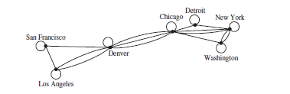
Loops
Edges in a graph that connect a vertex to itself. Such edges are called loops.
Graphs that may include loops, and possibly multiple edges connecting the same pair of vertices or a vertex to itself, are sometimes called pseudographs.

Slide 6
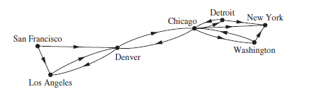
Directed Graph
A directed graph (or digraph) (V ,E) consists of a nonempty set of vertices V and a set of directed edges (or arcs) E.
Each directed edge is associated with an ordered pair of vertices.
The directed edge associated with the ordered pair (u, v) is said to start at u and end at v
Directed graphs that may have multiple directed edges from a vertex to a second (possibly the same) vertex are called directed multigraphs.

Slide 7
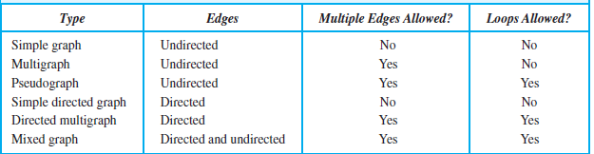
Summary

Slide 8
Basic Terms
Two vertices u and v in an undirected graph G are called adjacent (or neighbors) in G if u and v are endpoints of an edge e of G. Such an edge e is called incident with the vertices u and v and e is said to connect u and v.
The set of all neighbors of a vertex v of G = (V ,E), denoted by N(v), is called the neighborhood of v. If A is a subset of V , we denote by N(A) the set of all vertices in G that are adjacent to at least one vertex in A. So, N(A) = v∈A N(v).
The degree of a vertex in an undirected graph is the number of edges incident with it, except that a loop at a vertex contributes twice to the degree of that vertex. The degree of the vertex v is denoted by deg(v).

Slide 9
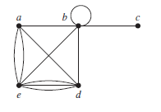
Example
What are the degrees and what are the neighborhoods of the vertices in the graph?
deg(a) = 4, deg(b) = deg(e) = 6, deg(c) = 1, and deg(d ) = 5.
The neighborhoods of these vertices are
N(a) = {b, d, e},
N(b) = {a, b, c, d, e},
N(c) = {b},
N(d) = {a, b, e}, and
N(e) = {a, b, d}.

Slide 10
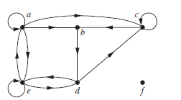
Example
Find the in-degree and out-degree of each vertex in following graph
deg−(a) = 2,
deg−(b) = 2,
deg−(c) = 3,
deg−(d) = 2,
deg−(e) = 3, and deg−(f ) = 0.
The out-degrees are
deg+(a) = 4, deg+(b) = 1, deg+(c) = 2,
deg+(d) = 2, deg+(e) = 3, and deg+(f ) = 0.

Slide 11
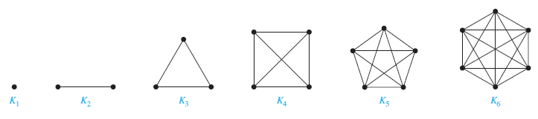
Complete Graph
A complete graph on n vertices, denoted by K_{n}, is a simple graph that contains exactly one edge between each pair of distinct vertices. The graphs K_{n}, for n = 1, 2, 3, 4, 5, 6, are displayed in Figure.
A simple graph for which there is at least one pair of distinct vertex not connected by an edge is called noncomplete.

Slide 12
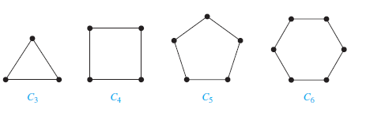
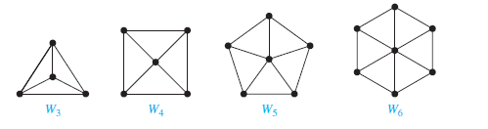
Cycle
A cycle Cn, n ≥ 3, consists of n vertices v1, v2, . . . , vn and edges {v1, v2},{v2, v3}, . . . , {vn−1, vn}, and {vn, v1}.
The cycles C₃, C₄, C₅, and C₆ are displayed in Figure:
We obtain a wheel Wn when we add an additional vertex to a cycle Cn, for n ≥ 3, and connect this new vertex to each of the n vertices in Cn, by new edges.
The wheels W3, W4, W5, and W6 are displayed in Figure:

Slide 13
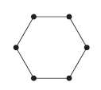
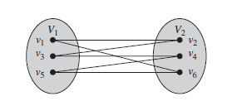
Bipartite Graph
A simple graph G is called bipartite if its vertex set V can be partitioned into two disjoint sets V1 and V2 such that every edge in the graph connects a vertex in V1 and a vertex in V2(so that no edge in G connects either two vertices in V1 or two vertices in V2). When this condition holds, we call the pair (V1, V2) a bipartition of the vertex set V of G.
Is this bipartite graph?
Ans : Yes

Slide 14
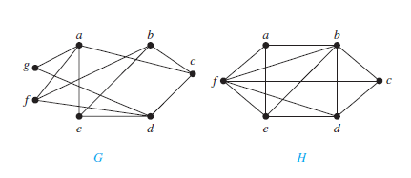
Another Example
Graph G is bipartite because its vertex set is the union of two disjoint sets, {a, b, d}and {c, e, f, g}, and each edge connects a vertex in one of these subsets to a vertex in the other subset
Graph H is not bipartite
A simple graph is bipartite if and only if it is possible to assign one of two different colors to each vertex of the graph so that no two adjacent vertices are assigned the same color.

Slide 15
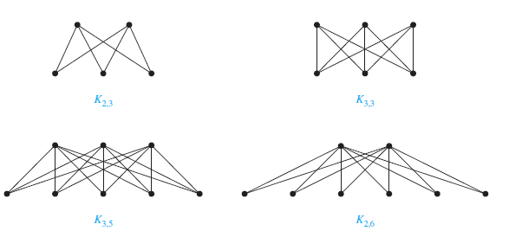
Complete Bipartite Graphs
A complete bipartite graph K_{m,n} is a graph that has its vertex set partitioned into two subsets of m and n vertices, respectively with an edge between two vertices if and only if one vertex is in the first subset and the other vertex is in the second subset.
The complete bipartite graphs K_{2,3}, K_{3,3}, K_{3,5}, and K_{2,6} are displayed in Figure:

Slide 16
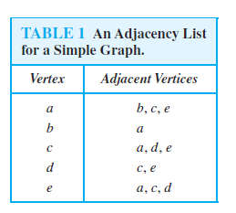
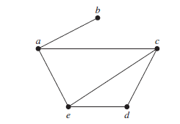
Representing Graphs
One way to represent a graph without multiple edges is to list all the edges of this graph.
Another way to represent a graph with no multiple edges is to use adjacency lists, which specify the vertices that are adjacent to each vertex of the graph.
Use adjacency lists to describe the simple graph given in Figure:

Slide 17
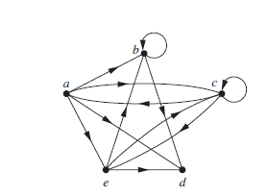
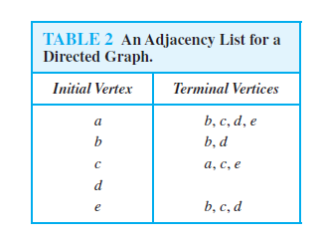
Adjacency List for Directed Graph

Slide 18
Adjacency Matrices
Suppose that G = (V ,E) is a simple graph where |V| = n. Suppose that the vertices of G are listed arbitrarily as v₁, v₂, . . . , v_{n}.
The adjacency matrix A of G, with respect to this listing of the vertices, is the n x n zero–one matrix with 1 as its (i, j )th entry when v_{i} and v_{j} are adjacent, and 0 as its (i, j )th entry when they are not adjacent.
In other words, if its adjacency matrix is A = [a_{ij} ], then
a_{ij} = 1 if{v_{i} , v_{j} } is an edge of G,
0 otherwise.

Slide 19
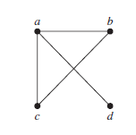
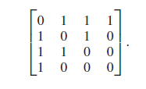
Example
Use an adjacency matrix to represent the graph shown in Figure:
a b c d
a
b
c
d

Slide 20
Some Points
There may be as many as n! different adjacency matrices for a graph with n vertices.
The adjacency matrix of a simple graph(undirected) is symmetric, that is, a_{ij} = a_{ji} , because both of these entries are 1 when v_{i} and v_{j} are adjacent, and both are 0 otherwise.
As a simple graph has no loops, each entry a_{ii}, i = 1, 2, 3, . . . , n, is 0.
When multiple edges connecting the same pair of vertices vi and vj, or multiple loops at the same vertex, are present, the adjacency matrix is no longer a zero–one matrix.
The adjacency matrix for a directed graph does not have to be symmetric.
In the adjacency matrix for a directed multigraph, a_{ij} equals the number of edges that are associated to (v_{i} , v_{j} ).

Slide 21
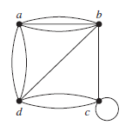
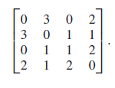
Example
Use an adjacency matrix to represent the pseudograph shown in Figure:
a b c d
a
b
c
d

Slide 22
Graph Isomorphism
The simple graphs G1 = (V1,E1) and G2 = (V2,E2) are isomorphic if there exists a one to-one and onto function f from V1 to V2 with the property that a and b are adjacent in G1 iff f (a) and f (b) are adjacent in G2, for all a and b in V1.
Such a function f is called an isomorphism.
Two simple graphs that are not isomorphic are called nonisomorphic.
Two graphs G=(V,E) and H=(W,F) are isomorphic if there is a bijective function f: V → W such that for all v, w ∈ V:
{v,w} ∈ E ⇔ {f(v),f(w)} ∈ F

Slide 23
Show that the graphs G = (V ,E) and H = (W, F) are isomorphic.
The function f with f (u1) = v1, f (u2) = v4, f (u3) = v3, and f (u4) = v2 is a one-to-one correspondence between V and W.
Note that adjacent vertices in G are u1 and u2, u1 and u3, u2 and u4, and u3 and u4, and each of the pairs f (u1) = v1 and f (u2) = v4, f (u1) = v1 and f (u3) = v3, f (u2) = v4 and f (u4) = v2, and f (u3) = v3 and f (u4) = v2 consists of two adjacent vertices in H.

Slide 24
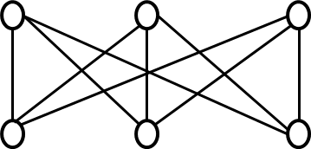
Isomorphic Or Not?
Check if the following graphs are isomorphic or not.
G1
G2
Thus, graphs G1 and G2 are isomorphic.
u
v
w
x
y
z
6
1
1
3
5
5
2
4
3
2
4
6

Slide 25
Contd..
G3
G3 is not isomorphic to G1 and G2.
It is often difficult to determine whether two simple graphs are isomorphic because there are n! possible one-to-one correspondences between the vertex sets of two simple graphs with n vertices.

Slide 26
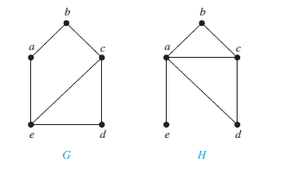
Some Points
Isomorphic simple graphs must have the same number of vertices.
Isomorphic simple graphs also must have the same number of edges.
Degrees of the vertices in isomorphic simple graphs must be the same
Show that the graphs displayed in Figure are not isomorphic
Both G and H have five vertices and six edges. However, H has a vertex of degree one, namely, e, whereas G has no vertices of degree one. It follows that G and H are not isomorphic

Slide 27
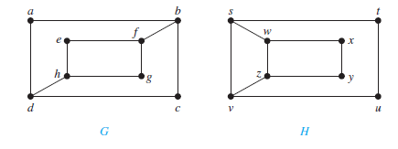
Contd..
The number of vertices, the number of edges, and the number of vertices of each degree are all invariants under isomorphism.
If any of these quantities differ in two simple graphs, these graphs cannot be isomorphic.
However, when these invariants are the same, it does not necessarily mean that the two graphs are isomorphic. E.g.
The graphs G and H both have eight vertices and 10 edges. They also both have four vertices of degree two and four of degree three. However, G and H are not isomorphic.
because deg(a) = 2 in G, a must correspond to either t , u, x, or y in H, because these are the vertices of degree two in H.
However, each of these four vertices in H is adjacent to another vertex of degree two in H, which is not true for a in G.

Slide 28
Connectivity
Many problems can be modeled with paths formed by traveling along the edges of graphs.
For instance, the problem of determining whether a message can be sent between two computers using intermediate links can be studied with a graph model.
Informally, a path is a sequence of edges that begins at a vertex of a graph and travels from vertex to vertex along edges of the graph.
Let n be a nonnegative integer and G an undirected graph. A path of length n from u to v in G is a sequence of n edges e₁, . . . , e_{n} of G for which there exists a sequence x₀ = u, x₁, . . . , x_{n−1}, x_{n} = v of vertices such that e_{i} has, for i = 1, . . . , n, the endpoints x_{i−1} and x_{i} .

Slide 29
Contd..
When the graph is simple, we denote this path by its vertex sequence x₀, x₁, . . . , x_{n}(because listing these vertices uniquely determines the path).
The path is a circuit if it begin and ends at the same vertex, that is, if u = v, and has length greater than zero.
The path or circuit is said to pass through the vertices x₁, x₂, . . . , x_{n−1} or traverse the edges e₁, e2, . . . , e_{n}.
A path or circuit is simple if it does not contain the same edge more than once.

Slide 30
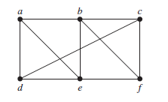
Example
a, d, c, f , e is a simple path of length 4,
However, d, e, c, a is not a path.
b, c, f , e, b is a circuit of length 4.
path a, b, e, d, a, b, which is of length 5, is not simple because it contains the edge {a, b} twice.

Slide 31
Path(In Directed Graph)
Let n be a nonnegative integer and G a directed graph. A path of length n from u to v in G is a sequence of edges e₁, e₂, . . . , e_{n} of G such that e₁ is associated with (x₀, x₁), e₂ is associated with (x₁, x₂), and so on, with e_{n} associated with (x_{n−1}, x_{n}), where x₀ = u and x_{n} = v.
When there are no multiple edges in the directed graph, this path is denoted by its vertex sequence x₀, x₁, x₂, . . . , x_{n}.
A path of length greater than zero that begins and ends at the same vertex is called a circuit or cycle.
A path or circuit is called simple if it does not contain the same edge more than once.

Slide 32
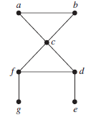
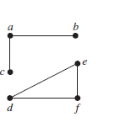
Connectedness in Undirected Graphs
When is there always a path between two vertices in the graph?
An undirected graph is called connected if there is a path between every pair of distinct vertices of the graph.
An undirected graph that is not connected is called disconnected.
We disconnect a graph when we remove vertices or edges, or both, to produce a disconnected subgraph.
Is this connected graph?
Ans: Yes No
There is a simple path between every pair of distinct vertices of a connected undirected graph.

Slide 33
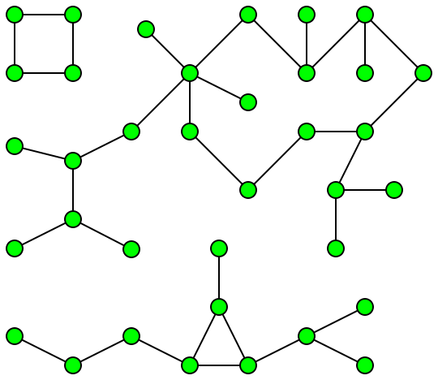
CONNECTED COMPONENTS
In graph theory, a connected component (or just component) of an undirected graph is a subgraph in which any two vertices are connected to each other by paths, and which is connected to no additional vertices in the super graph.
For example, the graph shown in the illustration has three connected components.
A vertex with no incident edges is itself a connected component.
A graph G that is not connected has two or more connected components that are disjoint and have G as their union.

Slide 34
Cut Vertices and Cut Edge
Sometimes the removal from a graph of a vertex and all incident edges produces a subgraph with more connected components. Such vertices are called cut vertices (or articulation points).
The removal of a cut vertex from a connected graph produces a subgraph that is not connected.
An edge whose removal produces a graph with more connected components than in the original graph is called a cut edge or bridge.
In a graph representing a computer network, a cut vertex and a cut edge represent an essential router and an essential link that cannot fail for all computers to be able to communicate.

Slide 35
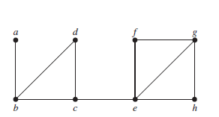
Example
Find the cut vertices and cut edges in the graph(G1):
The cut vertices of G1 are b, c, and e. The removal of one of these vertices (and its adjacent edges) disconnects the graph.
The cut edges are {a, b} and {c, e}. Removing either one of these edges disconnects G1

Slide 36
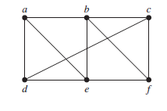
Vertex Cut
Not all graphs have cut vertices.
For example, the complete graph K_{n}, where n ≥ 3, has no cut vertices. When you remove a vertex from K_{n} and all edges incident to it, the resulting subgraph is the complete graph _{Kn−1}, a connected graph.
Connected graphs without cut vertices are called non separable graphs, and can be thought of as more connected than those with a cut vertex.
A subset V’ of the vertex set V of G = (V ,E) is a vertex cut, or separating set, if G − V’ is disconnected.
{b,c,e} is the vertex cut of the figure
edge cut of G: a set of edges E’ of G such that G − E’ is disconnected

Slide 37
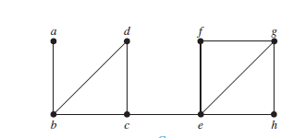
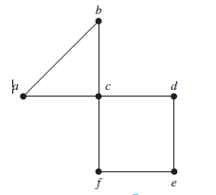
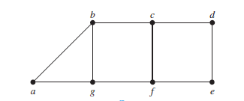
K-Connected Graph
We say that a graph is k-connected (or k-vertex-connected), if κ(G) ≥ k.
κ(G) or vertex connectivity is the minimum number of vertices in a vertex cut.
The larger κ(G) is, the more connected we consider G to be.
λ(G) (the edge connectivity of G): the size of a smallest edge cut of G
Find the vertex connectivity for each of the graphs
1
1
2

Slide 38
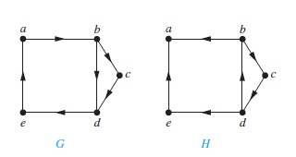
Connectedness in Directed Graphs
A directed graph is strongly connected if there is a path from a to b and from b to a whenever a and b are vertices in the graph.
A directed graph is weakly connected if there is a path between every two vertices in the underlying undirected graph.
Are the directed graphs G and H shown in Figure strongly connected? Are they weakly connected?
G is strongly connected because there is a path between any two vertices in this directed graph .
G is also weakly connected.
The graph H is not strongly connected. There is no directed path from a to b in this graph..
H is weakly connected,

Slide 39
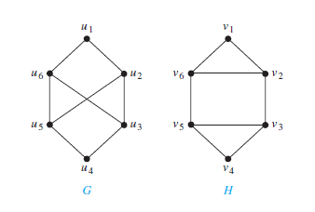
Paths and Isomorphism
There are several ways that paths and circuits can help determine whether two graphs are isomorphic.
For example, the existence of a simple circuit of a particular length can be used to show that two graphs are not isomorphic
Both G and H have six vertices and eight edges.
Each has four vertices of degree three, and two vertices of degree two.
However, H has a simple circuit of length three, namely, v1, v2, v6, v1, whereas G has no simple circuit of length three.
So, G and H are not isomorphic.

Slide 40
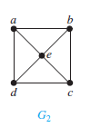
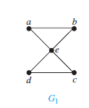
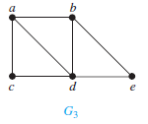
Euler Circuit and Path
An Euler circuit in a graph G is a simple circuit containing every edge of G.
An Euler path in G is a simple path containing every edge of G.
Which of the undirected graphs in Figure have an Euler circuit? Of those that do not, which have an Euler path?
The graph G1 has an Euler circuit,
for example, a, e, c, d, e, b, a.
The graph G2 do not have an
Euler circuit and euler path
No Euler Circuit
G3 has an Euler path, namely, a, c, d, e, b, d, a, b.

Slide 41
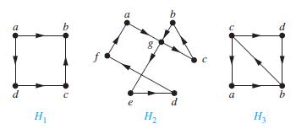
Example
Which of the directed graphs in Figure have an Euler circuit? Of those that do not, which have an Euler path?
The graph H2 has an Euler circuit, for example, a, g, c, b, g, e, d, f, a.
Neither H1 nor H3 has an Euler circuit .
H3 has an Euler path, namely, c, a, b, c, d, b, but H1 does not .

Slide 42
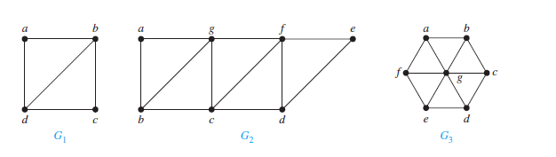
Euler Circuit(in multigraph)
A connected multigraph with at least two vertices has an Euler circuit if and only if each of its vertices has even degree.
A connected multigraph has an Euler path but not an Euler circuit if and only if it has exactly two vertices of odd degree.
Which graphs shown in Figure have an Euler path?
G1 contains exactly two vertices of odd degree(b and d), One such Euler path is d, a, b, c, d, b.
G2 has exactly two vertices of odd degree(b and d). One such Euler path is b, a, g, f, e, d, c, g, b, c, f, d.
G3 has no Euler path because it has six vertices of odd degree.

Slide 43
Hamilton Paths and Circuits
A simple path in a graph G that passes through every vertex exactly once is called a Hamilton path.
A simple circuit in a graph G that passes through every vertex exactly once is called a Hamilton circuit.
That is, the simple path x₀, x₁, . . . , x_{n-1}, x_{n} in the graph G = (V ,E) is a Hamilton path if V = {x₀, x₁, . . . , x_{n-1}, x_{n} } and x_{i} ≠ x_{j} for 0 ≤ i < j ≤ n, and the simple circuit x₀, x₁, . . . , x_{n-1}, x_{n}, x₀ (with n > 0) is a Hamilton circuit if x₀, x₁, . . . , x_{n-1}, x_{n} is a Hamilton path.

Slide 44
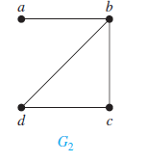
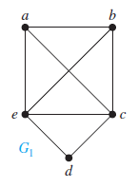
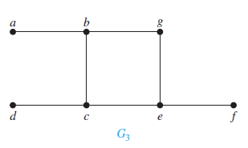
Example
Which of the simple graphs have a Hamilton circuit or, if not, a Hamilton path?
G1 has a Hamilton circuit: a, b, c, d, e, a.
No Hamilton circuit in G2 (this can be seen by noting that any circuit containing every vertex must contain the edge {a, b} twice),
G2 does have a Hamilton path, namely, a, b, c, d.
G3 has neither a Hamilton circuit nor a Hamilton path, because any path containing all vertices must contain one of the edges {a, b}, {e, f }, and {c, d} more than once.

Slide 45
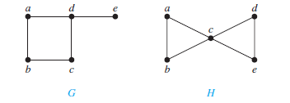
Some points
A graph with a vertex of degree one cannot have a Hamilton circuit, because in a Hamilton circuit, each vertex is incident with two edges in the circuit.
If a vertex in the graph has degree two, then both edges that are incident with this vertex must be part of any Hamilton circuit.
Show that neither graph displayed in Figure has a Hamilton circuit
There is no Hamilton circuit in G because G has a vertex of degree one, namely, e.
In H, the degrees of the vertices a, b, d, and e are all two, every edge incident with these vertices must be part of any Hamilton circuit and no Hamilton circuit can exist in H, for any Hamilton circuit would have to contain four edges incident with c, which is impossible.

Slide 46
Theorems
DIRAC’S THEOREM If G is a simple graph with n vertices with n ≥ 3 such that the degree of every vertex in G is at least n/2, then G has a Hamilton circuit.
ORE’S THEOREM If G is a simple graph with n vertices with n ≥ 3 such that deg(u) + deg(v) ≥ n for every pair of nonadjacent vertices u and v in G, then G has a Hamilton circuit.

Slide 47
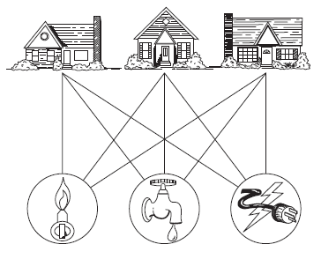
Planar Graphs
Consider the problem of joining three houses to each of three separate utilities, as shown in Figure. Is it possible to join these houses and utilities so that none of the connections cross?

Slide 48
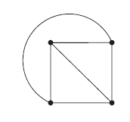
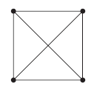
Contd..
A graph is called planar if it can be drawn in the plane without any edges crossing (where a crossing of edges is the intersection of the lines or arcs representing them at a point other than their common endpoint).
Such a drawing is called a planar representation of the graph.
Example

Slide 49
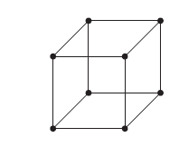
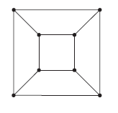


Example
Is the graph, shown in Figure , planar?
Yes
Is following graph , planar?
No

Slide 50

Euler’s Formula
A planar representation of a graph splits the plane into regions, including an unbounded region.
For instance, the planar representation of the graph shown in Figure splits the plane into six regions
Let G be a connected planar simple graph with e edges and v vertices. Let r be the number of regions in a planar representation of G.
Then r = e − v + 2.

Slide 51
Example
Suppose that a connected planar simple graph has 20 vertices, each of degree 3. Into how many regions does a representation of this planar graph split the plane?
Ans: 12
COROLLARY
If G is a connected planar simple graph with e edges and v vertices, where v ≥ 3, then e ≤ 3v − 6.
If G is a connected planar simple graph, then G has a vertex of degree not exceeding five.
If a connected planar simple graph has e edges and v vertices with v ≥ 3 and no circuits of length three, then e ≤ 2v − 4.

