Slide 1
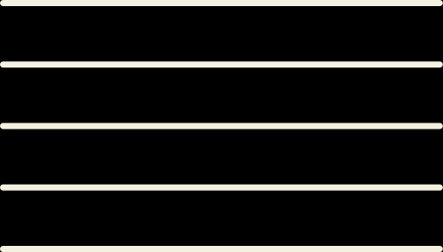

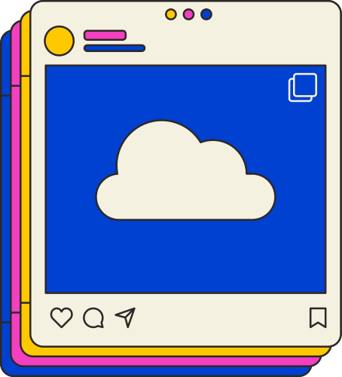



Challenge #3 - RAG
VIDEO
WEB
OmniAI
TEXT
MEME
IMAGE
Presented by The Newtrons - Kulindu, Peter, Vimukthi, Anubhav, Leon
Notes:
Hi, we are The Newtrons and this is our video of OmniAI for BuildWithAI Challenge #3 - RAG

Slide 2



Topic Outline
1
Team Introduction
2
Problem statement
3
Tech stack
}
4
Web API
RAG workflow
5
Summarizer
6
Text
7
Video
8
Image
9
Meme
10
Future enhancements
11
Demo video
Notes:
We will first have a team introduction, go over all the technologies used for each feature, and have a final video demo

Slide 3
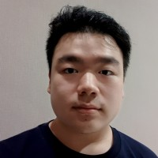
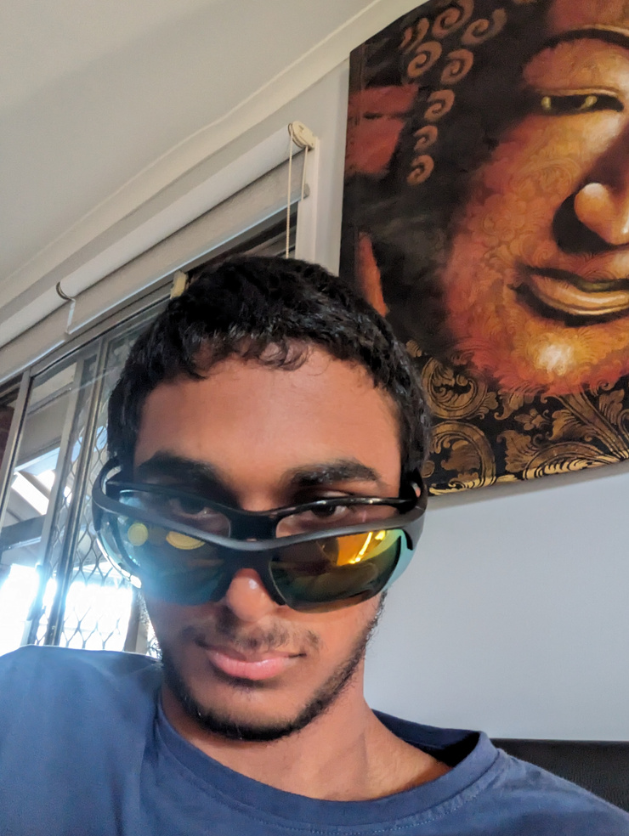
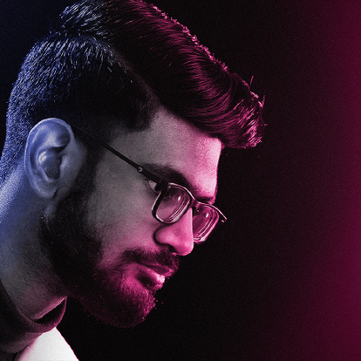
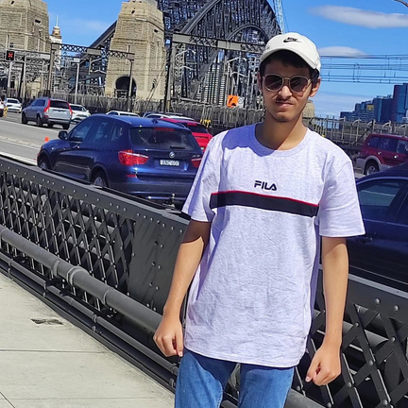

Team Introduction
Peter Nelson Subrata
Kulindu Chirantha Keeriwela Gamage
Vimukthi Weerabahu
4
Anubhav Patra
Leon Jayakusuma
Notes:
This is our team

Slide 4
Problem Statement
"Individuals and businesses struggle to effectively engage audiences with timely, visually appealing, and platform-optimized content derived from news articles.
Crafting engaging media requires significant time, creativity and expertise, posing a challenge for content creators, marketers and organizations to maintain relevance and audience interest"
Our application scours the internet for the latest news articles relevant to the prompt and creates text posts, images, videos and memes to engage all sorts of audience
Notes:
*Are you struggling to keep your audience engaged with fresh, eye-catching content?*
Our app finds the latest news and instantly turns it into stunning posts, videos, and memes—perfect for any platform. Engage effortlessly and stay ahead!

Slide 5



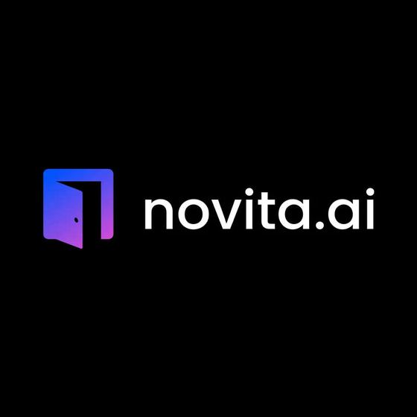




Tech Stack

Slide 6
Web API using News API
Search through millions of articles from over 150,000 large and small news sources and blogs.
This endpoint suits article discovery and analysis.

Slide 7
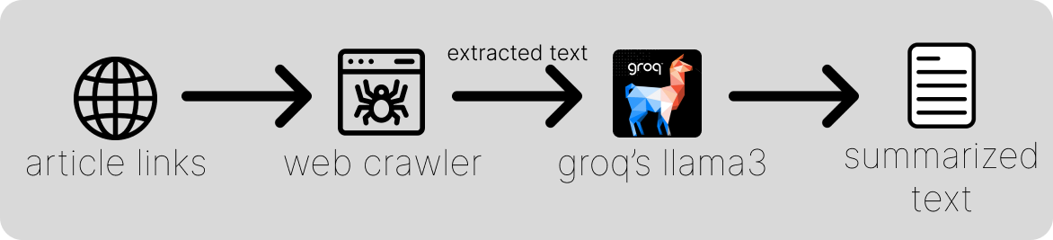
Summarizer

Slide 8


Text
Prompt Adjustment: Adjusts input using the Groq API.
Keyword Search: Generates keywords and queries NewsAPI if enabled.
Content Creation: Combines prompt and optional news for Groq-based text generation.
Response: Returns generated content and referenced news links (if any)
User
Prompt

Slide 9
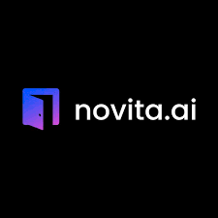

Text to Video Generation
Novita.ai API was used to generate captivating videos for the user from a simple prompt.
Groq was used to interpret the user’s query and enrich the prompt for each few frames as well as give a tagline for the post.
Text overlay is then added to generated video with FFMPEG.
After all that the video is then ready to be posted.
User
Prompt
Llama3
Text2Vid
Text Overlay

Slide 10

Image
User prompt
The prompt is sent
to the groq API.
A better image
generation prompt
groq API
Pollination AI
API
We give the user prompt.
We get a better prompt from Groq API.
We append that prompt with online API link.
Then the online API is called and returns the link of the image produced.

Slide 11
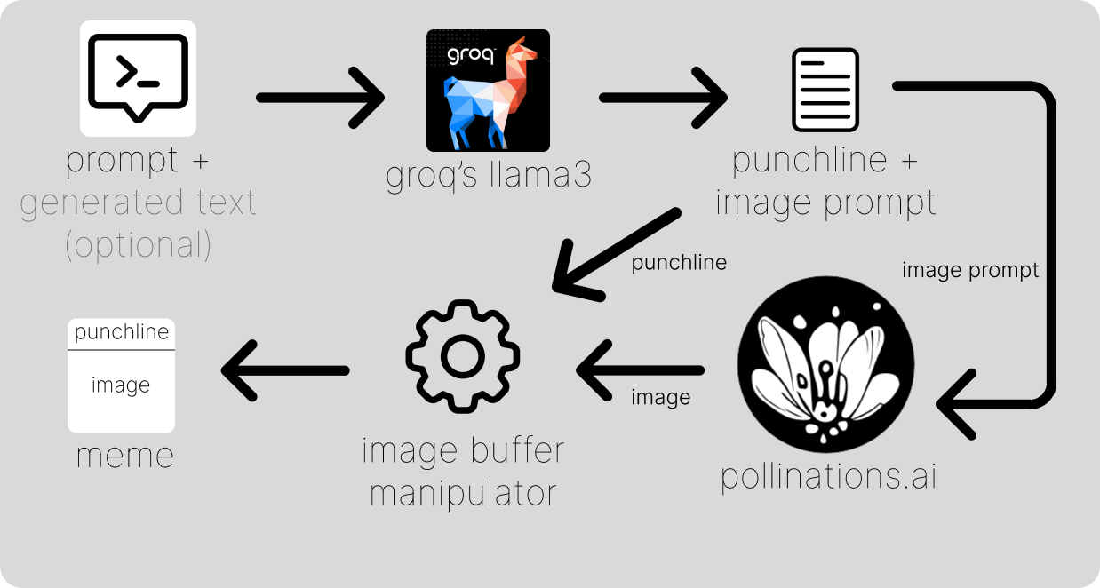
Meme

Slide 12



Future enhancements
- Speech recognition
- Profile and account system for chat history
- Desktop and mobile applications

Slide 13




DEMO

