Slide 1
APL 745
Deep Learning in Mechanics
Instructor: Sitikantha Roy

Slide 2
Important Information
Instructor: Sitikantha Roy
  Email: sroy@am.iitd.ac.in
  Office: Block IV, 243
TAs: Abhilash Awasthi, Shaswata Ghosh, Sanchita Mallya, Rajnish Kumar, Hemanthika .
  Email: saswath.ghosh3333@gmail.com
  Office hours: Online timing will be announced.
Web: Teams channel
Mailing list: 2102-apl745@courses.iitd.ac.in

Slide 3
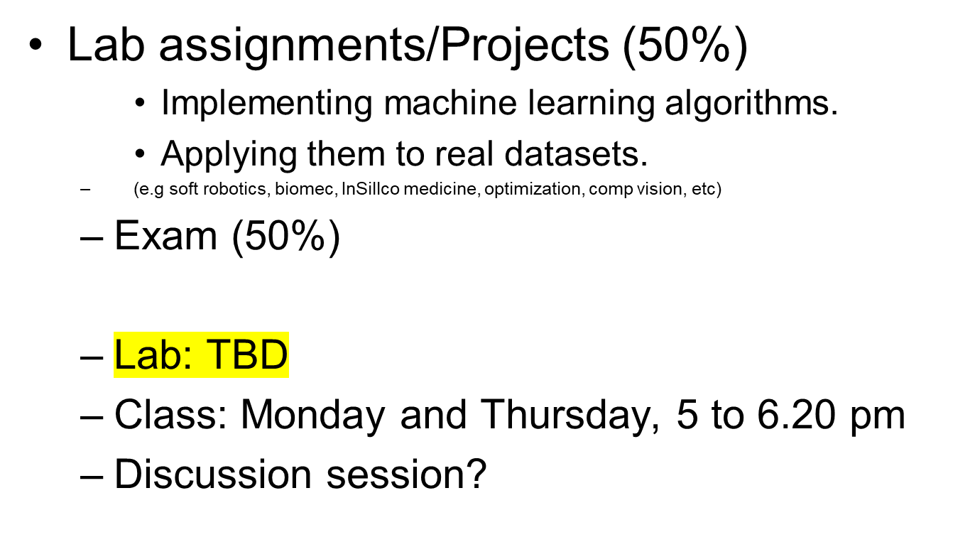
Evaluation

Slide 4
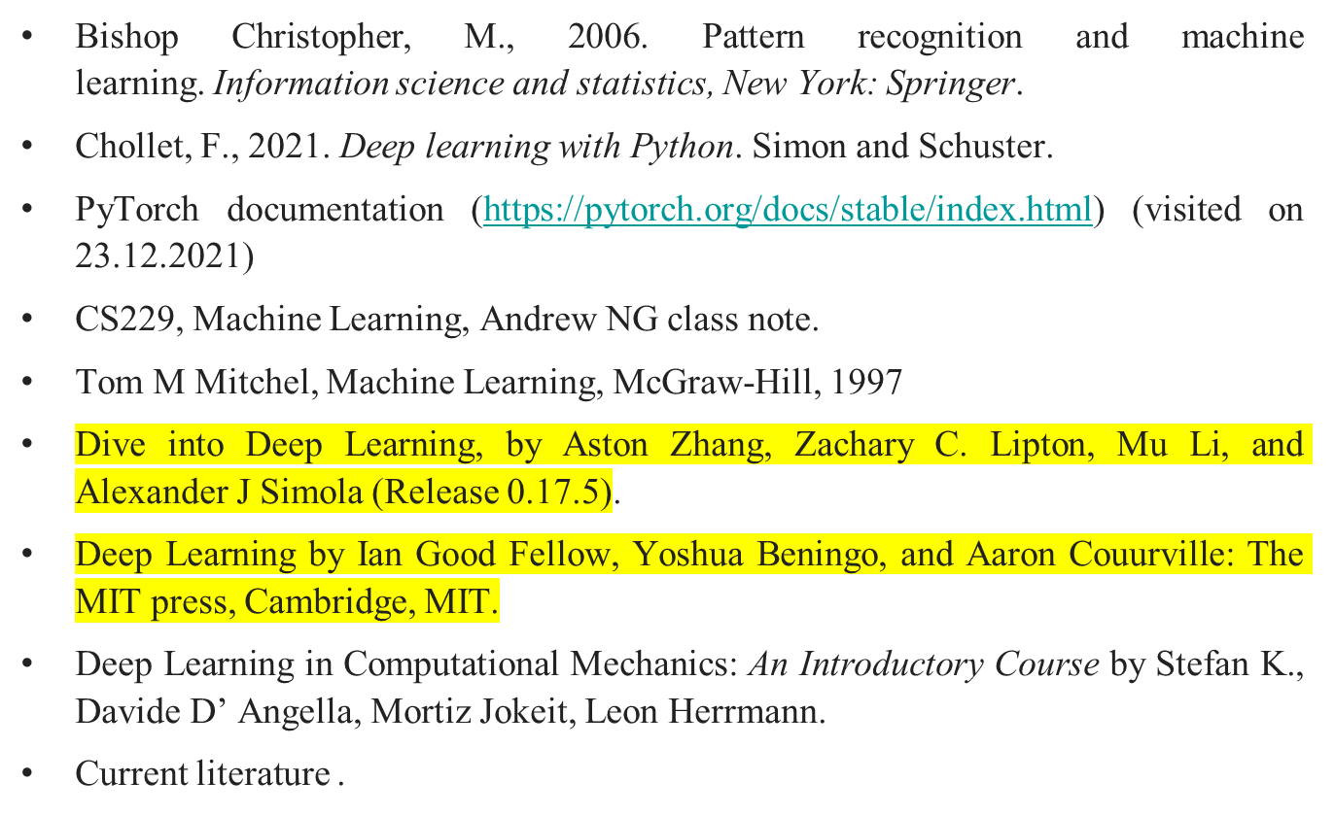
Source Materials (DL)

Slide 5
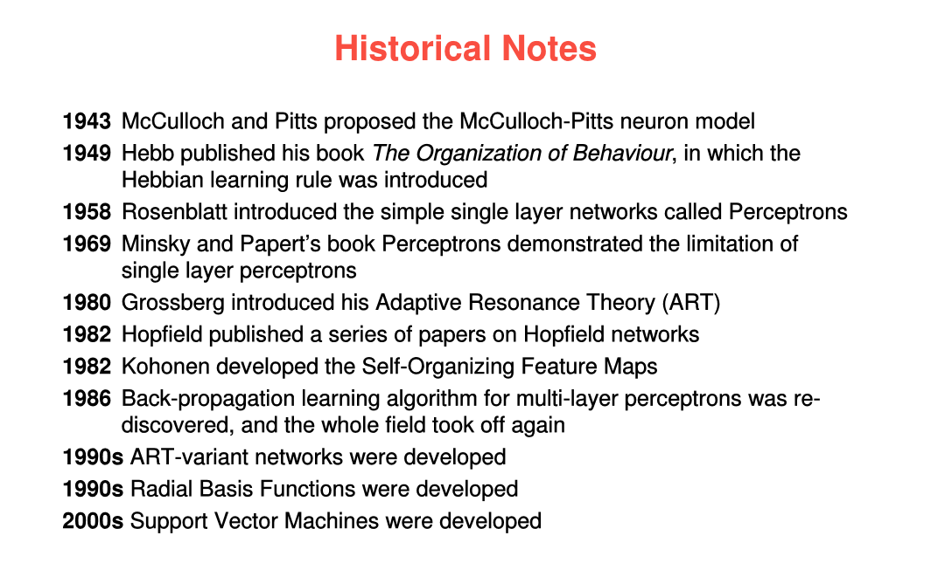
History of DL revolution

Slide 6
A Few Quotes
“A breakthrough in machine learning would be worth
ten Microsofts” (Bill Gates, Chairman, Microsoft)
“Machine learning is the next Internet”
(Tony Tether, Director, DARPA)
Machine learning is the hot new thing”
(John Hennessy, President, Stanford)
“Web rankings today are mostly a matter of machine learning” (Prabhakar Raghavan, Dir. Research, Yahoo)
“Machine learning is going to result in a real revolution” (Greg Papadopoulos, Former CTO, Sun)
“Machine learning is today’s discontinuity”
(Jerry Yang, Founder, Yahoo)
“Machine learning today is one of the hottest aspects of computer science” (Steve Ballmer, CEO, Microsoft)

Slide 7
So What Is Machine Learning?
Automating automation
Getting computers to program themselves
Writing software is the bottleneck
Let the data do the work instead!
Hollywood movies (on AI)
  Trancendence (Jonny Depp)
  Her (Joaquin Phoenix)
  Imitation Game (Based on Enigma machine)
Ref: Dapino

Slide 8
Traditional Programming
Machine Learning
Data
Computer
Output
Program
Data
Computer
Program
Output

Slide 9
What is ML
ML system are trained rather than explicitly programmed.
It is presented with many examples relevant to a task and find statistical significance in these examples (DATA)
The examples (training data) eventually allows the system to produce rules for automating the task.

Slide 10
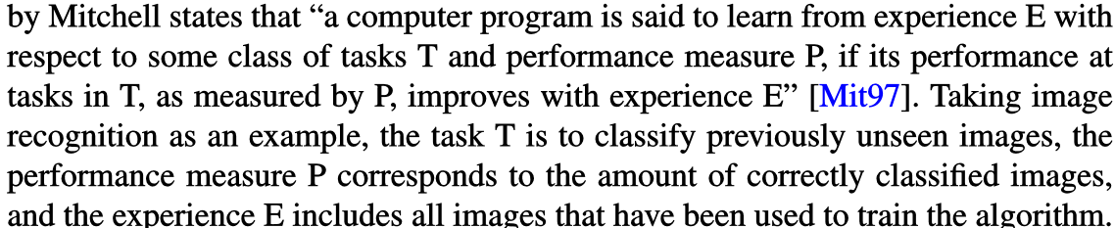
What is ML?
A formal definition
Taking image recognition as an example,
  Task T: Classify previously unseen images
  Performance measure P: Corresponds to the amount of correctly classified images.
  The experience E: Includes all the images that have been used to train the algorithm.

Slide 11
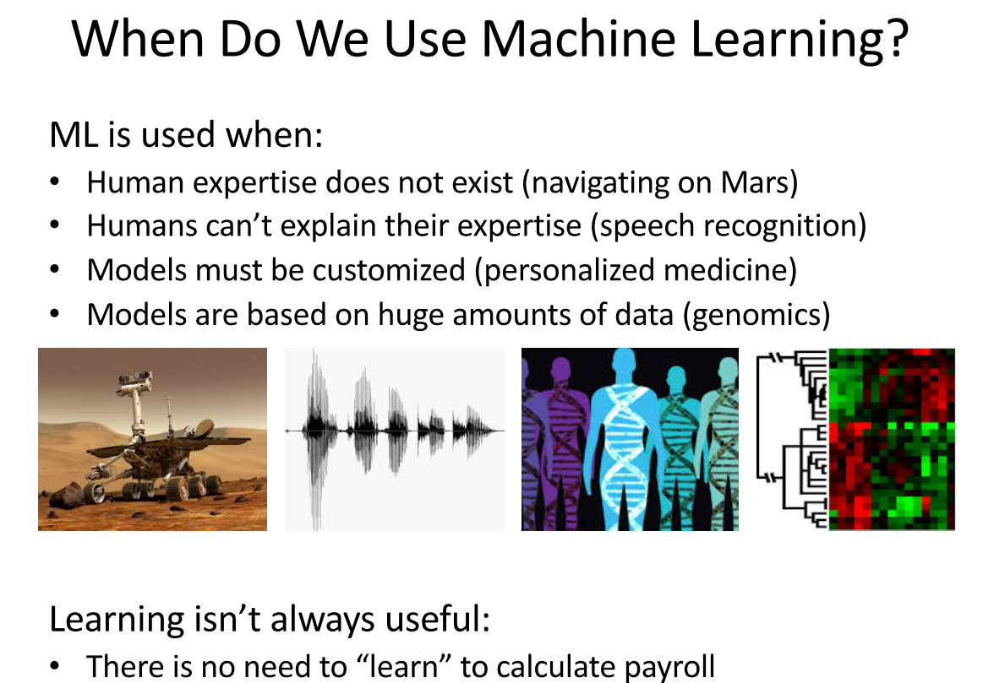

Slide 12
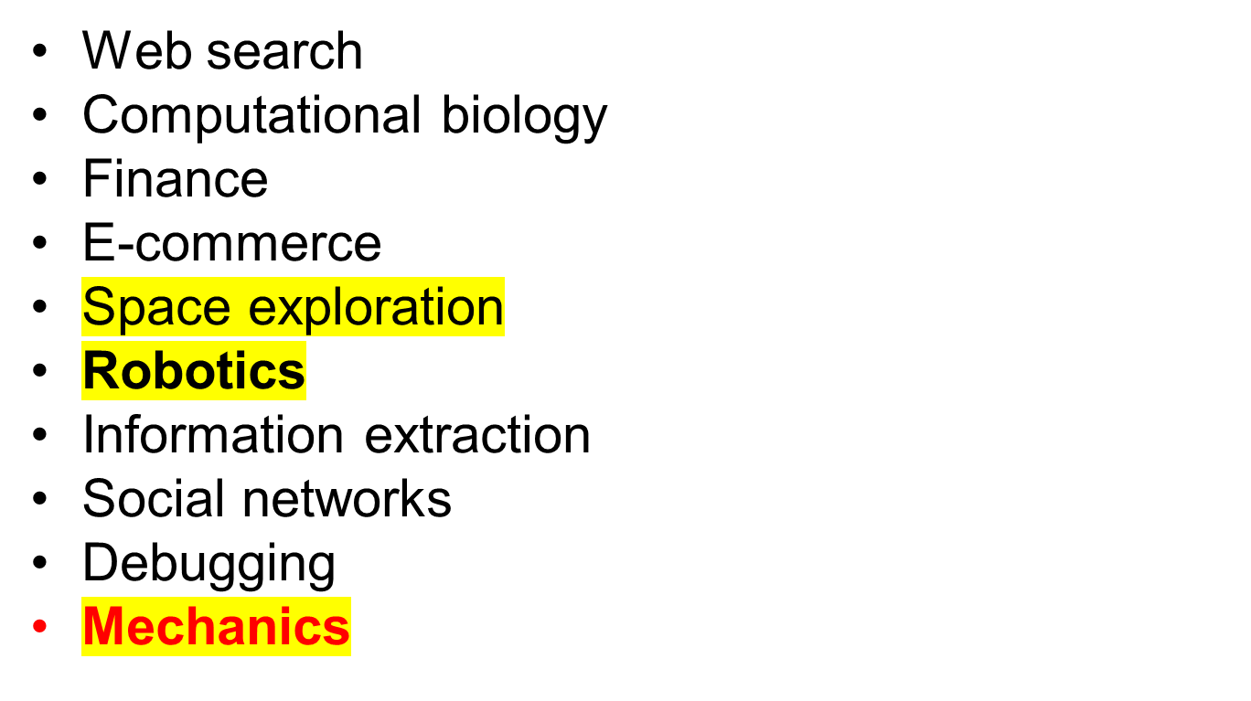
Sample Applications

Slide 13
Related Disciplines
Artificial Intelligence
Data Mining
Probability and Statistics
Information theory
Numerical optimization
Computational complexity theory
Control theory (adaptive)
Psychology (developmental, cognitive)
Neurobiology
Linguistics
Philosophy
Computational Neuroscience

Slide 14
ML in a Nutshell
Tens of thousands of machine learning algorithms
Hundreds new every year
Every machine learning algorithm has three components:
  Representation (Model)
  Evaluation
  Optimization

Slide 15
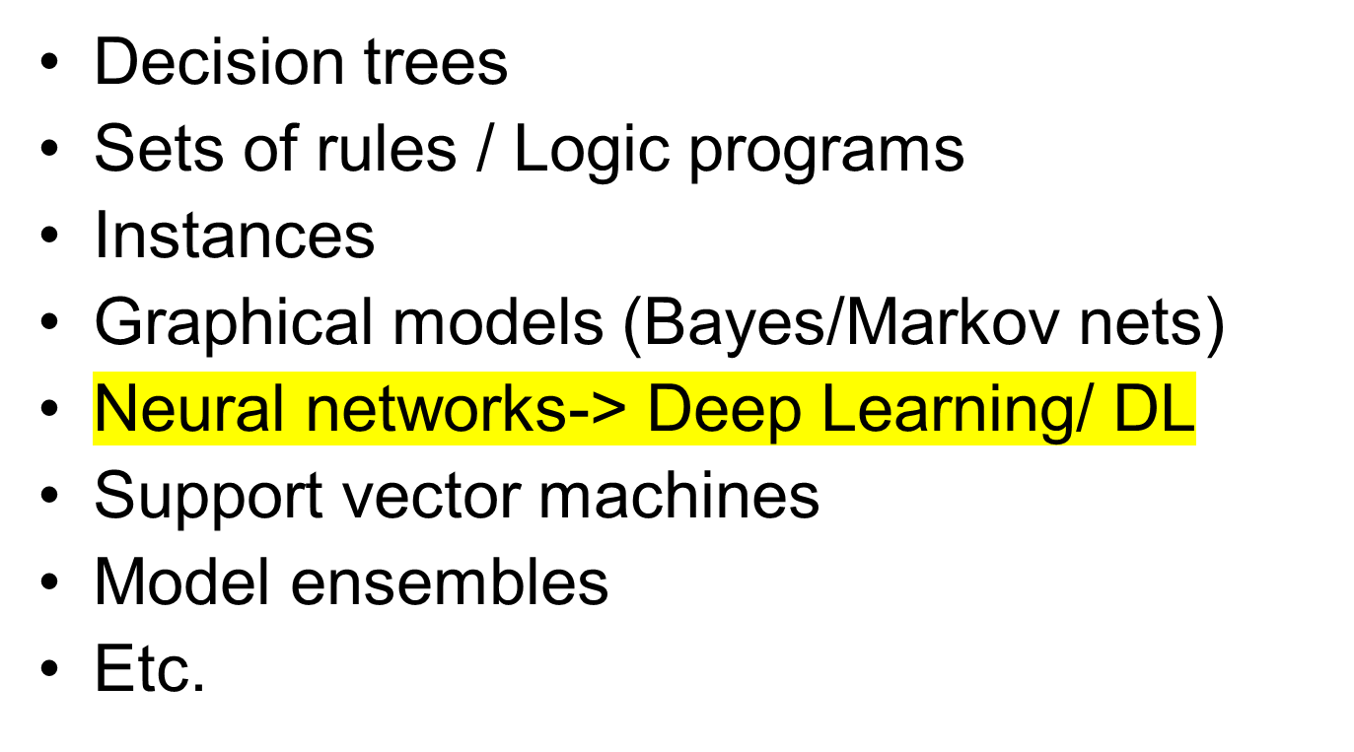
Representation

Slide 16
Evaluation
Accuracy
Precision and recall
Squared error
Likelihood
Posterior probability
Cost / Utility
Margin
Entropy
K-L divergence
Etc.

Slide 17
Optimization
Combinatorial optimization
  E.g.: Greedy search
Convex optimization
  E.g.: Gradient descent
Constrained optimization
  E.g.: Linear programming

Slide 18
Another way of looking
Most DL algorithms can be subdivided into the following
  A dataset
  A parameterized model
  A cost function or loss function
  An optimization procedure

Slide 19
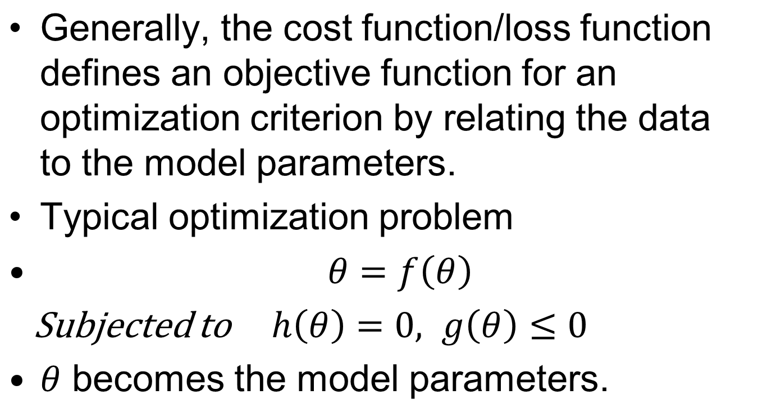




DL how it works

Slide 20
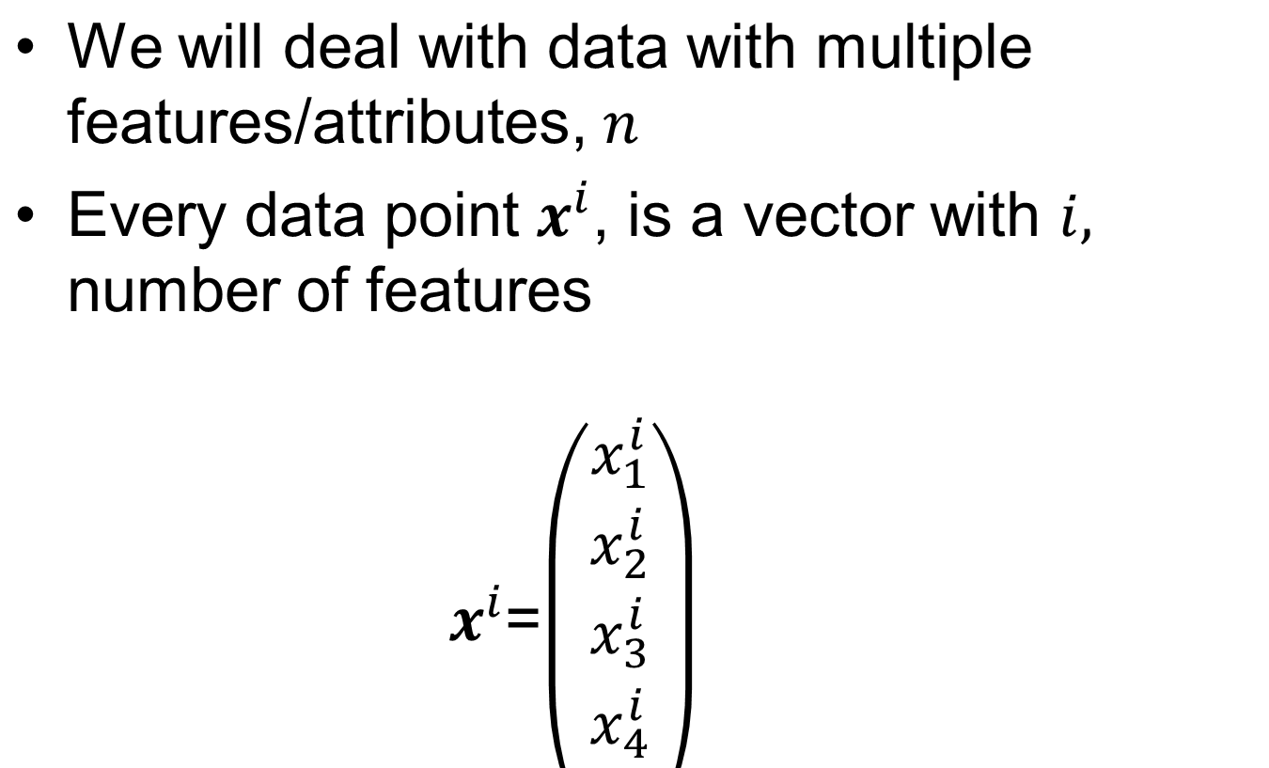



Terminologies & Data structure

Slide 21





Data structure
When we have multiple data points, each having these features---

Slide 22
Training data/testing data
Common practice to split the data into different subsets, namely a training set and testing set.
Majority of data are used for training/or finding out the model parameters.
The remaining part is used for validation purpose.

Slide 23
Types of Deep Learning
Supervised (inductive) learning
  Training data includes desired outputs (labelled dataset)
  Example: Image classification; Each image has previously been tagged into a certain category.
  The supervised learning algorithm studies the dataset and learns to classify the images into given category, by comparing its prediction with given ground truth level.
  Examples (Example: Is it a cat or a dog?, House prices, How’s the weather today?)

Slide 24
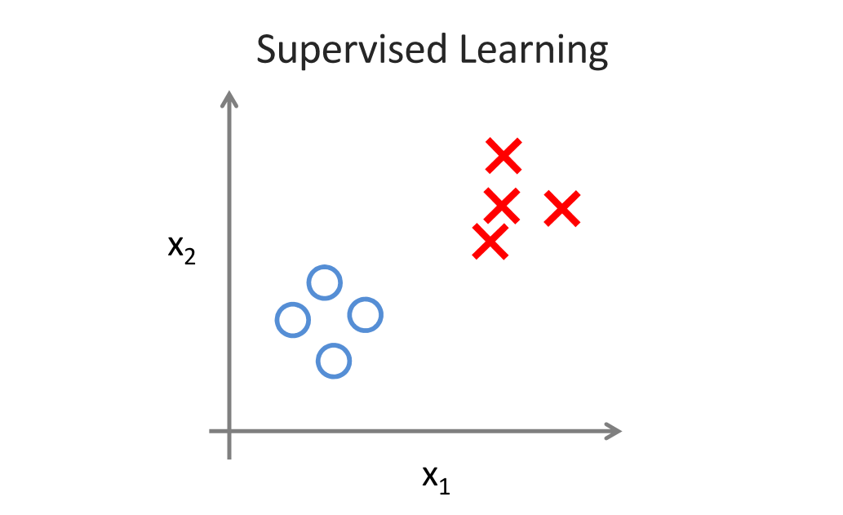

Slide 25
Types of Learning
Unsupervised learning
  The goal of unsupervised learning is to find a structure, or more precisely, the probability distribution in the provided data.
  The data is NOT labeled; hence no explicit prediction is possible.
  USL can find inherent structure from large dataset.
  Example: For instance, anomaly detection algorithms are used to identify fraudulent credit card transactions that differ from the usual purchasing behavior of the customer.

Slide 26
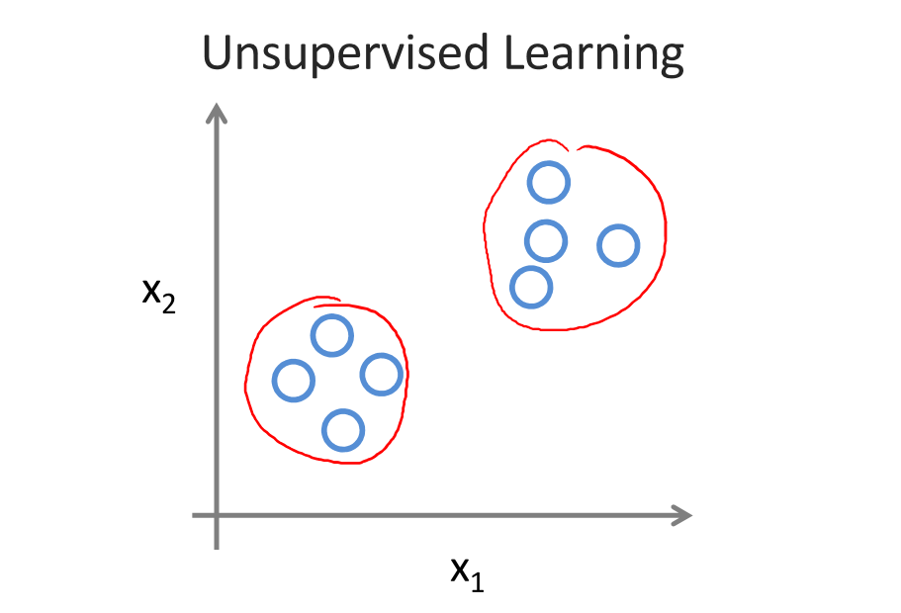

Slide 27
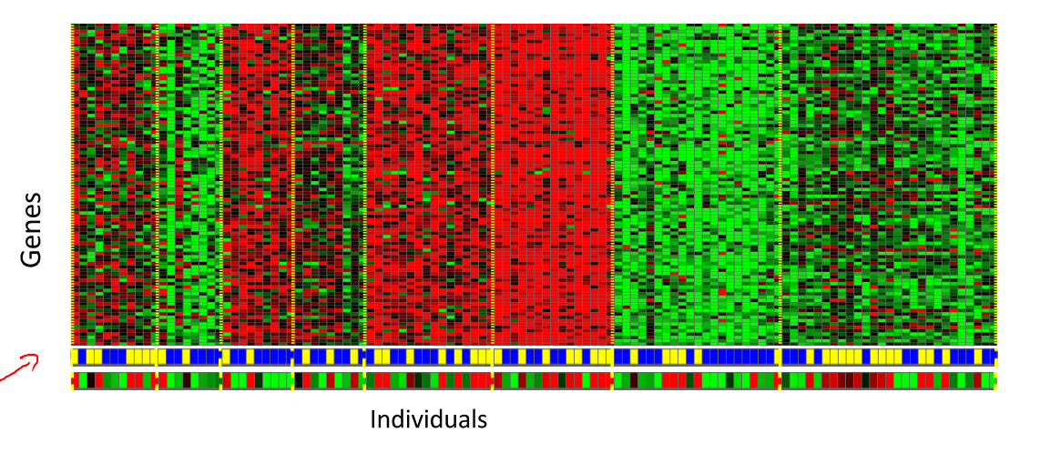

Slide 28
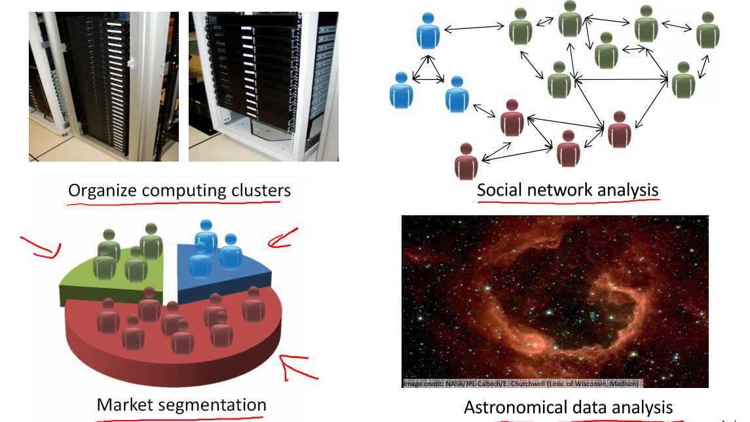
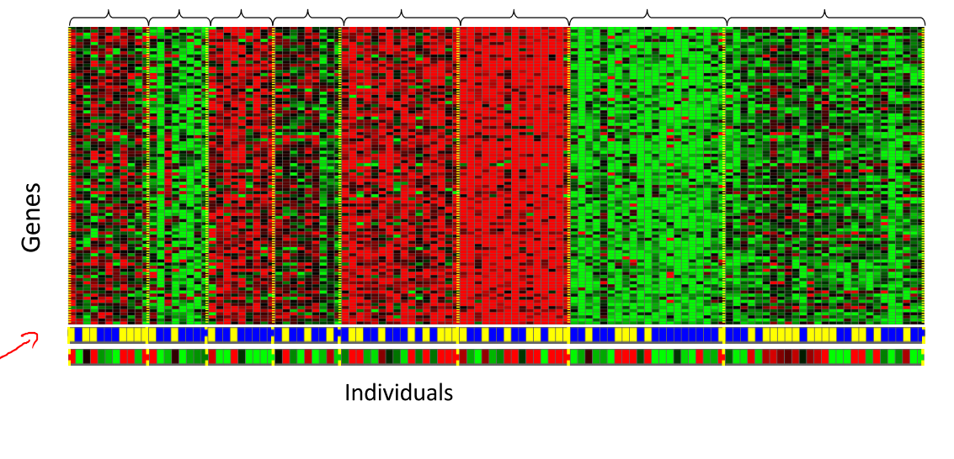

Slide 29
Type of learning
Semi-supervised learning
  Combines two preceding concepts
  In cases where small samples of data are labeled, the semi-supervised learning helps to improve the performance of the supervised learning algorithm
  When training DATA is sparse.

Slide 30
Types of Learning
Reinforcement Learning
  The basic idea of reinforcement learning is that an algorithm interacts with an environment, to learn a certain decision behavior maximizing the expected average reward.
  It is used for problems involving sequential decision-making in order to fullfil a long term goal.

Slide 31
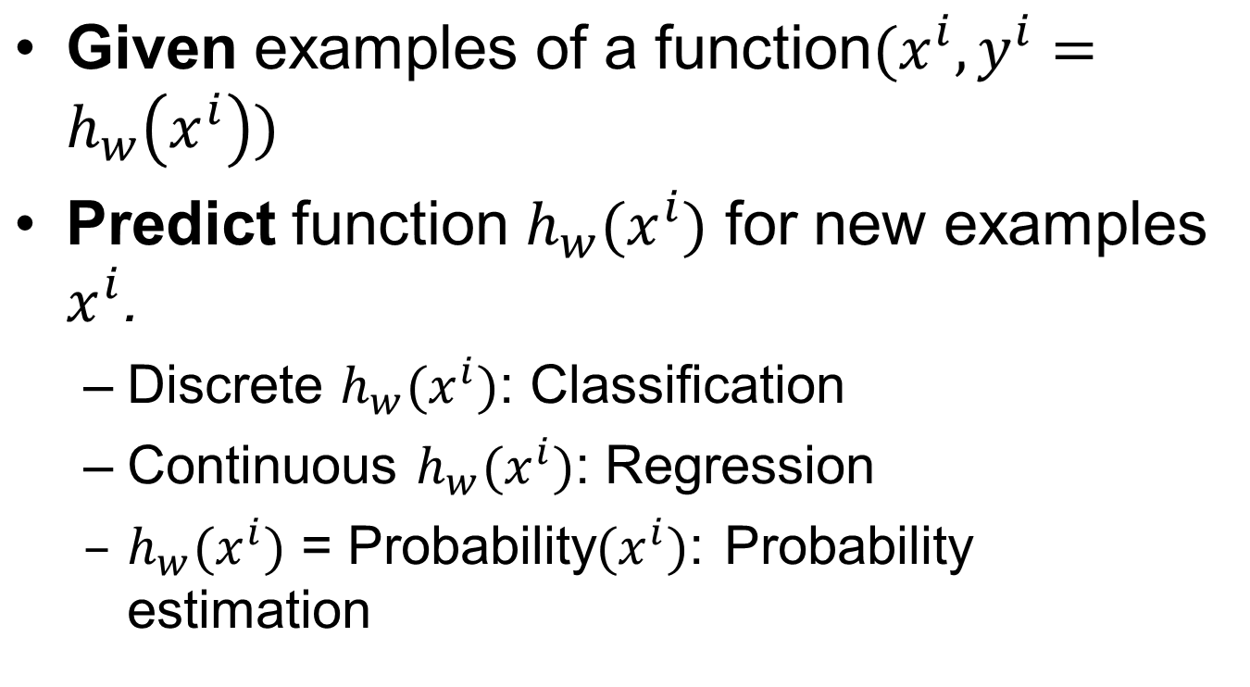
Supervised (Inductive) Learning

Slide 32
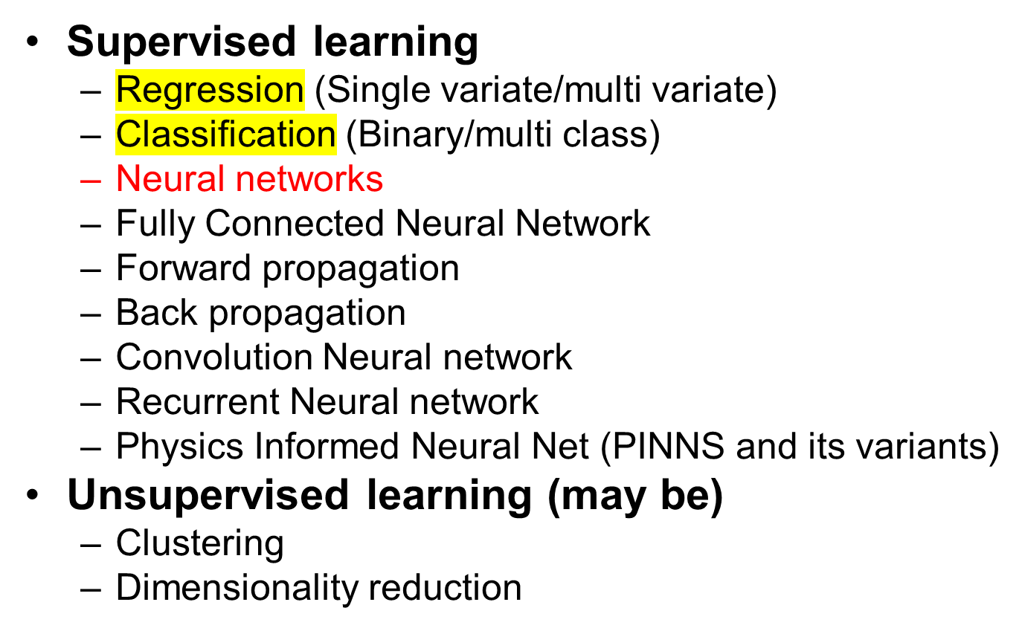
What We’ll Cover

Slide 33
DL in Practice
Understanding domain, prior knowledge, and goals
Data integration, selection, cleaning,
pre-processing, etc.
Learning models
Interpreting results
Consolidating and deploying discovered knowledge
Loop

