Slide 1
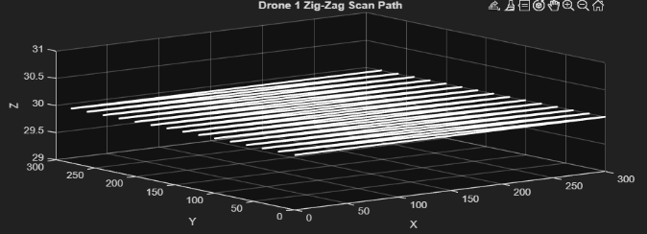
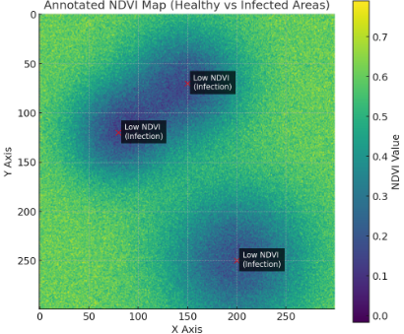
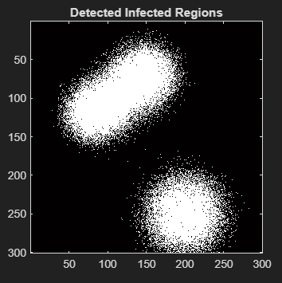

Drone-to-Drone Collaboration for Agricultural
Surveillance
College of Computer Science and Information Technology, King Faisal University, Saudi Arabia
Abstract
The rapid adoption of drones in precision agriculture has changed how large-scale crops are managed. This project proposes a drone to drone(D2D) framework for autonomous monitoring and targeted treatment. The system uses a Sensor Drone to identify unhealthy crops through thermal imaging and NDVI, while Response Drone follows up to apply pesticides exactly where needed.
IV. Results and Analyses
The Simulation was tested across various scenarios, including normal fields and fields with obstacles.
Metric | Formula | Explanation
Coverage Accuracy (%) | Scanned area / Total area 100 | Measures how much of the field Drone 1 scanned.
Response Time (s) | TimeEnd​−TimeStart​ | Time for Drone 2 to reach each infected zone.
Spray Precision (%) | Spray / Total spray area 100 | Measures how well the spray overlaps the infected region.
Battery Usage (%) | 100 – All battery | Percentage of battery consumed during scanning and spraying.
Introduction
The integration of IoT and aerial robotics has led to the rise of Smart Farming, which optimizes resources to improve crop yields. While modern drones with advanced sensors and GPS provide a unique overhead view of farms, current systems often rely on single-drone operations. As wireless networks improve, there is growing need to move toward multi-drone systems that can communicate and work together automatically. This project specifically addresses the “detection-to-action gap”. Usually, data from a drone must be processed by a person before a second treatment flight can happen, creating delays that allow pests or diseases to spread. This research aims to use lightweight protocols like MQTT to enable real-time communication between drones fully automating the process from detection to response.
II. Objectives of the project include:
This research establishes a drone-to-drone(D2D) framework for autonomous monitoring.
• Simulate a drone that calculates NDVI and identifies unhealthy crop areas.
• Implement MQTT communication so the detection drone can send coordinates to the response drone.
• Simulate a response drone that moves to infected areas and performs targeted pesticide spraying.
• Build a simple decision matrix to show how the drones choose actions.
• Measure performance
• coverage accuracy
• response coordination time
• and spraying accuracy
V. Software & Hardware Tools
Software :
MATLAB
Basic MATLAB functions for matrix generation, visualization, and numerical simulation
Custom MATLAB implementations for
NDVI generation
Zig-zag scanning Infection detection
Hardware :
Laptop or pc
Intel Core i5 and above
8 GB RAM and above
Any operating system can be used
III. Methodology
This project proposes a drone to drone collaboration system of agricultural surveillance based on NDVI-based crop health and infection detection and autonomous drone response
The system is built using two simulated drones:
Drone 1 – Surveillance Drone :
•Start → Generate NDVI → Scan Field → Detect Infection → Cluster Regions → Compute Severity → Output Infected Targets → End
Drone 2 – Response Drone :
•Start → Receive Targets → Plan A* Path → Navigate → Spray Simulation → Accuracy Calculation → Log Results → Check Remaining Targets → End
Main modules in the methodology :
1. NDVI field generation
2. Drone 1 scanning path
3. Infection detection
4. Severity classification
5. Performance computation
VI. Conclusion
In this project, a simple drone-to-drone collaboration system was simulated to detect and treat infected crop areas. Drone 1 scanned the field and generated an NDVI map, while Drone 2 used path planning to reach infection zones and perform spraying. The results showed that the system could identify unhealthy regions, navigate correctly, and apply treatment with good accuracy
References
[1]A. Al-Mansour, "Water Conservation Technologies," Saudi J. of Eng. Tech., vol. 12, 2022.
[2]S. Patel, "Edge Computing for Drone Networks," IEEE IoT J., vol. 9, no. 3, 2022.
[3]J. Anderson, "Drone Applications in Agriculture," IEEE Access, vol. 7, 2019
[4]S. Puspitasari, W. Septiani, A. R. Hakim, R. Adiono, and A. P. Nugroho,
“AI and Drone Technology for Agricultural Field Monitoring Using NDVI and Machine Learning,”
Drones, vol. 8, no. 11, p. 686, 2024.
[5]Y. Zhang, H. Li, M. Wang, and R. Zhang,
“Deep Learning-Guided Drone Systems for Precision Agriculture and Disease Detection,”
[6]R. Tucker and M. Chen, “Drone Applications in Precision Agriculture: A Review,” Precision Agriculture Journal, vol. 14, no. 2, pp. 87–98, 2023.
[7]N. O. Al-Mutairi and F. Hussain, “NDVI-Based Crop Stress Detection Using UAV Simulation,” International Journal of Smart Farming, vol. 5, no. 1, pp. 12–20, 2022.
College of Computer Science and Information Technology, King Faisal University, Saudi Arabia

