Slide 1


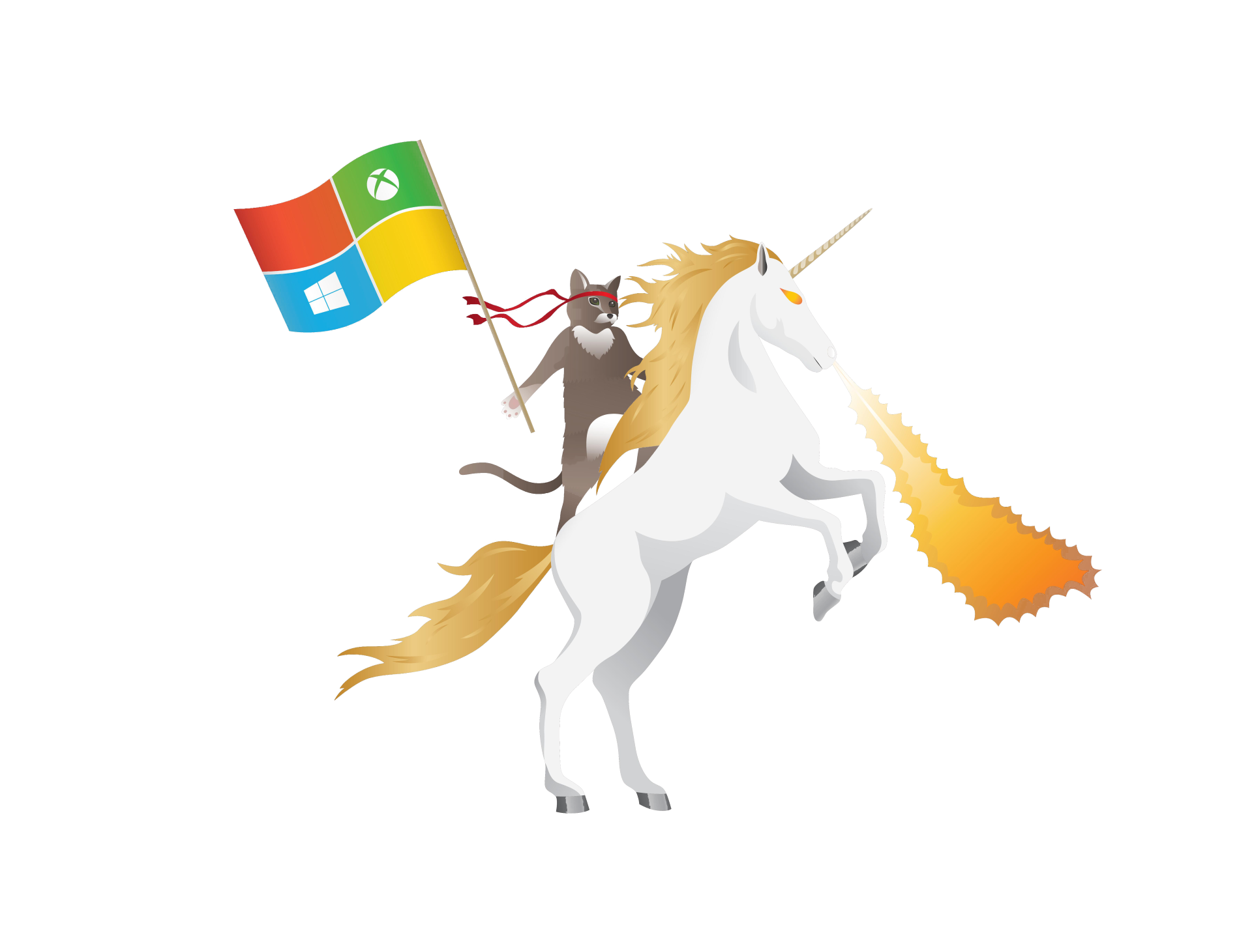
Angular 2
HEADS AND TAILS
Introduction to ASP.NET Core
@jorisbrauns
@sommertim

Slide 2




Tim Sommer Competence Manager Team4Talent, Coderdojo
@sommertim
tim.sommer@outlook.be
http://blog.timsommer.be

Slide 3
History of .NET
Visual Studio 2012
Windows store (Metro), Portable class lib, HTML 5, Async support
Visual Studio 2005
64-bit support, Generics
2.0
Visual Studio 2008
LINQ, AJAX, REST, RSS
(SP) MVC, EF
3.5
4.5
2002
2005
2006
2007
2010
2012
1.0
Visual Studio 2002
Winforms, ADO.NET, ASP.NET
3.0
Visual Studio 2008
WCF, WPF, WF
4.0
Visual Studio 2010
Parallel computing, new language features
Notes:
.NET Framework becomes bigger and bigger
ASP.NET, including MVC, tightly coupled to the framework
Difficult to keep release cycle

Slide 4
Fragmentation
Windows Desktop
Windows Store
Windows Phone
ASP.NET 4
App Model
App Model
App Model
App Model
Framework
Framework
Framework
Framework
Runtime
Runtime
Runtime
Runtime
Notes:
Multiple fragmented versions of .NET for different platforms
Different runtime, frameworks and application model
Different platforms are always going to have different features and capabilities

Slide 5







New kids on the block
Notes:
While the monolithic .NET Version releases new kids were appearing on the block.
Integration within VS studio works, but was never really good..

Slide 6
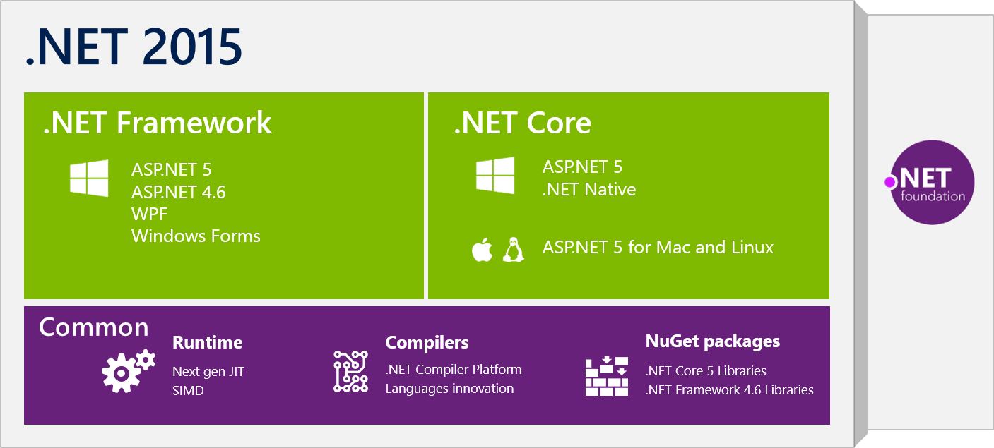
History of .NET - 2015

Slide 7
ASP.NET 5 is dead - Introducing ASP.NET Core 1.0
There are only two hard things in Computer Science: cache invalidation and naming things.
- Phil Karlton
Notes:
Microsoft decided to rename ASP.NET 5 and .NET Core 5 applications to .NET Core
Not an upgrade of .NET v1.4
.NET Core is build from scratch

Slide 8
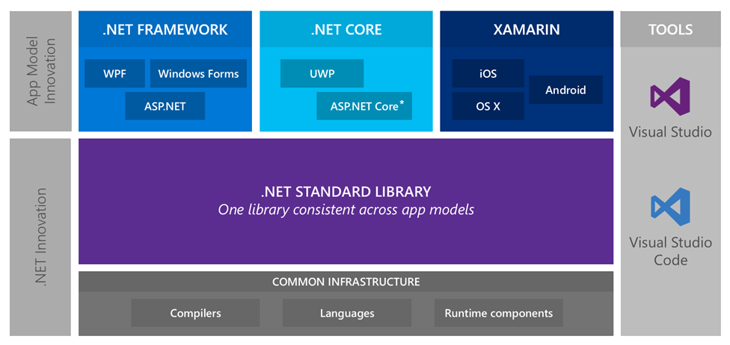
Innovation

Slide 9
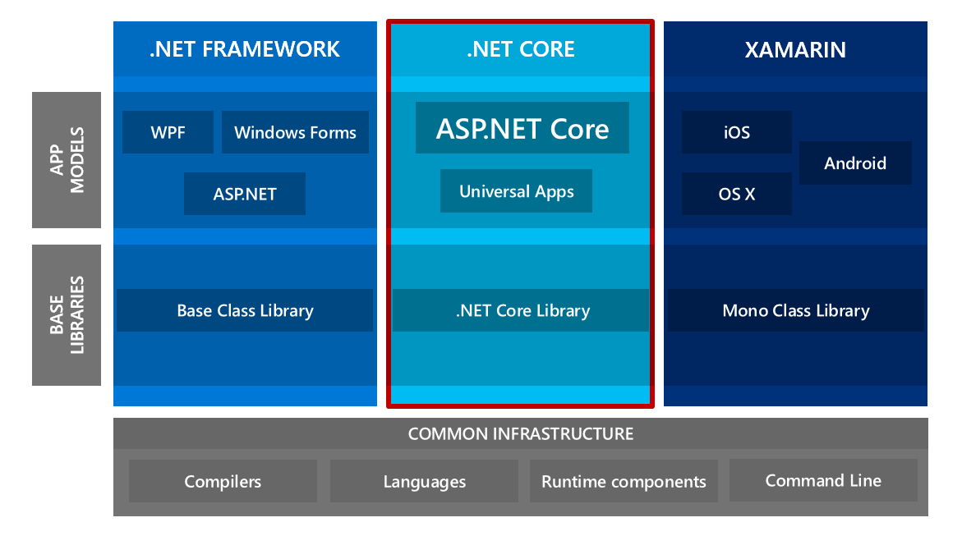
.NET Today

Slide 10






Why .NET Core
Cross-platform
Unified
Fast
Lightweight
Modern
Open Source
Notes:
Cross-platform
You can create .NET Core apps that run on Windows, Linux and macOS.
Unified
Leverage the unified .NET Standard library to target all platforms with the same code and use the same languages and tools to reuse your skills.
Fast
High performance server runtime for Windows Server and Linux make .NET 8x faster than Node.js and 3x faster than Go. That means applications provide better response times and require less compute power.
Lightweight
No impact deployment and a modular development model where you only take dependencies on the minimal set of packages you need.
Modern
Multiple language support with C#, VB, F# and modern constructs like generics, Language Integrated Query (LINQ), async support and more.
Open Source
Runtime, libraries, compiler, languages and tools are all open source on GitHub where contributions are accepted, tested and fully supported.

Slide 11
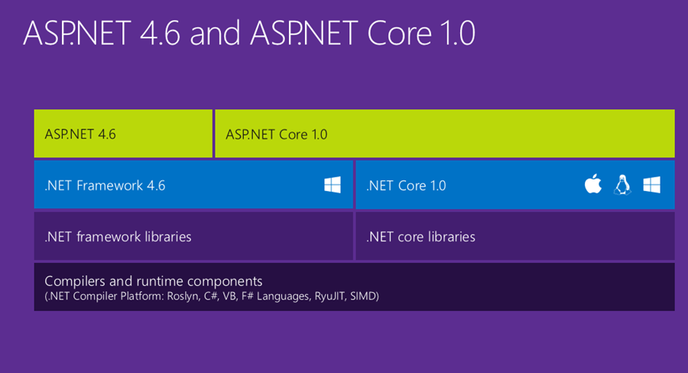
Composition

Slide 12
Keep in mind!
ASP.NET 4.6 is the more mature platform
ASP.NET Core 1.0 is a 1.0 release, but tooling is still in preview
SignalR and WebPages are not included (yet)
VB or F# is not included (yet)
Not all packages are available for .NET Core (yet)

Slide 13
.NET CLI
Let’s see it in action!

Slide 14
.NET CLI
Command line approach
dotnet new
dotnet restore
dotnet run
dotnet build
dotnet publish
Get the SDK at
http://dot.net

Slide 15
ASP.NET Core
Cross Platform Runtime
Unified programming model
bower, grunt, gulp
Simplified dependency mgmt
Cloud-ready config
Built in DI
Light-weight and modular HTTP request pipeline
Modular
Open Source
Identity updates
New tooling
Leaner, faster, simpler
Notes:
A unified story for building web UI and web APIs
Integration of modern client-side frameworks and development workflows
A cloud-ready environment-based configuration system
Built-in dependency injection
New light-weight and modular HTTP request pipeline
Ability to host on IIS or self-host in your own process
Ships entirely as NuGet packages
New tooling that simplifies modern web development
Build and run cross-platform ASP.NET apps on Windows, Mac and Linux
Open source and community focused

Slide 16
How to make a web app from a console app?
Application
‘Hello World’
Request
Response

Slide 17
How to make a web app from a console app?
Add Kestrel Server
Application
‘Hello World’
Kestrel
Request
Response
Notes:
Ketrel will bind a port and transform requests for ASP.NET Core

Slide 18
How to make a web app from a console app?
Kestrel passes the request to a middleware pipeline
Kestrel
Middleware A
Middleware B
Middleware C
Middleware D
Request
Response
Notes:
Middleware is request chaining !
First A, then B, then C, D
Return goes through C, B and A

Slide 19
Middleware
Kestrel does nothing by default!
Add features as middleware.
Runtime info page
Static files
Authentication
Developer exception page
ASP.NET MVC
Facebook Authentication
Status code pages
Error page

Slide 20
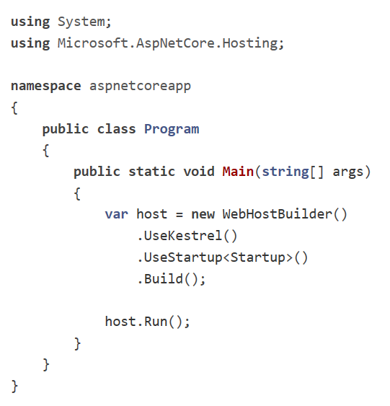
Anatomy of a ASP.NET Core app

Slide 21
Dependency Injection
Built in support for Dependency Injection
Constructor and Action injecton
Transient
Services are created each time they are requested
Scoped
Services are created once per request
Singleton
Services are created the first time they are requested and then every subsequent request will use the same instance

Slide 22

Yeoman
Notes:
Scaffolding tool to generate templates which you can use to start new applications

Slide 23
Yeoman
Scaffolding tool
npm install --global yo
Generates
Projects
Classes
Files
Uses generators
npm install --global generator-aspnet
yo aspnet

Slide 24
Creating an API project with ASP.NET Core
Let’s see it in action!

Slide 25
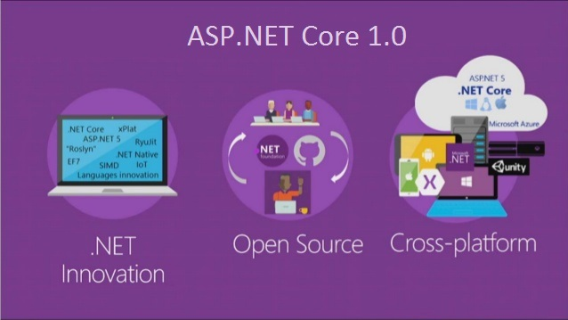
Future
Release | Time frame
1.1 | Q4 2016 / Q1 2017
1.2 | Q1 2017 / Q2 2017
1.1
WebSockets
URL Rewriting middleware
Response caching middleware
DI improvements for 3rd party containers
WebListener server (Windows only)
Middleware as MVC filters
ViewComponents as Tag Helpers
Improved Azure integration
App Service startup time improvements
App Service logging provider
Azure Key Vault provider
1.2
SignalR
View Pages (Views without MVC controllers)
Web API security
View precompilation

Slide 26



For you!
Starting point for .NET
http://dot.net
ASP.NET Core docs
http://docs.asp.net
Get Visual Studio Code
It’s awesome!
http://code.visualstudio.com
All open source on github !
http://github.com/dotnet
http://github.com/aspnet
https://github.com/aspnet/benchmarks
http://github.com/microsoft
Omnisharp intellisense for editors
http://omnisharp.net
http://github.com/omnisharp

Slide 27
Tim Sommer Competence Manager Team4Talent, Coderdojo
@sommertim
tim.sommer@outlook.be
http://blog.timsommer.be
Questions?

