Slide 1


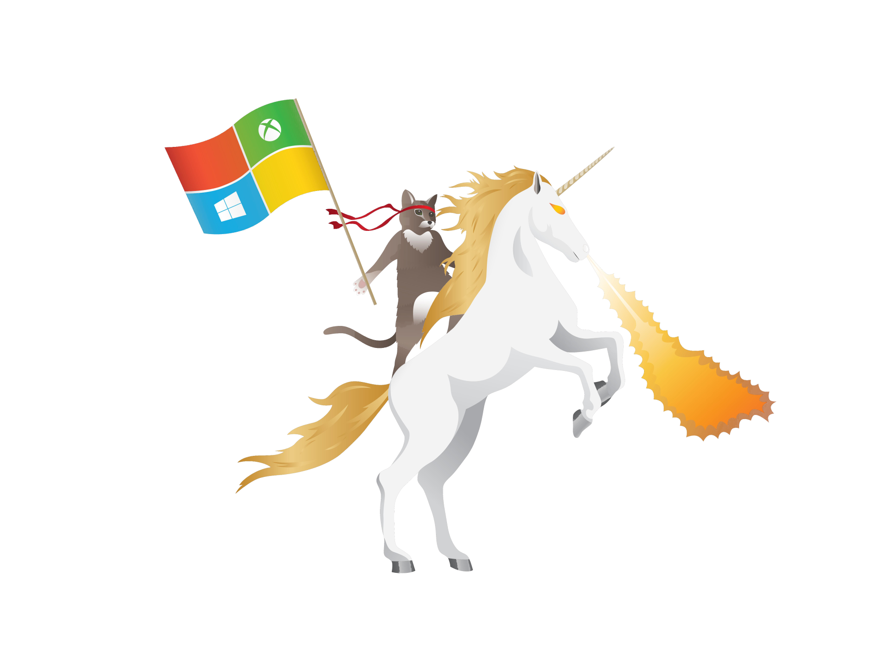
HEADS AND TAILS
Heads or Tails
@jorisbrauns

Slide 2




Joris Brauns Microsoft MVP, Consultant Team4Talent
@jorisbrauns
info@jorisbrauns.be
http://www.jorisbrauns.be
http://blog.jorisbrauns.be

Slide 3


Instructions
Is the answer head?
Hands on the head!
Is the answer tail?
Hands on the lower back!

Slide 4


Let’s test
OWIC STANDS FOR
OPEN WINDOWS
INSIDERS COMMUNITY
OPEN WHATEVER
INSIDERS COMMUNITY

Slide 5

Let’s test
OWIC STANDS FOR
OPEN WINDOWS
INSIDERS COMMUNITY
OPEN WHATEVER
INSIDERS COMMUNITY

Slide 6
TypeScript is created by
Google Microsoft

Slide 7
TypeScript is created by
Google Microsoft

Slide 8
Angular is created by
Google Microsoft

Slide 9
Angular is created by
Google Microsoft

Slide 10
TypeScript compiles to Vanilla JS
YES NO

Slide 11
TypeScript compiles to Vanilla JS
YES NO

Slide 12
.NET Core runs on
Cross platform Only Windows

Slide 13
.NET Core runs on
Cross platform Windows

Slide 14
Angular 2.0 Final has been released
YES NO

Slide 15
Angular 2.0 Final has been released
YES NO

Slide 16
Windows Insiders are…
Awesome Wicked Powerful

Slide 17

Windows Insiders are…
Awesome Wicked Powerful

Slide 18
Are there mobile UI frameworks supporting Angular2
YES NO

Slide 19
Are there mobile UI frameworks supporting Angular2
YES NO

Slide 20
Scaffolding is
Transpiling Code generation

Slide 21
Scaffolding is
Transpiling Code generation

Slide 22
ECMAScript is a
Language Standardization

Slide 23
ECMAScript is a
Language Standardization

Slide 24
The new webserver for ASP.NET Core is called
Kestrel IIPS

Slide 25
The new webserver for ASP.NET Core is called
Kestrel IIPS

Slide 26
The CLR is
Common language runtime
Compiler language runtime

Slide 27
The CLR is
Common language runtime
Compiler language runtime

Slide 28
In Angular 2 a component is a directive
YES
NO

Slide 29
In Angular 2 a component is a directive
YES
NO

Slide 30
Angular 2 directive are divided into how many groups
4
3

Slide 31
Angular 2 directive are divided into how many groups
4
3

Slide 32
.NET Core applications are console apps
SOMETIMES
ALWAYS

Slide 33
.NET Core applications are console apps
SOMETIMES
ALWAYS

Slide 34
Who is lead of the Windows Insiders Program?
Dona Sarkar
Gabe Aul

Slide 35
Who is lead of the Windows Insiders Program?
Dona Sarkar
Gabe Aul

Slide 36
The new cross platform compiler is called
RyuJIT
Roslyn

Slide 37
The new cross platform compiler is called
RyuJIT
Roslyn

Slide 38
TypeScript supports generics?
YES
NO

Slide 39
TypeScript supports generics?
YES
NO

Slide 40
When was .NET 1.0 been released?
2001
2002

Slide 41
When was .NET 1.0 been released?
2001
2002

Slide 42
Who was the inventor of JavaScript
Brendan Eich
Igor Minar

Slide 43
Who was the inventor of JavaScript
Brendan Eich
Igor Minar

Slide 44
Who was the inventor of TypeScript
Anders Hejlsberg
Mark Hejlsberg

Slide 45
Who was the inventor of TypeScript
Anders Hejlsberg
Mark Hejlsberg

