Slide 1

Classifying Personality Types with NLP
Using Natural Language Processing to analyze user text and predict personality types.
Dataset: Myers-Briggs Personality Type Indicator (MBTI) from Kaggle.
Goal: Accurately classify personality types from written text data.

Slide 2

Introduction to Personality Classification
Project Overview
Importance
Leverage NLP techniques for personality type classification.
Useful in psychology, marketing, human resources.
Challenges
Handling text variability and personality subjectivity.

Slide 3
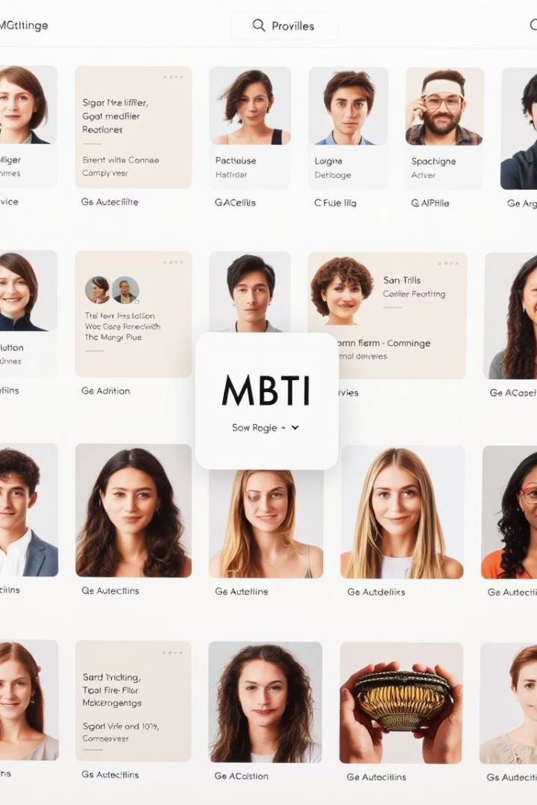
MBTI Dataset Overview
Source
Data Content
Kaggle dataset by datasnaek, 8,675 profiles.
Each user has 50 recent text posts collected.
Personality Types
16 MBTI categories (e.g., INFJ, ENTP)
Reflects diverse personality traits.

Slide 4
NLP Pipeline Methodology
Text Preprocessing
Feature Extraction
Model Selection & Evaluation
Cleaning, tokenization, stemming for data preparation.
Using TF-IDF and word embeddings (Word2Vec, GloVe).
Naive Bayes, SVM, Random Forest
Neural Networks
Metrics: accuracy, precision, recall, F1-score

Slide 5
Text Preprocessing Details
Cleaning
Tokenization
Stemming & Lemmatization
Remove URLs, special characters, stop words.
Split text into individual meaningful words.
Reduce words to root forms, e.g., "running" → "run".

Slide 6
Feature Extraction Techniques
TF-IDF
Word Embeddings
Popular Models
Measures important words frequency in documents.
Vector representations capturing word semantics.
Word2Vec trained on Google News (3B words)
GloVe trained on Wikipedia and web texts

Slide 7
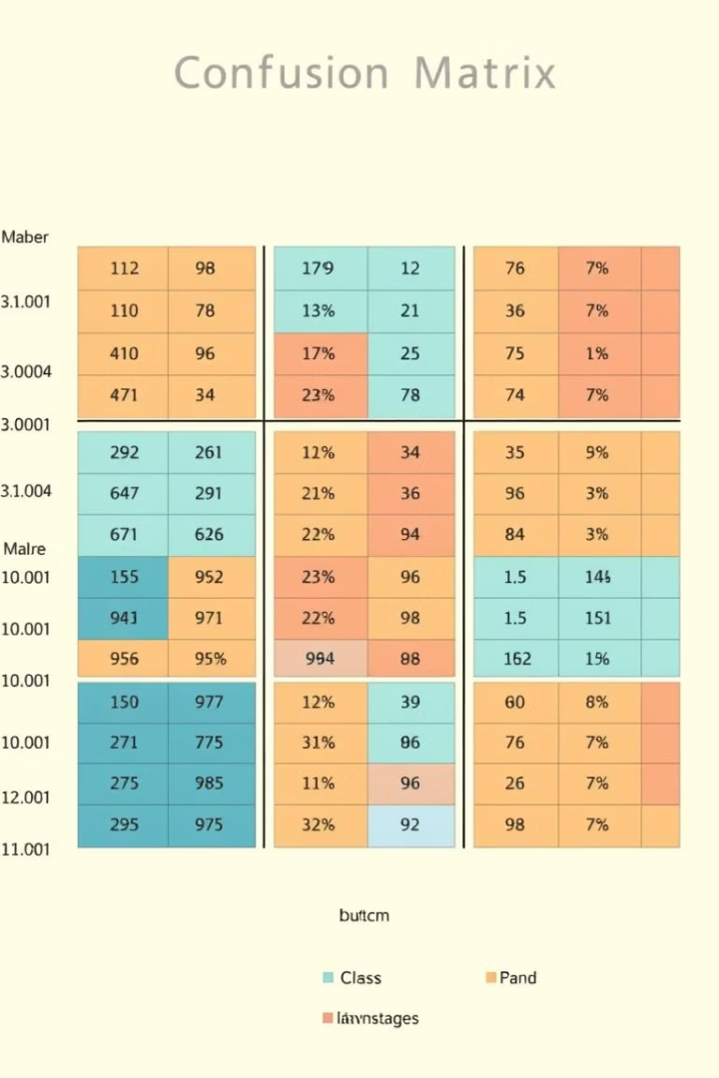
Results and Evaluation
Model Accuracy
Feature Importance
Random Forest achieved 65% classification accuracy.
Identified key words aiding type differentiation.
Confusion Matrix
Highlights common misclassifications between types.

Slide 8

Conclusion and Future Work
Summary
NLP shows promising results in personality classification.
Limitations
Dataset biases, text length, and contextual challenges.
Next Steps
Integrate more data, refine models, apply advanced NLP.

