Slide 1
Micro Credit Defaulter Model
Submitted by:
Kumar Gourabh
Data Science Intern at Flip Robo

Slide 2
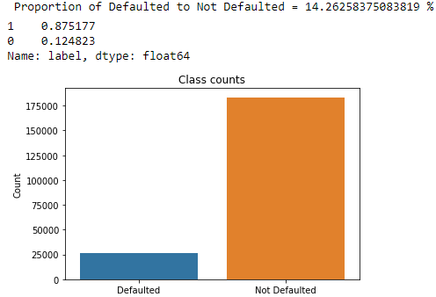
Problem Statement and Understanding
The goal was to predict whether a customer will be paying back the loaned amount within 5 days of insurance of loan be a defaulter.
The Data contained 2,09,593 rows and 37 columns. Label 0 were defaulters and those having label 1 weren’t

Slide 3
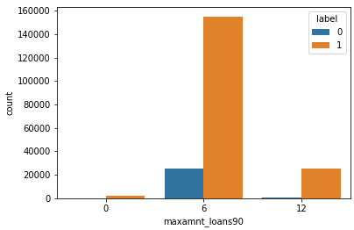
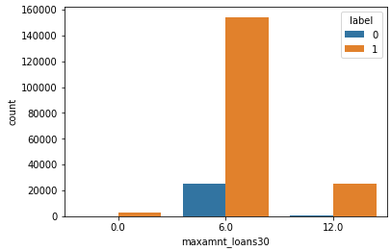
EDA Steps and Visualizations
Performed necessary cleaning of the data by dropping redundant columns.
Used correlation heatmap and further reduced certain features.
Identified categorical and continuous features.
Treated for outliers upto z-score of six by deleting the rows. Also applied cube root on continuous features to make the data normalized.
Performed Standard Scaling of the data.
Did PCA to reduce curse of dimensionality, with n_components =15, after looking at the explained variance
The 2 plots shown are: Max amount (90 days and 30 days) vs count, hued with label

Slide 4
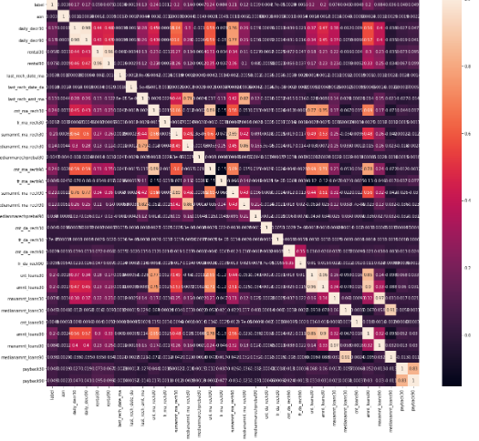
EDA Steps and Visualizations
There was a lot of imbalance in the dataset
Columns like maxamnt_loans30 etc should have values 0 or 6 or 12 bur we see other values as well.
Max amt for both 30 and 90 days are more for 6, i.e 5
We can see that there is strong positive as well as negative correlation within features, and I’ve used PCA also to eliminate the curse of dimensionality.

Slide 5
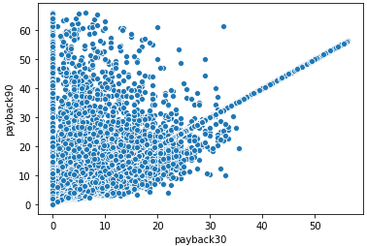
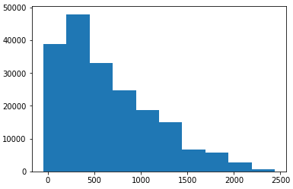
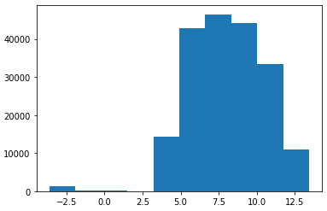
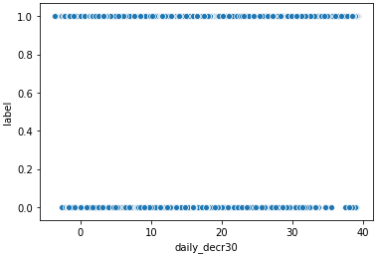
EDA Steps and Visualizations
Between Payback 30 and 90, A lot of data points are correlated strongly, but there are also a few anomalies.
Most of the data is not normalized, so I’ve done a cube root transform on the continuous features.
Fig: Correlation between Payback 30 and 90
Fig: Histplot of aon before normalizing
Fig: Histplot of aon after normalizing
Fig: Scatterplot of daily_decr30 vs label

Slide 6
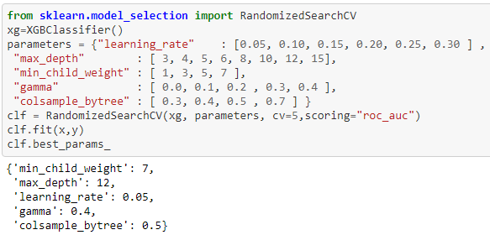
Steps and assumptions used to complete the project
This was a classification problem. My steps were:
I will be checking various Algorithms and compare the roc-auc scores.
I’ll further be tuning the best performing model using randomized search CV and iterating over 42-100 r_state values to find the best score.
Algorithms Tested:
Random Forest Classifier
KNN Classifier
DecisionTree Classifier
Logistic Regression Classifier
Gaussian NB Classifier
Gradient Boost Classifier
Adaboost Classifier
XGBoostClassifier
Fig: Hyper Parameter Tuning using Randomized Search CV

Slide 7
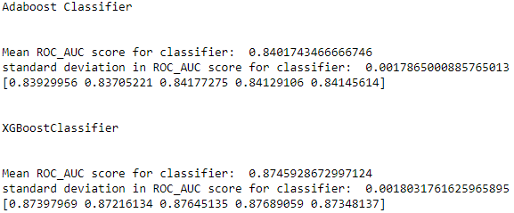
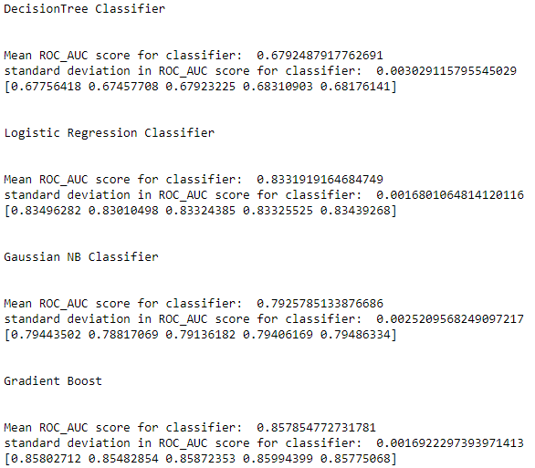
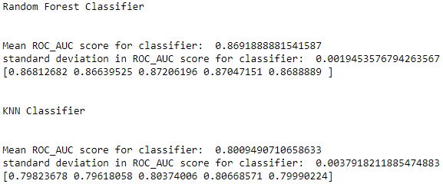
Model Dashboard
These are the snapshots of cross validations for above models with scoring= ‘roc_ auc’ and cv = 5

Slide 8
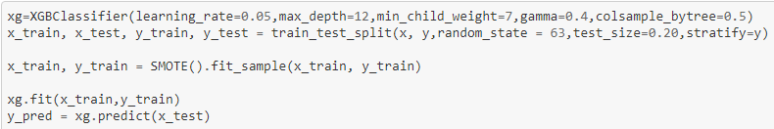
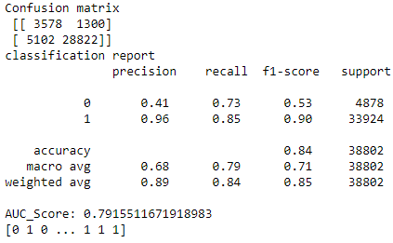
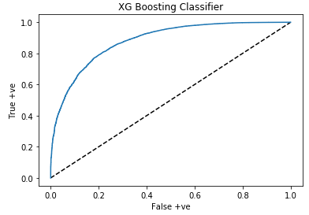
Finalized model – XG Boost Classifier

Slide 9


Key Findings & Conclusions
An auc_roc score of almost 80% is quite good to predict the results. Overall, the total cases of defaulters are 12-13% which is still a high ratio and there is a need to predict the chances of a new case being defaulter or not, so that action can be taken, and the ratio can be brought down.
As the dataset was comparatively large, the testing was taking a lot of time. All the ML Algorithms took long time to execute, as a result I could tune only 1 best performing model.
Also, Grid Search CV seemed to never stop running, so I tried Randomized Search CV for this task, and it gave decent results.

