Slide 1
Jenkins
Jenkins:
Jenkins is a self-contained, open source automation server which can be used to automate all sorts of tasks related to building, testing, and delivering or deploying software.
Pipeline
A Pipeline is a user-defined model of a CD pipeline.
A Pipeline’s code defines your entire build process, which typically includes stages for building an application, testing it and then delivering it.
Types of pipeline
Declarative pipeline
Scripted pipeline
Declarative vs scripted pipeline
Declarative Pipeline is a more recent feature of Jenkins Pipeline.
It provides richer syntactical features over Scripted Pipeline syntax.
Is designed to make writing and reading Pipeline code easier.
Limits: which limit the maximum size of the code with in pipeline{} block.

Slide 2
Declarative pipeline:
pipeline block defines all the work done throughout entire pipeline
Syntax:
Pipeline{
agent any --------- execute pipeline any available agent
stages{
Stage(‘build’){ ---------define build stage
Steps{
// ---------perform some steps related to build
}
}
Stage(‘test’){ -------define test stage
Steps{
// --------perform some steps related to test
}
}
Stage(‘deploy’){ ----define deploy stage
Steps{
// -----perform some steps related to deploy
}
}
}

Slide 3
Scripted pipeline:
Syntax:
Node{
Stage(‘build’){
//
}
Stage(‘test’){
//
}
Stage(‘deploy’){
//
}
}

Slide 4
Terminology
Node :
A node is a machine which is part of the Jenkins environment and is capable of executing a Pipeline.
Stage:
A stage block defines a conceptually distinct subset of tasks performed through entire pipeline.
Step
A single task. Fundamentally, a step tells Jenkins what to do at a particular point in time (or "step" in the process).
Jenkins file:
Jenkins file is an text file that contains definition of Jenkins pipeline.

Slide 5
Hands-on (declarative and scripted pipeline)
pipeline {
agent any
stages {
stage('Build’)
{
steps
{
git 'https://github.com/skillrary/welcometoskillrary.git'
sh "mvn -Dmaven.test.failure.ignore=true clean package "mvn -Dmaven.test.failure.ignore=true clean package"
}
post
{
success
{
junit '**/target/surefire-reports/TEST-*.xml'
archiveArtifacts 'server/target/*.jar'
} } } }}

Slide 6
Scripted pipeline:
Node {
stage('Preparation') {
git 'https://github.com/skillrary/welcometoskillrary.git’
}
stage('Build’)
{
sh '"$MVN_HOME/bin/mvn" -Dmaven.test.failure.ignore clean package'
}
stage('Results’)
{
junit '**/target/surefire-reports/TEST-*.xml' archiveArtifacts 'server/target/*.jar’
}
}

Slide 7
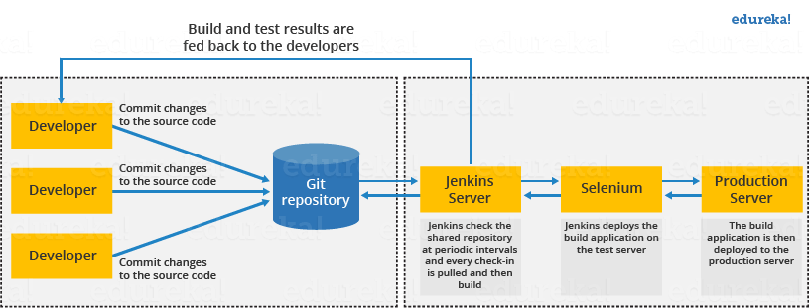
Jenkins Architecture:
This single Jenkins server was not enough to meet certain requirements like:
Sometimes you might need several different environments to test your builds. This cannot be done by a single Jenkins server.
If larger and heavier projects get built on a regular basis then a single Jenkins server cannot simply handle the entire load.

Slide 8
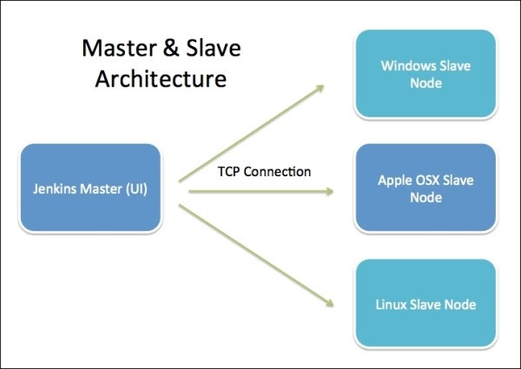
Jenkins Distributed Architecture
Jenkins uses a Master-Slave architecture to manage distributed builds.
jenkins Master:
Scheduling build jobs.
Dispatching builds to the slaves for the actual execution.
Monitor the slaves (possibly taking them online and offline as required).
Recording and presenting the build results.
A Master instance of Jenkins can also execute build jobs directly.
jenkins Slave:
It hears requests from the Jenkins Master instance.
Slaves can run on a variety of operating systems.

Slide 9
Up stream and down stream jobs:
An upstream job is a configured project that triggers a project as part of its execution.
A downstream job is a configured project that is triggered as part of a execution of pipeline.
A job b job c job
Note : for B job A job is an up stream job and C job is an down stream job

