Slide 1
Credit EDA Assignment Report & Analysis
kumar saransh

Slide 2
Project Description
The objective of this case study is to illustrate the practical application of EDA in a genuine business context. Throughout this assignment, you will not only employ the EDA techniques you've acquired but also gain a foundational comprehension of risk analytics within the banking and financial services sector. You will discover how data is leveraged to reduce the risk of financial losses when extending loans to customers.
Objective:
To comprehend the factors contributing to challenges in making loan payments for certain individuals.
To uncover any additional trends within the data that could aid in identifying elements associated with loan defaults.

Slide 3
Business understanding
The loan providing companies find it hard to give loans to the people due to their insufficient or non-existent credit history. Because of that, some consumers use it to their advantage by becoming a defaulter. Suppose you work for a consumer finance company which specializes in lending various types of loans to urban customers. You have to use EDA to analyze the patterns present in the data. This will ensure that the applicants capable of repaying the loan are not rejected.
When the company receives a loan application, the company has to decide for loan approval based on the applicant’s profile. Two types of risks are associated with the bank’s decision:
If the applicant is likely to repay the loan, then not approving the loan results in a loss of business to the company
If the applicant is not likely to repay the loan, i.e. he/she is likely to default, then approving the loan may lead to a financial loss for the company.

Slide 4
Business Objectives
This case study aims to identify patterns which indicate if a client has difficulty paying their instalments which may be used for taking actions such as denying the loan, reducing the amount of loan, lending (to risky applicants) at a higher interest rate, etc. This will ensure that the consumers capable of repaying the loan are not rejected. Identification of such applicants using EDA is the aim of this case study.
In other words, the company wants to understand the driving factors (or driver variables) behind loan default, i.e. the variables which are strong indicators of default. The company can utilize this knowledge for its portfolio and risk assessment.

Slide 5
EDA Methodologies
Read and load the csv files (data).
Perform Data Quality Checks (treatment of missing values, outliers, binning and type correction)
Check data imbalance & split the data
Perform univariate analysis to compare trends between defaulters and non defaulters
Perform bivariate analysis, including correlation analysis to find some pattern.
Load the previous application data and merge with current application data (inner join).
Perform the same steps as before to find new trends between previous application and current application, in relation with defaulters and non defaulter.

Slide 6
Analysis on ‘application_data.csv’

Slide 7
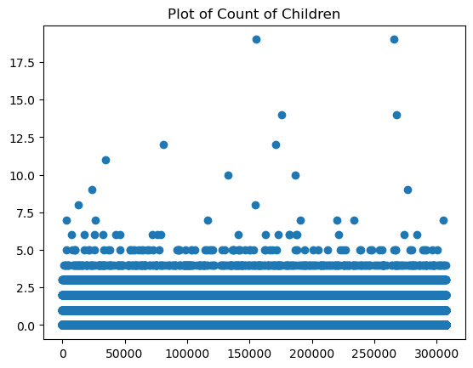
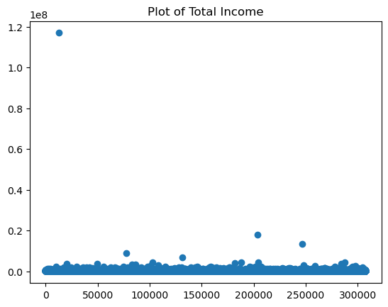
Outlier Analysis
Inferences:
Majority of the families has children below 5.
There are 19 children in a family, These outliers may reflect unique family structures or cultural dynamics
Inferences:
Total income have outliers, indicating a presence of individuals with significantly higher incomes compared to the majority.
These outliers may represent the high earning professionals, Founder of some organization.

Slide 8
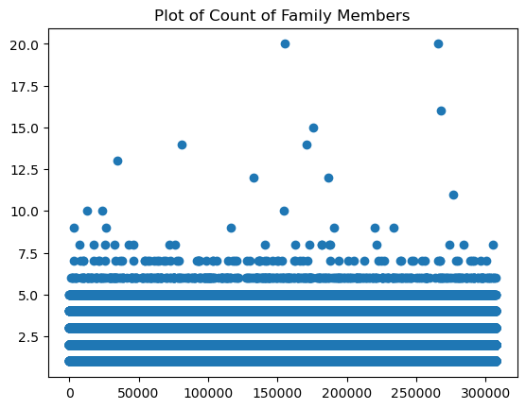
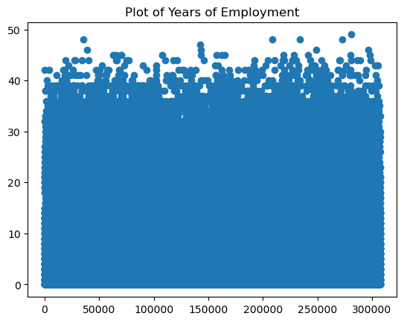
Outlier Analysis
Inferences:
Majority of the families has below 7 family members.
There are some families who has more than 20 family members, These outliers may reflect joint family or multi-generational family.
Inferences:
These outliers indicates that there are certain employees who has been employed from a long time in the same organization.
This also indicates that there is a lower risk of job loss.

Slide 9
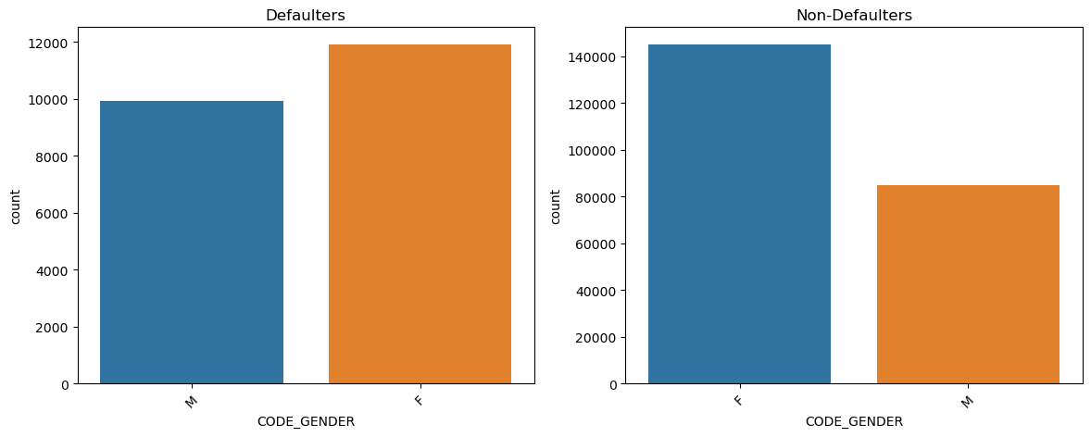
univariate Analysis on code_Gender
Inferences:
It is observed that the count of females are slightly more than males as Defaulters.
It is observed that the count of females are slightly more than males as Non-Defaulters.

Slide 10
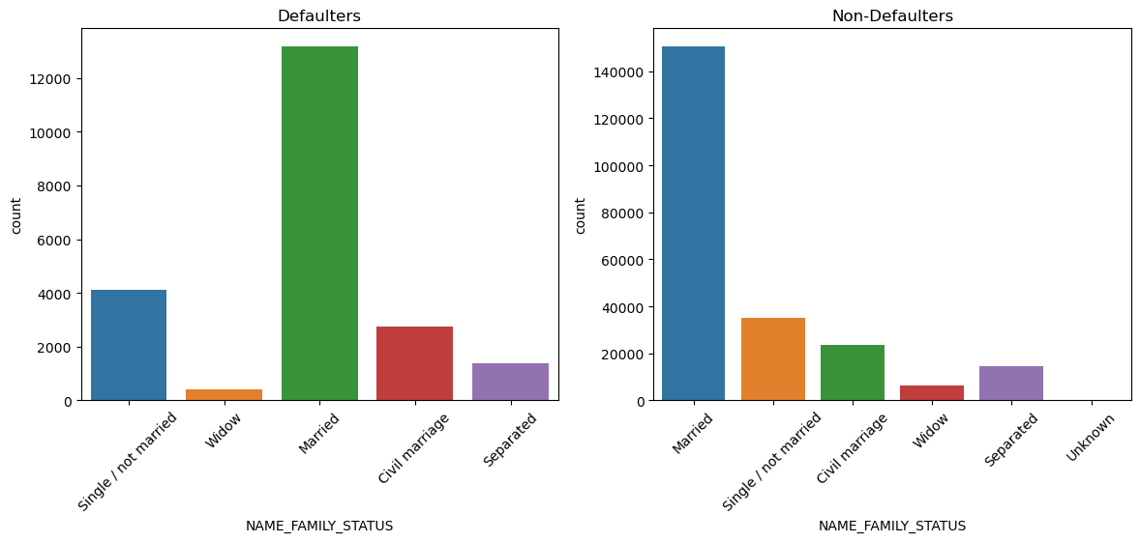
univariate Analysis on NAME_FAMILY_STATUS
Inferences:
It is observed that the count of married are significantly higher as Defaulters & Widow are the least defaulters than any other family status.
It is observed the similar pattern for non-defaulters, married peoples are high as non-defaulters and widow as the least.

Slide 11
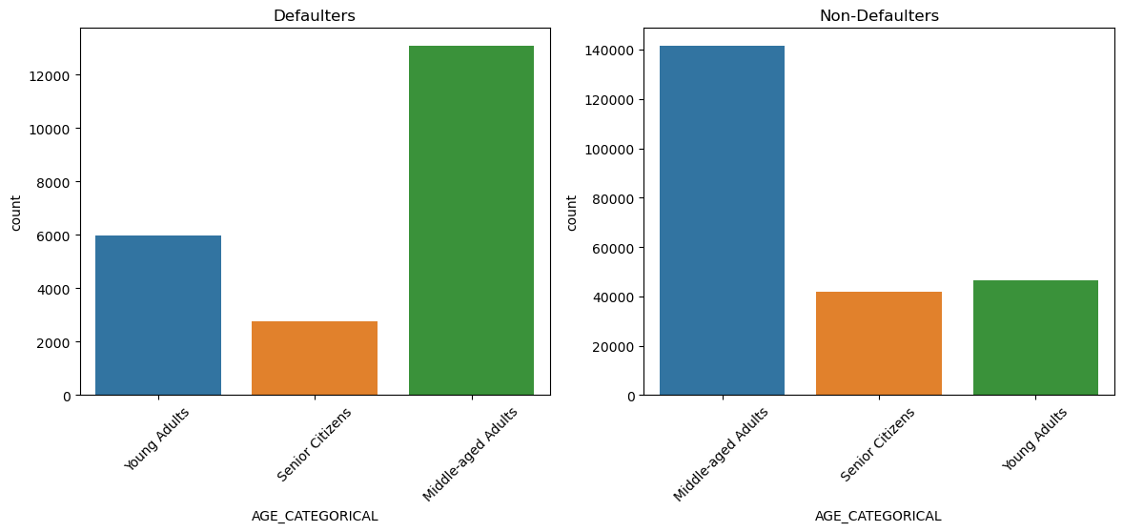
univariate Analysis on AGE_CATEGORICAL
Inferences:
It is observed that Senior Citizens are compared to be less defaulters than young and middle aged youths.
Middle Aged youth are the least defaulters.
Young adults are seems to be more defaulter than the non-defaulter.

Slide 12
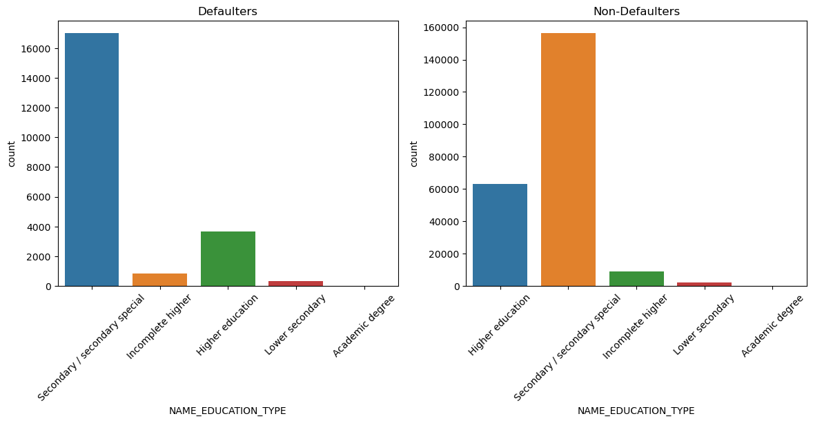
univariate Analysis on 'NAME_EDUCATION_TYPE'
Inferences:
It is observed that applicants having education type ‘secondary/secondary special’ are more likely to be defaulters than the non-defaulters.
Applicants having education type ‘Higher Education’ are more likely to be Non-defaulters than the defaulters.
Applicants with lower education level tends to take less loan.

Slide 13
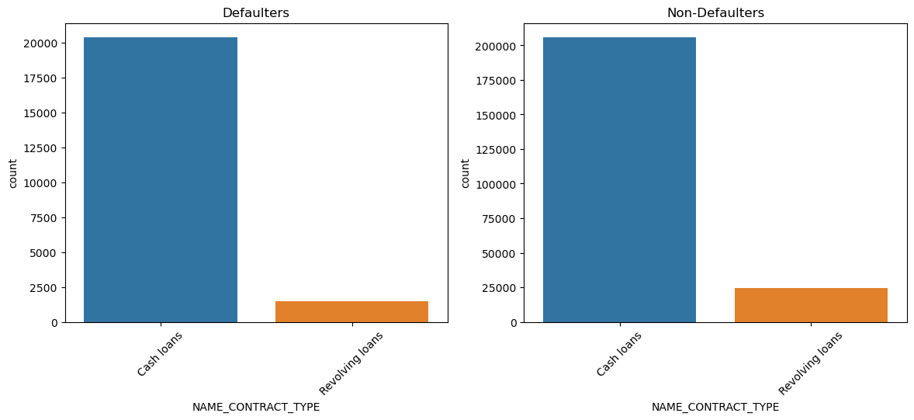
univariate Analysis on NAME_CONTRACT_TYPE
Inferences:
We see, in both the cases Revolving loans are very less in number compared to Cash loans and tends to have less defaulters.

Slide 14
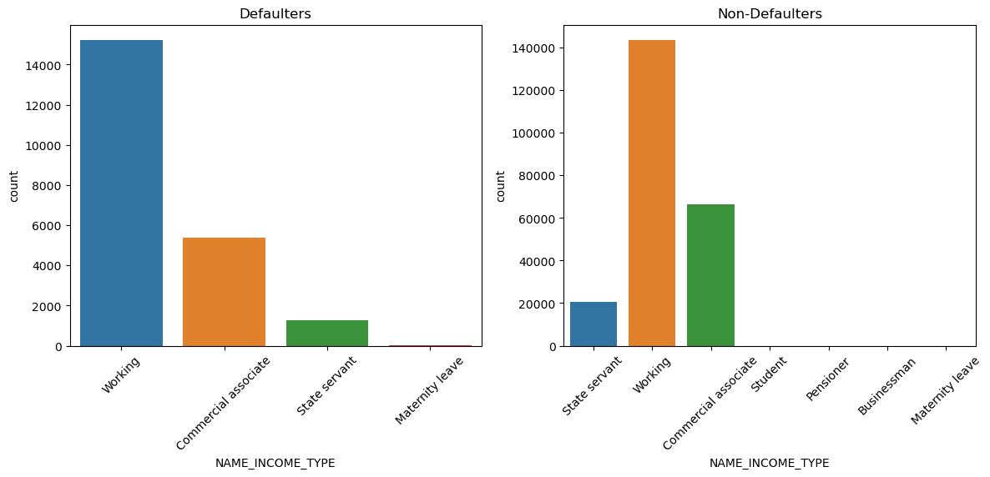
univariate Analysis on NAME_INCOME_TYPE
Inferences:
Defaulters - Working people are mostly defaulted as their numbers are high with compare to other pfrofessions.
Non-defaulters - Similarly here also working people are more in number who are not defaulted.

Slide 15
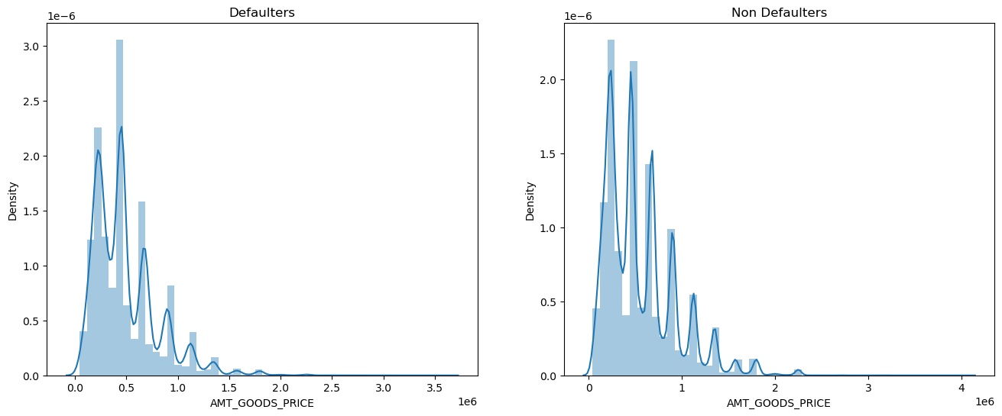
univariate Analysis on AMT_GOODS_PRICE
Inferences:
It is observed that applicants having higher goods price tends to be more defaulter than non-defaulters.
When goods price are between 0-5,00,000. Applicants seems to be more non-defaulter than defaulters.

Slide 16
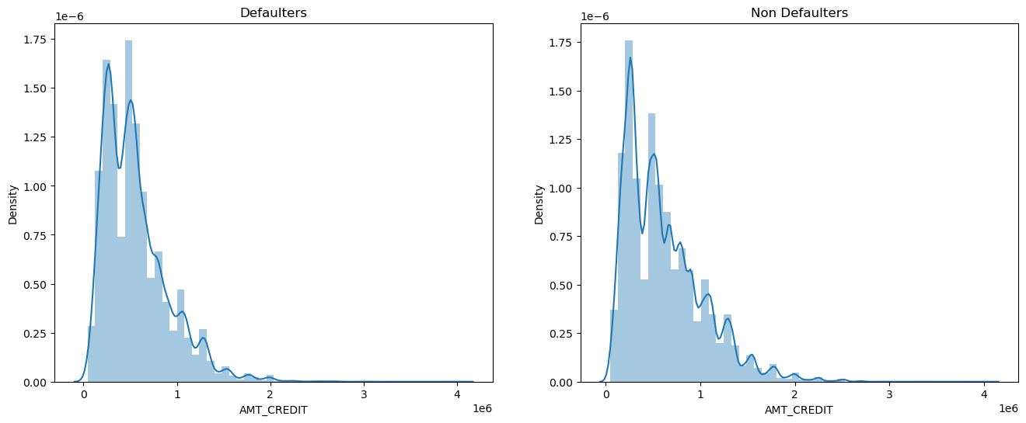
univariate Analysis on AMT_CREDIT
Inferences:
It is observed that, credit amount is slightly higher for non defaulters.
applicants having higher credited amount tends to be more defaulter than non-defaulters.

Slide 17
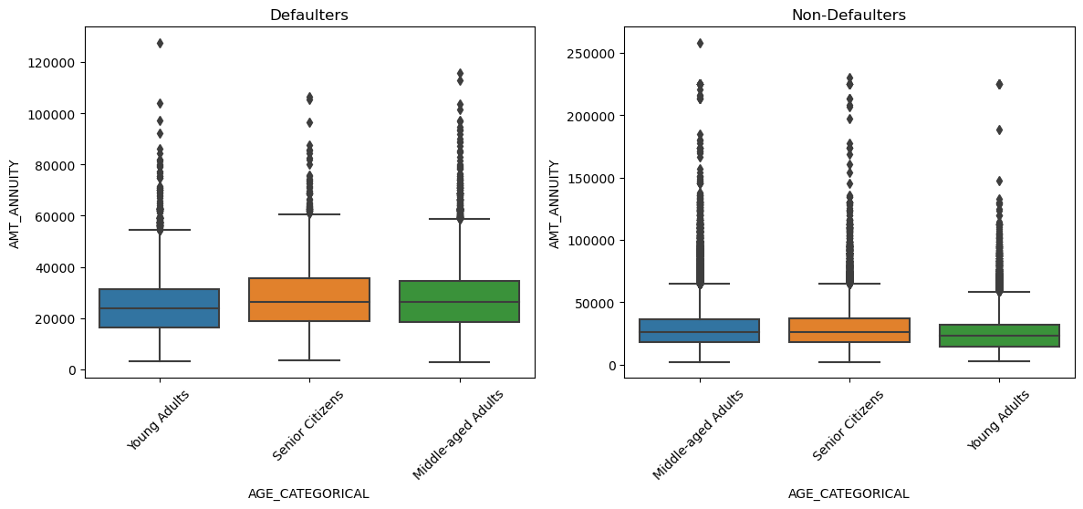
bivariate Analysis on 'AGE_CATEGORICAL','AMT_ANNUITY'
Inferences:
Here we observe that overall, middle aged adults have the highest annuity loan and tends to be more non-defaulter.
Whereas, young adults has moderate annuity and tends to be more defaulter.

Slide 18
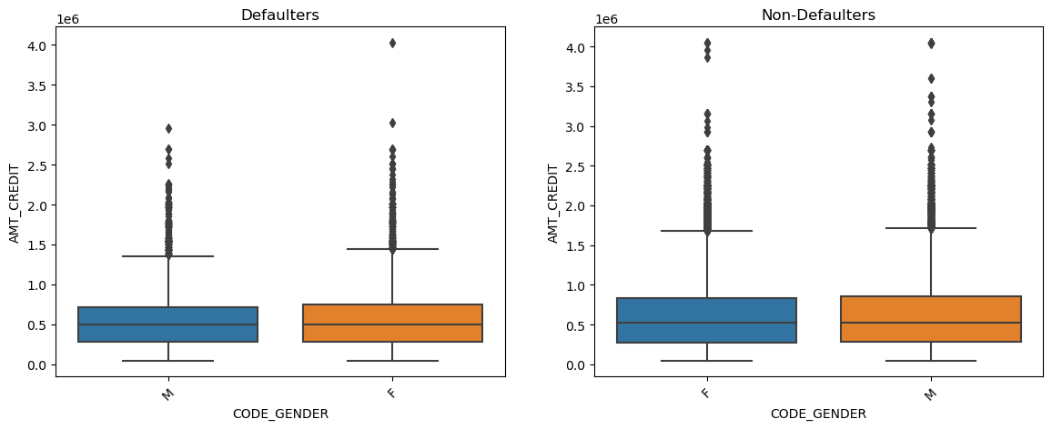
Bivariate Analysis on 'CODE_GENDER','AMT_CREDIT'
Inferences:
It is observed females when credited with more amount tends to be a defaulter than males.
The most amount is credited to males and are least defaulters.

Slide 19
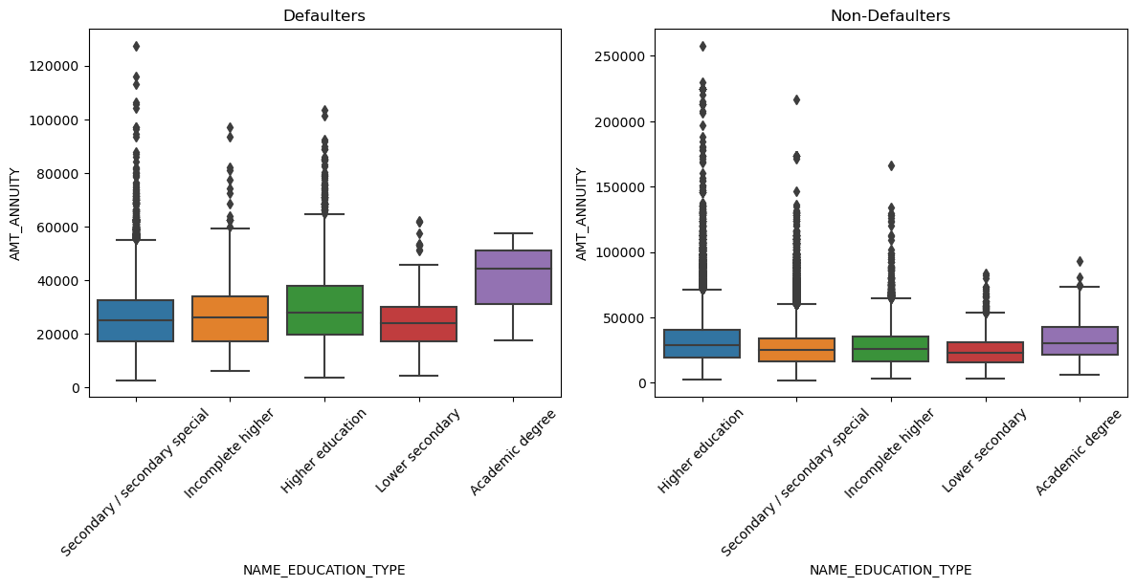
bivariate Analysis on 'NAME_EDUCATION_TYPE','AMT_ANNUITY'
Inferences:
It is observed that applicants with lower-secondary education has the least annuity and tends to be more defaulter.
Applicants with Higher education has more annuity and tends to be defaulter.
Applicants with secondary/secondary special education type has the maximum annuity and tends to be least defaulters

Slide 20
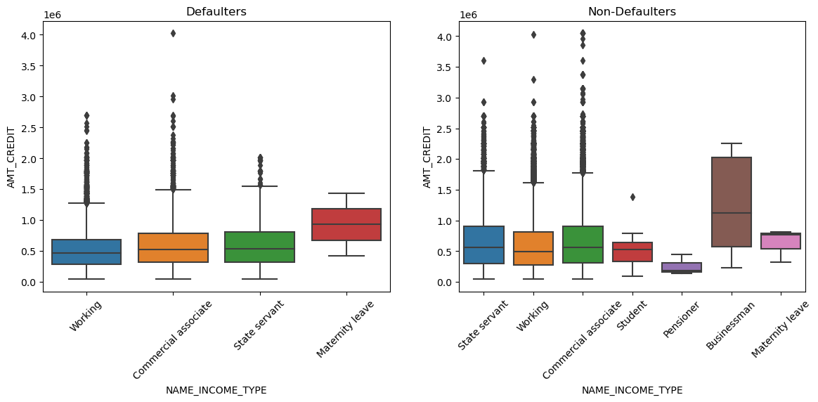
bivariate Analysis on NAME_INCOME_TYPE','AMT_credit'
Inferences:
Here we observe that businessman gets the most amount of loan and also very unlikely to be defaulters

Slide 21
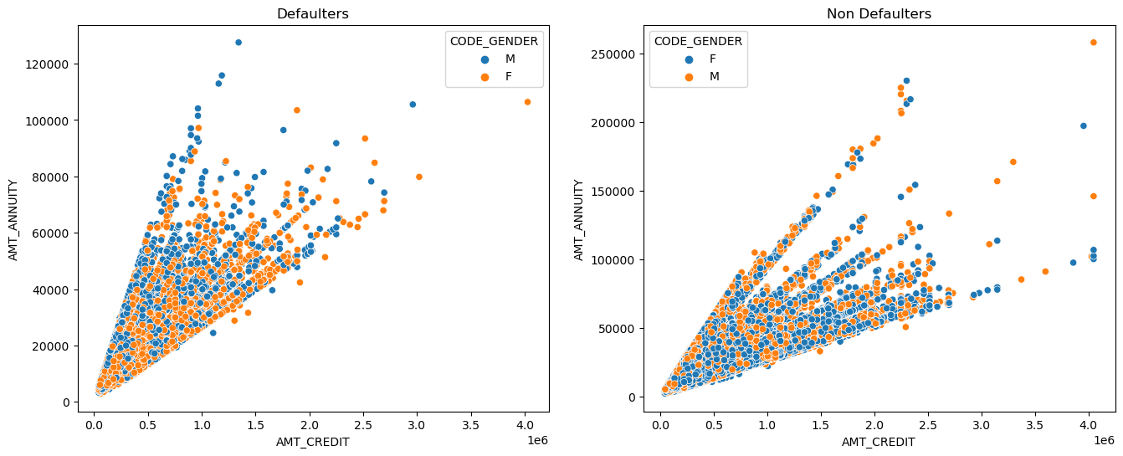
bivariate Analysis on 'AMT_CREDIT','AMT_ANNUITY','CODE_GENDER'
Inferences:
It is observed that, when credited amount increases annuity also increases.
when credited amount lies between 200000-400000 and annuity lies between 60000-120000, applicants tends to be more defaulter.
In comparison to males, females are more likely to be defaulter.

Slide 22
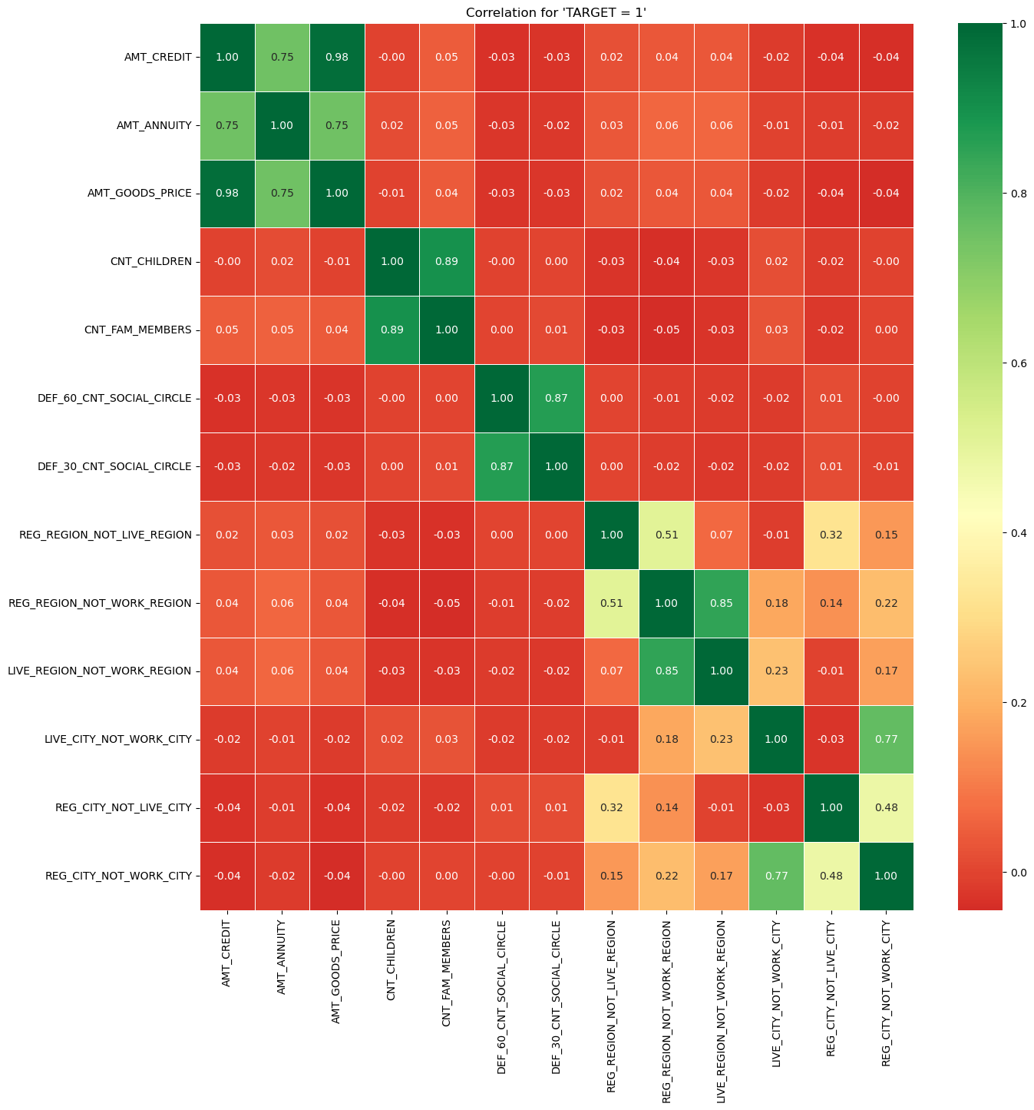
Top 10 Correlations on Defaulter (target=1)
AMT_ CREDIT and AMT_GOODS_PRICE has a positive correlation of 0.982464
CNT_CHILDREN and CNT_FAM_MEMBERS has a positive correlation of 0.893829
DEF_60_CNT_SOCIAL_CIRCLE and DEF_30_CNT_SOCIAL_CIRCLE has a positive correlation of 0.867983
LIVE_REGION_NOT_WORK_REGION and REG_REGION_NOT_WORK_REGION has a positive correlation of 0.846872
REG_CITY_NOT_WORK_CITY and LIVE_CITY_NOT_WORK_CITY has a positive correlation of 0.768247
AMT_GOODS_PRICE and AMT_ ANNUITY has a positive correlation of 0.748940
AMT_CREDIT and AMT_ANNUITY has a positive correlation of 0.748708
REG_REGION_NOT_LIVE_REGION and REG_REGION_NOT_WORK_REGION has a positive correlation of has a positive correlation of 0.506747
REG_CITY_NOT_LIVE_CITY and REG_CITY_NOT_WORK_CITY has a positive correlation of 0.478266
REG_REGION_NOT_LIVE_REGION and REG_CITY_NOT_LIVE_CITY has a positive correlation of 0.322030

Slide 23
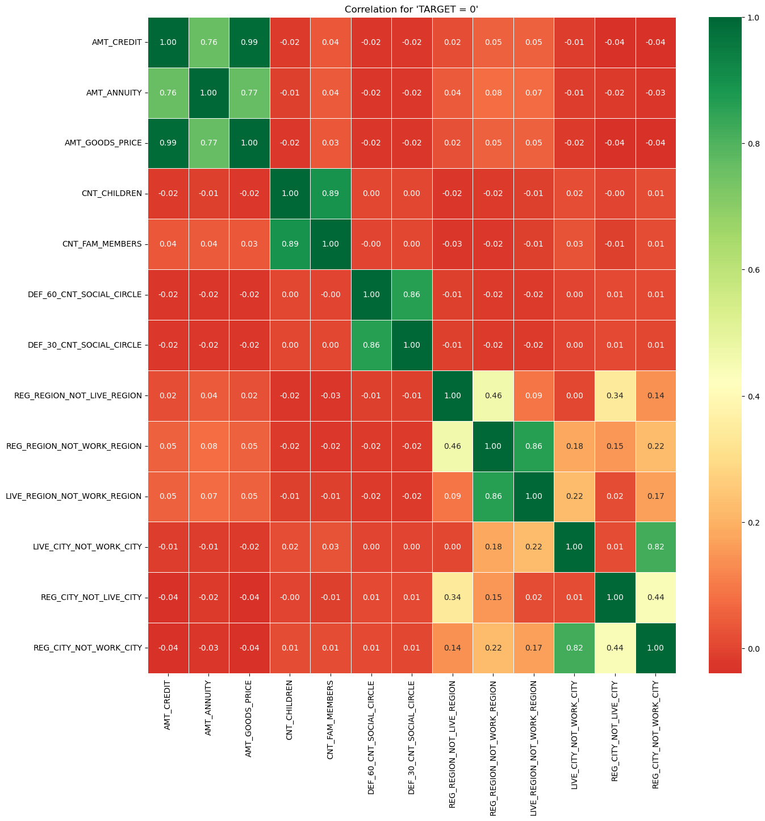
Top 10 Correlations on non-Defaulter (target=0)
AMT_ CREDIT and AMT_GOODS_PRICE has a positive correlation of 0.986471
CNT_CHILDREN and CNT_FAM_MEMBERS has a positive correlation of 0.893275
DEF_60_CNT_SOCIAL_CIRCLE and DEF_30_CNT_SOCIAL_CIRCLE has a positive correlation of 0.861492
LIVE_REGION_NOT_WORK_REGION and REG_REGION_NOT_WORK_REGION has a positive correlation of 0.860421
REG_CITY_NOT_WORK_CITY and LIVE_CITY_NOT_WORK_CITY has a positive correlation of 0.820828
AMT_GOODS_PRICE and AMT_ ANNUITY has a positive correlation of 0.766669
AMT_CREDIT and AMT_ANNUITY has a positive correlation of 0.762117
REG_REGION_NOT_LIVE_REGION and REG_REGION_NOT_WORK_REGION has a positive correlation of has a positive correlation of 0.461596
REG_CITY_NOT_LIVE_CITY and REG_CITY_NOT_WORK_CITY has a positive correlation of 0.442640
REG_REGION_NOT_LIVE_REGION and REG_CITY_NOT_LIVE_CITY has a positive correlation of 0.342321

Slide 24
Analysis on ‘previous_application.csv’

Slide 25
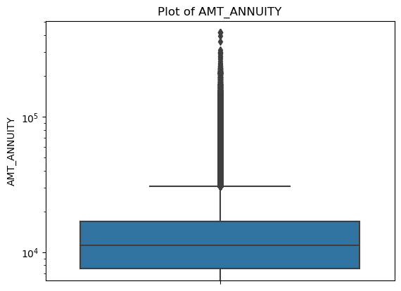
Outlier Analysis on AMT_ANNUITY
Insights:
Some of outliers are noticed in AMT_ANNUITY column.
This indicates that annuity client are borrowing large amount

Slide 26
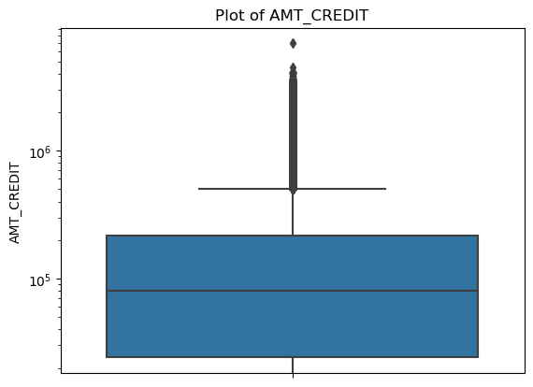
Outlier Analysis on AMT_CREDIT
Insights:
Some of outliers are noticed in AMT_CREDIT column.
This indicates that some clients received more credit amount than the amount they applier for.
The first quartile is bigger than third quartile for credit amount which means most of the clients are from first quartile

Slide 27
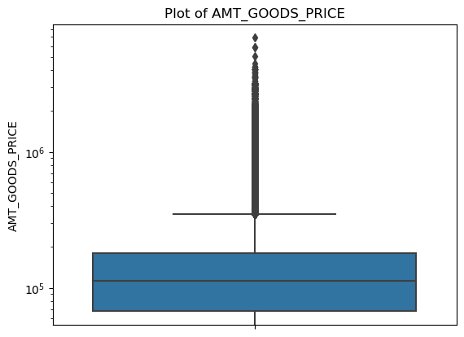
Outlier Analysis on AMT_GOODS_PRICE
Insights:
Some of outliers are noticed in AMT_CREDIT column.
This indicates that some clients has demanded for higher goods price.

Slide 28
Analysis After Merging Both csv files ‘application_data.csv’ & ‘previous_application.csv’

Slide 29
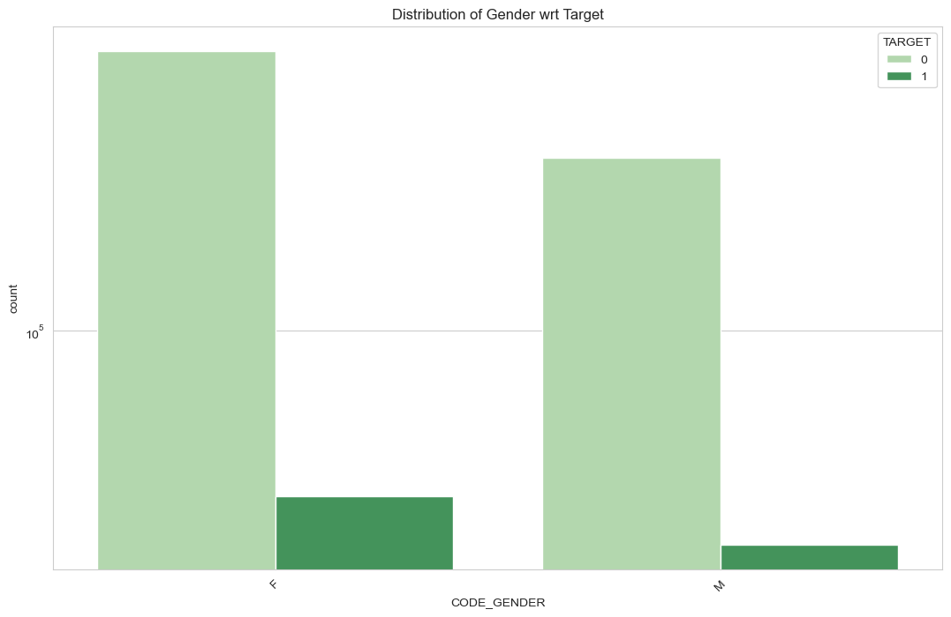
Analysis on CODE_GENDER w.r.t TARGET
Inferences:
It is observed that, males are less defaulter than females.
Count of females are more than males.

Slide 30
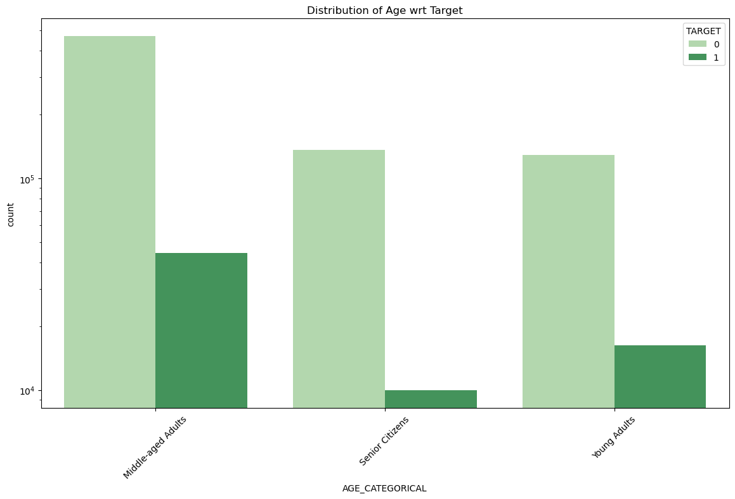
Analysis on AGE_CATEGORICAL w.r.t TARGET
Inferences:
Senior Citizens are the least defaulters
Middle aged adults are the most defaulters.

Slide 31
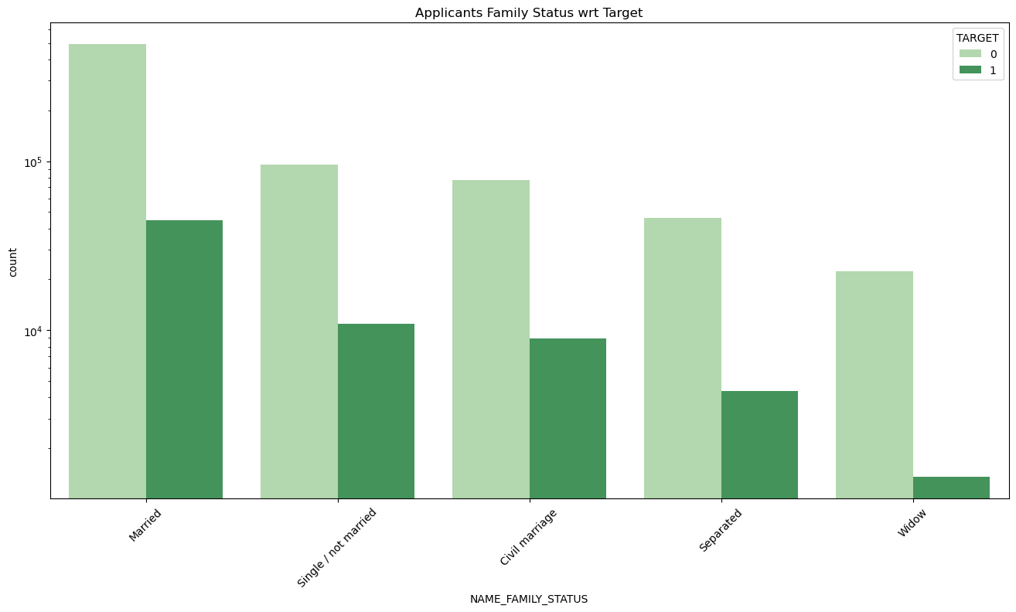
Analysis on NAME_FAMILY_STATUS w.r.t TARGET
Inferences:
widows are the least defaulter.
married are the most defaulter.

Slide 32
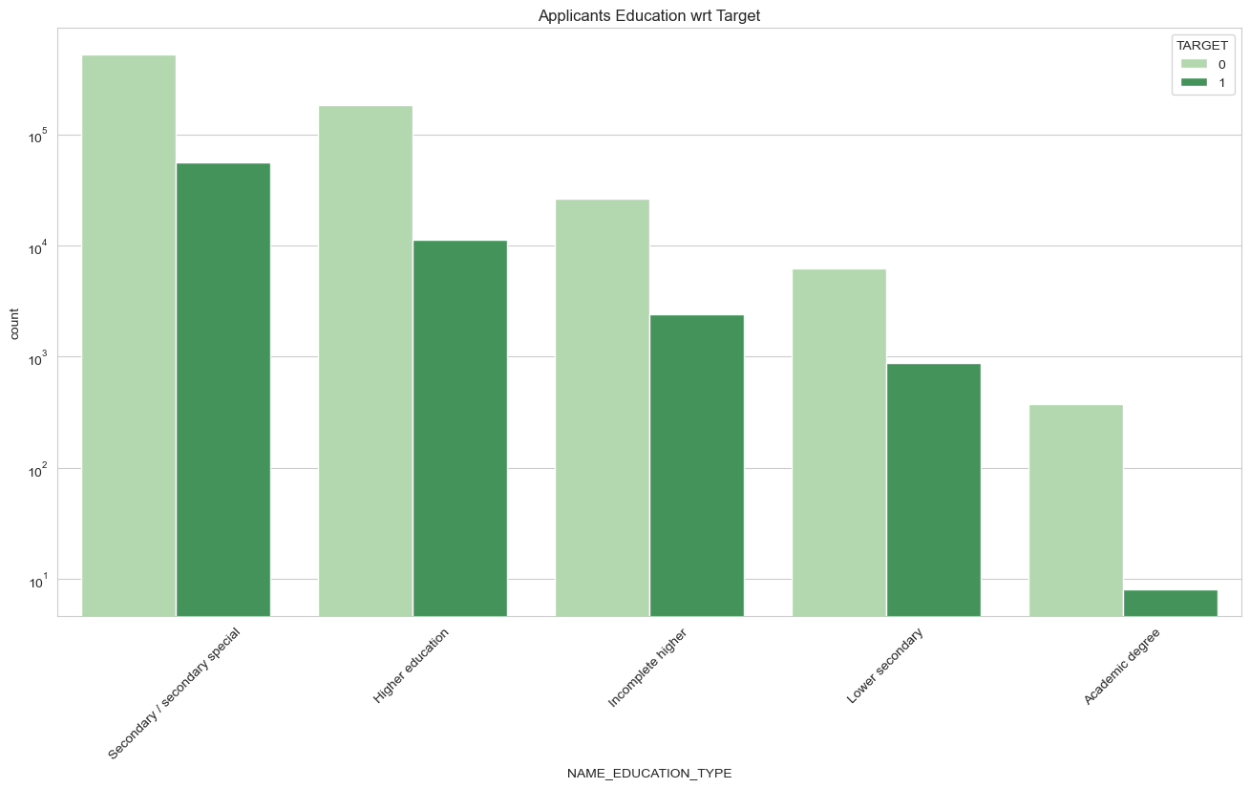
Analysis on NAME_EDUCATION_TYPE w.r.t TARGET
Inferences:
It is observed that applicants having education type ‘secondary/secondary special’ are more likely to be defaulters than the non-defaulters.
Applicants having education type ‘Higher Education’ are more likely to be Non-defaulters than the defaulters.
Applicants with lower education level tends to take less loan.

Slide 33
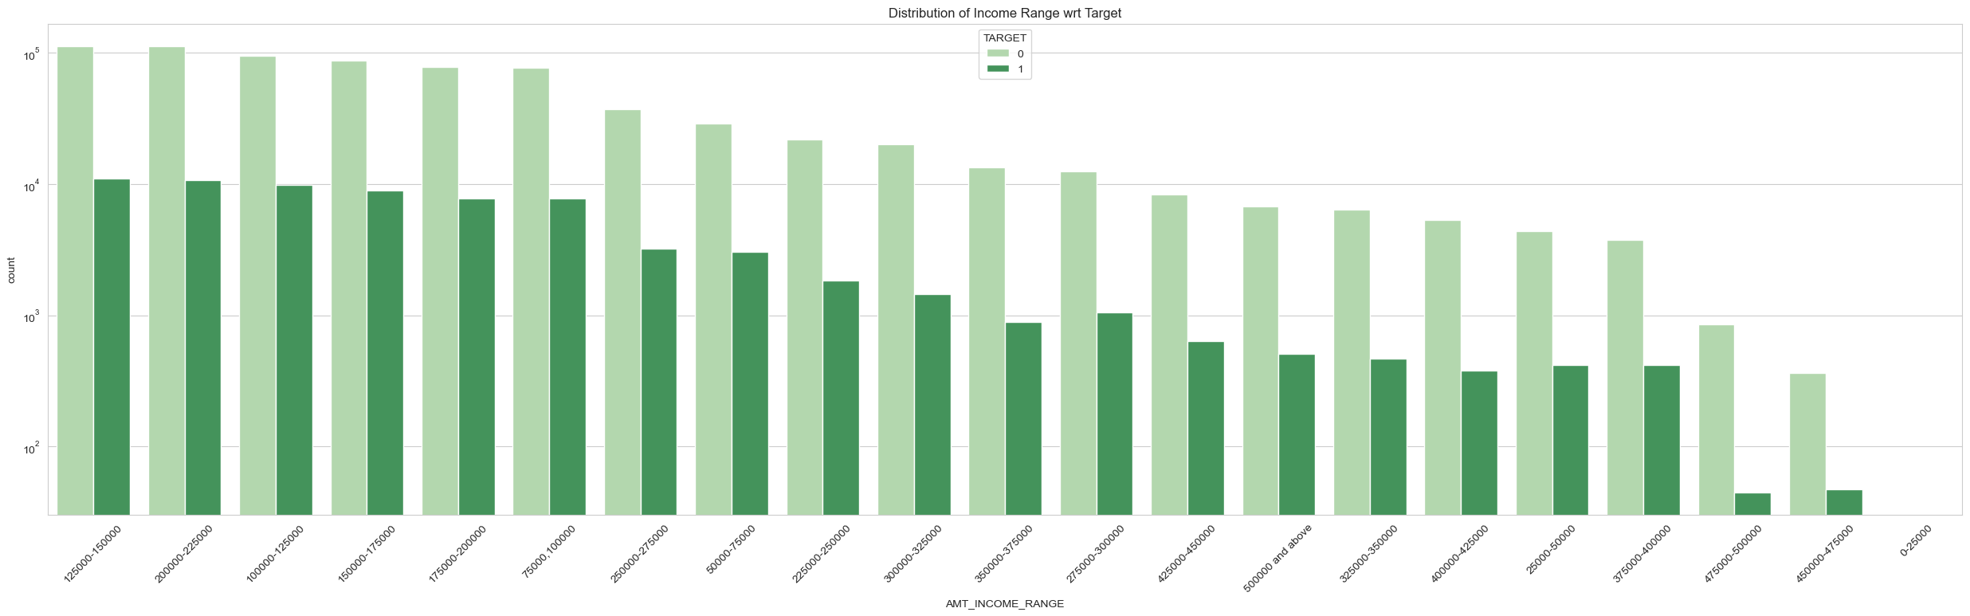
Analysis on AMT_INCOME_RANGE w.r.t TARGET
Inferences:
Applicants with higher income range tends to be less defaulter than lower income range.

Slide 34
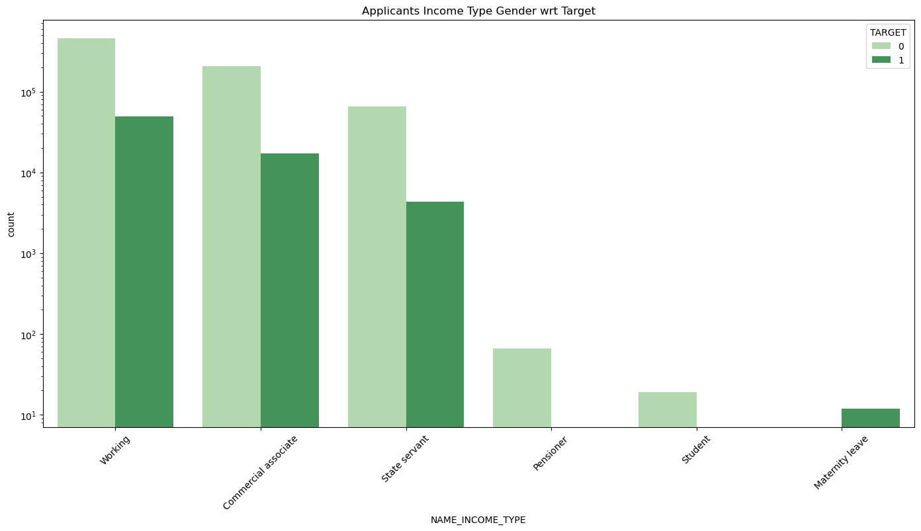
Analysis on NAME_INCOME_TYPE w.r.t TARGET
Inferences:
Working professional are the most defaulters followed by Commercial associate and state servants.
Students, pensioner are the least defaulters followed by Maternity leave.

Slide 35
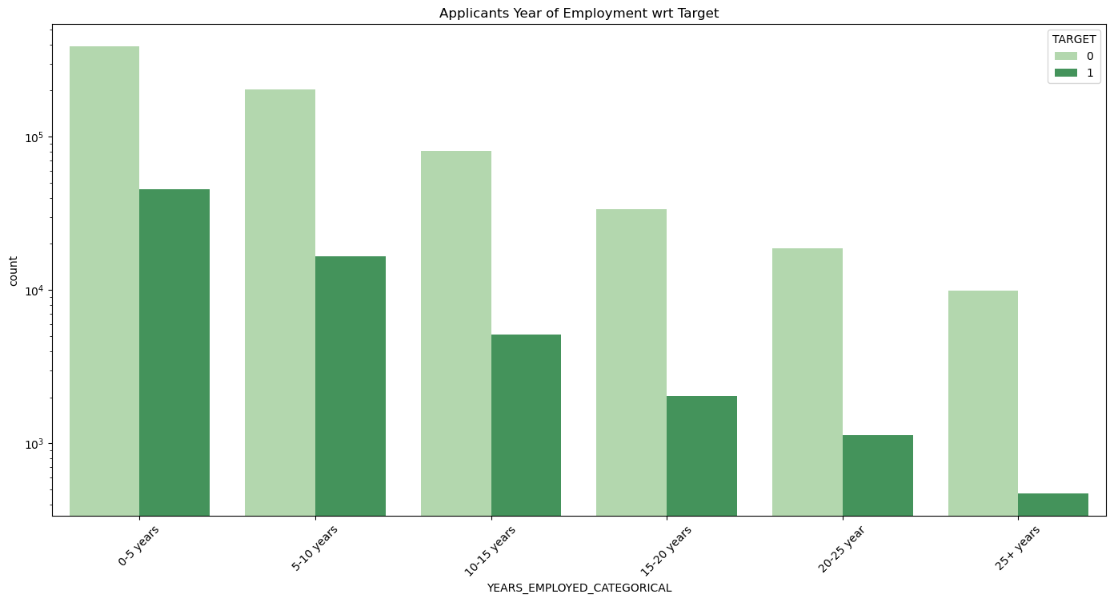
Analysis on YEARS_EMPLOYED_CATEGORICAL w.r.t TARGET
Inferences:
Applicants with more years of employment tends to be less defaulter than with less years of employment

Slide 36
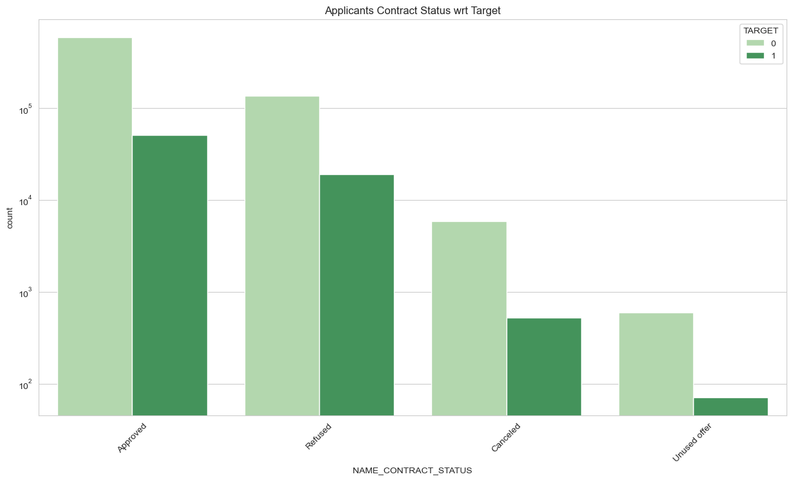
Analysis on NAME_CONTRACT_STATUS w.r.t TARGET
Inferences:
Applicants when contract status is approved tends to be more defaulter than others.

Slide 37
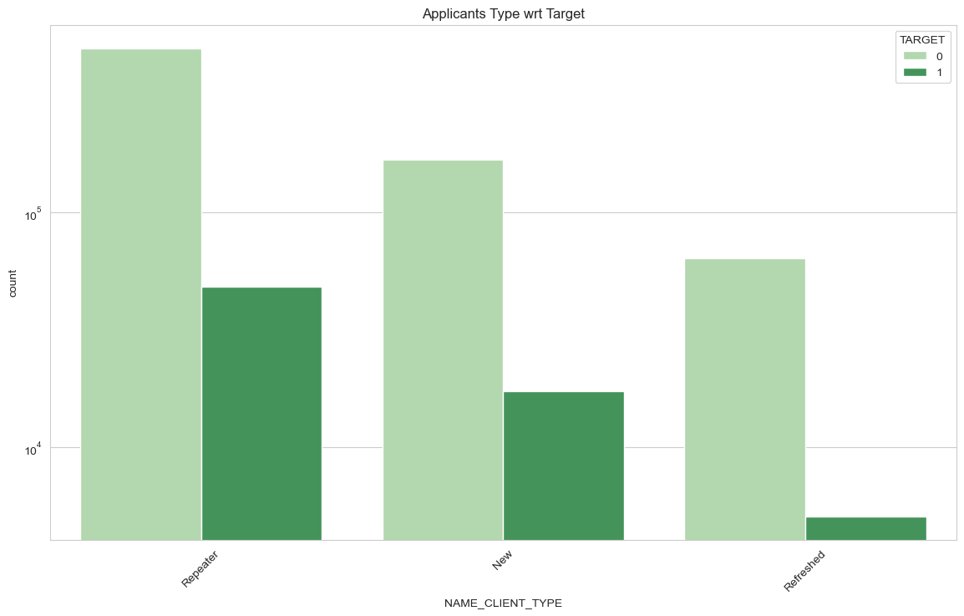
Analysis on NAME_CLIENT_TYPE w.r.t TARGET
Inferences:
Applicants of type ‘Refreshed’ are tends to be the least defaulter.
Applicants of type ‘Repeater’ are tends to be the most defaulter.

Slide 38
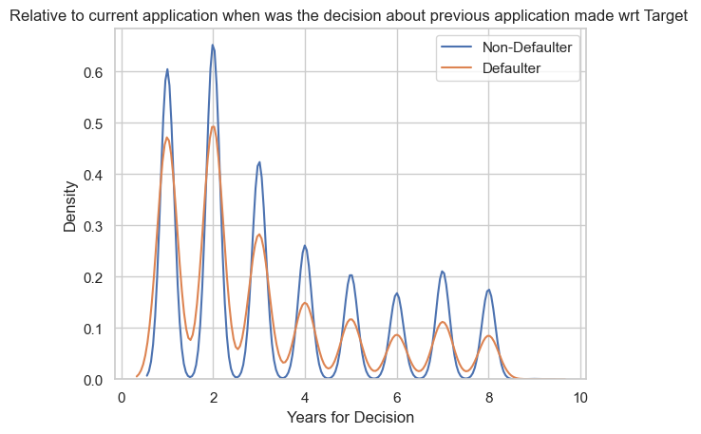
Analysis on YEARS_DECISION w.r.t TARGET
Inferences:
Relative to current application when the decision about previous application made early are tends to be more defaulter.
Relative to current application when the decision about previous application made late are tends to be least defaulter.

Slide 39
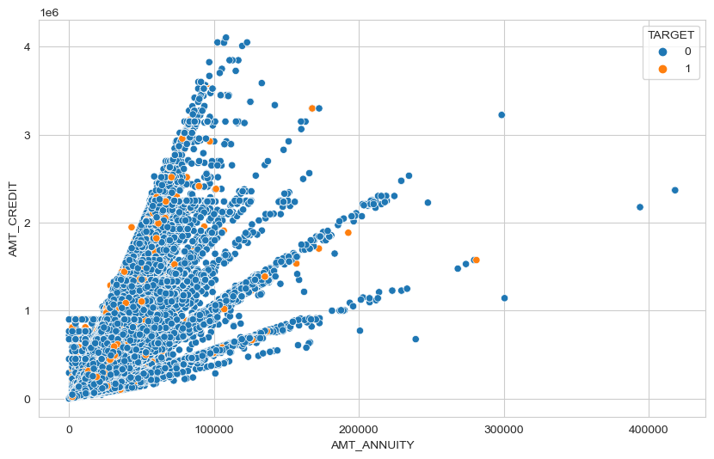
Analysis on AMT_ANNUITY, AMT_CREDIT w.r.t TARGET
Inferences:
When credit amount is increase, annuity amount also increases.
when the amount credited lies between 2000000-3500000 and annuity amount lies between 100000-300000, applicants tends to be more defaulter.

Slide 40
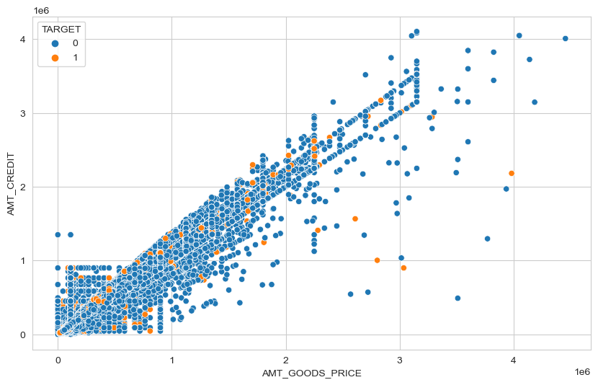
Analysis on AMT_goods_Price, AMT_CREDIT w.r.t TARGET
Inferences:
It is observed that when amount of goods price is increased, amount credit is less.
Applicants with higher goods price and higher credited amount are tends to be more defaulter.

Slide 41
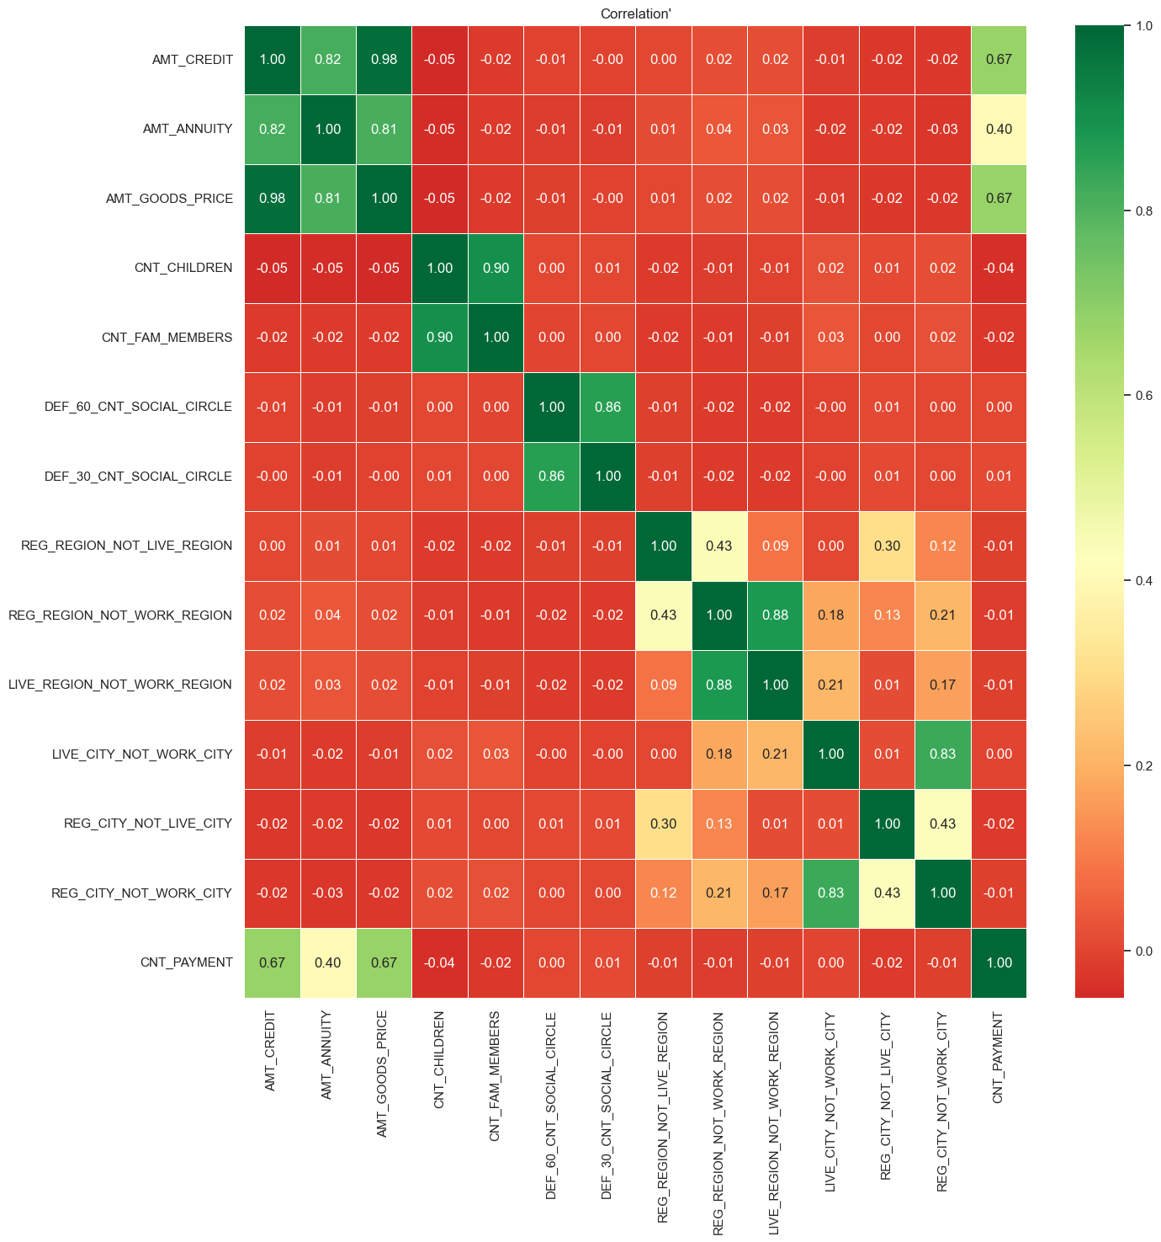
Top 10 Correlations
AMT_ CREDIT and AMT_GOODS_PRICE has a positive correlation of 0.980139
CNT_CHILDREN and CNT_FAM_MEMBERS has a positive correlation of 0.898487
LIVE_REGION_NOT_WORK_REGION and REG_REGION_NOT_WORK_REGION has a positive correlation of 0.878678
DEF_60_CNT_SOCIAL_CIRCLE and DEF_30_CNT_SOCIAL_CIRCLE has a positive correlation of 0.861250
REG_CITY_NOT_WORK_CITY and LIVE_CITY_NOT_WORK_CITY has a positive correlation of 0.828603
AMT_CREDIT and AMT_ANNUITY has a positive correlation of 0.817685
AMT_GOODS_PRICE and AMT_ ANNUITY has a positive correlation of 0.811931
AMT_CREDIT and CNT_PAYMENT has a positive correlation of 0.673977
AMT_GOODS_PRICE and CNT_PAYMENT has a positive correlation of 0.673027
REG_REGION_NOT_LIVE_REGION and REG_REGION_NOT_WORK_REGION has a positive correlation of has a positive correlation of 0.433681

Slide 42
conclusion
In conclusion, the insights gathered from this project shed light on various aspects of loan applicant’s characteristics and behaviours. The analysis of income totals revealed the presence of outliers, indicating individuals with significantly higher incomes compared to the majority. This highlights the importance of considering income disparity when assessing borrower risk and tailoring financial products to cater to different income levels.
Overall, these insights contribute to a more nuanced understanding of loan applicants’ characteristics, allowing financial institutions to develop tailored loan products, assess borrower risk more effectively, and provide inclusive financial solutions that cater to the diverse needs of their clients. By leveraging these insights, lenders can enhance their decision-making processes, promote responsible lending practices, and support the financial well-being of their customers.

