Slide 1
Capstone Research
Northeastern University
ALY 6980: Capstone
Predicting Healthcare
Expenditure Risk
A Risk Adjustment Model Incorporating Demographic, Clinical, Economy, and Healthcare Utilization
MEPS Panels 11–15 (2006–2010)
49,820 Non-Cancer Adults
Submitted by
Professor
Kumar Saransh
Ajit Appari
College of Professional Studies
Group 2

Slide 2
Navigation
Executive Overview
01
02
03
Study Overview & Objectives
Data Foundation
Patient Segmentation
Research framework, data foundation, and methodology approach
Cleaning, preprocessing, feature engineering, and patient segmentation
K-means clustering analysis and clinical burden phenotypes
04
05
06
Exploratory Data Analysis
Predictive Modeling
Key Insights & Conclusions
Patterns in healthcare utilization, expenditure drivers, and risk factors
Model comparison, performance metrics, and feature importance
Summary findings, policy implications, and future directions

Slide 3
Study Overview
Study Abstract
Research Objective
Key Findings
Develop a longitudinal healthcare expenditure risk framework using MEPS Panels 11-15 to predict inflation-adjusted Year-2 healthcare expenditures among adult, non-cancer patients using Year-1 demographic, socioeconomic, clinical, and behavioral determinants.
Socioeconomic Gradients
Strong patterns in healthcare utilization across income levels
Age-Based Multimorbidity
Chronic conditions cluster with age progression
Nonlinear BMI-Cost Relationships
Obesity shows extreme spending variability
Methodology
Payer Mix Transitions
Insurance coverage shifts across lifespan
Extensive data cleaning and cancer exclusion harmonization
Distinct Patient Phenotypes
Feature engineering and exploratory data analysis (EDA)
Two clear clusters: high vs. low clinical burden
K-means clustering for unsupervised patient segmentation
CPI inflation adjustment to constant 2011 dollars
Quartile-based risk-stratified classification modeling
Keywords
Medical Expenditure Panel Survey · Longitudinal Analysis · Healthcare Utilization · Chronic Conditions · Patient Clustering · Risk Stratification

Slide 4
Research Framework
Research Objectives & Framework
Primary Objectives
Integrated Determinants
1
Data Consolidation
Consolidate and clean longitudinal MEPS data from five consecutive panels (11-15)
Demographic
Socioeconomic
Age, sex, race, marital status, region
Income level, employment status
2
Feature Engineering
Conduct meaningful feature engineering to enhance predictive power
Health Factors
Lifestyle
3
Exploratory Analysis
Physical & mental health, joint pain,
Vision/Hearing Impairment
Smoking, physical activity, BMI
Conduct EDA for identifying patterns in healthcare utilization
4
Predictive Modeling
Prepare a robust dataset for subsequent predictive modeling
Chronic Disease Burden
11 chronic conditions including diabetes, hypertension, heart disease, stroke
Prospective Risk Stratification
Cancer
Insurance
This project focuses on predicting Year-2 healthcare expenditures using Year-1 characteristics, supporting prospective risk stratification rather than retrospective cost explanation.
Cancer Flag, ICD9 code
Private, Public, Self pay, Medicare, Medicaid, Tricare
Enables early intervention and resource allocation
Healthcare Utilization
Total Healthcare Expenditure (Year 1), Total Healthcare Expenditure (Year 2), Doctor Visits, Outpatient Visits, Inpatient Stays, Emergency Room Visits, Prescription Usage, Service-wise Healthcare Costs

Slide 5
Data Foundation
Data Cleaning & Preprocessing Pipeline
Total Observations
Data Integration & Filtering
Missing Value Handling
78,022
Custom Python Parser
Converted MEPS negative codes [-1, -7, -8, -9] to missing values (NA)
Across 56 variables
Extracted fixed-width fields using SAS layout specifications
Panel 11 Year-1 chronic conditions replaced using Round 5 data
Dropped columns with >50% missing values
MEPS Panels
Median imputation for continuous variables (TOTEXPY2, BMINDX5)
11–15
Panel Merging
Merged multiple MEPS longitudinal panels (11–15) using DUPERSID
Mode imputation for categorical variables (ADSMOK2, PHYACT3, etc.)
Years 2006–2010
Health status filled with neutral category 3 ("Good")
Employment filled with category 4 ("Not Employed")
Final Dataset
Filtering Criteria
Handled Missing Year information by Panel-Year Maping
49,820
• Adults (AGEY1X ≥ 18)
• Non-cancer patients (ICD-9 codes for Panel 11)
After filtering
Panel-wise Record Counts
Panel
Records (Before)
Records (After)
Retention
11
16,533
10,991
66.5%
12
12,440
7,795
62.7%
13
18,287
11,421
62.5%
14
16,221
10,336
63.7%
15
14,541
9,277
63.8%
Total
78,022
49,820
63.9%

Slide 6
Data Foundation
Feature Engineering Strategy
Chronic Disease Burden
BMI Categorization
Inflation Adjustment
Summing 11 binary chronic conditions:
WHO standards:
CPI adjustment to constant 2011 dollars:
total_chronic = sum(chronic_vars == 1)
1: Underweight (<18.5)
Factor = CPI_year / CPI_2011
2: Normal (18.5–25.0)
Angina, Arthritis, Asthma, CHD, Cholesterol, Diabetes, Emphysema, Hypertension, MI, Other Heart Disease, Stroke
3: Overweight (25.0–30.0)
Variables adjusted: TOTEXPY1/2, TOTSLFY1, TOTMCDY1, TOTMCRY1, TOTPRVY1, TOTTRIY1, TOTOPUY1
4: Obese (≥30.0)
Age Stratification
Expenditure Categorization
5 clinically meaningful groups:
Binary Encoding
Log transformation + quantile binning:
1: 18–29 (Young adults)
Converted 1=Yes, 2=No to binary:
log_exp = log(1 + TOTEXPY2_adj)
2: 30–44 (Middle-aged)
1 → 1, 2 → 0
0: Low
50%
3: 45–59 (Pre-elderly)
Variables: ADSMOK2, PHYACT3, JTPAIN1, VISION2, HEARNG2, EMPST1, TRIEVY1, MCREVY1, MCDEVY1
1: Medium
40%
4: 60–74 (Young elderly)
2: High
10%
5: 75+ (Elderly)
One-Hot Encoding
Applied to nominal variables: SEX, RACETHNX, MARRYY1X, REGIONY1, INSCOVY1

Slide 7
Patient Segmentation
Patient Segmentation by Clinical Burden
Clustering Features
Cluster Profile Comparison
Demographics
Clinical Burden | Cluster 0(High Burden) | Cluster 1(Low Burden)
Cluster Size | 15,905 (34%) | 33,915 (66%)
Age Group | 61.0 years | 44.0 years
Total Chronic Conditions | 3.48 | 1.57
Joint Pain (%) | 44.0% | 19.0%
Vision Impairment (%) | 19.0% | 7.0%
Hearing Impairment (%) | 17.0% | 2.0%
Smoking (%) | 14.0% | 17.0%
Physical Activity (%) | 7.0% | 62.0%
BMI Category | 3.21 | 2.83
age_group, SEX
Health Factors
JTPAIN1, VISION2, HEARNG2
Lifestyle
ADSMOK2, PHYACT3, bmi_category
Chronic Burden
total_chronic_conditions
Cluster Selection
Silhouette score indicates k = 2 provides optimal cluster separation with highest score.
PCA projection shows two clearly distinguishable patient groups based on clinical burden.
Applications
• Risk-stratified predictive modeling
Cluster 0: High Clinical Burden
Cluster 1: Low Clinical Burden
• Targeted intervention strategies
Older age, higher chronic conditions, more health factor issues with less physical activity
Younger age, lower chronic conditions, fewer health issues with high physical activity

Slide 8
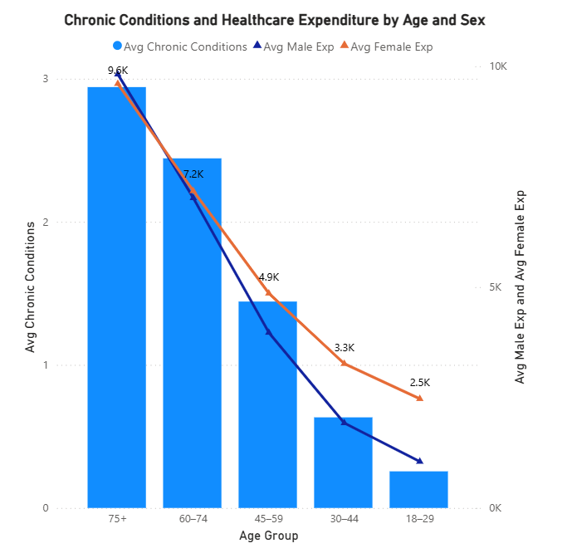
Exploratory Data Analysis
Chronic Conditions & Healthcare Expenditure by Age and Sex
Key Findings
Age-Related Increase
Both chronic conditions and healthcare expenditure rise sharply with age, especially after 45 years
Gender Patterns
Females spend slightly more than males in younger ages, but the gap closes in older groups (almost equal at 75+)
Strong Positive Relationship
More chronic conditions = disproportionately higher cost. The relationship is multiplicative, not additive
Clinical Insight: The steep increase in both chronic conditions and expenditure after age 45 suggests this as a critical intervention point for preventive care and early disease management strategies.

Slide 9
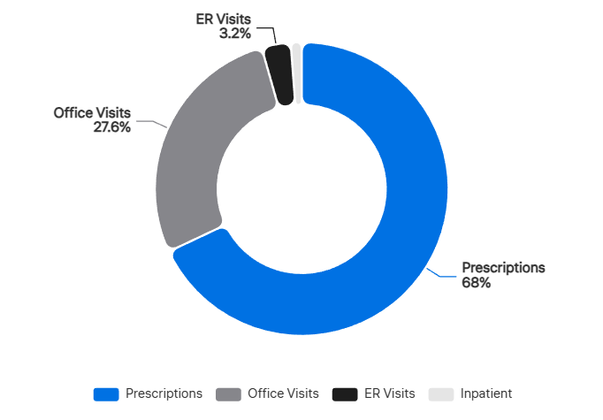
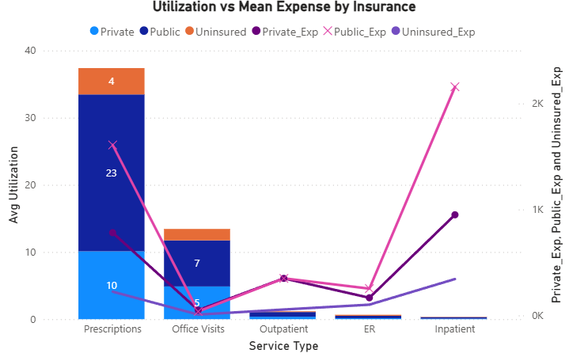
Exploratory Data Analysis
Healthcare Utilization Distribution & Cost Structure
Utilization Distribution by Service Type
Key Insights
Prescriptions
68.4%
Prescriptions Dominate Volume
Office Visits
27.6%
Prescriptions dominate utilization (~68%) but not highest cost per service
Outpatient
2.3%
ER Visits
1.2%
Inpatient
0.8%
Inpatient: Low Volume, High Cost
Inpatient care is low volume but extremely high cost per episode
Office Visits: Steady Contributor
Office visits are second most common (27.6%) with moderate cost
Spending by Insurance Type
Public insurance consistently shows highest spending per service
Uninsured shows the lowest spending per service

Slide 10
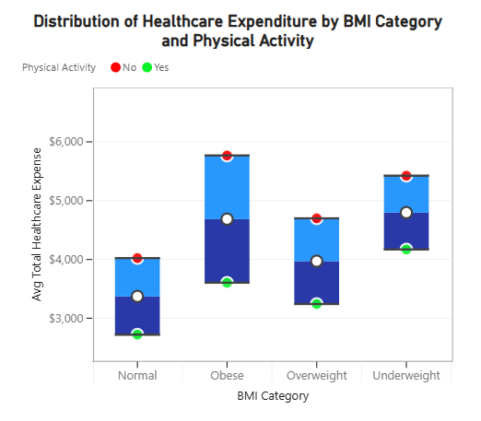
Exploratory Data Analysis
BMI, Physical Activity & Healthcare Spending Patterns
Key Findings
Obesity Shows Extreme Variability
Obese category shows highest variability and extreme spending outliers, indicating strong link between high BMI and costly health events
Physical Activity Protective Effect
Physically active individuals generally cluster at lower expenditure levels, especially in normal and overweight groups
Nonlinear Escalation
Spending dispersion increases from normal to overweight to obese, suggesting risk and cost escalate non-linearly with BMI
Prevention Opportunity: The protective effect of physical activity across all BMI categories suggests lifestyle interventions could yield significant cost savings.

Slide 11
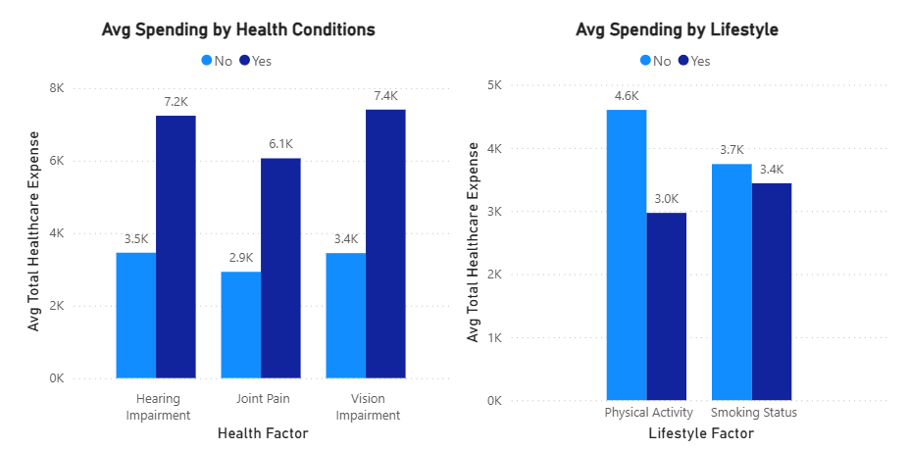
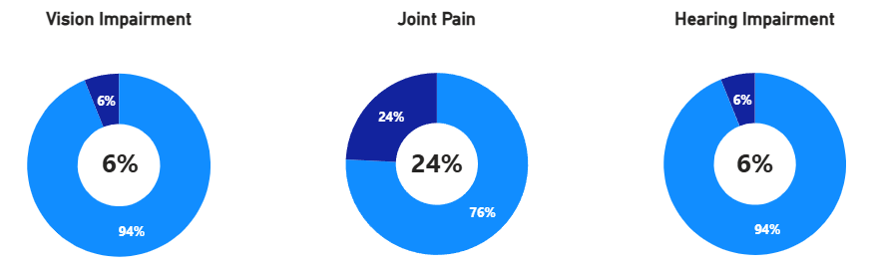
Exploratory Data Analysis
Health Conditions & Behaviors Impact on Expenditure
Average Expenditure by Health Conditions & Behaviors
Key Findings
Clinical Conditions Drive Costs
Health conditions (joint pain, vision, hearing issues) sharply increase spending, far above overall mean
Behaviors Show Mixed Patterns
Smoking and physical activity show mixed patterns, but not as impactful as health conditions
Diagnosed Conditions Matter Most
Behavioral factors alone don't spike costs as much as diagnosed conditions, highlighting clinical burden drives major expenses
Clinical Priority: While lifestyle interventions are important, managing diagnosed conditions (joint pain, vision/hearing impairment) should be the primary focus for cost containment.

Slide 12
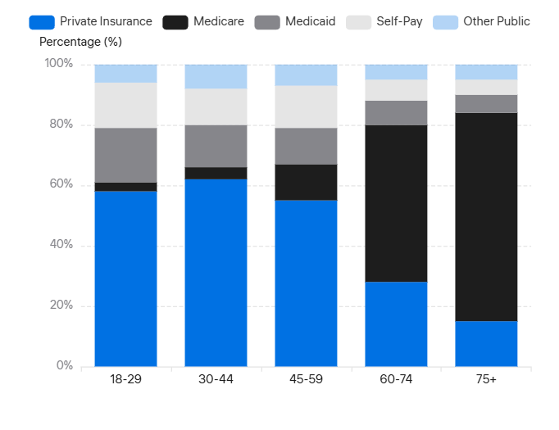
Exploratory Data Analysis
Healthcare Payer Mix Evolution Across Age Groups
Insurance Coverage by Age
Key Insights
Medicare Dominance
Medicare dominates spending in older age groups (60+), becoming the primary payer (~69% at 75+)
Private Insurance Peak
Private insurance is the main payer for younger and middle-aged groups, peaking around 30–59
Clear Transition Pattern
Medicaid and self-pay proportions decline with age, showing a shift from mixed payers to Medicare-heavy coverage
Policy Implication: The dramatic shift to Medicare at age 65+ highlights the importance of pre-Medicare health management and the potential cost savings from preventive care in the 45-64 age group.

Slide 13
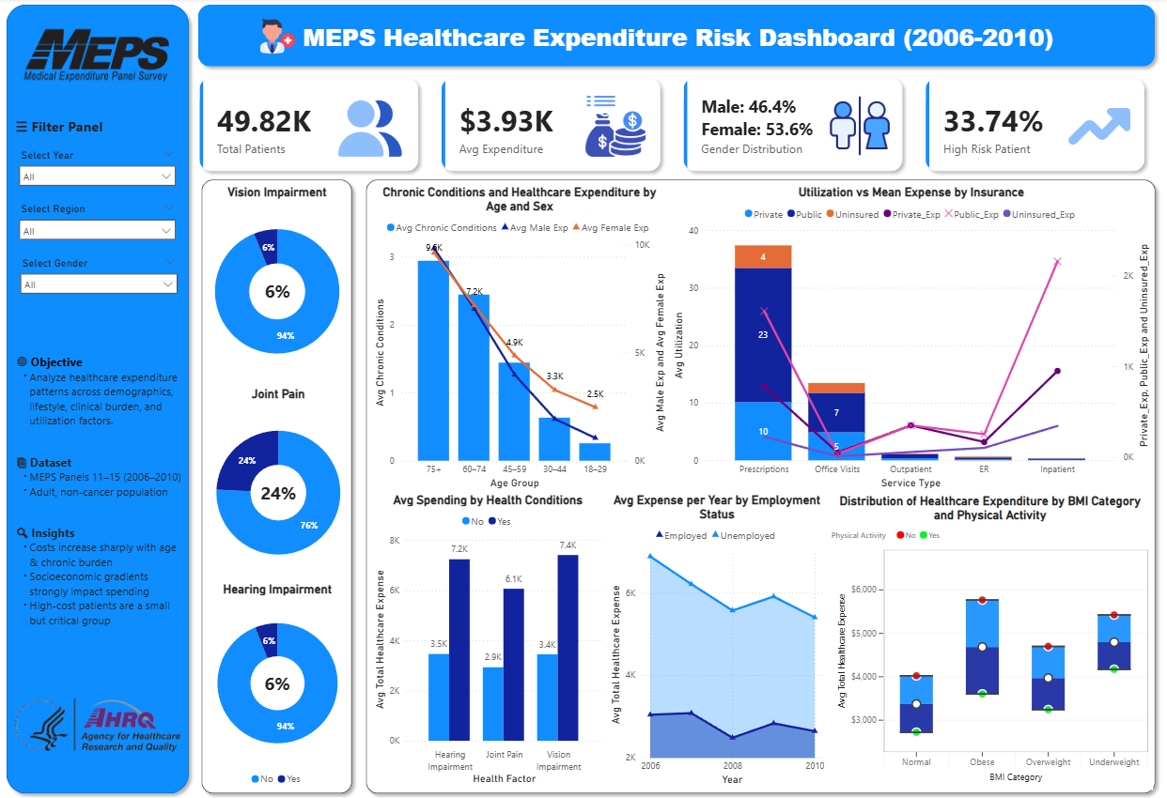
Exploratory Data Analysis
Final Power BI Dashboard

Slide 14
Predictive Modeling
Predictive Modeling Framework
Modeling Objective
Predictor Variables
Classify individuals into three healthcare expenditure categories for Year-2 based on Year-1 characteristics:
Demographic
REGIONY1, AGEY1X, SEX, RACETHNX, MARRYY1X
Socioeconomic
0
1
2
POVCATY1, employed_flag
Low
Medium
High
Health Factors
50%
40%
10%
RTHLTH1, MNHLTH1, total_chronic_conditions, clinical_burden_cluster, bmi_category, HEARNG2, VISION2, JTPAIN1
Train-Test Split
Lifestyle
PHYACT3, ADSMOK2
70%
:
30%
Training Set
Test Set
Insurance Coverage
INSCOVY1, TRIEVY1, MCREVY1, MCDEVY1, TOTSLFY1_adj, TOTMCDY1_adj, TOTMCRY1_adj, TOTPRVY1_adj, TOTTRIY1_adj, TOTOPUY1_adj
Stratified sampling to preserve balanced distribution
Healthcare Utilization
OBTOTVY1, OPTOTVY1, ERTOTY1, IPDISY1, RXTOTY1
Total Expenditure (Year 1)
TOTEXPY1_adj

Slide 15
Predictive Modeling
Model Performance Comparison
Comprehensive Model Performance Metrics
Model | Accuracy | WeightedPrecision | WeightedRecall | WeightedF1 Score | MacroF1 Score
Logistic Regression | 0.71 | 0.71 | 0.71 | 0.69 | 0.59
Random Forest | 0.72 | 0.72 | 0.72 | 0.71 | 0.62
XGBoost | 0.72 | 0.72 | 0.72 | 0.71 | 0.62
Ordinal Model | 0.71 | 0.71 | 0.71 | 0.70 | 0.61
Interaction Model | 0.71 | 0.71 | 0.71 | 0.70 | 0.62
XGBoost (Weighted) | 0.68 | 0.69 | 0.68 | 0.68 | 0.62
Best Overall Accuracy
Class Balance
Key Limitation
72%
Challenge
F1 = 0.38
Random Forest & XGBoost
High-cost class = 10% of data
High-cost class detection

Slide 16
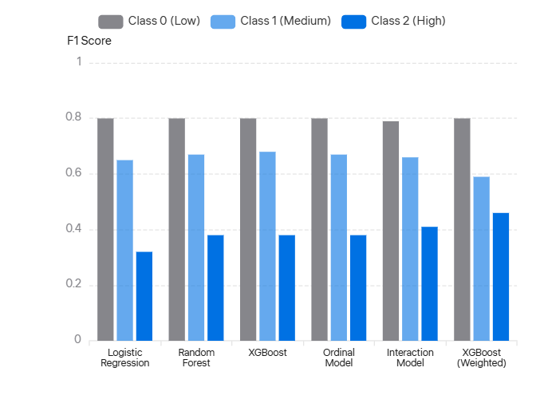
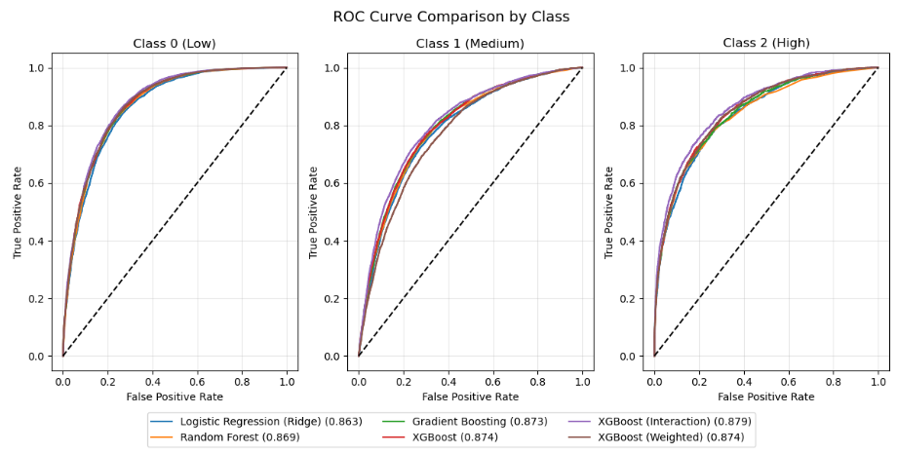
Predictive Modeling
Class-wise Performance & High-Cost Detection Improvement
F1 Scores by Expenditure Class
Class-wise F1 Score Analysis
Model | Class 0(Low) | Class 1(Medium) | Class 2(High)
Logistic Regression | 0.80 | 0.65 | 0.32
Random Forest | 0.80 | 0.67 | 0.38
XGBoost | 0.80 | 0.68 | 0.38
Ordinal Model | 0.80 | 0.67 | 0.38
Interaction Model | 0.79 | 0.66 | 0.41
XGBoost (Weighted) | 0.80 | 0.59 | 0.46
High-Cost Detection Improvement
44%
F1 improved from 0.32 to 0.46
Critical Insight: While standard models achieve good overall performance, they struggle with the minority high-cost class. Weighted XGBoost addresses this imbalance, significantly improving detection of the most critical patient group.

Slide 17
Predictive Modeling
Model Selection & Justification
Selection Criteria
Final Decision
The final model was selected based on its ability to effectively identify high-cost individuals, rather than solely maximizing overall accuracy. Since high-cost patients represent a small but critical group, improving their detection was prioritized.
Although the standard XGBoost model achieved the highest overall accuracy (~72%), it underperformed in identifying high-cost patients, which represent the most critical segment in healthcare expenditure analysis.
To address this limitation, a class-weighted XGBoost model was implemented to account for class imbalance. While this resulted in a reduction in overall accuracy (~68%), it significantly improved the F1-score for the high-cost class from 0.32 to 0.46.
Standard Models
Achieved higher accuracy (~72%) but showed limited performance for high-cost class (F1 ≈ 0.38)
Weighted XGBoost
Given the objective of early identification of high-expenditure individuals for targeted intervention, the weighted XGBoost model was selected as the final model, as it better aligns with the practical and policy-driven goals of the study.
Improved high-cost detection to F1 = 0.46 (~44% improvement)
Trade-offs Observed
Weighted XGBoost Selected
Better Real-World Objective
Prioritizes Impact Over Accuracy
Overall Accuracy
Medium Class F1
72% → 68%
0.68 → 0.59
Class weighting addresses 10% high-cost group imbalance

Slide 18
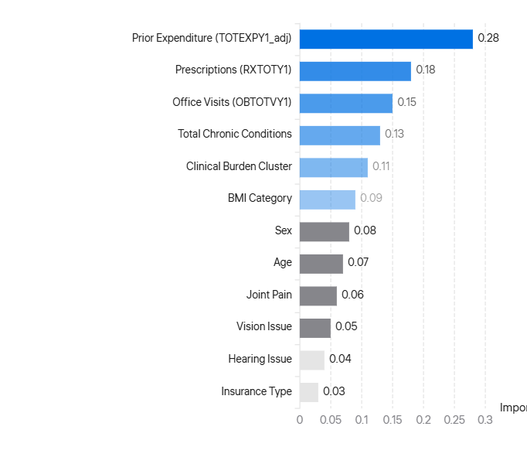
Predictive Modeling
Feature Importance Analysis
Top Predictive Features
Key Drivers of Healthcare Expenditure
Prior Expenditure (TOTEXPY1_adj)
Strongest predictor — past spending heavily influences future healthcare costs
Healthcare Utilization (RXTOTY1, OBTOTVY1)
Key drivers — frequent service use leads to higher future expenditure
Chronic Disease Burden
Significant impact — increases likelihood of high-cost classification
Demographic Factors (age, sex)
Moderate influence — older individuals contribute more to higher cost categories
Clinical Indicators
Joint pain, vision, hearing issues help identify individuals with elevated healthcare needs
Overall Insight: The model relies more on historical spending and utilization patterns than demographic or socioeconomic factors, suggesting that past behavior is the strongest predictor of future healthcare costs.

Slide 19
Limitations & Future Work
Study Limitations
Moderate Performance
Skewed Distribution
Self-Reported Data
F1 = 0.46 for high-cost class indicates room for improvement in detecting the most critical patient segment.
Healthcare expenditure is highly skewed and inherently difficult to predict due to extreme outliers and zero-inflation.
MEPS data is self-reported, introducing potential bias in health conditions, utilization, and expenditure reporting.
While this represents a 44% improvement over baseline, further enhancement is needed for clinical deployment.
The long-tail distribution of costs presents fundamental challenges for predictive modeling.
Recall bias and social desirability may affect the accuracy of reported information.
Temporal Limitations
Class Imbalance
Model uses Year-1 features only, missing temporal dynamics and longitudinal patterns that could improve predictions.
Class imbalance leads to trade-offs in model performance between overall accuracy and minority class detection.
Transparent Reporting
These limitations are acknowledged to provide context for interpreting results and guide future research directions. The study provides a robust foundation while identifying areas for improvement.
Changes over time within Year-1 are not captured in the current framework.
The 10% high-cost group is difficult to identify without sacrificing performance on majority classes.

Slide 20
Limitations & Future Work
Future Research Directions
Advanced Resampling Techniques
Cost-Sensitive Learning
Apply SMOTE and advanced resampling to improve minority class detection and address class imbalance more effectively.
Experiment with cost-sensitive learning and hybrid modeling approaches that explicitly account for misclassification costs.
Synthetic oversampling could generate more representative high-cost cases for training.
Different costs for false negatives vs. false positives could better align with business objectives.
Two-Part (Hurdle) Models
Temporal Dynamics
Implement two-part models for better cost modeling of zero-inflated and highly skewed expenditure distributions.
Incorporate temporal dynamics and longitudinal feature engineering to capture changes within and across years.
Separate models for utilization decision and expenditure amount could improve accuracy.
Time-series features and trend analysis could reveal important patterns.
Research Impact
SHAP Analysis
These future directions aim to address current limitations while building on the solid foundation established in this study. Each enhancement targets specific challenges identified in the modeling process.
Use SHAP (SHapley Additive exPlanations) for enhanced model interpretability and explainability at individual prediction level.
SHAP values would provide insights into feature contributions for each prediction.
Improved high-cost patient detection
Enhanced model interpretability
Better alignment with clinical needs

Slide 21
Key Findings
Key Insights Summary: EDA Findings
Highly Skewed Costs
BMI Extremes Cost More
Healthcare costs are highly skewed — few patients drive most spending
Obese and Underweight categories show higher spending than normal
Age & Chronic Conditions
Employment Status Impact
Costs increase with age and chronic conditions, especially after 45
Unemployed people spend more than employed ones
Prior Utilization Predicts Future
Payer Mix Transitions
Prior utilization is strongest predictor of future expenditure
Medicare dominates spending in older groups (60+), Private insurance for younger (30-60)
Insurance Spending Patterns
Public insurance shows highest spending, uninsured the lowest
Patient Segmentation
Identified 2 distinct clusters enabling risk-based patient stratification
Clinical vs. Behavioral Drivers
Clinical conditions drive cost more than lifestyle factors (smoking)
Clinical Burden Clusters
High-Burden Group
Low-Burden Group
Older, more conditions, less active
Younger, healthier, more active

Slide 22
Key Findings
Predictive Modeling Insights
Overall Accuracy
Detection Improvement
Trade-off Accepted
71–72%
44%
Lower overall accuracy (72% → 68%) accepted for better real-world impact in identifying high-risk patients
Models achieved strong overall accuracy across all three expenditure categories
Baseline high-cost detection improved from 0.32 → 0.46
Weighted XGBoost significantly enhanced identification of critical patient segment
Model Drivers
High-Cost Challenge
Model performance driven by three key factors:
High-cost patients are hardest to predict due to imbalanced data (only 10% of population)
Prior cost (TOTEXPY1_adj)
Best Model
Healthcare utilization (RXTOTY1, OBTOTVY1)
Weighted XGBoost is best for high-cost identification, prioritizing real-world impact over aggregate accuracy
Chronic burden (total_chronic_conditions)

Slide 23
Conclusion
Conclusion & Policy Implications
Study Success
Policy Implications
This study successfully developed a longitudinal predictive modeling framework to classify healthcare expenditure levels among non-cancer adults using MEPS data.
Risk Stratification
Provides a robust foundation for healthcare risk stratification enabling early identification of high-cost patients
Through rigorous data preprocessing, feature engineering, and exploratory analysis, the study identified key drivers of healthcare costs: prior expenditure, healthcare utilization, and chronic disease burden.
Targeted Interventions
Enables targeted intervention strategies for the 10% high-cost population driving majority of spending
Model Selection Rationale
Resource Allocation
The weighted XGBoost model was selected due to its superior ability to detect high-cost individuals, the most critical segment for healthcare planning and intervention.
Offers valuable insights for resource allocation and healthcare budget planning
Insurance Planning
Informs payer mix strategies and coverage planning across age groups
Despite a slight reduction in overall accuracy, the model achieved a substantial improvement in high-cost prediction, highlighting the importance of prioritizing real-world impact over aggregate metrics.
Future Impact: This framework can be extended to other populations and integrated into clinical decision support systems for proactive care management.

Slide 24
Reference
References
Agency for Healthcare Research and Quality (AHRQ). Medical Expenditure Panel Survey (MEPS). https://meps.ahrq.gov/
Federal Reserve Bank of Minneapolis. (n.d.). Consumer price index, 1913–. https://www.minneapolisfed.org/about-us/monetary-policy/inflation-calculator/consumer-price-index-1913-
Wang, J., & Shi, L. (2020). Prediction of medical expenditures of diagnosed diabetics and the assessment of its related factors using a random forest model, MEPS 2000–2015. International Journal for Quality in Health Care, 32(2), 99–112. https://doi.org/10.1093/intqhc/mzz135
Bloniarz, A., Karwa, V., & Scott, C. (2022). A two-stage super learner for healthcare expenditures. Statistics and Its Interface, 15(4), 489–503. https://doi.org/10.1007/s10742-022-00275-x
McClellan, C., Mitchell, E., Anderson, J., & Zuvekas, S. (2023). Using machine-learning algorithms to improve imputation in the Medical Expenditure Panel Survey. Health Services Research, 58(2), 423–432. https://doi.org/10.1111/1475-6773.14115
Petrović, I., Njegovan, S., Tomašević, O., Vlahović, D., Rajić, S., Živanović, Ž., ... & Jorgovanović, N. (2025). Dynamic, Interpretable, Machine Learning–Based Outcome Prediction as a New Emerging Opportunity in Acute Ischemic Stroke Patient Care: A Proof‐of‐Concept Study. Stroke Research and Treatment, 2025(1), 3561616. https://doi.org/10.1155/srat/3561616

Slide 25
Thank You
Questions & Discussion
49,820
44%
2 Clusters
Non-Cancer Adults
High-Cost Detection Improvement
Patient Phenotypes Identified
Northeastern University · College of Professional Studies
ALY 6980: Capstone · Professor Ajit Appari · Group 2

