Slide 1


Connecticut Property Sales Dashboard (1999-2023): A Tableau Visualization
Professor: Jack Bergersen
Submitted by: Kumar Saransh
Northeastern University: College of Professional Studies
ALY 6070: Communication and Visualization for Data Analytics
11th February, 2025

Slide 2
Abstract
This project analyzes real estate sales data from 2001 to 2022, providing insights into property transactions across various towns. The study aims to uncover trends in property sales, price variations, and assessment accuracy using data visualization techniques in Tableau. Through interactive dashboards, we will explore the relationship between assessed values and sale prices, geographical sales distribution, and property type preferences. The findings will assist real estate investors, policymakers, and buyers in making informed decisions.
Introduction
Real estate markets are dynamic and influenced by multiple factors, including property type, location, assessed value, and market demand. Understanding these factors through historical sales data can help identify patterns and predict future trends. This study utilizes a dataset comprising over 1 million property sales records to visualize key real estate metrics.
Data Overview
The dataset consists of 1,048,575 records with the following key attributes:
Transaction Details: Serial Number, List Year, Date Recorded, Town, Address
Financial Metrics: Assessed Value, Sale Amount, Sales Ratio
Property Classification: Property Type (Residential, Commercial), Residential Type (Single Family, Condo, etc.)
Geographic Data: Latitude, Longitude (available for ~30% of records)

Slide 3
Preprocessing Steps:
Converted blank values to NA values
Replaced NA values in categorical columns using mode.
Dropped columns with more than 60% missing data.
Research Questions for Tableau Dashboard
How have real estate sales trends changed over time?
Is there a seasonal trend in property sales, and which months see the highest and lowest transactions?
Which towns have shown the highest property price growth over the last decade?
What is the distribution of median sales between different residential types?
What is the distribution of total sales between different property types?
How has property values appreciated year-over-year across different property types?
KPIs:

Slide 4
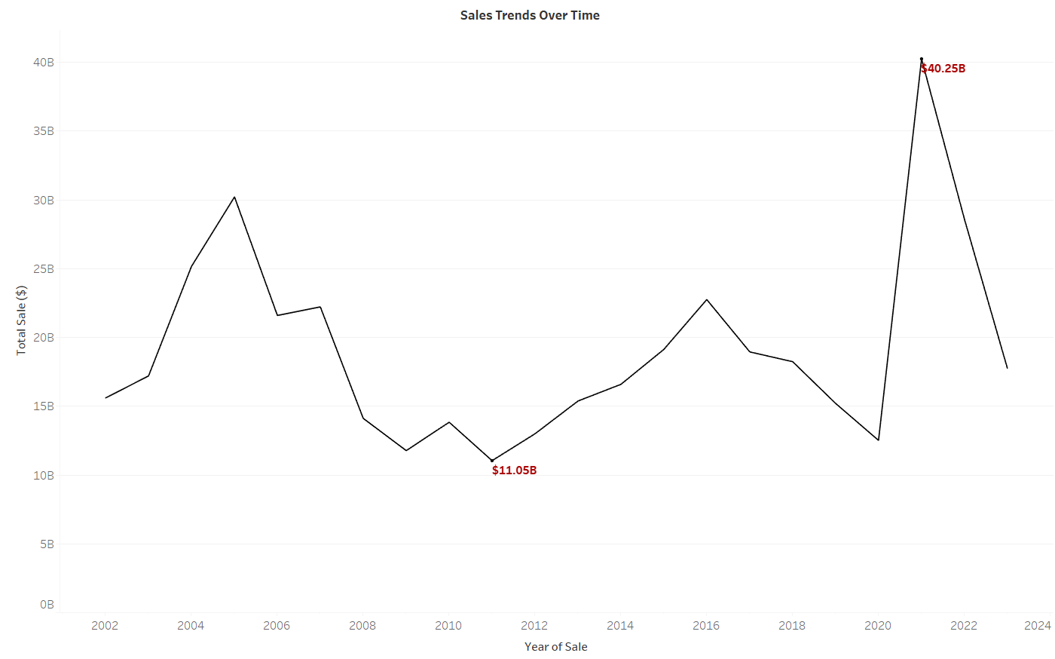
Sales Trends Over Time
Insights:
2007-2011: Significant decline in sales, coinciding with the 2008 financial crisis.
2012-2019: Gradual recovery with steady growth in sales.
2020-2021: Sharp spike, possibly due to pandemic-driven real estate demand and low-interest rates.

Slide 5
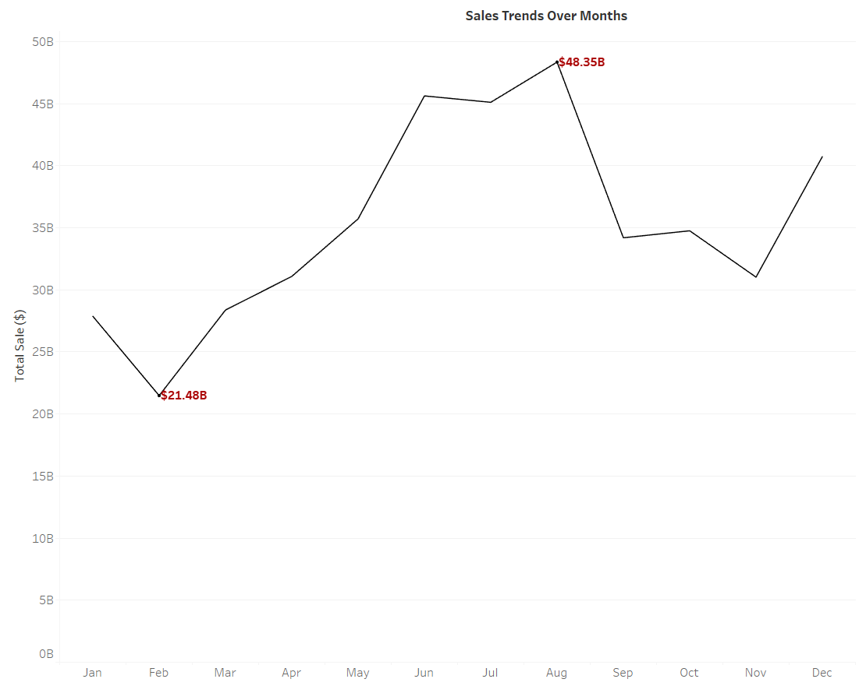
Total Sale by Month
Insights:
Spring & summer months (March–August) show peak activity, while early winter (January-February) and post-summer (September-October) experience slowdowns.

Slide 6
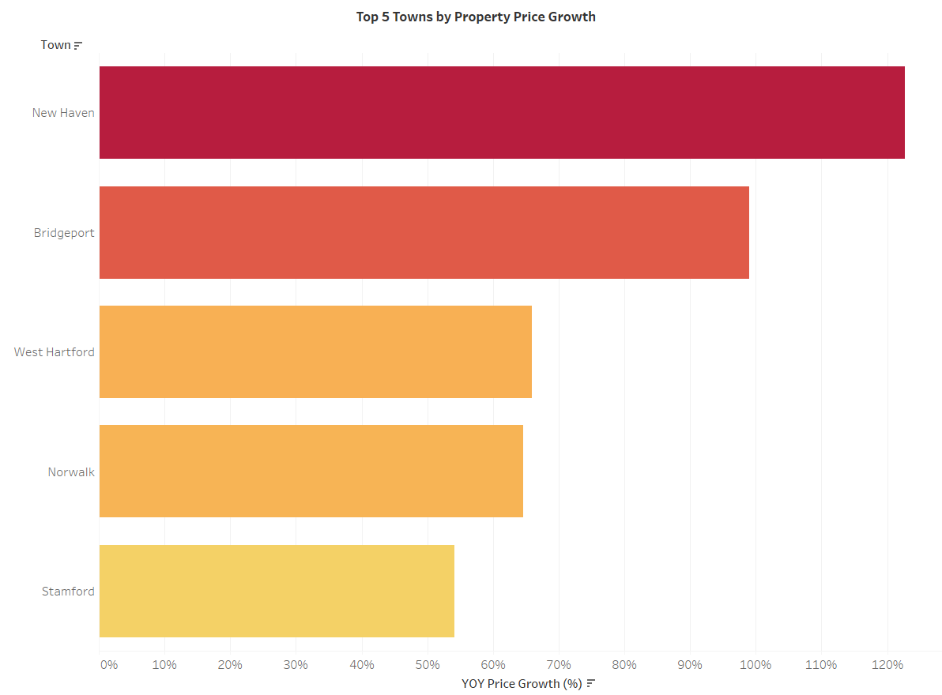
Top 5 Towns by Year-Over-Year Property Price Growth
Insights:
The Top 5 Towns by Property Price Growth indicate that New Haven experienced the highest YoY price growth, followed by Bridgeport and West Hartford, suggesting significant property value appreciation in these areas. This trend highlights strong real estate demand and potential investment opportunities in these towns.

Slide 7
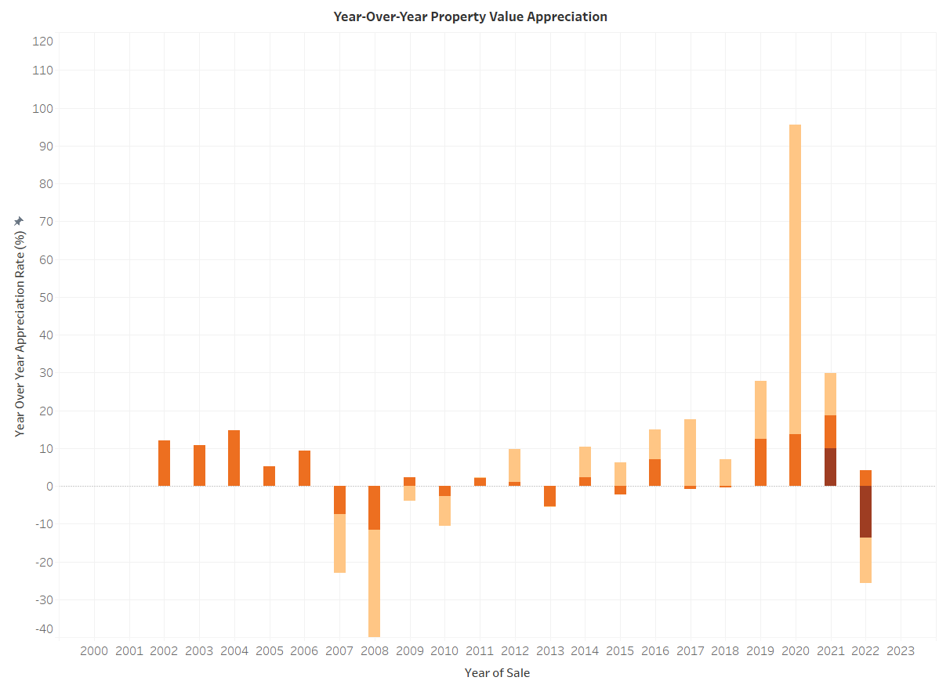
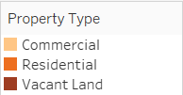
Year-Over-Year Property Value Appreciation
Insights:
2008-2009: Severe decline in property appreciation, coinciding with the 2008 financial crisis, with some property types experiencing over 36% depreciation.
2011-2019: Gradual recovery with consistent positive appreciation, especially for Commercial, and Residential properties.
2020-2021: Sharp spike in appreciation, likely due to pandemic-driven housing demand and low interest rates but the drop in 2023 suggests a market correction or economic slowdown.

Slide 8
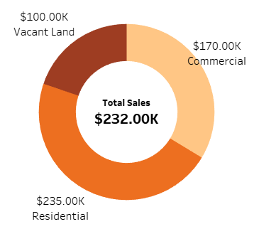
Median Sales Distribution by Property Type
Insights:
The Median Sales Distribution by Property Type shows that Residential properties have the highest median sales price at $235K, followed by Commercial properties at $170K, while Vacant Land has the lowest median price at $100K.
This suggests that residential properties hold the most value, whereas vacant land transactions are comparatively lower-priced, potentially indicating less demand or lower valuation.

Slide 9
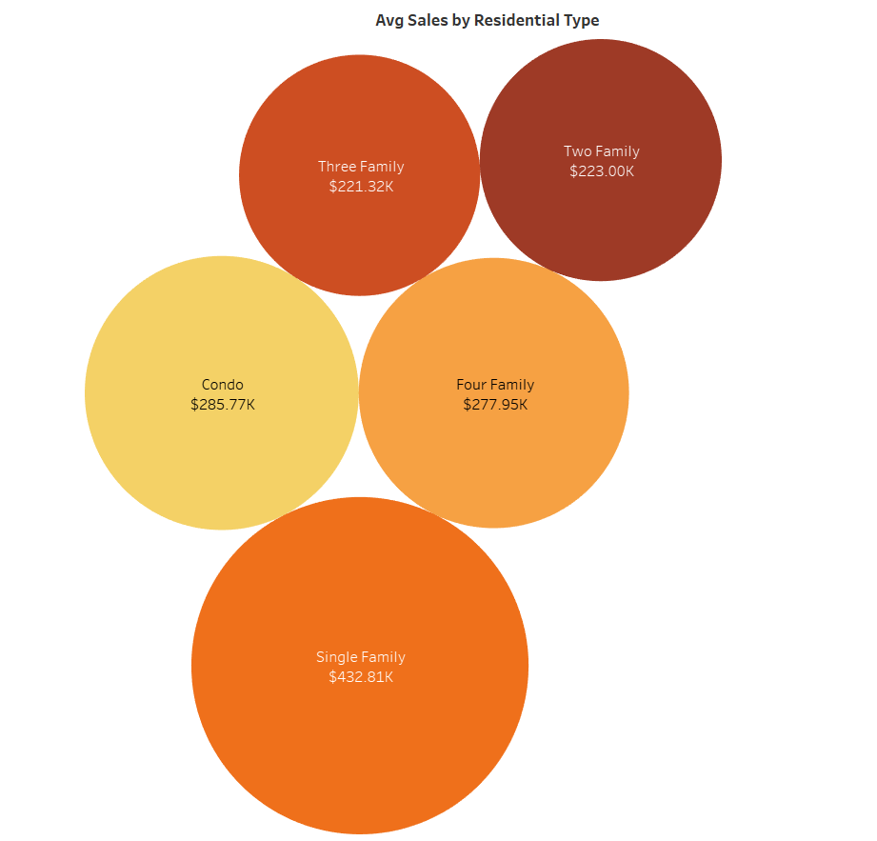
Median Sales Distribution by Residential Type
Insights:
The Median Sales Distribution by Residential Type shows that Single Family homes have the highest median sale price at $432.81K, followed by Condos ($285.77K) and Four Family homes ($277.95K). Multi-family properties (Two, Three, and Four Family homes) tend to have lower median prices, suggesting they might be more affordable for investors or buyers looking for rental income opportunities.

Slide 10
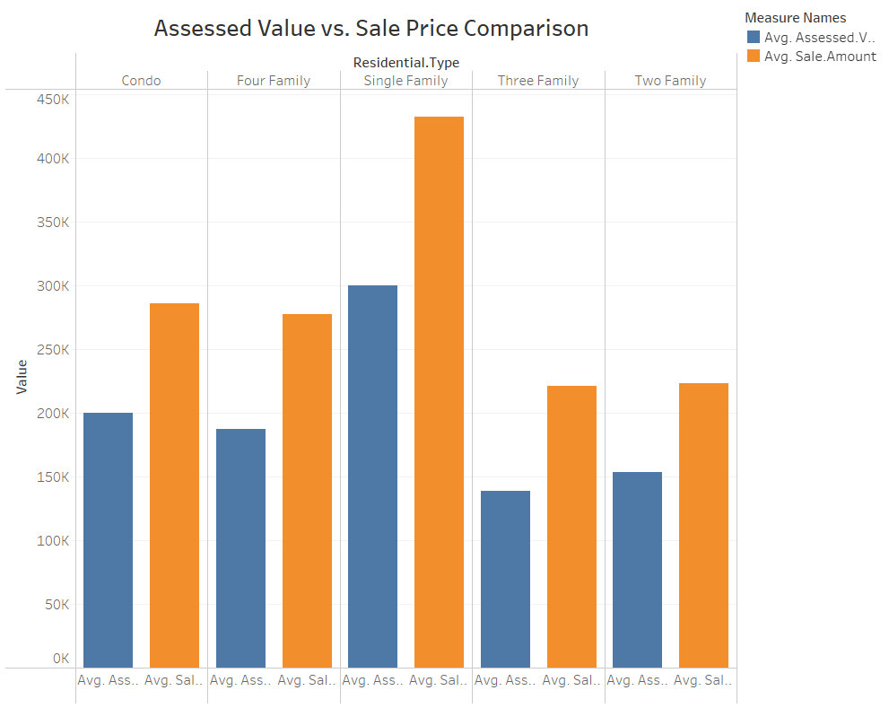
Sales Distribution by Property Type
Insights:
The Assessed Value vs. Sale Price Comparison shows that across all residential types, sale prices (orange bars) tend to be higher than assessed values (blue bars), indicating a strong market where properties are selling for more than their tax-assessed value. Single Family homes exhibit the highest gap between sale price and assessed value, suggesting strong demand and appreciation in this category.

Slide 11
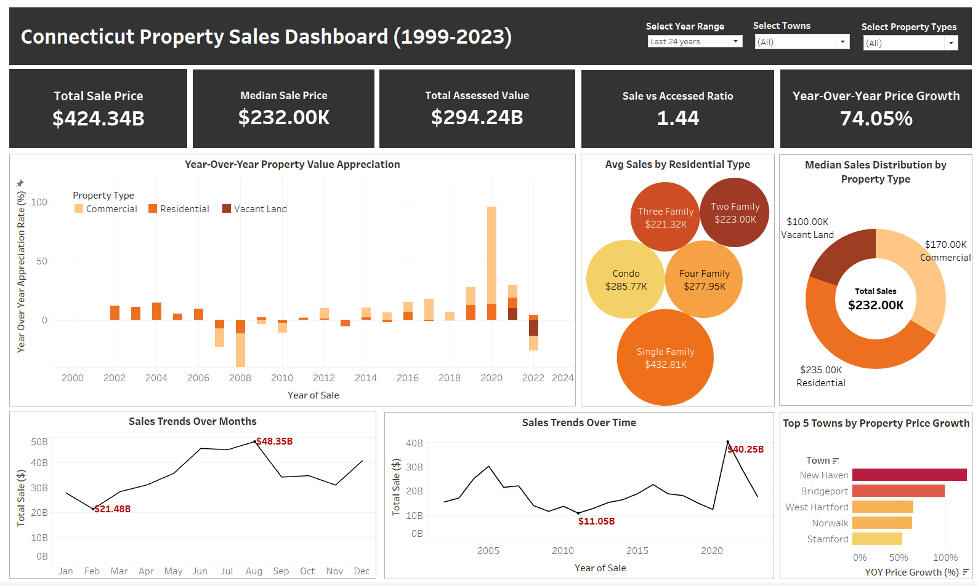
Final Tableau Dashboard

Slide 12
Key Findings
Real estate sales have fluctuated over the years, with notable peaks and dips in certain periods, likely influenced by economic conditions.
Some towns consistently have higher average property prices, while others remain affordable.
Residential properties dominate the market, with single-family homes being the most common type.
The assessed value of properties does not always align with sale prices, indicating potential inaccuracies in property evaluations.
The Sales Ratio varies significantly between towns, suggesting different assessment methodologies or market conditions.
Recommendations:
For Buyers & Investors:
Consider towns with a low sales ratio, as properties may be undervalued.
Look at trends in residential type pricing to make cost-effective decisions.
For Government & Assessors:
Improve property assessment accuracy in towns with high discrepancies between and sale price.
Ensure fair and standardized property evaluations to prevent over/under-taxation.
For Real Estate Agents & Developers:
Focus on high-growth towns for new developments.
Use historical sales data to strategize marketing and pricing.
Conclusion
This study provides a comprehensive visual analysis of real estate sales from 2001-2022 using Tableau. We identified trends in sales volume, property pricing, and geographic distributions. The analysis highlights inconsistencies in assessed values and reveals insights into property demand across towns. Future work can integrate economic indicators (inflation, interest rates) to further understand market dynamics.

Slide 13
Thank You!

