Slide 1
Capstone Project
Play Store App Review Analysis
By Sudhanshu Kumar Data Science Trainee, AlmaBetter

Slide 2
Introduction
* Preparation of Data set
* Attribute in Google Play store Data
* Attribute in User Review
* Top Categories in Play Store
* Ratings of the Content
* Percentage of Paid App Vs Free App
* Bar Graph of Paid App and Free App
* Most Number Of Install
* Top Genres in Play Store
* Rating of Content
* Percentage of Reviews Sentiments
* Bar Graph of Sentiments
* Conclusion

Slide 3

s
Problem:
Two database are provided:
* Basic information of Play Store Analysis
* User reviews
We have to examine and evaluate data in both datasets.

Slide 4
Preparation of Dataset
* Loading the data sets: Two datasets, First Play store app dataset and User Reviews
dataset.
* Import Libraries: 1) NumPy
2) Pandas
3) Seaborn
4) Matplotlib
* Data cleaning: 1) Finding and removing Outliers
2) Converting string to numeric
* Exploratory Data Analysis: Analyzing the data sets to summarize their main characteristics using statistical graphics and data visualizations method.

Slide 5

Attributes in Google Play store Data
* App : This column Contains the name of the app for each observation. * Category : This column Contains Category to which the app belongs. * Rating : This column contains the average rating for the app. * Reviews : This column contains the number of reviews that the app has received. * Size : This column contains the amount of memory the app occupies on the device. * Installs : This column contains the number of times that the app has been downloaded. * Type : This column contains the information whether the app is free or paid. * Price : If the app is a paid app, this column contains the data about its price. * Content Rating : This column contains the rating of the app. * Genres : This column contains the data about to which genre the app belongs. * Last Updated : Contains the date on which the latest update of the app was released. * Current Version : Contains information on the current version of the app available on the play store.
* Android Version : Contains information about the android versions on which the app is supported.

Slide 6
Attributes in User reviews
* App- Application name
* Translated Review- User review
* Sentiment- Positive/Negative/Neutral
* Sentiment Polarity- Sentiment polarity score
* Sentiment Subjectivity- Sentiment subjectivity score

Slide 7
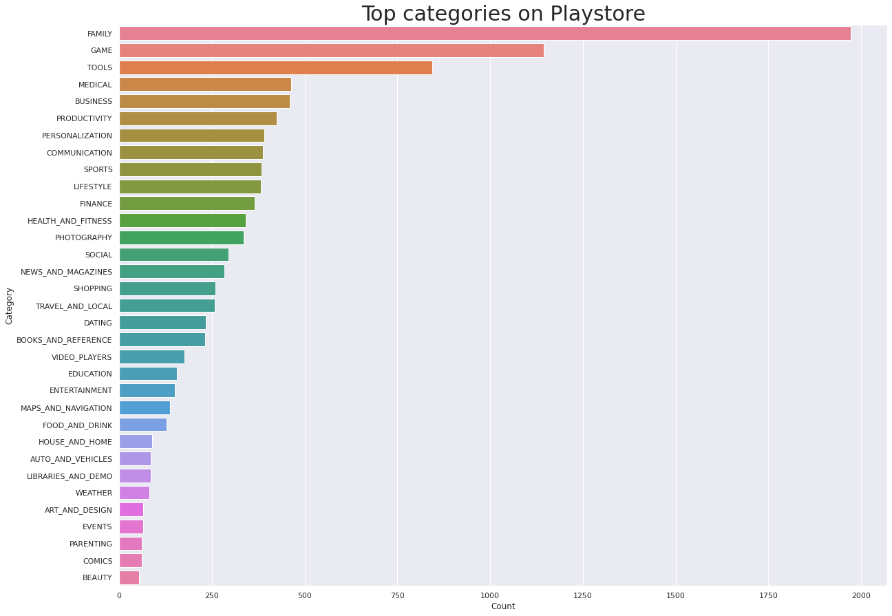
Top Categories on Play Store
As we see the most famous category is
Family

Slide 8
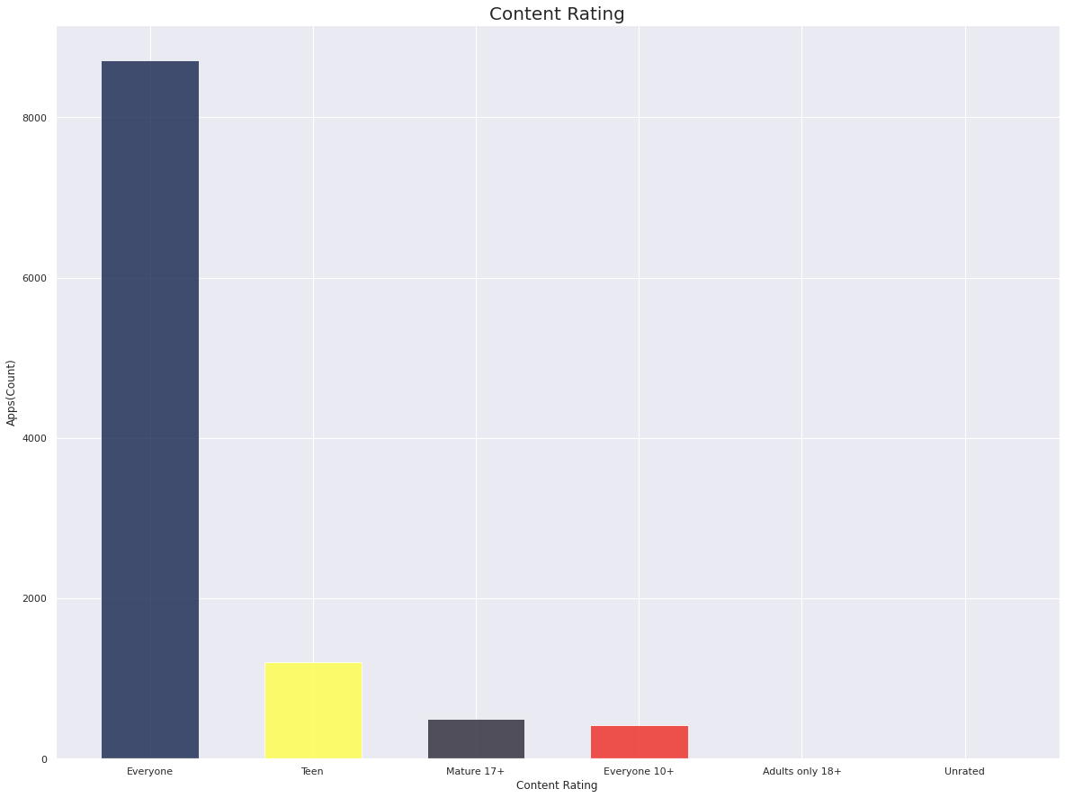
Ratings of the Content
This Bar Graph Shows the Ratings
of the content.

Slide 9
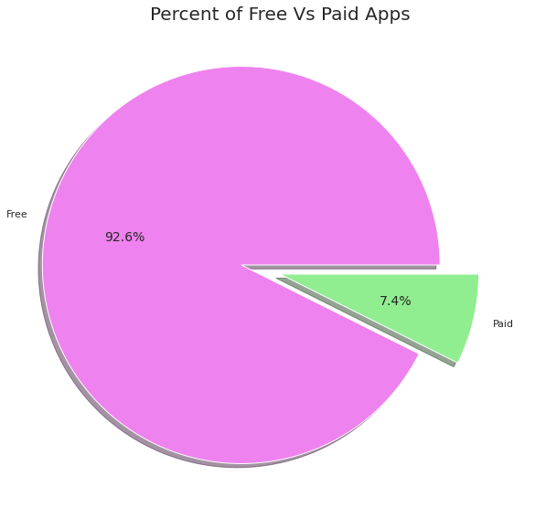
Percentage of Paid apps v/s Free apps
We Observed that 92.20% of Apps are free and only 7.80% of Apps are paid in Play store.

Slide 10
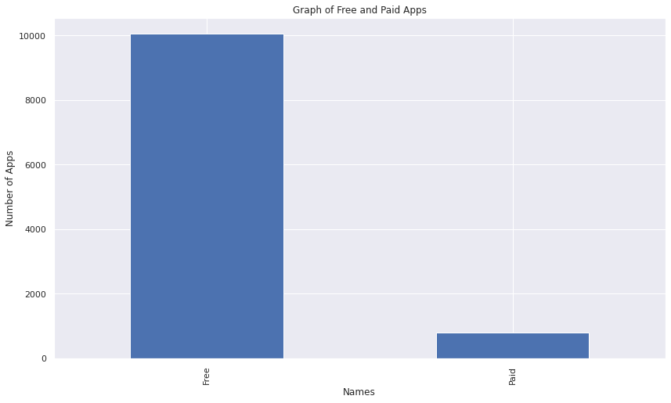
Bar Graph of Free And Paid App
This Bar Graph tells us the Number of Apps which are Paid and Free.

Slide 11
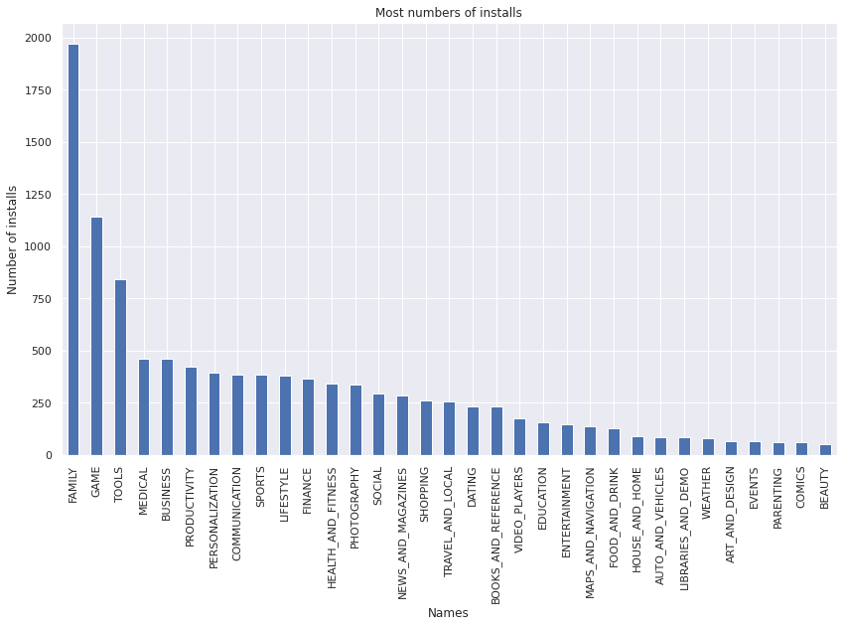
Most Numbers of Install
This graph
is showing the
most numbers of
installs

Slide 12
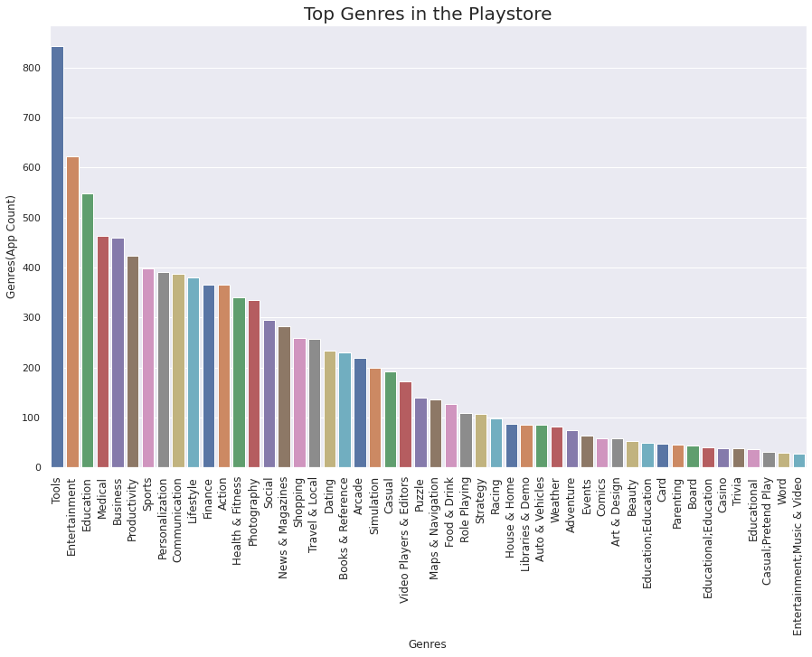
Top Genres in PlayStore
These are the top Genres in the Play Store

Slide 13
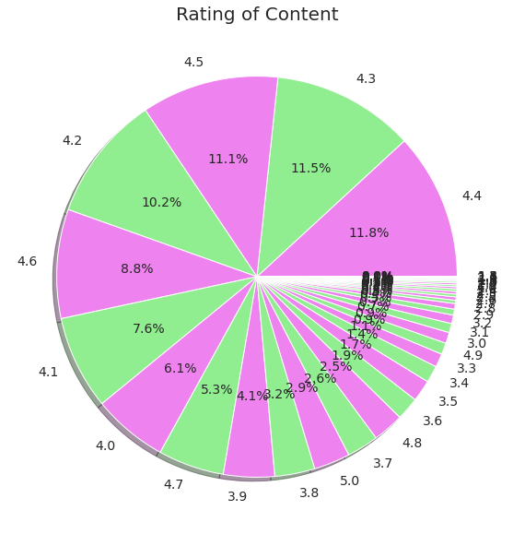
Rating of Content

Slide 14
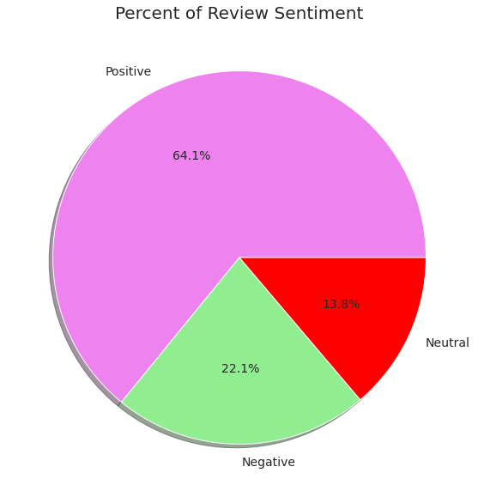
Percentage of Review Sentiments
As we
can see
the percentage of
Review Sentiments

Slide 15
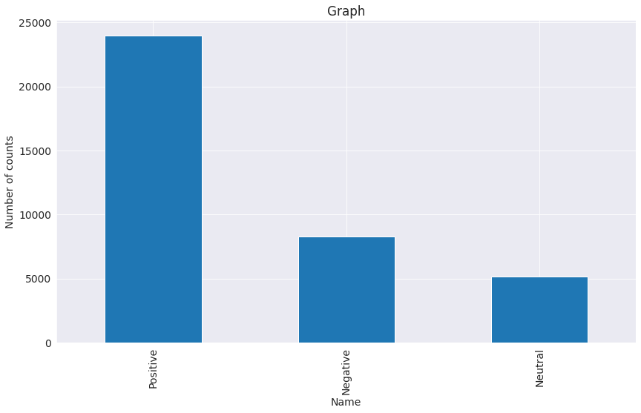
Sentiments

Slide 16
Conclusion’s
Top category on Play Store is Family
Then we saw the Ratings of the Content
92.6% apps are Free and 7.4% apps are paid.
81.80% apps have Everyone content rating.
Most number of installs: Family
Tools, Entertainment, Education, Business and Medical are top Genres.
64.1% Positive, 22.1% Negative, 13.8% Neutral is the percentage of Review Sentiment.

Slide 17
Thank You

