Slide 1

RAJARAJESWARI COLLEGE OF ENGINEERING MYSORE ROAD ,BANGALORE-560074 (Affiliated to Visvesvaraya Technological University, Belgaum)
DEPARTMENT OF COMPUTER SCIENCE AND ENGINEERING
Technical Seminar
on
“IoT-EQ and AI-Enabled Next Generation Smart Agriculture”
Under The Guidance Of
Mr. R. Rajkumar
Asst. Professor
Dept. of CSE,RRCE
Presented by
Keerthan R
1RR19CS068
8TH SEM,CSE, RRCE

Slide 2
PRESENTATION FLOW
Introduction
Technology
Methodologies
Advantages
Disadvantages
Applications
Conclusion
References

Slide 3
INTRODUCTION
The data as input to state-of-the-art, AI-based predictors, which can give more wellinformed decisions to the farmer.
They can efficiently analyze the latest trends in the data and provide several insights to the farmer.
These benefits range from greater crop productivity, saving of tightly managed resources such as water for irrigation purposes, and minimization of the use of toxic chemicals such as those used in fertilizers, pesticides, and herbicides.
Such a level of control over agriculture not previously possible gives the farmer greater flexibility and insight to plan his activities, such as determining what crops will result in optimum yield under existing and predicted climatic conditions.
It keeps him well informed about his current and projected use of permissible fertilizer and pesticide use. It also helps him regulate the usage of tightly managed resources such as water for irrigation purposes.

Slide 4
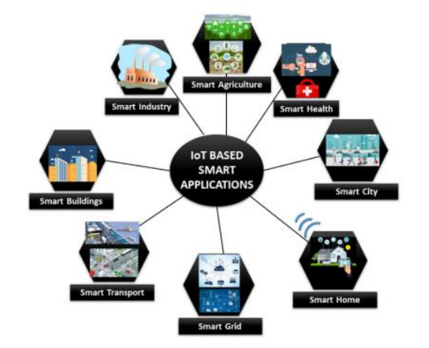
TECHNOLOGY
Figure 1: Block diagram showing IoT based emerging smart applications.

Slide 5
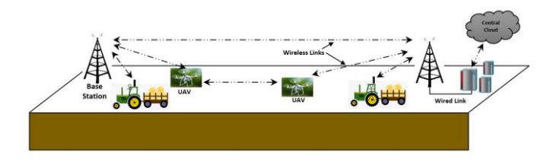
Use of cellular network for real-time monitoring in large fields using smart agriculture machinery
USE OF UAVs IN SMART AGRICULTURE UAVs are primarily used for crop monitoring through aerial images being acquired by the UAV and crop spraying owing to the ease offered by its aerial mobility and maneuverability. Velusamy et al. provide an excellent taxonomy of the type of UAVs being used in precision agriculture being classified as fixedwing, vertical take-off and landing (VTOL) based on their flight patterns and other architectural design such as the number of rotors, being classified as single rotor, multi-rotor (tri-copter, quad-copter, hexa-copter, octo-copter).

Slide 6
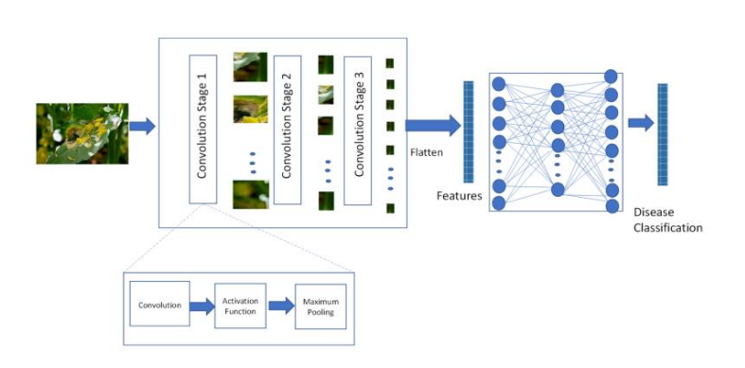
METHODOLOGIES
A deep learning framework using convolutional neural networks to detect and classify plant diseases

Slide 7
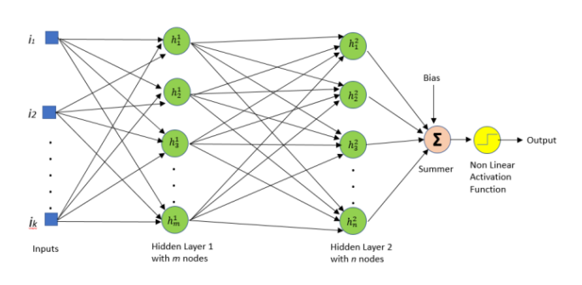
.
USE OF DEEP LEARNING IN SMART AGRICULTURE Z. have compiled a comprehensive bibliography on the recent trends of DL-based CNNs in the area of Smart Agriculture. The main feature by which DL networks are distinguished from neural networks is their depth, and that feature makes them capable of discovering latent structures within unlabeled and unstructured data.

Slide 8
B. AGRICULTURAL ADVISORY SYSTEMS discuss a chat-bot based farmers’ query answering system through which they can get specific answers to their queries. The system uses online web resources like documents as training data and Natural Language Processing to develop a DL-based Recurrent Neural Network (RNN) framework.
C. EDAPHIC PARAMETERS ESTIMATION Many researchers have devoted attention to the estimation of soil parameters which play a dominant role in other factors such as prevention of non-infectious diseases and increasing crop yield.
D. REAL-TIME PEST DETECTION Pest detection has been investigated by some researchers.

Slide 9
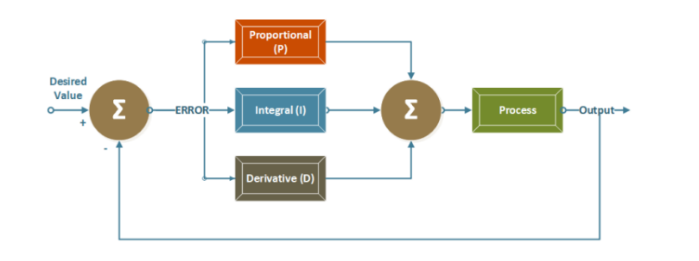
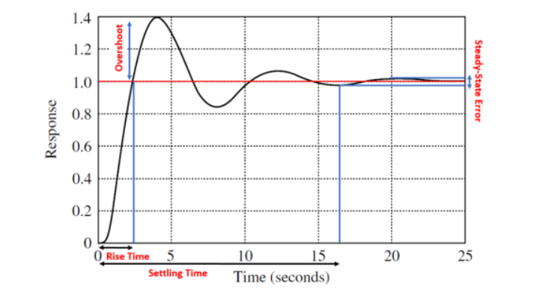
Figure 3: Photo Alive! Services

Slide 10
ADVANTAGES
1. Increased Efficiency: IoT devices can monitor the health of crops and soil in real-time, enabling farmers to optimize resource use and minimize waste.
2. Improved Crop Yield: With real-time monitoring and AI analytics, farmers can identify potential problems early on and take corrective action.
3. Reduced Labor Costs: Smart agriculture can reduce the need for manual labor, as IoT devices can perform tasks such as irrigation, fertilization, and pest control automatically.
4. Better Resource Management: IoT devices can monitor and control water and energy usage, reducing waste and improving sustainability.
5.Increased Sustainability: Smart agriculture can help reduce the environmental impact of farming by optimizing resource use, reducing waste, and minimizing the use of harmful chemicals.
6. Enhanced Decision Making: AI algorithms can analyze large amounts of data and provide insights that can help farmers make better decisions about planting, harvesting, and resource management

Slide 11
DISADVANTAGES
1. High Cost: Implementing IoT and AI technology can be expensive, and smaller farms may not be able to afford it.
2. Complexity: IoT and AI technology can be complex and require specialized skills and knowledge to implement and maintain.
3. Reliance on Technology: Smart agriculture relies heavily on technology, and any failure or outage could have a significant impact on crop yield and profitability.
4. Data Privacy and Security: IoT devices and AI algorithms generate large amounts of data, which could be vulnerable to hacking or data breaches.

Slide 12
APPLICATIONS
1. Precision Farming: IoT devices and AI algorithms can be used to monitor soil moisture levels, nutrient levels, and crop growth in real-time.
2. Livestock Management: IoT devices can be used to monitor the health and wellbeing of livestock, including tracking their location, activity levels, and health data.
3. Crop Monitoring: IoT devices and AI algorithms can be used to monitor crop health and detect potential issues such as pests, disease, or nutrient deficiencies.
4. Supply Chain Management: IoT devices can be used to track the movement of goods and materials throughout the agricultural supply chain, from farm to table.

Slide 13
CONCLUSION
A comprehensive review of existing research literature and recent state-of-the-art developments in the area of Smart Agriculture Systems was presented.
The significant contributions of this paper are:
1) A detailed tutorial on the available advancements in the field of SAS through IoT technologies and AI techniques.
2) A critical review of these two available technologies and challenges in their widespread deployment.
3) An in-depth discussion about the future trends including both technological and social when SASs will be widely adopted by the farmers globally.

Slide 14
REFERENCES
[1] Programme, Water and Jobs, the United Nations World Water Devel opment Report, UN World Water Develop. Rep. Arch., United Nations Educ., Sci. Cultural Org., Paris, France, 2016.
[2] M. S. Farooq, S. Riaz, A. Abid, K. Abid, and M. A. Naeem, ‘‘A sur vey on the role of IoT in agriculture for the implementation of smart farming,’’ IEEE Access, vol. 7, pp. 156237– 156271, 2019, doi: 10.1109/ACCESS.2019.2949703.
[3] M. Ayaz, M. Ammad-Uddin, Z. Sharif, A. Mansour, and E. M. Aggoune, ‘‘Internet-of-Things (IoT)-based smart agriculture: Toward making the fields talk,’’ IEEE Access, vol. 7, pp. 129551–129583, 2019, doi: 10.1109/ACCESS.2019.2932609.
[4] R.-A. Li, X. Sha, and K. Lin, ‘‘Smart greenhouse: A real-time mobile intelligent monitoring system based on WSN,’’ in Proc. Int. Wireless Commun. Mobile Comput. Conf. (IWCMC), Nicosia, Cyprus, Aug. 2014, pp. 1152–1156, doi: 10.1109/IWCMC.2014.6906517.
[5] R. Nalwade and T. Mote, ‘‘Hydroponics farming,’’ in Proc. Int. Conf. Trends Electron. Informat. (ICEI), Tirunelveli, India, May 2017, pp. 645–650, doi: 10.1109/ICOEI.2017.8300782.

Slide 15
THANK YOU…

