Slide 1
DATA ANALYTICS CAPSTONE PROJECT
Healthcare Prior Authorization Leakage & Utilization Intelligence Platform
Turning payer claims and utilization data into actionable prior-authorization insights using MySQL, ETL, and Power BI.
K
Kumaresan V
Presented by

Slide 2
INTRODUCTION
Project Overview
Goal
Approach
Outcome
Build an end-to-end analytics platform that tracks prior-authorization requests, approvals, denials, and downstream utilization leakage for a healthcare payer.
Consolidate claims and authorization data in MySQL, transform it through an ETL pipeline, and surface it through interactive Power BI dashboards.
A decision-ready dashboard suite that helps operations and clinical review teams reduce leakage, speed up turnaround time, and control avoidable utilization.
Prior Authorization Leakage & Utilization Intelligence
2

Slide 3
CONTEXT
Industry & Problem Statement
Industry Context
Problem Statement
Health insurance payers process large volumes of prior-authorization (PA) requests before approving procedures, drugs, or services. Manual review, fragmented data, and inconsistent policy application create delays, denials, and revenue leakage across the utilization lifecycle.
No unified view of PA volume, approval rate, and turnaround time
Leakage from denied, delayed, or bypassed authorizations is hard to quantify
Utilization patterns by provider, procedure, and region stay hidden in raw claims tables
Stakeholders lack a self-service dashboard to monitor SLAs and cost impact
Prior Authorization Leakage & Utilization Intelligence
3

Slide 4
STACK
Tools & Technologies
1
MySQL
2
Power Query / ETL
3
Power BI
Relational database for storing claims, authorization, and provider tables
Extract, clean, and transform raw tables into an analysis-ready model
Data modeling, DAX measures, and interactive dashboard design
4
DAX
5
Power BI Service
6
GitHub
Business logic for approval rate, leakage %, and turnaround KPIs
Publishing, refresh scheduling, and dashboard sharing
Version control for scripts, documentation, and project artifacts
Prior Authorization Leakage & Utilization Intelligence
4

Slide 5
DATA
Dataset Introduction & Source
Dataset Snapshot
Source
Domain
Health insurance / payer operations
Simulated healthcare prior-authorization and claims dataset, structured to reflect real-world payer data — covering member demographics, provider details, procedure codes, request status, and turnaround timestamps.
Core entities
Members, Providers, Procedures, PA Requests, Claims
Granularity
One row per prior-authorization request
Time span
Multi-year historical authorization records
Key tables
Format
Structured relational tables loaded into MySQL
members • providers • procedures • prior_auth_requests • claims
Prior Authorization Leakage & Utilization Intelligence
5

Slide 6
DATA LAYER
MySQL — Database & Tables
members
member_id, age, gender, plan_type, region
providers
provider_id, specialty, network_status, region
procedures
procedure_code, category, avg_cost
prior_auth_requests
auth_id, member_id, provider_id, procedure_code, status, request_date, decision_date
claims
claim_id, auth_id, billed_amount, paid_amount, claim_status
Tables are linked through primary/foreign keys — auth_id and member_id join requests to claims and demographics for unified analysis.
Prior Authorization Leakage & Utilization Intelligence
6

Slide 7
INTEGRATION
Connecting MySQL with Power BI & Loading to ETL
›
›
›
1
2
3
4
MySQL Connector
Power Query Editor
Transform & Load
Data Model
Power BI connects to MySQL via the native MySQL database connector using host, port, and credentials.
Tables are imported into Power Query as the ETL staging layer for transformation.
Queries clean, merge, and reshape data before loading into the Power BI data model.
Star-schema style model with fact (requests, claims) and dimension (members, providers, procedures) tables.
Prior Authorization Leakage & Utilization Intelligence
7

Slide 8
PREPARATION
Data Cleaning & Basic DAX Measures
Data Cleaning Steps
DAX Measures
✓
Removed duplicate authorization records
Approved Authorizations
CALCULATE([Total Authorizations],'Authorizations'[Authorization_Status] = "APPROVED")
✓
Standardized status labels (Approved / Denied / Pending)
Approval Rate %
DIVIDE([Approved Authorizations], [Total Authorizations], 0)
✓
Handled nulls in decision_date and paid_amount
Total Billed Amount
✓
Corrected data types for dates and numeric fields
SUM('Claims'[Billed_Amount])
✓
Mapped procedure codes to readable categories
Mismatch %
DIVIDE([Mismatched Claims], [Total Claims], 0)
Prior Authorization Leakage & Utilization Intelligence
8

Slide 9
DESIGN
Dashboard Design — Pages Overview
1
Executive Summary
2
Utilization Analysis
High-level KPIs: total requests, approval rate, leakage %, turnaround time
Volume trends by procedure category, provider specialty, and region
3
Leakage Drill-Down
4
Provider Performance
Denied and delayed authorizations broken down by cause and cost impact
Provider-level approval rates, TAT, and network comparison
Prior Authorization Leakage & Utilization Intelligence
9

Slide 10
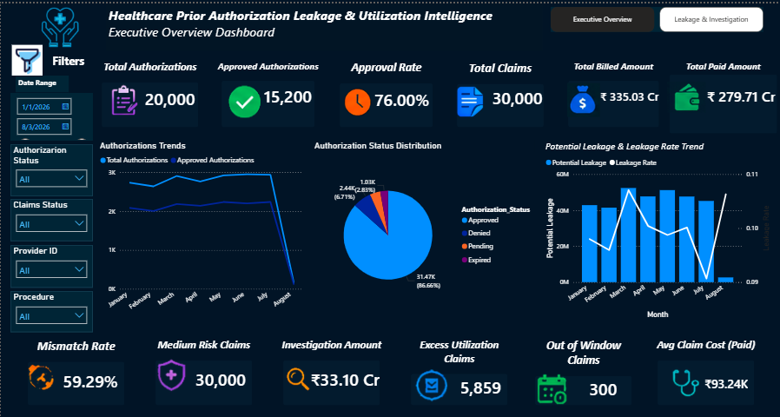
DASHBOARD
Executive Overview Dashboard
Prior Authorization Leakage & Utilization Intelligence
10

Slide 11
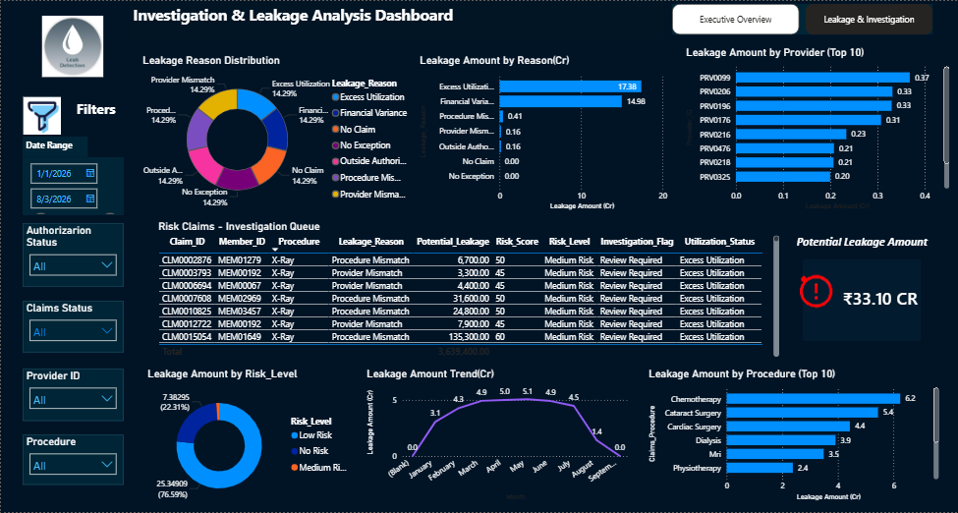
DASHBOARD
Investigation & Leakage Analysis Dashboard
Prior Authorization Leakage & Utilization Intelligence
11

Slide 12
DESIGN
Dashboard Visuals & Filters/Slicers
Key Visuals Used
Filters & Slicers
KPI cards — total requests, approval rate, leakage %
Date range
Trend line chart — requests & approvals over time
Region
Stacked bar chart — status by procedure category
Provider specialty
Donut chart — denial reasons breakdown
Procedure category
Matrix table — provider-level performance
Request status
Map visual — regional utilization distribution
Prior Authorization Leakage & Utilization Intelligence
12

Slide 13
RESULTS
Key Insights & Project Workflow
Key Insights
Project Workflow
A defined subset of specialties account for a disproportionate share of authorization leakage
1
Data collection
From raw claims to
actionable insight in
seven steps.
2
MySQL setup
Turnaround time is a leading indicator of downstream denial risk
3
ETL & cleaning
Regional variation in approval rates points to inconsistent policy application
4
Data modeling
Certain procedure categories show consistently higher leakage percentage
5
DAX measures
6
Dashboard build
7
Insights & review
Prior Authorization Leakage & Utilization Intelligence
13

Slide 14
SOURCE CODE & DOCUMENTATION
GitHub Repository
SQL/
MySQL schema and table-creation scripts
ETL/
Power Query transformation steps
DAX/
Measure definitions used in the model
Dashboard/
Power BI .pbix file and screenshots
README.md
Project overview, setup, and findings
Prior Authorization Leakage & Utilization Intelligence
14

