Slide 1




SMART INDIA HACKATHON 2026
Problem Statement ID – PS 26105 Problem Statement Title – AI-Powered Continuous Cyber Risk Quantification and Investment Optimization Platform
Theme – Blockchain & Cybersecurity PS Category – Software
Team ID – NSUT030
Team Name – _Private Keys_
SMART INDIA HACKATHON 2026
1

Slide 2
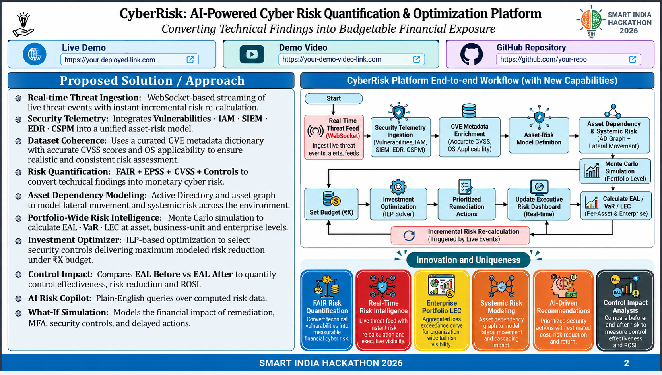
Live Demo
Project Demo Video
github.com/kshitij3103/SIH2026

Slide 3

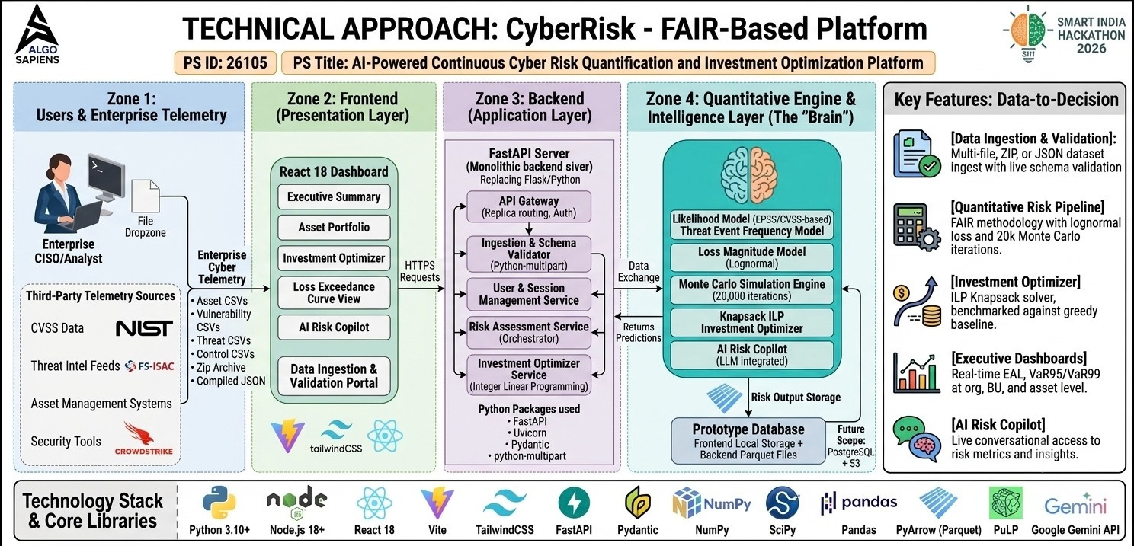
SMART INDIA HACKATHON 2026
3

Slide 4
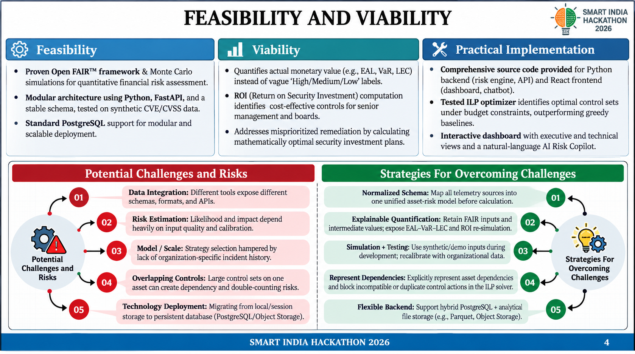

Slide 5
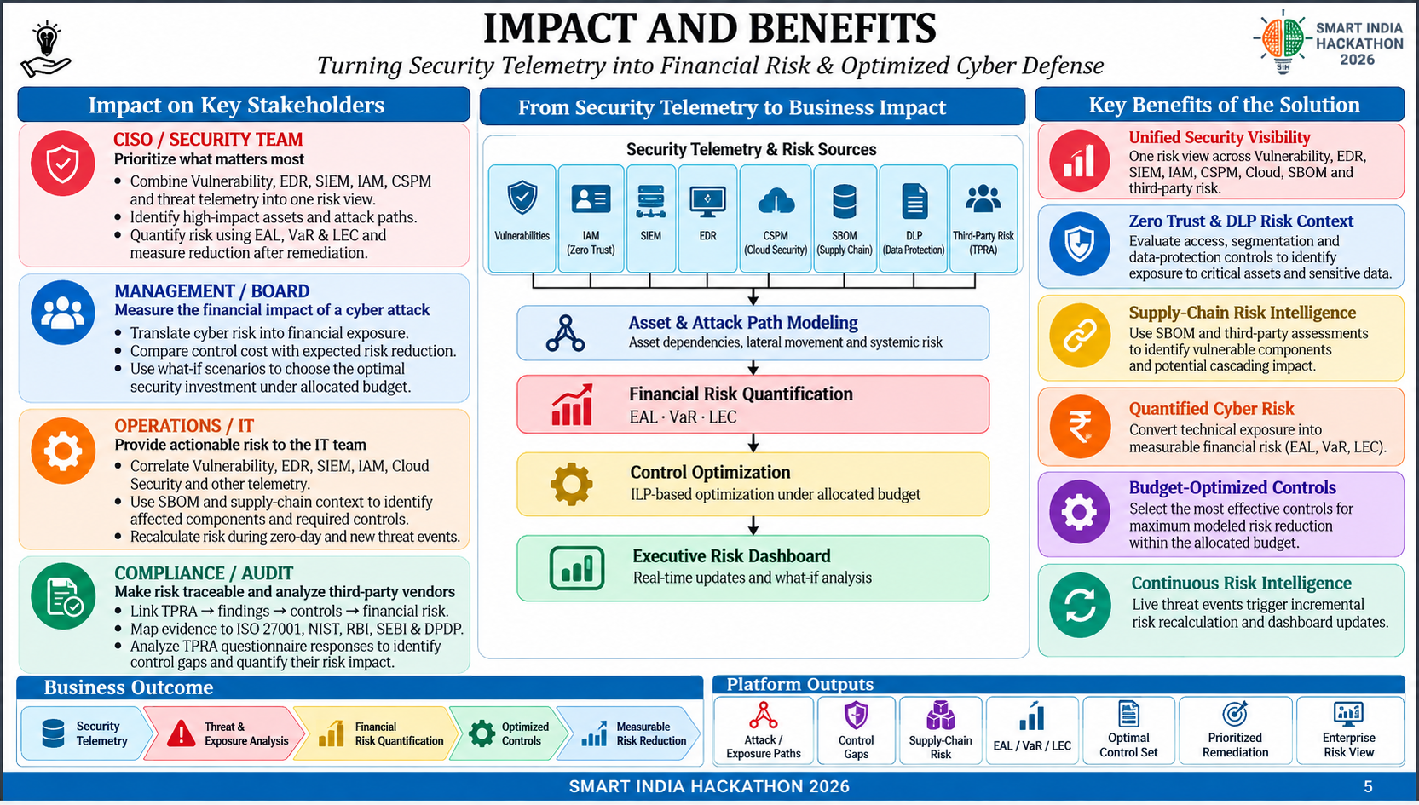
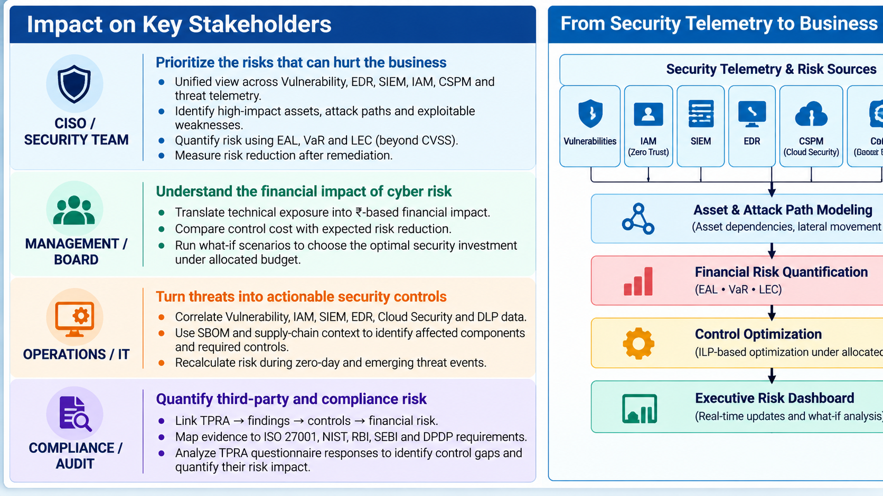
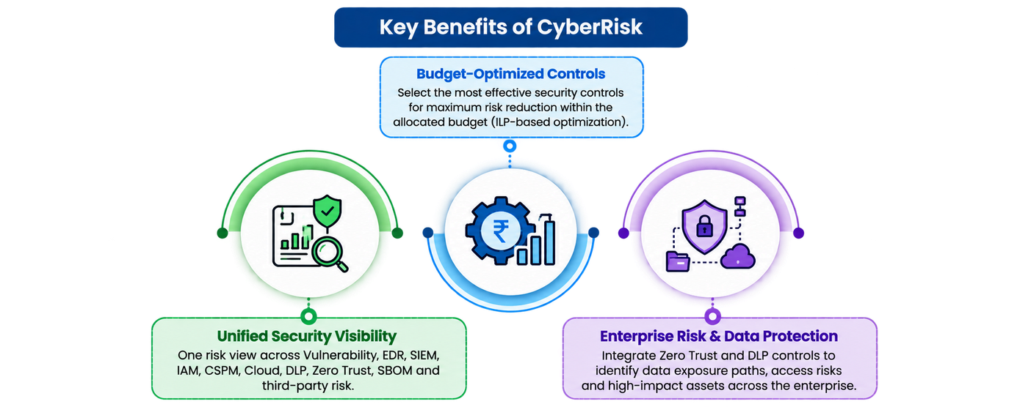
SMART INDIA HACKATHON 2026
5

Slide 6
RESEARCH AND REFERENCES
Methodology & Standards Foundations
FAIR Institute – Factor Analysis of Information Risk (Open FAIR): Core quantitative risk taxonomy underlying the platform's Monte Carlo risk-quantification engine. https://www.fairinstitute.org/what-is-fair
The Open Group – Open FAIR Body of Knowledge (O-RA / O-RT Standards): Formal risk analysis and risk taxonomy standards referenced for the likelihood, frequency, and loss-magnitude modeling. https://www.opengroup.org/open-fai
FIRST.org – Exploit Prediction Scoring System (EPSS):Daily-updated exploitation-probability scores used as the likelihood input for the vulnerability layer. https://www.first.org/epss/
Regulatory & Compliance References (India)
Reserve BankofIndia –CyberSecurityFrameworkinBanks(2016): Regulatory basis for board-level, financially-quantified cyber risk
reporting in Indian BFSI institutions. https://www.rbi.org.in/commonman/english/scripts/Notification.aspx?Id=1721
SEBI – Cybersecurity and Cyber Resilience Framework (CSCRF), Aug 2024: Governance-Identify-Protect-Detect-Respond-Recover structure informing the platform's compliance-mapping roadmap. https://nsdl.co.in/downloadables/pdf/2024-0118-Policy- SEBI_Circular_on_Cybersecurity_and_Cyber_Resilience_Framework_(CSCRF)_for_SEBI_Regulated_Entities_(REs).pdf
Engineering & Quantitative Tooling
NISTCybersecurityFramework(CSF)2.0:Six-function (Govern-Identify-Protect-Detect-Respond-Recover) reference model used for control
categorization. https://www.nist.gov/cyberframework
PuLP / COIN-OR CBC Solver Documentation: Open-source Integer Linear Programming library powering the Knapsack ILP investment optimizer. https://coin-or.github.io/pulp/
\
SMART INDIA HACKATHON 2026
6

