Slide 1




SMART INDIA HACKATHON 2026
Problem Statement ID – SIH26155 Problem Statement Title – AI-Driven Multi-Vendor Network Security Compliance Auditor
Theme – Blockchain & Cybersecurity PS Category – Software
Team ID – NSUT030
Team Name – _Private Keys_
SMART INDIA HACKATHON 2026
1

Slide 2
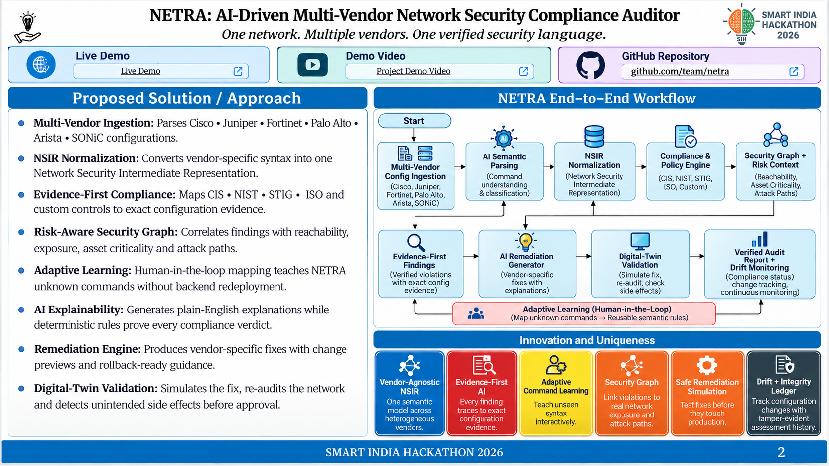
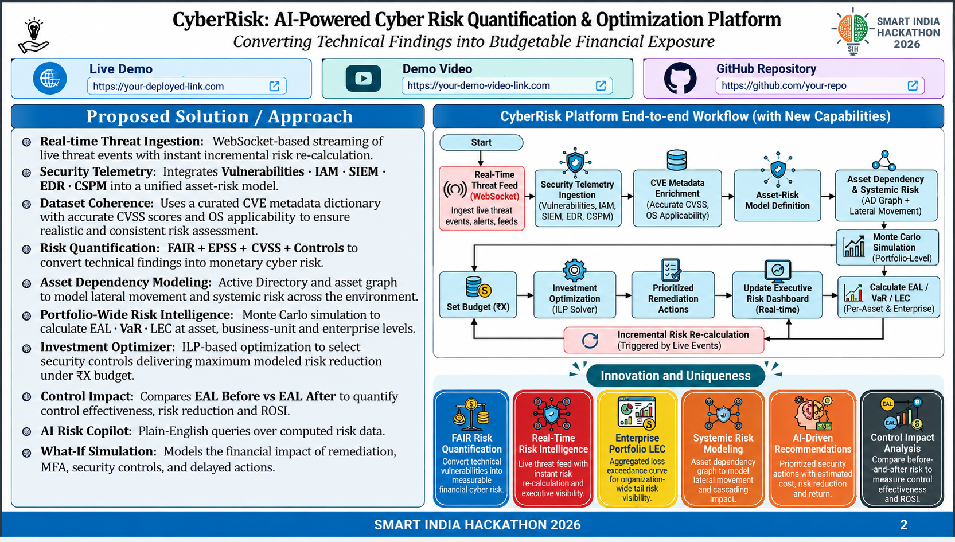
Live Demo
Project Demo Video
github.com/kumar/SIH2026

Slide 3
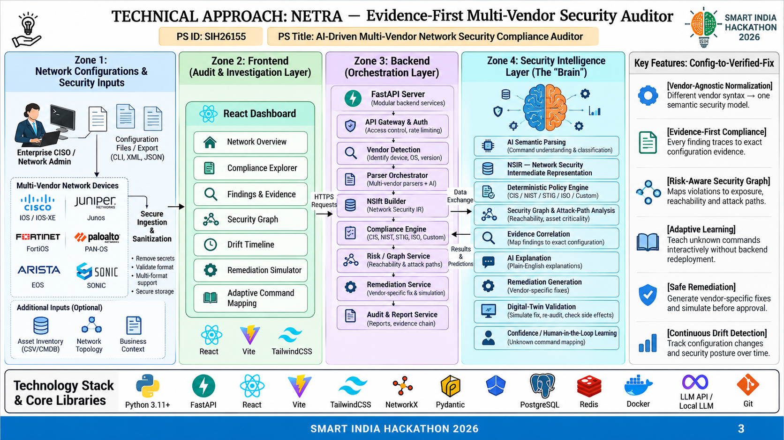

Slide 4
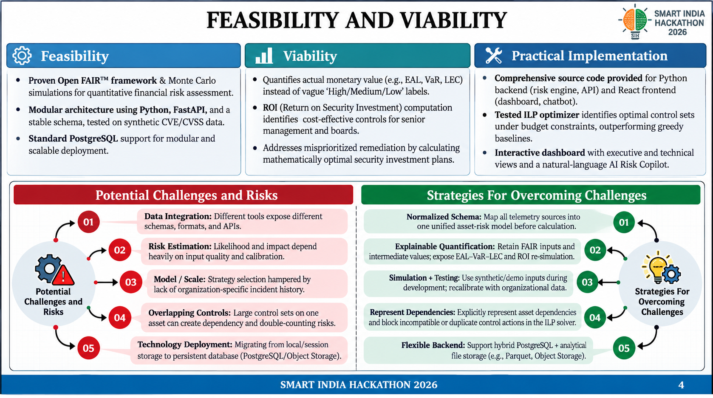
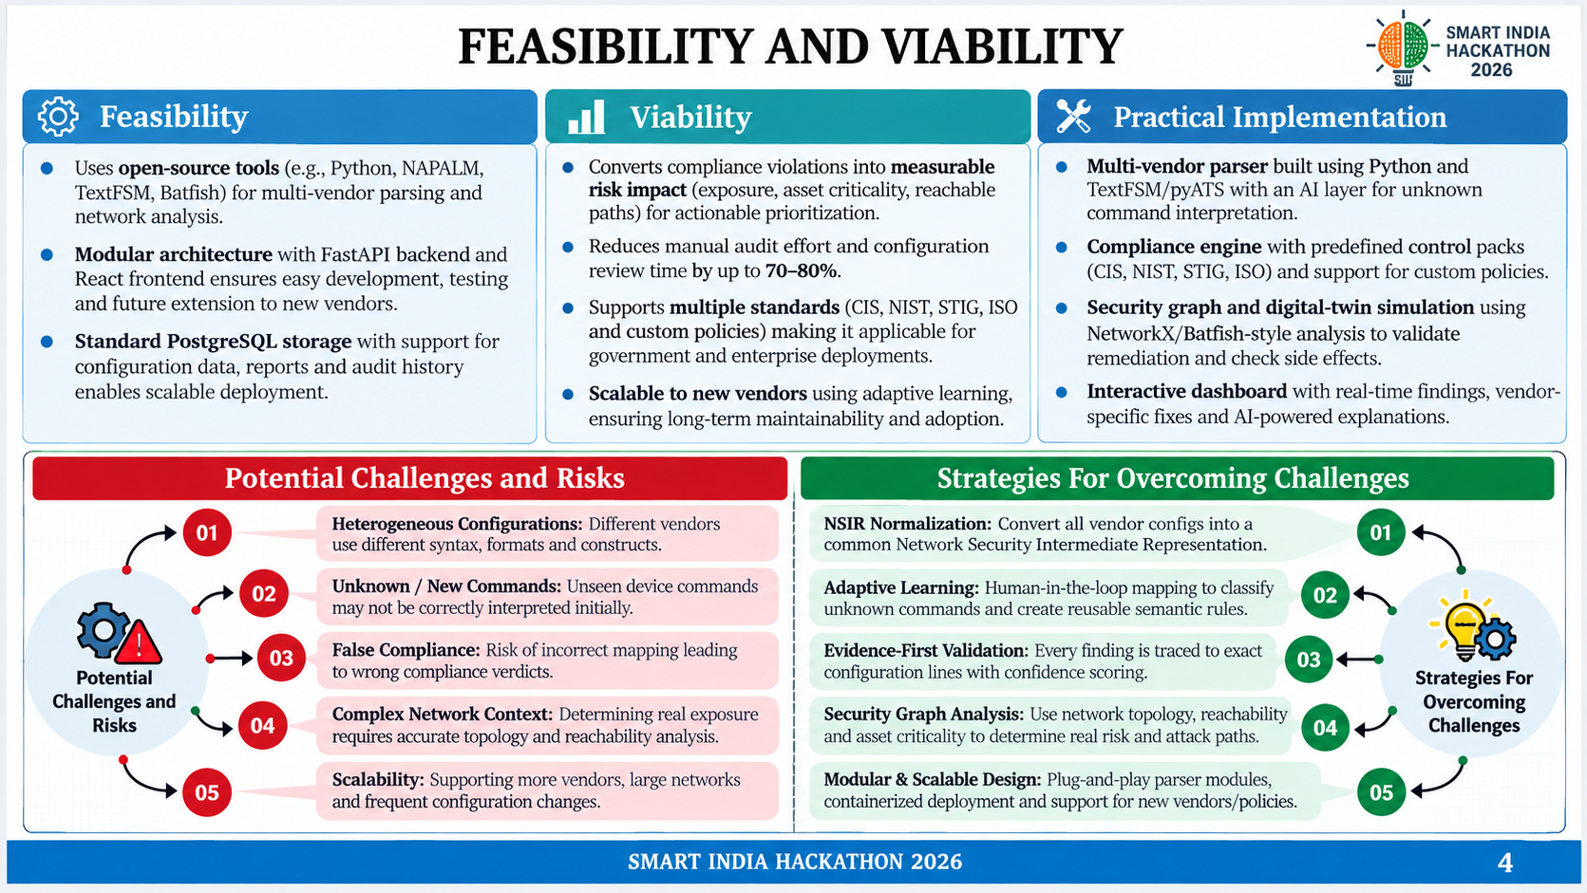

Slide 5
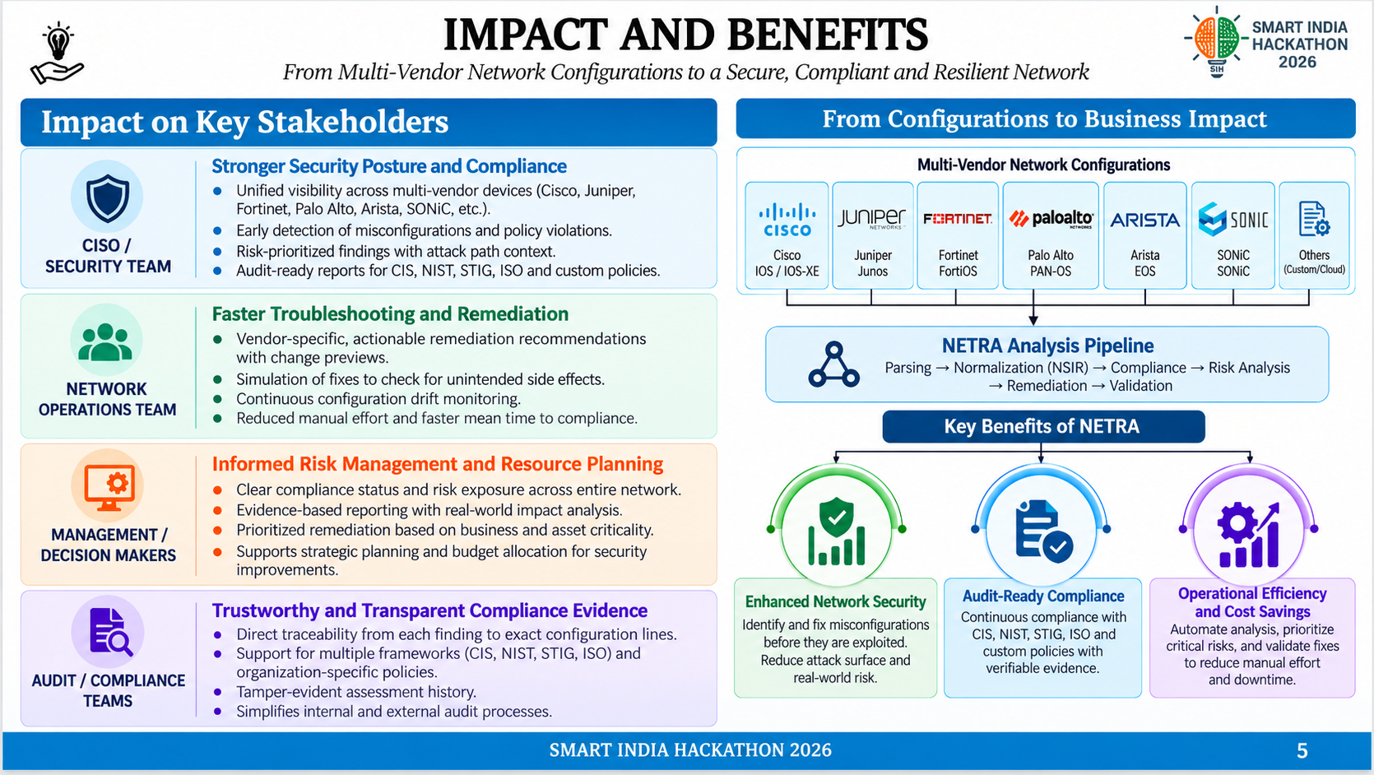
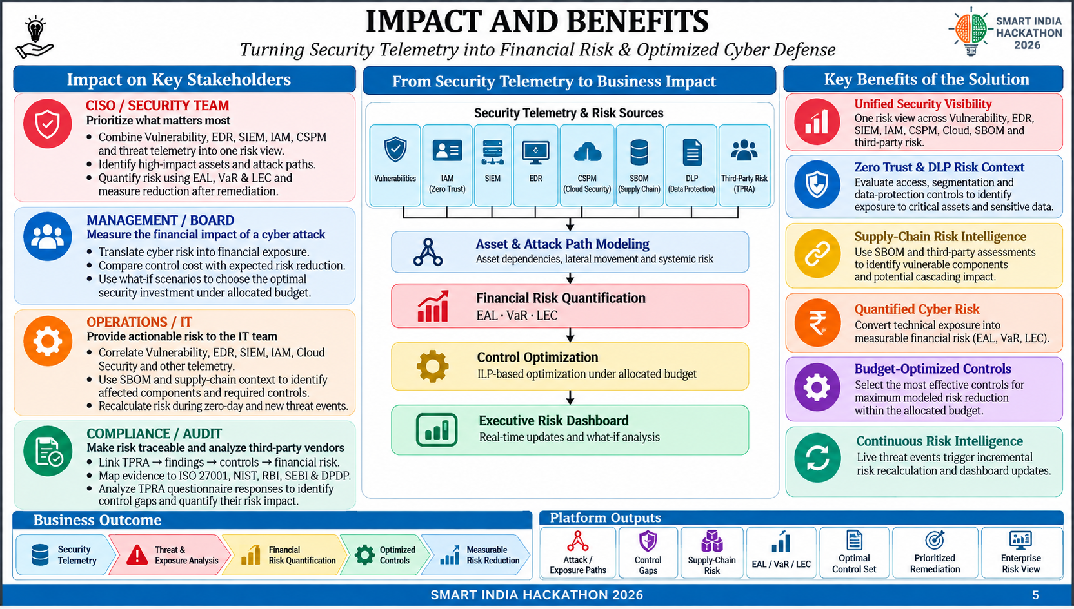
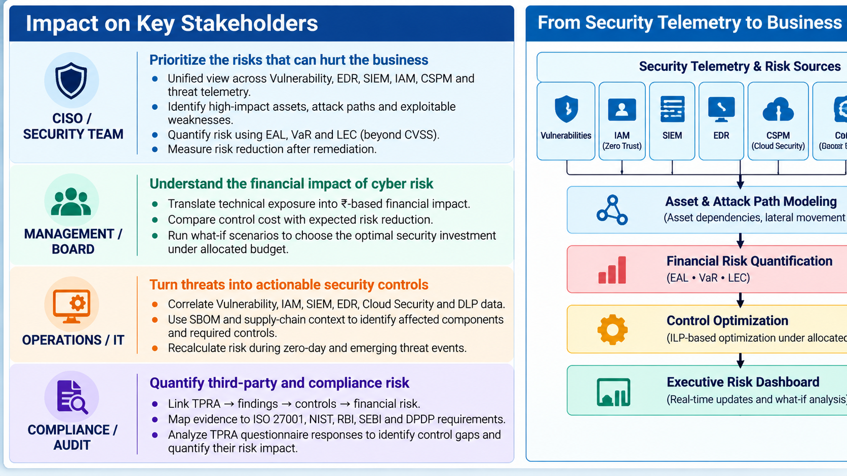
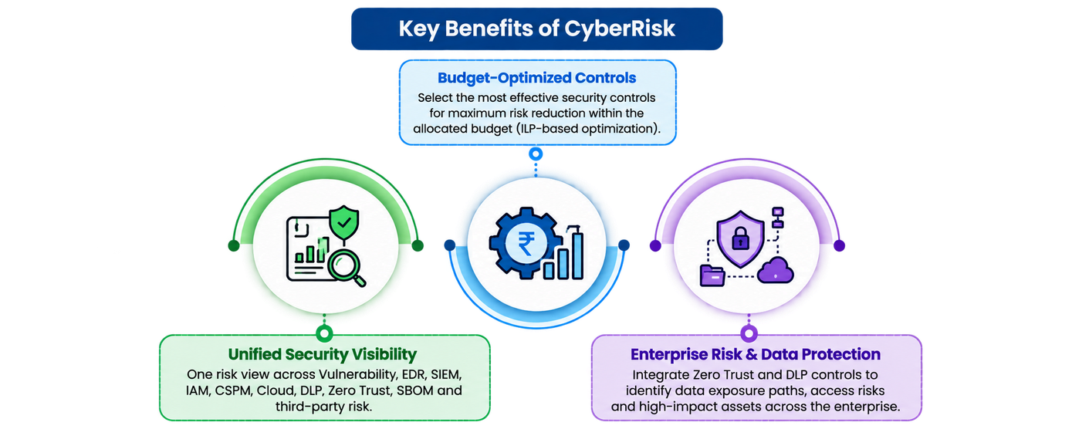

Slide 6


RESEARCH AND REFERENCES
SMART INDIA HACKATHON 2026
Network Configuration Analysis & Verification
SHH
  Ari Fogel, Stanley Fung, Luis Pedrosa, Meg Walraad-Sullivan, Ramesh Govindan, Ratul Mahajan, Todd Millstein. “A General Approach to Network Configuration Analysis,” UENIX NSDI 2015: Proactive configuration analysis, what-if analysis, and provenance of detected errors.
https://www.usenix.org/conference/nsdi15/technical-sessions/presentation/fogel
  Siva Kesava Reddy Kakarla, Alan Tang, Ryan Beckett, Barthick Jayaraman, Todd Millstein, Yuval Tamir, George Vaghese. “Finding Network Misconfigurations by Automatic Template Inference,” UENIX NSDI 2020: Detects configuration outliers without complete formal specifications; SelfStarter found 43 previously unknown bugs. https://www.usenix.org/conference/nsdi20/presentation/kakarta
  Rüdiger Birkner, Dana Drachler-Cohen, Laurent Vanbever, Martin Vechev. “Config2Spec: Mining Network Specifications from Network Configurations,” UENIX NSDI 2020: Mines formal network policies/specifications from existing configurations. https://www.usenix.org/conference/nsdi20/presentation/birkner
LLM-Assisted Network Configuration
  Changjie Wang, Mariano Scazzariello, Alireza Farshin, Simone Ferlin, Dejan Kostić, Marco Chiesa. “NetConfEval: Can LLMs Facilitate Network Configuration?” Proceedings of the ACM on Networking, CoNEXT2, 2024: Benchmark and study of LLM-assisted network configuration. https://www.org/10.1145/3656296
  Yunze Wei, Xiaohui Xie, Yiwei Zuo, Tianshuo Hu, Xinyen Chen, Kaiwen Chi, Yong Cui. “Leveraging LLM Agents for Translating Network Configurations,” arXiv 2025: Intent-based configuration translation with retrieval and two-stage syntax/semantic verification. https://arxiv.org/abs/2501.08760
  Fan Liu, Behrooz Farkiani, Patrick Crowley. “Large Language Models for computer networking operations and management: A survey on applications, key techniques, and opportunities,” Computer Networks, 2025, Volume 271, Article 111614: Survey of LLMs across network design, automation, optimization, and security; discusses privacy, explainability, and legacy integration. https://dior.org/10.1016/f/comm net.2025.111614
Security Graphs & Evidence Integrity
  “Attack graph analysis: An explanatory guide,” Computers & Security, Volume 126, March 2023, Article 103081: Attack graph modeling from topology, configuration, vulnerabilities, and security-control analysis. https://dior.org/10.1016/f/case.2022.103081
  Andreas Haeberlen, Ioannis Avramopoulos, Jennifer rexford, Peter Drusche. “NetReview: Detecting when interdomain routing goes wrong,” USEIX NSDI 2009: Tamper evident logs and verifiable audit evidence for routing behavior.
https://www.usenix.org/legacy/events/nsdi09/techfull papers/hauberlen/hauberlen.html/index.html
Standards & Compliance Foundations
  CIS Benchmarks:
  Configuration best practices for network devices.
  NIST SP 800-53:
  Security and privacy controls for federal systems.
  DISA STIGS:
  Secure configuration standards for network devices.
  ISO/IEC 27001:
  Information security management framework.
SMART INDIA HACKATHON 2026
6

