Slide 1
FUNCTIONS
Presented By : Umesh Belle

Slide 2
PPT includes :
Intruduction to functions
Types of C functions
Function naming rule in c
General form of function
Parameter / argument
Scope of function
Three main parts of function
Categarized based on argument and return value
Creating user defined header file
Advantage of function

Slide 3
Introduction :
Function are used for divide a large code into module, due to this we can easily debug and maintain the code.
A function is a block of code which only runs when it is called.You can pass data, known as parameters, into a function.
Functions are used to perform certain actions, and they are important for reusing code: Define the code once, and use it many times.
Depending on whether a function is defined by the user or already included in C compilers, There are two types of functions in C programming
1.Standard library functions or pre-define function
2.User defined functions

Slide 4
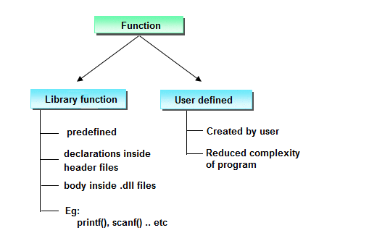

Slide 5
Function naming rule in c
A function name must begin with an alphabetic letter or the underscore _ character, but the other characters in the name can be chosen from the following groups:
Any lower-case letter from a to z
Any upper-case letter from A to Z
Any digit from 0 to 9
The underscore character
The general form of a function definition in C
return_data_type function_name(parameter list)
{
// body of the function
}

Slide 6
Parts of user-defined function in C
Function declaration return_Type function_Name(parameter1,parameter2,......);
function call function_Name(Argument list);
Function definition return_Type function_name(parameter_1, parameter_2,....)
{
//body of the function
}
Types of the user-defined function in C language
function with a return value and with an argument
function with a return value and without argument
function with no return value and with an argument
function with no return value and without argument

Slide 7
There are two methods to pass the data into the function in C language
1.Call by value
2.Call by reference.
Call by value in C
In call by value method, the value of the actual parameters is copied into the formal parameters. In other words, we can say that the value of the variable is used in the function call in the call by value method.
In call by value method, we can not modify the value of the actual parameter by the formal parameter.
In call by value, different memory is allocated for actual and formal parameters since the value of the actual parameter is copied into the formal parameter.
The actual parameter is the argument which is used in the function call whereas formal parameter is the argument which is used in the function definition.

Slide 8
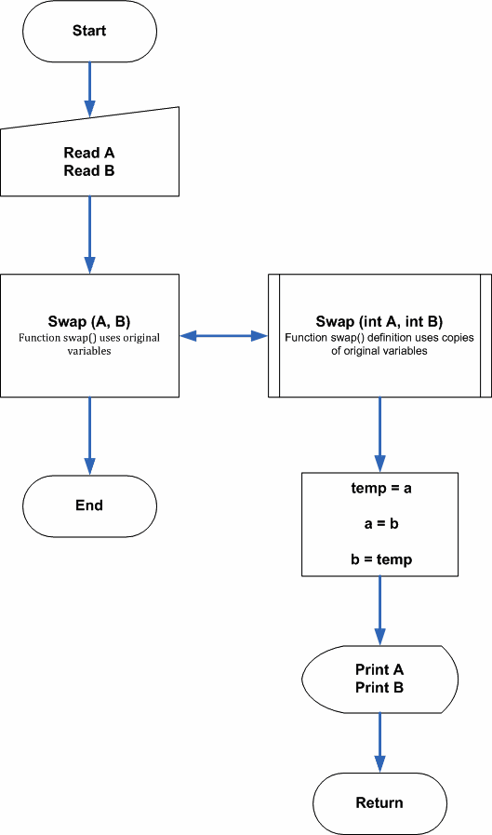
call by value flow chart

Slide 9
Call by reference in C
In call by reference, the address of the variable is passed into the function call as the actual parameter.
The value of the actual parameters can be modified by changing the formal parameterssince the address of the actual parameters is passed.
In call by reference, the memory allocation is similar for both formal parameters and actual parameters. All the operations in the function are performed on the value storedat the address of the actual parameters, and the modified value gets stored at the same address.

Slide 10
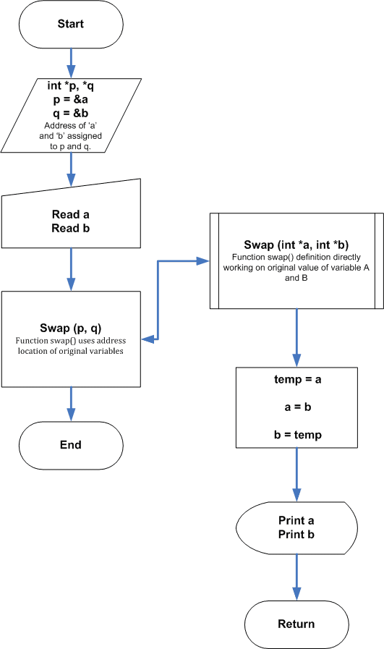
call by referance flow chart

Slide 11
1.Passing array as arguments in functions
2.Passing structure as an arguments in function
3.Passing pointer as an arguments in function
4.Passing string as an arguments in function

Slide 12
Advantages of Using Functions in C Programming
It will reduce the time complexity
One of the primary achievements of the C functions is reusability.
we can call a function any place in program
can easily correct or debug the program
We can perform the tracking of a large C program pretty easily if we divide it into various functions.

