Slide 1
Medical Visual Question Answering - Multimodal Fusion
brought to you by - Anjali Mudgal, Udbhav Kush, Aditya Kumar

Slide 2
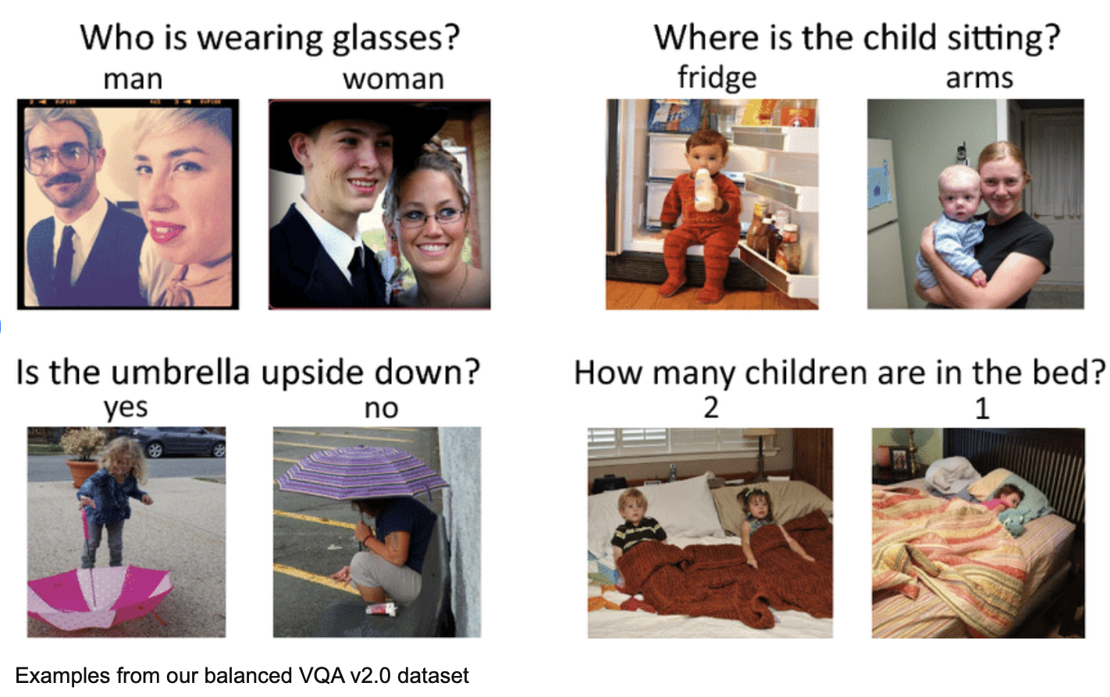
Vision-Language Pre-training -> Image Scene Understanding
Notes:
Recent years have seen significant advancements not only in the respective domains of Natural Language Processing (NLP) and Computer Vision (CV) but also in tasks involving multiple modalities (text + image features) such as image captioning, visual question answering (VQA), cross-modal retrieval, visual common-sense reasoning, and more. Among these, VQA has particularly drawn the interest of several researchers. VQA is a multimodal task wherein, given an image and a natural language question related to the image, the objective is to produce a natural language answer correctly as output. It involves understanding the content of the image and correlating it with the context of the question asked. Because we need to compare the semantics of information present in both of the modalities — the image and natural language question related to it — VQA entails a wide range of sub-problems in both CV and NLP (such as object detection and recognition, scene classification, counting, and so on). Thus, it is considered an AI-complete task. Vision-Language Pre-training (VLP) has advanced the performance for many vision-language tasks. However, most existing pre-trained models only excel in either understanding-based tasks or generation-based tasks.

Slide 3
Why Medical VQA?
Increased Electronic Health Records -> Increased Autonomy and Accessibility
Where’s the gap? 1. Not accompanied by credible, reliable and accurate diagnosis. 2. Preventing misleading or incorrect diagnosis from open-source agents. 3. Patient DLP
Notes:
The field of medicine has seen great technological advancements with increases in the amount and accessibility of data. With the federal regulations around electronic health records (EHR), patients have now more access to their medical data than ever before. Given that patients can independently check their health records outside of their official consultations, there is an increased need for an accessible way to have their questions answered correctly. Patients can book a consultation with a doctor to obtain answers to their questions, but may be hesitant due to time and money constraints. On the other hand, patients have the option to rely on search engines and conversational agents such as Chat-GPT [3]. However, there is an increased risk of getting misleading or incorrect information. To overcome these challenges, there is a need for a system that helps patients to better manage and understand their medical data without oversight from a healthcare professional. A Med-VQA system could fulfill this need, particularly as its inclusion of natural language question input makes it suited for answering unguided natural language questions, like those that patients may have about their medical images.

Slide 4
Contributions
Dataset limitations -> long-way from clinical applications. I. Combined data source from two largest annotated medical dataset and performed strategic augmentations.
Medical vs general domain texts and images I. Hypothesized specialized pre-training / fine-tuning for improved domain-centric performance. (using BLIP) -> Faster training and improved performance II. Proposed unified vision-language pre-training architecture with novel fusion
Classification heads for Med-VQA I. Generation-based solution
Notes:
Medipix database - 8,000 question-answer pair to 24,000 question-answer pair.
The simple classifier approach for answer generation is inherently limited by its fixed answer space, restricting flexibility. Therefore, we explore decoder models that can generate free-form natural language answers, more suitable for complex medical reasoning. Additionally, we investigate late fusion techniques, as we believe separate bulky encoders can better capture rich representations from medical images and text before fusing them, compared to fusing from simple encoders. We hypothesize this late, powerful multimodal fusion can enhance Med-VQA performance.

Slide 5
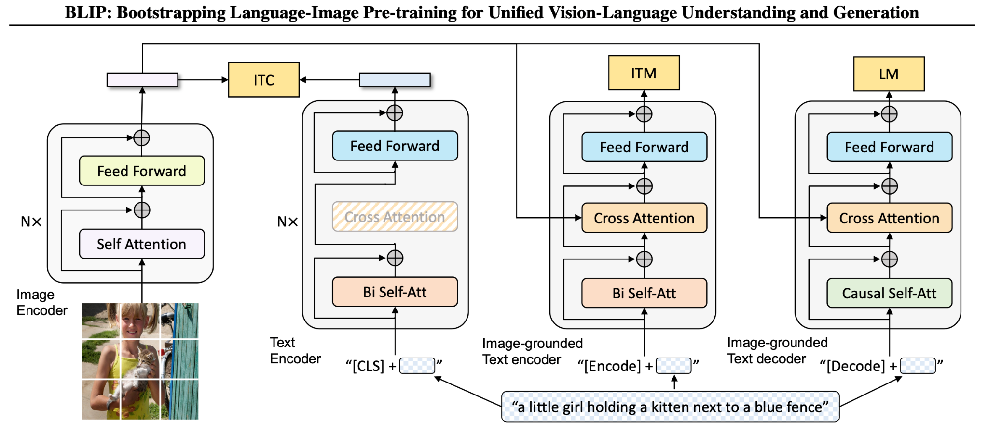
BLIP, BLIP, BLIP
Notes:
We also used BLIP as base since it is an answer generation model - For the task of Visual Question Answering (VQA), BLIP formulates it as an answer generation problem. During fine-tuning, the pre-trained model encodes an image-question pair into multimodal embeddings using the image-grounded text encoder, which are then passed to the answer decoder to generate the answer. The VQA model is fine-tuned using the language modeling (LM) loss with ground-truth answers as targets [11]. Pre-trained model details:
1.
The image transformer is initialized from ViT
pre
-trained on ImageNet [15][19],
2.
The text transformer is initialized from BERT_base[16].
They use the same pre-training dataset as [21] with:
1.
Two Human-annotated datasets COCO and Visual Genome [22].
2.
Three web datasets: Conceptual Captions [23], Conceptual 12M [23], SBU captions [24].

Slide 6
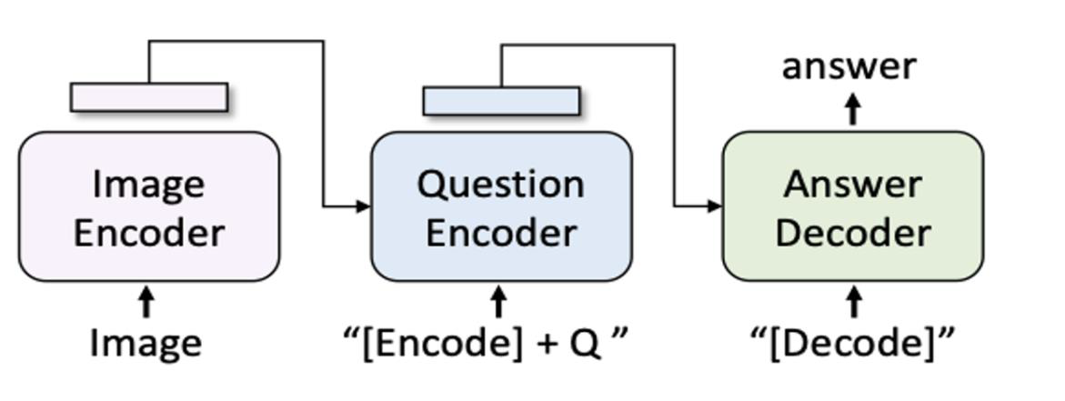
VQA Using BLIP
Notes:
The BLIP model architecture consists of layers that process both visual and textual inputs in a unified manner.
Visual Processing: Pass the visual features extracted from the images through a visual encoder network, which captures the visual information.
Textual Processing: Process the encoded textual data through a textual encoder network, which understands the semantic meaning of the text.
Fusion: Combine the visual and textual representations using fusion mechanisms such as attention mechanisms or multi-modal fusion layers. This step aims to create a joint representation that captures the correlation between the visual and textual modalities.

Slide 7
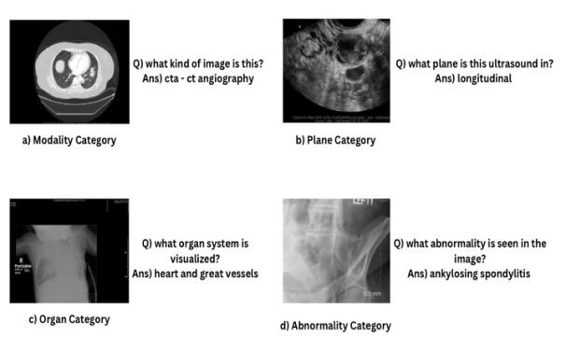
Medical VQA Dataset
Notes:
After consolidating the datasets, our combined corpus comprises 14,590 question-answer pairs in the training set, 2,000 pairs in the validation set, and 500 pairs in the test set.

Slide 8
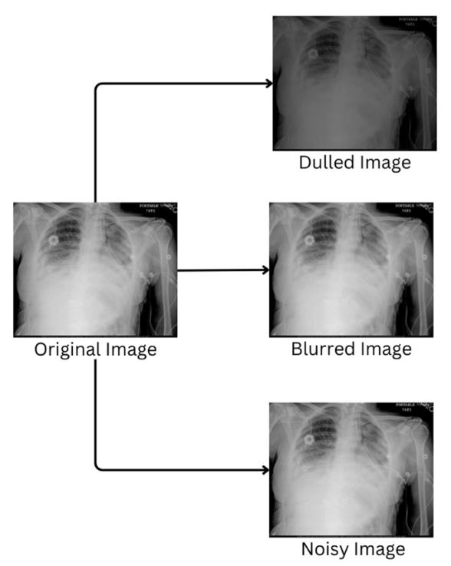
Augmentations

Slide 9
Experimentations
BLIP Pre-trained – Benchmarking
BLIP end-to-end Fine-tuning I. Time consuming + Dataset limitations II. Why not try specialized fine-tuning?

Slide 10
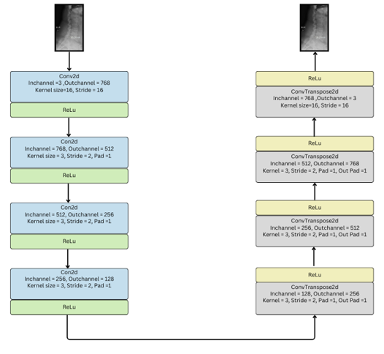
BLIP Vision Encoder – Incorporating Medical Domain Knowledge
3. Dissecting Vision Encoder - Convolution Patch Embedding layer was selected
Notes:
Pre-training is key - Therefore a more domain-centric trained model component should perform better than non-domain centric model component.

Slide 11
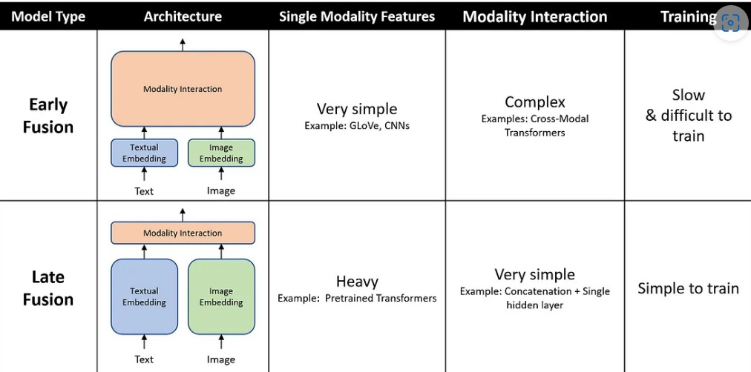
Early Fusion vs Late Fusion
Notes:
Combination of both these is the proposed architecture.

Slide 12
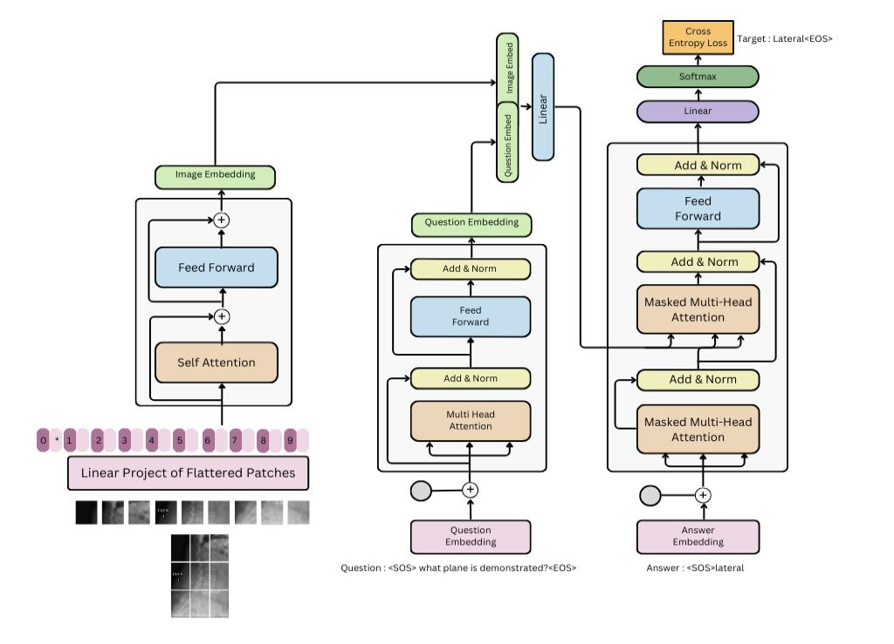
4. Proposed Architecture
Notes:
Combination of both these is the proposed architecture.
Start
Target was to get domain specific rich medical image embedding
For text encoder ->
1) Auto tokenizer
2) Question encoding
Fusion
Vision transformer -> each image is resized 384 * 384
With the kernel size of 16 and stride of 16 -> we will result in 24*24 features i.e 576 after attaching a positional embedding at the start we get the patch wise embedding from vision encoder of size (Batch, 577,768)
To make the text encoding of the same size we keep question seq size as 577 and d_model as 768 .
For vocabulary
We tried to create our own subword tokenizer and vocabulary using the train dataset available.
The concatenated embedddng would be (Batch, 577, 768*2 ). We then

Slide 13
Metrics
BLEU Score
ROUGE Score

Slide 14
Results - Quantitative
S no. | Model Version | BLEU score | ROUGE score
1. | Base BLIP | 0.12 | 0.15
2. | Fine-tuned BLIP - end-to-end | 0.37 | 0.40
3. | Convolution Patch Embedding Fine-tuned + Base BLIP | 0.13 | 0.17
4. | Convolution Patch Embedding Fine-tuned + Fine-tuned BLIP model | 0.38 | 0.42
5. | Proposed Architecture | 0.41 | 0.44

Slide 15
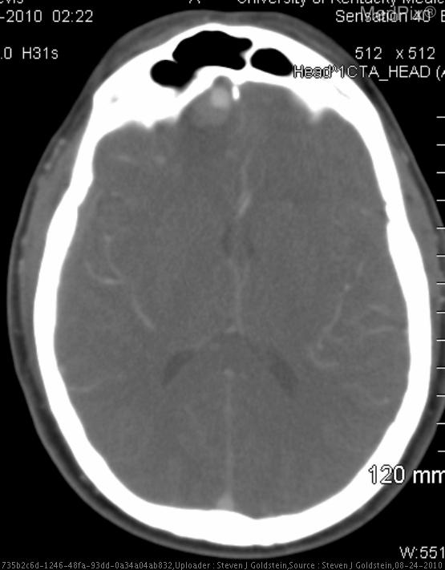
Results - Qualitative
Question - what modality is shown? Ground Truth - cta - ct angiography Answers - 1. Pre-trained BLIP: no 2. Fine-tuned BLIP: ct noncontrast 3. Convolution Fine-tuned BLIP: cta - ct angiography 4. Proposed Architecture: cta - ct angiography

Slide 16
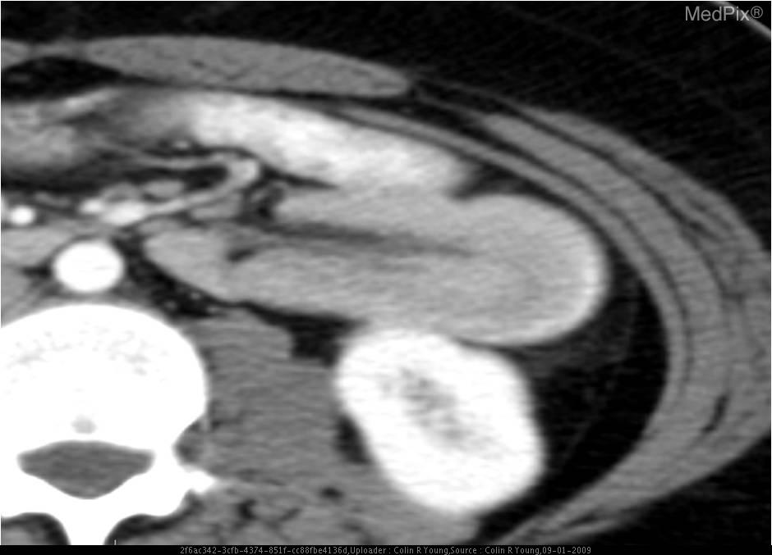
Results - Qualitative
Question: what type of contrast did this patient have? Ground Truth: iv Answers: 1. Pre-trained BLIP: no 2. Fine-tuned BLIP: iv 3. Convolution Fine-tuned BLIP: iv 4. Proposed Architecture: iv

Slide 17
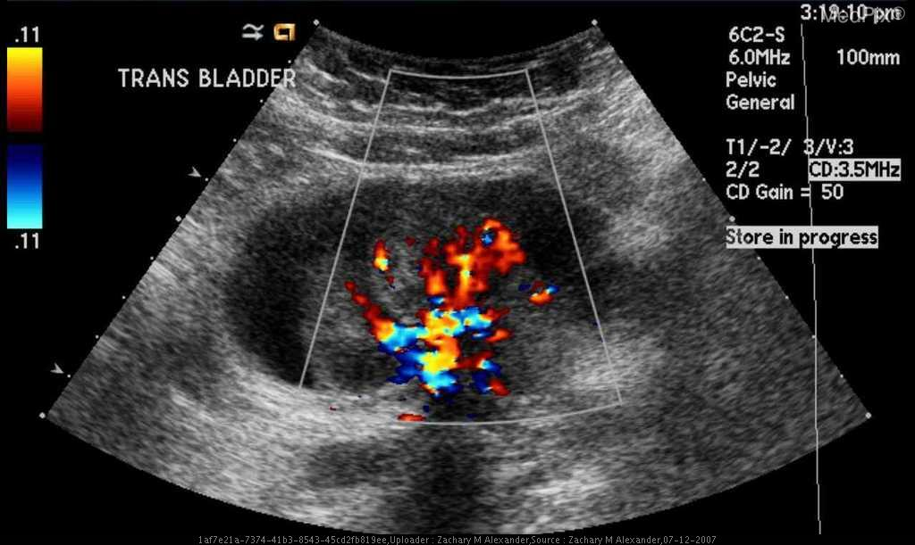
Results - Qualitative
Question: what imaging method was used? Ground Truth: us-d - doppler ultrasound Answers: 1. Pre-trained BLIP: yes 2. Fine-tuned BLIP: us - ultrasound 3. Convolution Fine-tuned BLIP: us - ultrasound 4. Proposed Architecture: us - ultrasound

Slide 18
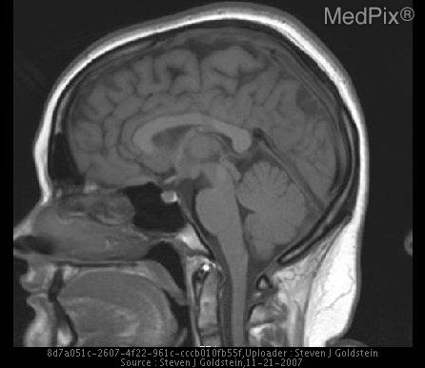
Results - Qualitative
Question: is this a noncontrast mri? Ground Truth: yes Answers: 1. Pre-trained BLIP: yes 2. Fine-tuned BLIP: no 3. Convolution Fine-tuned BLIP: yes 4. Proposed Architecture: yes

Slide 19
Conclusion
Explored medical VQA on radiology scans using enhanced BLIP architecture, showing promising improvements
Key limitations: lack of large medical datasets, need for data augmentation/custom tokenizers and further medical expert validation
VQA technology has potential to revolutionize radiology analysis but requires continued dataset growth, architecture innovations, clinical evaluations
Notes:
This research paper explored the application of Visual Question Answering (VQA) technology in the medical domain, focusing on radiology scans. By leveraging and enhancing the BLIP architecture and proposing a multimodal transformer-based architecture, we demonstrated significant improvements in generating accurate answers to questions about medical images.
However, the study has limitations, primarily the lack of large-scale annotated medical datasets. To address this, we employed data augmentation techniques and developed a custom medical tokenizer. Despite these efforts, further research, validation, and collaboration with medical experts are necessary to curate larger datasets and assess the models' performance in clinical settings.
In conclusion, this paper showcases the potential of VQA technology in revolutionizing medical radiology analysis. With continued advancements in dataset curation, architectural innovations, and extensive clinical validation, VQA systems hold great promise in empowering healthcare professionals and enhancing patient care. Future research should focus on addressing the limitations and conducting thorough clinical evaluations to facilitate the successful integration of VQA technology in real-world medical settings.

