Slide 1
Multi-Agent Pathfinding
with Real-Time Heuristic Search
BMAA* — Bounded Multi-Agent A*
MUKESH GUPTA 2511CS10
MANISH SINGH 2511AI52
KUMAR ARYAN 2511AI01
ANUP KUMAR GOND 2511CS01
Presented for CS5201 Advanced AI — IIT Patna

Slide 2
Presentation Outline
01
Problem Formulation
02
Related Work
What is MAPF? Formal definition & metrics
A*, WHCA*, FAR, Real-Time Heuristic Search
03
Our Approach — BMAA*
04
Working Examples
Core algorithm, parameters, pseudocode
Step-by-step visual walkthroughs
05
Experiments & Results
06
Conclusions
Completion rate, time, travel distance
Key takeaways & future directions
Multi-Agent Pathfinding with Real-Time Heuristic Search | BMAA*

Slide 3
01 | Problem Formulation
Defining Multi-Agent Pathfinding (MAPF)
Multi-Agent Pathfinding | BMAA*

Slide 4
What is Multi-Agent Pathfinding (MAPF)?
Find collision-free paths for multiple agents on a known map
Each agent moves from its start location to its goal location
Common in video games for Non-Player Characters (NPCs)
StarCraft, Dragon Age, WarCraft III — real-world use cases
Agents must not swap positions or occupy the same node simultaneously
A1
A2
G3
A3
G2
G1
🟢 = Agent □ = Goal ■ = Wall
8-neighbor grid (Dragon Age: Origins style)
Multi-Agent Pathfinding with Real-Time Heuristic Search | BMAA*

Slide 5
Formal MAPF Definition
Graph G = (N, E, c)
Agents A = {a¹ ... aⁿ}
N = set of nodes (grid cells)
E ⊆ N × N = edges between cells
c(e) = edge cost (1 or √2)
Diagonal neighbors: cost √2
Self-loop edges: cost 0 (wait)
8-neighbor rectangular grid
Each agent: (nᵢstart, nᵢgoal) pair
Time advances in discrete steps
One node occupied per time step
Collision: swap or same-node move
Central NPC controller manages moves
Agent waits if path blocked
Time step when agent last reached goal
Performance Metrics
Completion Rate
Completion Time
Travel Distance
% agents at goal when time limit reached
Sum of edge costs traversed by agent
Multi-Agent Pathfinding with Real-Time Heuristic Search | BMAA*

Slide 6
02 | Related Work
A* • WHCA* • FAR • RTAA*
Multi-Agent Pathfinding | BMAA*

Slide 7
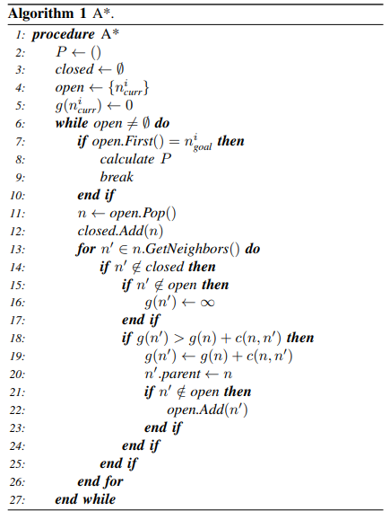
A* — Foundation Algorithm
pseudocode
f(n) = g(n) + h(n)
procedure A*
P ← ()
closed ← ∅
open ← {n_curr}
g(n_curr) ← 0
while open ≠ ∅ do
if open.First() = n_goal then
calculate P; break
end if
n ← open.Pop()
closed.Add(n)
for n' ∈ n.GetNeighbors() do
if n' ∉ closed then
if g(n') > g(n)+c(n,n') then
g(n') ← g(n)+c(n,n')
n'.parent ← n
open.Add(n')
end if
end if
end for
end while
f-value drives expansion
g(n)
Cost of cheapest path found so far
h(n)
Heuristic estimate to goal (octile distance)
Open List
Nodes to be expanded (priority queue)
Closed List
Already expanded nodes
Multi-Agent Pathfinding with Real-Time Heuristic Search | BMAA*

Slide 8
A* — Visual Working Example
S
1+3=4
2+2=4
Legend
Expansion Order
Start node
① Start S: f=0+5=5
1+4=5
■
■
4+2=6
Goal node
② (0,1): f=1+4=5
■
3+2=5
4+1=5
Early expansion
③ (0,2): f=2+3=5
④ (1,3): f=4+2=6
Mid expansion
4+1=5
■
■
⑤ (2,3): f=5+1=6
Late expansion
⑥ (3,2): f=6+1=7
6+1=7
G
Wall obstacle
⑦ (4,3): f=7+1=8
⑧ Goal G reached!
Multi-Agent Pathfinding with Real-Time Heuristic Search | BMAA*

Slide 9
Online MAPF Algorithms — WHCA* & FAR
WHCA* — Windowed Hierarchical
Cooperative A*
FAR — Flow Annotated Replanning
Finds paths for next W moves (window)
Reservation table adds time dimension
Expensive searches (3D space-time)
Ignores collisions beyond window
Requires complete NPC control
Window must be large → slow
Reservation table (no time dimension)
Flow annotations = one-way streets
Agents wait for blocked moves to clear
Deadlock breaking via goal-pushing
Agents still get stuck sometimes
Low travel distances but poor scaling
⚠️ Both are non-real-time: must find complete paths before any agent moves — too slow for large-scale games!
Multi-Agent Pathfinding with Real-Time Heuristic Search | BMAA*

Slide 10
FAR — Flow Annotations Explained
Makes undirected graph DIRECTED (one-way streets)
Row 1: westbound → Row 2: eastbound → alternating
Col 1: northbound → Col 2: southbound → alternating
Sink/source nodes get diagonal edges added
Corridor edges remain undirected
Reduces head-to-head agent collisions
Any node still reachable from all original nodes
FAR Flow Direction Legend:
← West (even rows)
→ East (odd rows)
↑ North (even cols)
↓ South (odd cols)
Multi-Agent Pathfinding with Real-Time Heuristic Search | BMAA*

Slide 11
Real-Time Heuristic Search (RTHS)
RTHS performs a CONSTANT amount of search per move — regardless of map size or distance to goal
Why RTHS?
How It Works
Key Property
NPC starts moving immediately
Small search loss on re-tasking
No map preprocessing needed
Works with dynamic environments
Search only within lookahead L
Move along computed prefix path
Update heuristic values to avoid loops
Repeat until goal reached
Heuristic values grow over time
Becomes locally consistent → complete
Avoids cycling without reaching goal
Trades path quality for speed
RTAA* (Real-Time Adaptive A*) — the RTHS foundation for BMAA*
Multi-Agent Pathfinding with Real-Time Heuristic Search | BMAA*

Slide 12
RTAA* — Real-Time Adaptive A*
pseudocode
Key Innovations of RTAA*
procedure RTAA*
repeat
// Search phase (bounded A*)
run A* for at most 'expansions' nodes
let n_best = open.First() // best frontier node
f_best = g(n_best) + h(n_best)
// Update heuristic values (learn!)
for each n in closed:
h(n) ← f_best − g(n)
// Move along path prefix
move agent along path toward n_best
for at most 'moves' steps
until agent reaches goal
Bounded Search
Limited to 'expansions' node expansions → guaranteed real-time
Heuristic Update
h(n) ← f_best − g(n) for all expanded nodes
Path Prefix
Only compute prefix, not full path — move and repeat
Completeness
Monotonically increasing heuristics prevent infinite loops
BMAA* = one RTAA* instance per agent, treating other agents as moving obstacles
Multi-Agent Pathfinding with Real-Time Heuristic Search | BMAA*

Slide 13
03 | Our Approach — BMAA*
Bounded Multi-Agent A*
Multi-Agent Pathfinding | BMAA*

Slide 14
BMAA* — Core Idea & Design Philosophy
Every agent runs its own independent RTAA* copy and treats other agents as (moving) obstacles
Central NPC Controller
Agent 1
RTAA*
Agent 2
RTAA*
Agent 3
RTAA*
Agent 4
RTAA*
Agent 5
RTAA*
h-values
(private)
h-values
(private)
h-values
(private)
h-values
(private)
h-values
(private)
✓ Real-time ✓ No coordination ✓ No map pre-processing ✓ Dynamic re-tasking ✓ Modular design
Multi-Agent Pathfinding with Real-Time Heuristic Search | BMAA*

Slide 15
BMAA* — Parameters
expansions
Limit on A* node expansions per search phase
Default:
32
Effect: Controls search depth per move
vision
Distance within which agents see other agents
Default:
√2
Effect: Treating nearby agents as obstacles
moves
Number of moves per path prefix before replanning
Default:
32
Effect: Balances replanning vs. movement
push
Boolean: can agents push others off goal nodes?
Default:
true/false
Effect: Prevents permanent blockage
flow
Boolean: use FAR-style flow annotations?
Default:
true/false
Effect: Reduces head-on collisions
Multi-Agent Pathfinding with Real-Time Heuristic Search | BMAA*

Slide 16
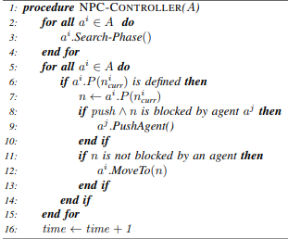
Algorithm 2 — BMAA* NPC Controller
Execution Flow (per time step)
All agents:
Search-Phase()
For each agent:
get next node n
push=true ∧
n is blocked?
PushAgent()
blocker moves
n not blocked?
MoveTo(n)
time ← time + 1
Multi-Agent Pathfinding with Real-Time Heuristic Search | BMAA*

Slide 17
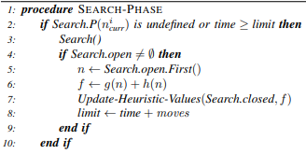

Algorithm 3 & 4 — Search Phase & Heuristic Update
Why does this work?
Re-plan condition
Path expired (moves steps taken) OR agent was pushed off path → triggers new search
Bounded A* search
Expands at most 'expansions' nodes → guaranteed time budget per step
Best frontier node
The node A* was about to expand next = target for path prefix
h(n) ← f − g(n)
Raises heuristics of expanded nodes
Prevents revisiting dead-end paths
Monotone increase
Heuristics only increase → agent always makes progress toward goal
Multi-Agent Pathfinding with Real-Time Heuristic Search | BMAA*

Slide 18
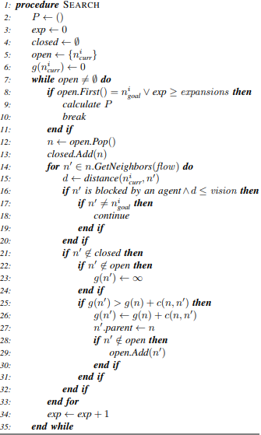
Algorithm 5 — BMAA*'s Modified A* (Search)
Key Differences from Standard A*
1. Expansion Bound
Stops after 'expansions' nodes
→ prefix path, not full path
2. Agent as Obstacle
If n' is an agent within 'vision'
→ skip (treat as wall)
3. Goal Exception
Agents blocking the goal node
are NOT treated as obstacles
4. Flow Filter
GetNeighbors(flow=true) returns
only FAR-annotated neighbors
5. Private h-values
Each agent maintains own
heuristic table — never shared
Multi-Agent Pathfinding with Real-Time Heuristic Search | BMAA*

Slide 19
04 | Working Examples
Step-by-step visual walkthrough of BMAA*
Multi-Agent Pathfinding | BMAA*

Slide 20
BMAA* Walkthrough — Time Steps 0 & 1
T = 0 (Initial State)
T = 1 (After Search + Move)
A1
A2
A1
A2
→
G2
G1
G2
G1
T=0: Search Phase
T=0: Execute Phase
Heuristic Update
Each agent runs RTAA* (expansions=4)
A1 searches toward G1=(5,5), A2 toward G2=(5,0)
Other agent treated as obstacle in vision range
A1 moves (0,0)→(1,1) | A2 moves (0,5)→(1,4)
No collision — different nodes
h(n) ← f_best − g(n) for all closed nodes
Values updated locally for each agent independently
Multi-Agent Pathfinding with Real-Time Heuristic Search | BMAA*

Slide 21
BMAA* Walkthrough — Collision Avoidance
Agents approaching each other
T=1: Close proximity (vision=√2)
A1 →
← A2
A1
A2
G2
A1
A2
G1
Agent sees blocker → marks cell as obstacle → re-plans detour path via updated h-values
Collision Avoidance Mechanism:
Within vision=√2: each agent sees the other and treats its cell as obstacle. Each agent re-plans individually — no communication needed
Result: agents take alternate paths around each other
Multi-Agent Pathfinding with Real-Time Heuristic Search | BMAA*

Slide 22
BMAA* — Push Mechanism (push = true)
Problem: Agent parked at goal blocks another
A2
↗
A1
→?
G2
A2
✓
G1
PUSH!
G1✓
A1
A1 wants → G1
but A2 blocks path
(A2 already at goal)
After push: A2 moved to neighbor,
A1 reaches G1.
A2 returns to G2 later.
A2 always re-runs RTAA* even at goal → automatically returns to G2 after being pushed
Multi-Agent Pathfinding with Real-Time Heuristic Search | BMAA*

Slide 23
BMAA* — Heuristic Update Walkthrough
Before Search (iteration 1):
After Search (iteration 1):
∞
∞
∞
∞
∞
8
7
6
5
5
∞
∞
∞
∞
7
■
5
4
4
S
∞
∞
∞
After RTAA*
iteration →
0
■
4
3
3
∞
∞
∞
∞
5
4
■
2
2
∞
∞
∞
∞
G
5
4
4
1
G
h-values mostly ∞
→ agent has not explored yet
h-values updated for all expanded nodes
→ gradient pointing toward goal
h(n) = f_best − g(n)
Multi-Agent Pathfinding with Real-Time Heuristic Search | BMAA*

Slide 24
BMAA* Variants — Feature Combinations
Variant
push
flow
Description
Key Benefit
BMAA*
Base version
✗
✗
Real-time, no coordination
Real-time, no coordination
BMAA*-c
Push enabled
✓
✗
Handles goal-blocking agents
Handles goal-blocking agents
BMAA*-f
Flow annotations
✗
✓
Reduces head-on collisions
Reduces head-on collisions
BMAA*-f-c
Push + Flow
✓
✓
Best overall (7/10 maps)
Best overall (7/10 maps)
All variants: lookahead=32, moves=32, vision=√2, octile heuristic
Multi-Agent Pathfinding with Real-Time Heuristic Search | BMAA*

Slide 25
05 | Experiments & Results
Evaluation on MovingAI benchmark maps
Multi-Agent Pathfinding | BMAA*

Slide 26
Experimental Setup
Benchmark Maps (10 total)
Algorithm Settings
Dragon Age: Origins (DAO) — 3 maps
WarCraft III (WCIII) — 3 maps
Baldur's Gate II (BGII) — 3 maps (512×512)
Baldur's Gate II — 1 original size map
MovingAI benchmark dataset
BMAA* params: lookahead=32, moves=32, vision=√2
FAR / A*-Replan: reservation size = 3
Heuristic: Octile distance (all algorithms)
C# implementation, single Intel Broadwell 2.1GHz core
3 GB RAM, 30 second runtime limit per instance
Travel Distance ∝ 1 / Lookahead (Lookahead ↑ → Travel distance ↓, but search time per move ↑)
Completion Rate ∝ 1 / Vision (Vision ↑ → Agents react to far agents → Completion rate ↓)
Agent Counts Tested:
10 MAPF instances per map | Unique random start & goal per agent
25 to 400 agents (increments of 25) + 400 to 2000 agents (increments of 200)
Multi-Agent Pathfinding with Real-Time Heuristic Search | BMAA*

Slide 27
Results — Aggregate Completion Rates
Key Findings
BMAA* > FAR
Significantly higher rates for >200 agents
Push helps
BMAA*-c/-f-c slightly > BMAA*
Flow helps
BMAA*-f/-f-c best on 7/10 maps
FAR collapses
Near 0% for 1000+ agents
BMAA* scales
Still 26-38% at 2000 agents
Multi-Agent Pathfinding with Real-Time Heuristic Search | BMAA*

Slide 28
Results — Completion Time & Travel Distance
⏱ BMAA* is Fastest
📏 FAR Travels Less
✅ Good Trade-off
BMAA* (3.5s) and BMAA*-f (3.4s)
are 3–4× faster than FAR (12.3s)
FAR travel dist = 225 vs BMAA* = 986
BMAA* explores more due to RTHS detours
Longer paths but much higher completion
rates — players notice NPCs NOT arriving!
Multi-Agent Pathfinding with Real-Time Heuristic Search | BMAA*

Slide 29
Failure Cases — FAR vs BMAA*
FAR Problem: One-cell Corridors
BMAA* Problem: Dead Ends
A1
A2
A3
A4
A5
G1
A1
All FAR agents pile into
the corridor → gridlock!
Path sharing creates
massive congestion.
G1
Misleading initial h-values
→ agent enters dead end
→ heuristic update fixes it
(may take extra moves)
BMAA* agents take
individual detours!
Addressed by h-value
update over iterations!
Multi-Agent Pathfinding with Real-Time Heuristic Search | BMAA*

Slide 30
Conclusions & Takeaways
✅ BMAA* outperforms FAR
⚡ Real-Time by Design
🔧 Modular & Extensible
Higher completion rates for >200 agents
Faster completion times (3–4× better)
Works in constant time per move
No preprocessing or agent coordination
Flow annotations + Push mechanism
Easily add/remove enhancement modules
⚠️ Trade-off Exists
🔮 Future Directions
Longer travel distances vs FAR
Dead-end problem partially unresolved
Search space reduction, precomputation
Per-problem algorithm selection with DL
Multi-Agent Pathfinding with Real-Time Heuristic Search | CS5201 — IIT Patna | BMAA* by Sigurdson et al.

