Slide 1
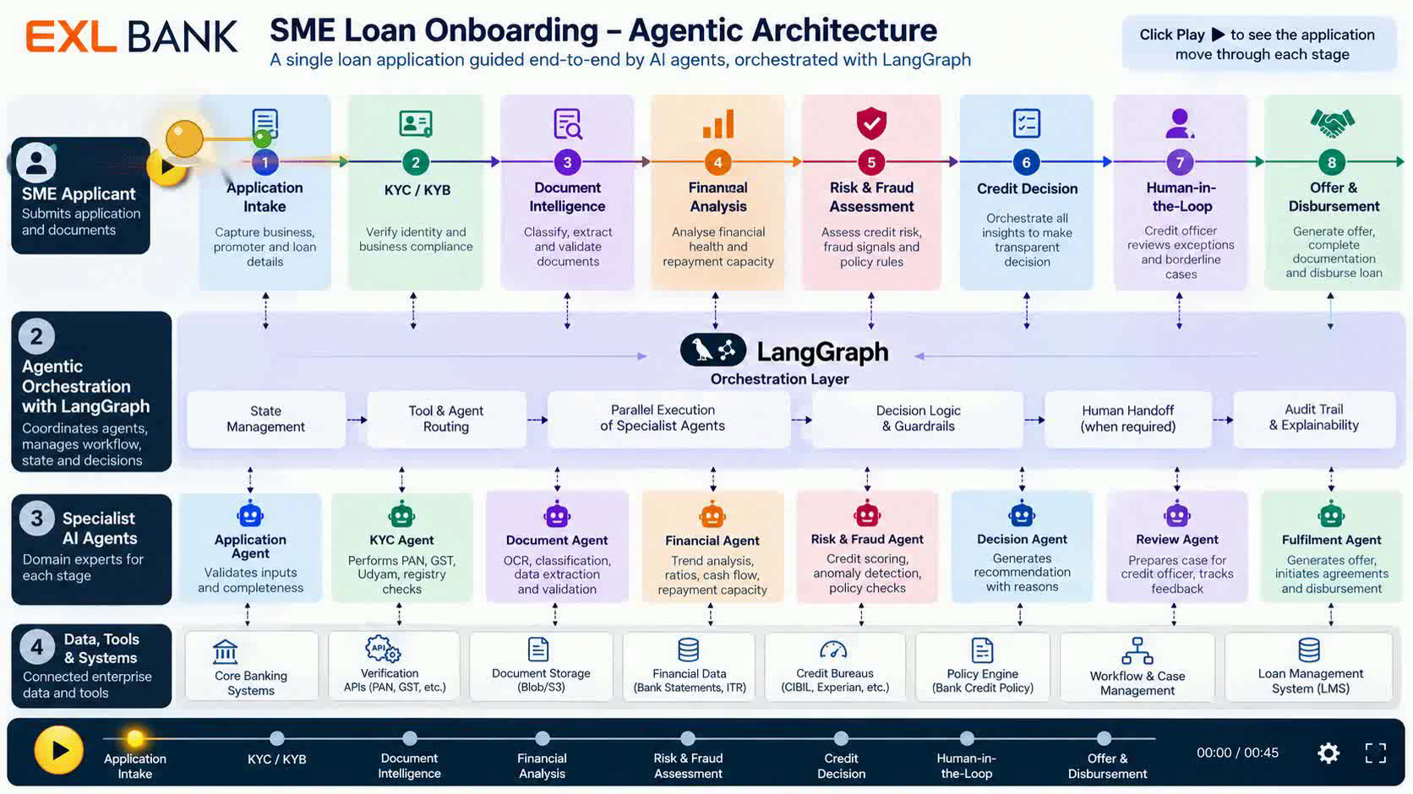
Notes:
Click the Play button. The gold loan-application ball rolls through all 8 stages. The central LangGraph layer represents the agentic orchestration workflow: state management, agent/tool routing, parallel execution, decision guardrails, HITL routing, and audit/explainability.

