Slide 1
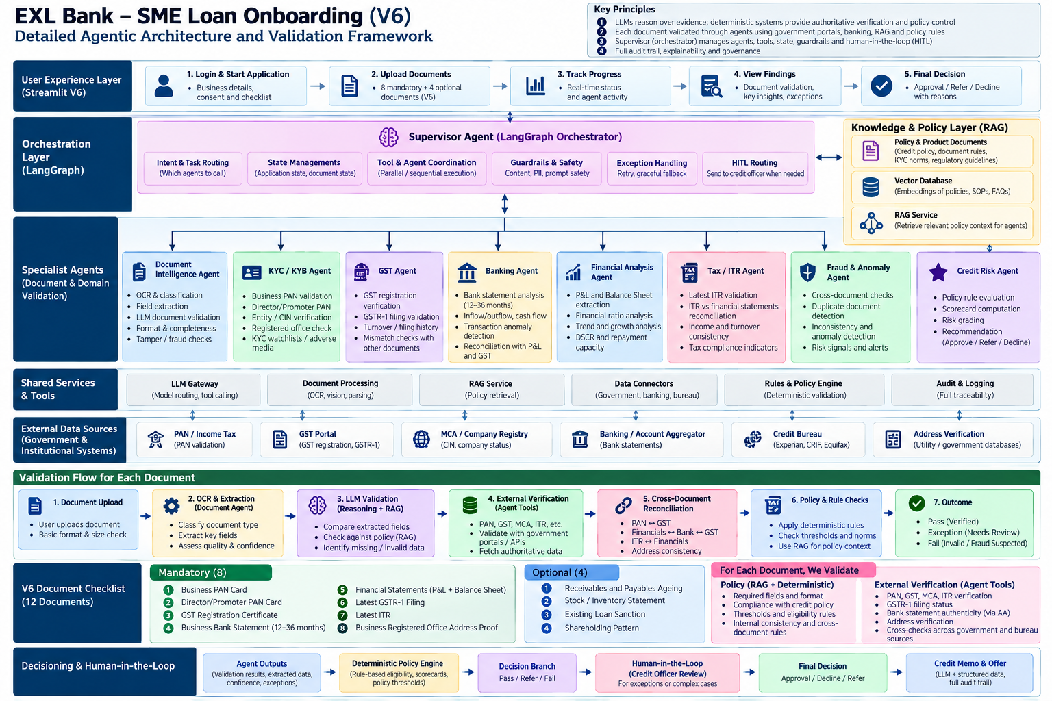
EXL Bank – SME Loan Onboarding
Detailed Agentic Architecture & Validation Framework
EXL Bank SME Loan Onboarding — Concept architecture | Synthetic data / mock integrations

Slide 2
1. Supervisor & LangGraph Orchestration
The Supervisor does not approve the loan; it controls state, sequencing, parallelism, tools, exceptions and human handoff.
SUPERVISOR AGENT — LANGGRAPH ORCHESTRATOR
Intent & task routing • State/checkpoint management • Agent/tool coordination • Parallel execution • Guardrails • Retry/recovery • HITL routing
Document Intelligence
OCR / vision
field extraction
LLM validation
KYC / KYB
PAN / promoter
MCA / address
KYC checks
GST / Tax
GSTIN / GSTR-1
ITR / filing
turnover
Banking / Cashflow
12–36M statements
inflows/outflows
reconciliation
Financial Analysis
P&L / BS
ratios / DSCR
repayment capacity
Fraud / Anomaly
duplicates
inconsistency
risk signals
Credit Risk
scorecard
risk grade
recommendation
RAG / VECTOR DB
Retrieves policy, SOP, product and regulatory context.
TYPED TOOLS / MCP
GST, PAN, MCA, bureau, banking, address and document services.
DETERMINISTIC ENGINES
Policy thresholds, calculations, scorecards, eligibility and limits.
EXL Bank SME Loan Onboarding — Concept architecture | Synthetic data / mock integrations

Slide 3
2. Document Control — Validation of Every Uploaded Document
LLM reasoning interprets evidence; external systems establish authoritative facts; policy rules determine whether the evidence is acceptable.
1. UPLOAD
File type, size,
required document
2. OCR / VISION
Classification,
field extraction,
confidence
3. LLM + RAG
Semantic validation,
missing fields,
policy context
4. EXTERNAL VERIFY
GST / PAN / MCA /
Bank / Bureau /
Government APIs
5. RECONCILE
PAN↔GST
GST↔GSTR-1
Bank↔Financials
6. POLICY CHECK
Mandatory evidence,
thresholds,
product rules
7. OUTCOME
PASS / EXCEPTION /
FAIL
WHAT THE LLM VALIDATES
• Document type / semantics
• Extracted fields and relationships
• Internal consistency
• Missing or suspicious information
• Relevant policy context retrieved via RAG
WHAT EXTERNAL SYSTEMS VALIDATE
• GSTIN active / registration / filing
• PAN / entity records
• MCA company status / directors
• Bank statement authenticity / data
• Bureau exposure / DPD / obligations
WHAT POLICY ENGINE VALIDATES
• Mandatory documents present
• Product eligibility
• Turnover / DSCR / exposure thresholds
• Risk-grade cut-offs
• Referral / decline conditions
EXL Bank SME Loan Onboarding — Concept architecture | Synthetic data / mock integrations

Slide 4
3. RAG, Vector DB, Government Portals & Policy — Clear Separation
The architecture prevents the LLM from becoming the source of truth for regulated verification or credit approval.
RAG / VECTOR DATABASE
SOURCE OF KNOWLEDGE
• Credit policy
• Product rules
• KYC/KYB SOPs
• Regulatory guidance
• Operational SOPs
Question answered:
“What does our policy / SOP say?”
EXTERNAL SYSTEMS / MCP TOOLS
SOURCE OF FACTS
• GST portal
• PAN / Income Tax
• MCA / registry
• Account Aggregator / banking
• Credit bureaus
• Address / utility sources
Question answered:
“What is true in the external record?”
DETERMINISTIC POLICY ENGINE
SOURCE OF DECISION LOGIC
• Eligibility rules
• Thresholds
• Scorecards
• Exposure limits
• Product constraints
• Approve / refer / decline logic
Question answered:
“Does the verified evidence satisfy policy?”
EXAMPLE — GST CERTIFICATE VALIDATION
1. Document Agent extracts GSTIN = 20XXXXXXXXXX1Z5 → LLM checks document semantics and completeness.
2. RAG retrieves the applicable GST / lending SOP → tells the agent which evidence is required.
3. GST Tool calls the approved portal/API → authoritative status, legal name and filing information.
4. Reconciliation compares GST ↔ PAN ↔ GSTR-1 ↔ bank/financial evidence.
5. Policy Engine applies deterministic rules → PASS / EXCEPTION / FAIL.
6. Supervisor records evidence + confidence + exceptions in the LangGraph state/audit trail.
EXL Bank SME Loan Onboarding — Concept architecture | Synthetic data / mock integrations

Slide 5
4. From Evidence to Final Credit Decision
Agent outputs become structured evidence; the deterministic policy engine creates the decision branch; the credit officer remains the human authority.
Evidence State
Verified fields
source references
confidence
exceptions
Specialist Agent Outputs
KYC/KYB
GST/Tax
Banking
Financial
Fraud/Risk
Policy Engine
Eligibility
thresholds
scorecard
exposure
Decision Branch
PASS
REFER
FAIL
HITL Credit Officer
Review evidence
resolve exceptions
authorize decision
Final Decision
Approve / Refer /
Decline + reason
SUPERVISOR OWNS
Workflow, state, routing, retries, tool calls, exception handling and HITL handoff.
POLICY ENGINE OWNS
Binding calculations and policy gates — not the LLM.
HUMAN OWNS
Exceptions, judgement, authorization and final commitment.
Core principle: LLMs orchestrate, interpret and explain • External systems verify facts • Deterministic engines enforce policy • Humans authorize commitment
EXL Bank SME Loan Onboarding — Concept architecture | Synthetic data / mock integrations

Slide 6
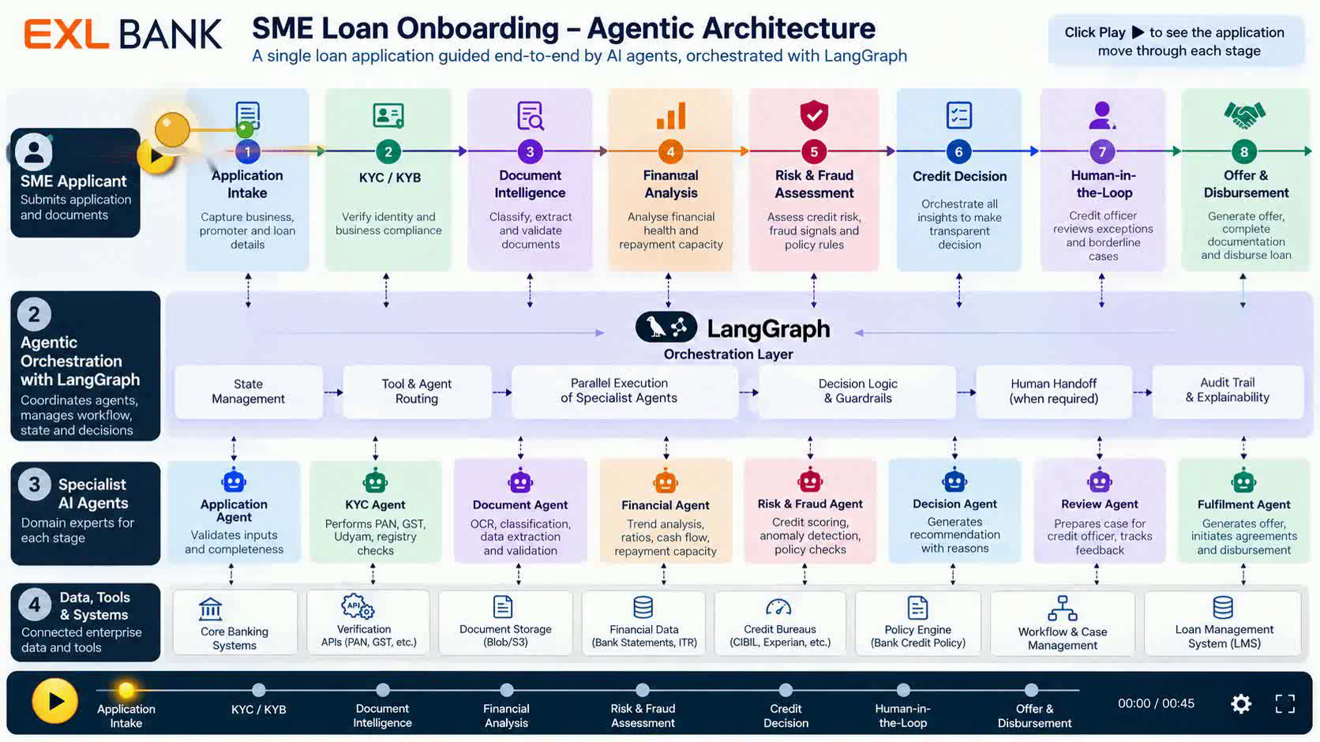
Notes:
Click the Play button. The gold loan-application ball rolls through all 8 stages. The central LangGraph layer represents the agentic orchestration workflow: state management, agent/tool routing, parallel execution, decision guardrails, HITL routing, and audit/explainability.

