Slide 1
Financial Data Analysis in Python
-A mini project
By
Bhupendra Kumar
MS - DS
Carolina University

Slide 2
The goal of this project was to analyze financial data and extract meaningful insights using Python
Question
Question
Question
Question
How has Dogecoin's price and market cap changed over time?
How volatile is Dogecoin?
What factors influence price changes?
Can we predict future prices?
What is the relationship between price, volume, and market capitalization?

Slide 3
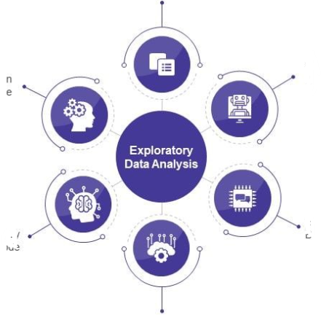
Exploratory Data Analysis
Handling Missing Values
Data Cleaning
Univariate Analysis
Bivariate Analysis
Statistical Data Analysis
Time Series Decomposition

Slide 4
Methodology:
Data Source
Modules Used
Data Overview
Dogecoin dataset obtained from Kaggle, containing daily price, volume, and market capitalization data from 2013 to 2021.
Conducted analysis in Google Colab using Python libraries such as Pandas, NumPy, Seaborn, Matplotlib, SciPy, and Sklearn."
The dataset included 2760 rows with information on price such as high, low, open, and close prices, along with trading volume and market cap. It has 10 columns with Sl.no. Name and symbol of the crytocurrency.

Slide 5
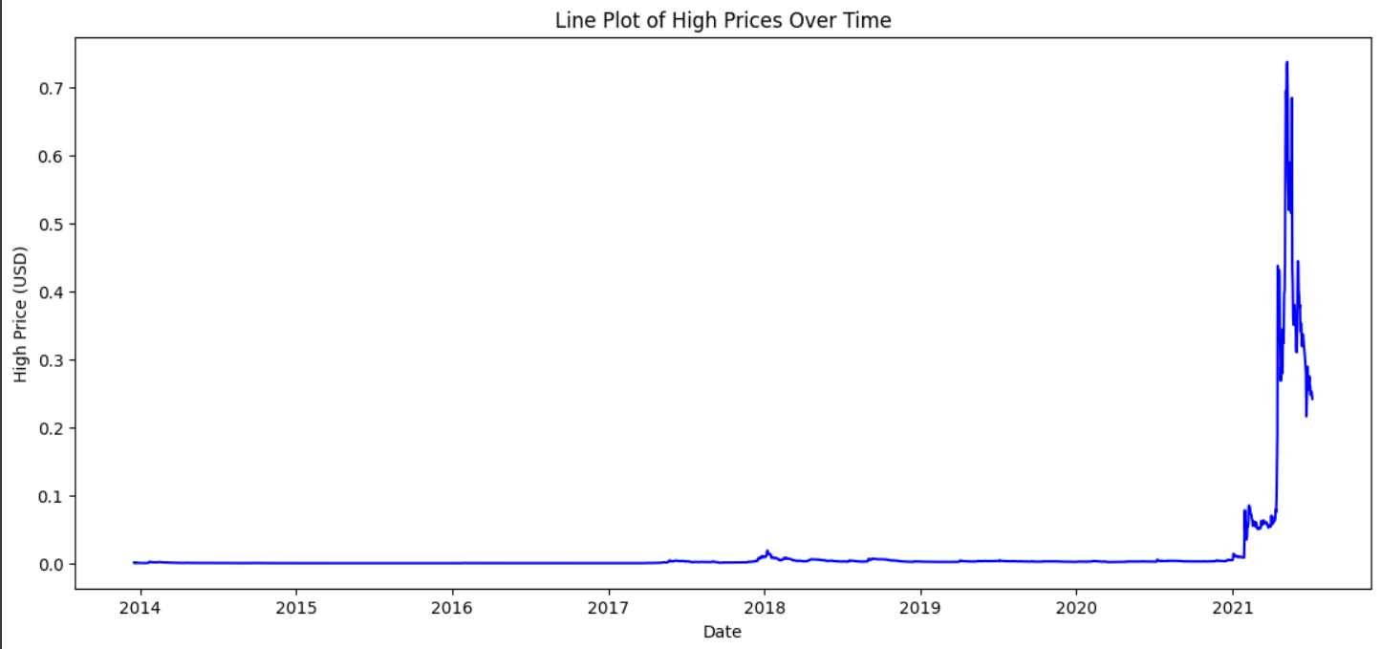
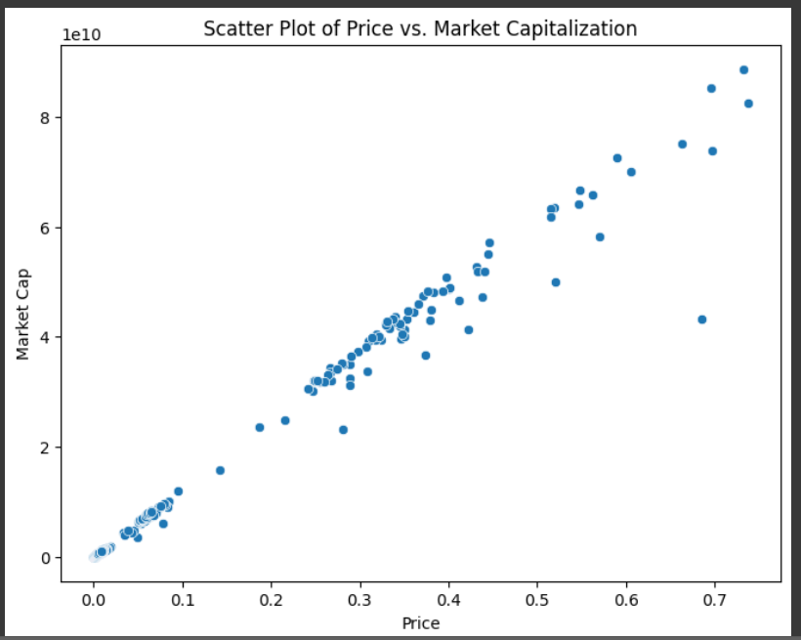
Univariate Analysis: The Univariate analysis provides that most of the variables are positively skewed with values grouping near low ranges and occasionally spikes and peaks.
Bivariate Analysis: A Scatter plot has been generated to analyze relationships between the Price and Market Cap of the cryptocurrency. The figures shows that there is a positive correlation between the price and the Market cap

Slide 6
Statistical Data Analysis:
T-Test showed that Dogecoin’s price mean was close to the hypothesis mean, meaning there were no extreme deviations.
A Paired T-Test comparing open and close prices showed that closing prices were slightly higher than opening prices, but not significantly.
One Sample T Test
Two Sample T-Test
Paired T-Test
ANOVA
T-Test showed no significant difference between high and low prices.
The result showed no major variations, meaning these values move together rather than independently.

Slide 7
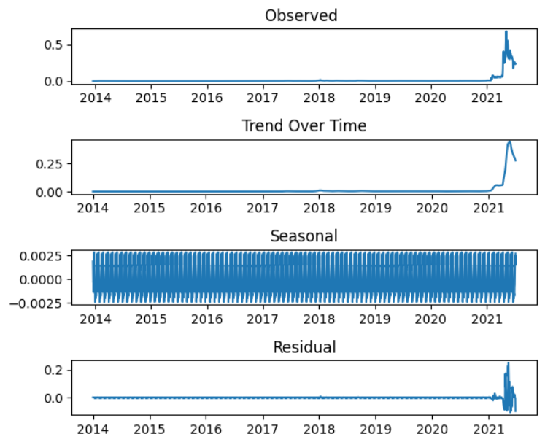
Time Series Analysis
Trend
Dogecoin’s price had an upward trend with periodic rises and falls.
Seasonality
There were recurring price fluctuations, likely due to external market factors.
Residuals
This component captured random noise in the data.

Slide 8
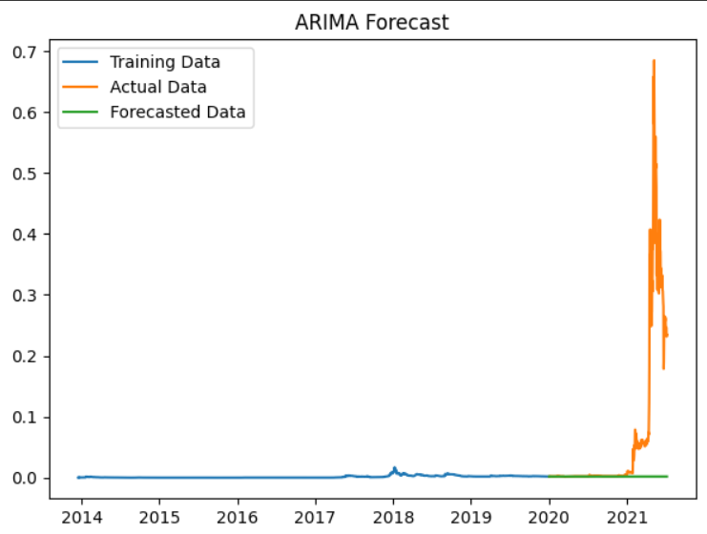
Forecasting price using ARIMA:
The data was split into training (80%) and testing (20%) sets with order (5, 1, 0) was fitted to the training data. The model's performance was evaluated using MSE

Slide 9
Key findings and Conclusion
✔️There is a strong positive correlation between Dogecoin’s price and its market capitalization.
✔️ High volatility was observed, especially in later years.
✔️ Statistical tests (T-tests, ANOVA) showed no significant price differences over time.
✔️ ARIMA provided better accuracy in forecasting compared to simpler models.

Slide 10
Thank You
Questions?

