Slide 1
Amazon Sales Dashboard
Sales Performance Analysis
By- Kumar Dushyant Patel

Slide 2
Project Objectives
Analyze Amazon sales performance
Identify top-performing categories and products
Monitor monthly trends using regional insights
Guide business decisions using Power BI

Slide 3
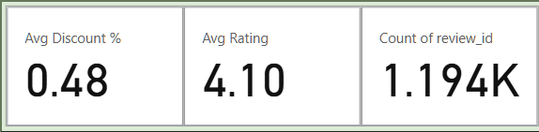
Key Performance Indicators (KPIs)
Average Discount: 0.48% – Indicates minimal promotional pricing, suggesting room to offer more competitive discounts.
Average Rating: 4.10 – Shows generally high customer satisfaction across products.
Review Count: 1.19K – Represents significant customer engagement and feedback volume.

Slide 4
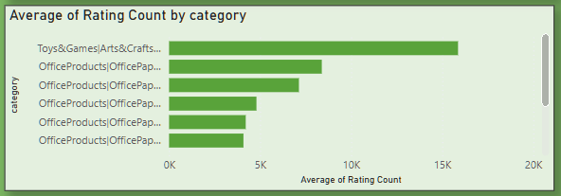
Customer Ratings by Category
The "Toys & Games | Arts & Crafts" category has the highest number of customer ratings, indicating high engagement or popularity.
Other categories under Office Products also show significant but lower rating volumes.
The visualization helps identify which categories receive the most customer attention, which can inform inventory or marketing focus.

Slide 5
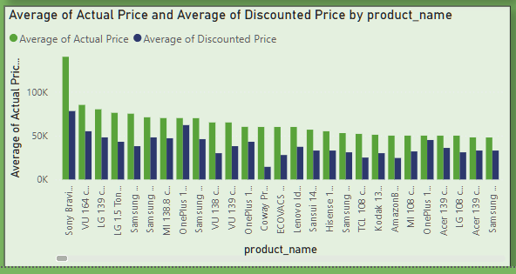
Top Products and Pricing Trends
Sony Bravia is the highest-priced product on average, both before and after discount.
A clear price gap is visible across many products, reflecting significant discounting strategies.
Products from brands like Samsung, LG, OnePlus, VU, and Kodak dominate the list, indicating strong market presence.
This visualization helps assess:
Pricing competitiveness
Discount effectiveness
Consumer interest in high-value products

Slide 6
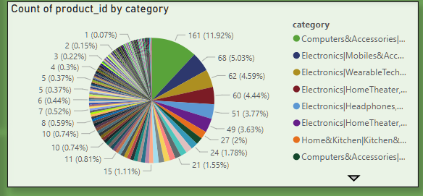
Product Distribution by Category
The largest category is Computers & Accessories with 161 products
(11.92%), indicating a strong representation in this segment.
Other notable categories include:
Mobiles & Accessories – 68 products (5.03%)
Wearable Technology – 62 products (4.59%)
Home Theater – 60 products (4.44%)
Headphones – 51 products (3.77%)
The chart highlights the broad diversity of categories with long-tail distribution, meaning many categories have small but relevant product counts.

Slide 7
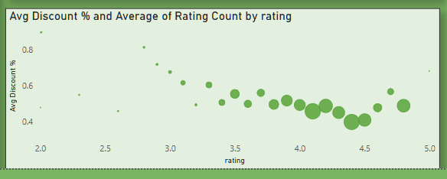
Discount Impact on Customer Ratings
Scatter plot shows relationship between discount % and review volume.
Products with moderate discounts and high ratings perform best.
Avoid aggressive discounting for highly-rated products — focus on value.

Slide 8
Strategic Recommendations
Increase discounts strategically for low-rated but high-volume products.
Promote categories with strong engagement like Electronics.
Align pricing strategy with customer feedback trends.
Monitor high-rating + high-discount clusters for ROI optimization.

Slide 9
Thank You

