Slide 1
Introduction to Apache Spark
and its real time use cases
Notes:
Preamble:
* Excited to kick off first day of training
* This first tutorial is about using Spark CORE
* We’ve got a curriculum jammed packed with material, so let’s go ahead and get started

Slide 2
Agenda
• Big Data
• Challenges in Big Data Analytics
• Hadoop MapReduce vs Spark
• What is Apache Spark
• Spark Core, SQL, Streaming, MLlib, and GraphX
• Spark in Production pipeline
• Q&A

Slide 3
Features of Big Data
Volume - size of data
Variety - diversity of formats from many different sources
Velocity- is the speed with which new data becomes available

Slide 4
Challenges in Big Data Analytics
Emergence of Latency-Sensitive Analytics
Focus on Analytic Productivity
Integrated Advanced Analytics

Slide 5
Spark vs Hadoop MapReduce
Apache Spark | Hadoop MapReduce
Easy to program as less coding required. | Difficult to program as coding is verbose.
Programmers can perform streaming, batch processing and machine learning ,all in the same cluster. | It is used for generating reports that help find answers to historical queries.
Has in-built interactive mode. | No in-built interactive mode except tools like Pig and Hive.
Executes jobs 10 to 100 times faster than Hadoop MapReduce. | Hadoop MapReduce does not leverage the memory of the Hadoop cluster to the maximum.
Programmers can modify the data in real-time through Spark streaming. | Allows you to just process a batch of stored data.

Slide 6
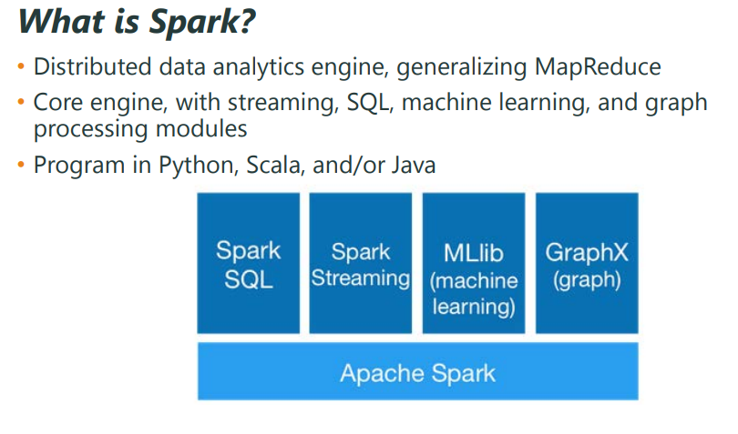
Spark

Slide 7
Spark - Resilient Distributed Dataset (RDD)
Write programs in terms of operations on distributed datasets
Resilient Distributed Datasets
Collections of objects spread across a cluster, stored in RAM or on Disk
Built through parallel transformations
Automatically rebuilt on failure
Operations
Transformations (e.g. map, filter, groupBy)
Actions (e.g. count, collect, save)
Notes:
RDD ➔ Colloquially referred to as RDDs
(e.g. caching in RAM)
Lazy operations to build RDDs from other RDDs
Return a result or write it to storage

Slide 8
SparkContext
Main entry point to Spark functionality.
Available in shell as variable sc.
In standalone programs, we need to create sc by importing.
distData = sc.parallelize(data)
disData = sc.textFile(“data.txt”)

Slide 9
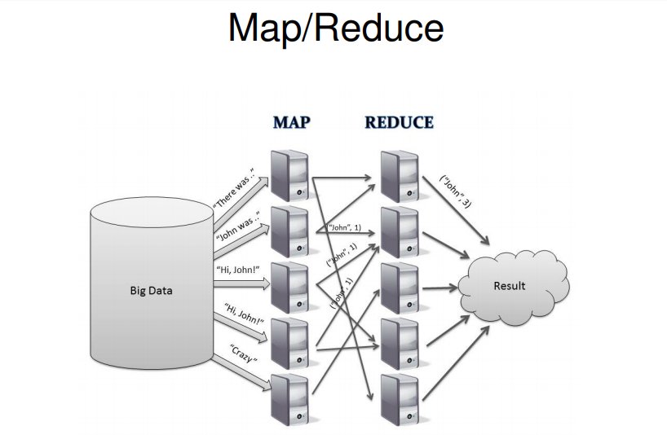
Map/Reduce

Slide 10
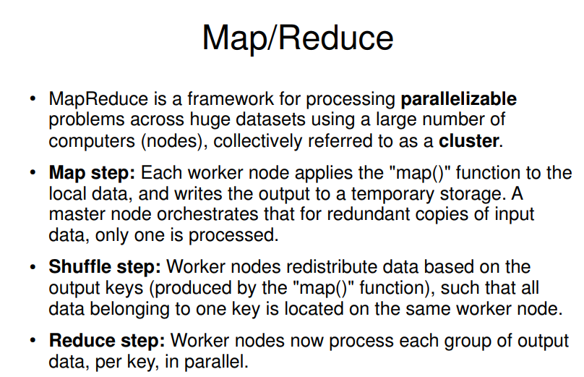
Map/Reduce

Slide 11
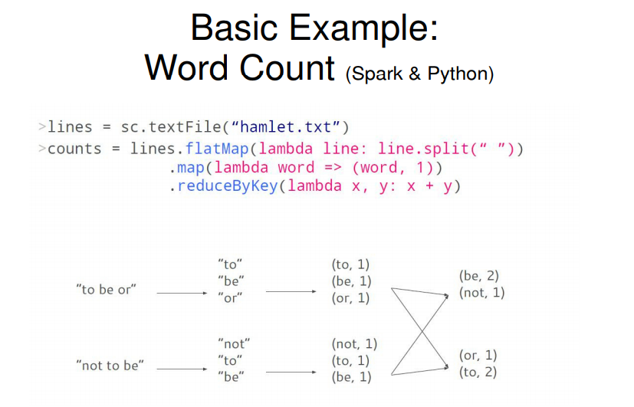
Word Count

Slide 12
Spark SQL
Spark SQL provides three main capabilities for using structured and semi structured data:
It provides a DataFrame abstraction in Python, Java, and Scala to simplify working with structured datasets. DataFrames are similar to tables in a relational database.
It can read and write data in a variety of structured formats (e.g., JSON, Hive Tables, and Parquet).
It lets you query the data using SQL, both inside a Spark program and from external tools that connect to Spark SQL through standard database connectors (JDBC/ ODBC), such as business intelligence tools like Tableau.

Slide 13
Spark Streaming
• Spark Streaming expresses streams as a series of RDDs over time
• Combine streaming with batch and interactive queries
• Stateful and Fault Tolerant

Slide 14
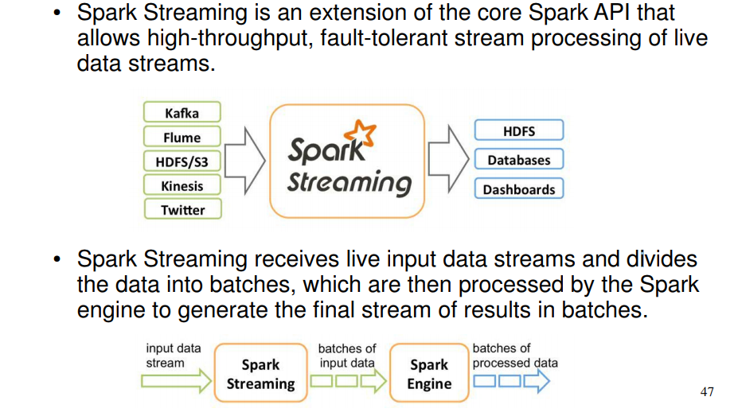
Spark Streaming –Inputs/Outputs

Slide 15
Spark Machine Learning(MLib)
• Iterative computation
• Vectors, Matrices = RDD[Vector]
Current MLlib Algorithms
• linear SVM and logistic regression
• classification and regression tree
• k-means clustering
• recommendation via alternating least squares
• singular value decomposition
• linear regression with L1- and L2-regularization
• multinomial naive Bayes
• basic statistics
• feature transformations
Range object (sequence of numbers 0, 1, …, x-1)
Notes:
All lazy

Slide 16
GraphX
GraphX is Apache Spark’s API for graphs and graph-parallel computation.
Relations can be represented using edges and vertices forming a graph.
The vertices represent the objects and the edges show the various relationships between those objects

Slide 17
Features of GraphX
Flexibility: Spark GraphX works with both graphs and computations. GraphX unifies ETL (Extract, Transform & Load), exploratory analysis and iterative graph computation within a single system. We can view the same data as both graphs and collections, transform and join graphs with RDDs efficiently and write custom iterative graph algorithms using the Pregel API.
Speed: Spark GraphX provides comparable performance to the fastest specialized graph processing systems. It is comparable with the fastest graph systems while retaining Spark’s flexibility, fault tolerance and ease of use.
Growing Algorithm Library: We can choose from a growing library of graph algorithms that Spark GraphX has to offer. Some of the popular algorithms are page rank, connected components, label propagation, SVD++, strongly connected components and triangle count.
Notes:
Launch computations

Slide 18
Use Cases of Graph Computation
Facebook’s friends.
LinkedIn’s connections.
Relationships between galaxies and stars in astrophysics and Google’s Maps.
Disaster Detection System
Financial Fraud Detection
Geographic Information Systems

Slide 19
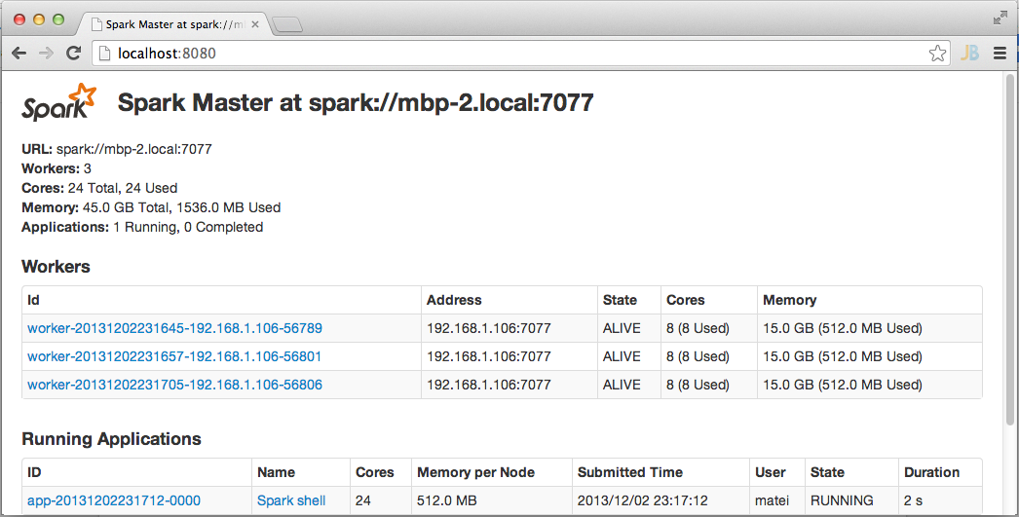
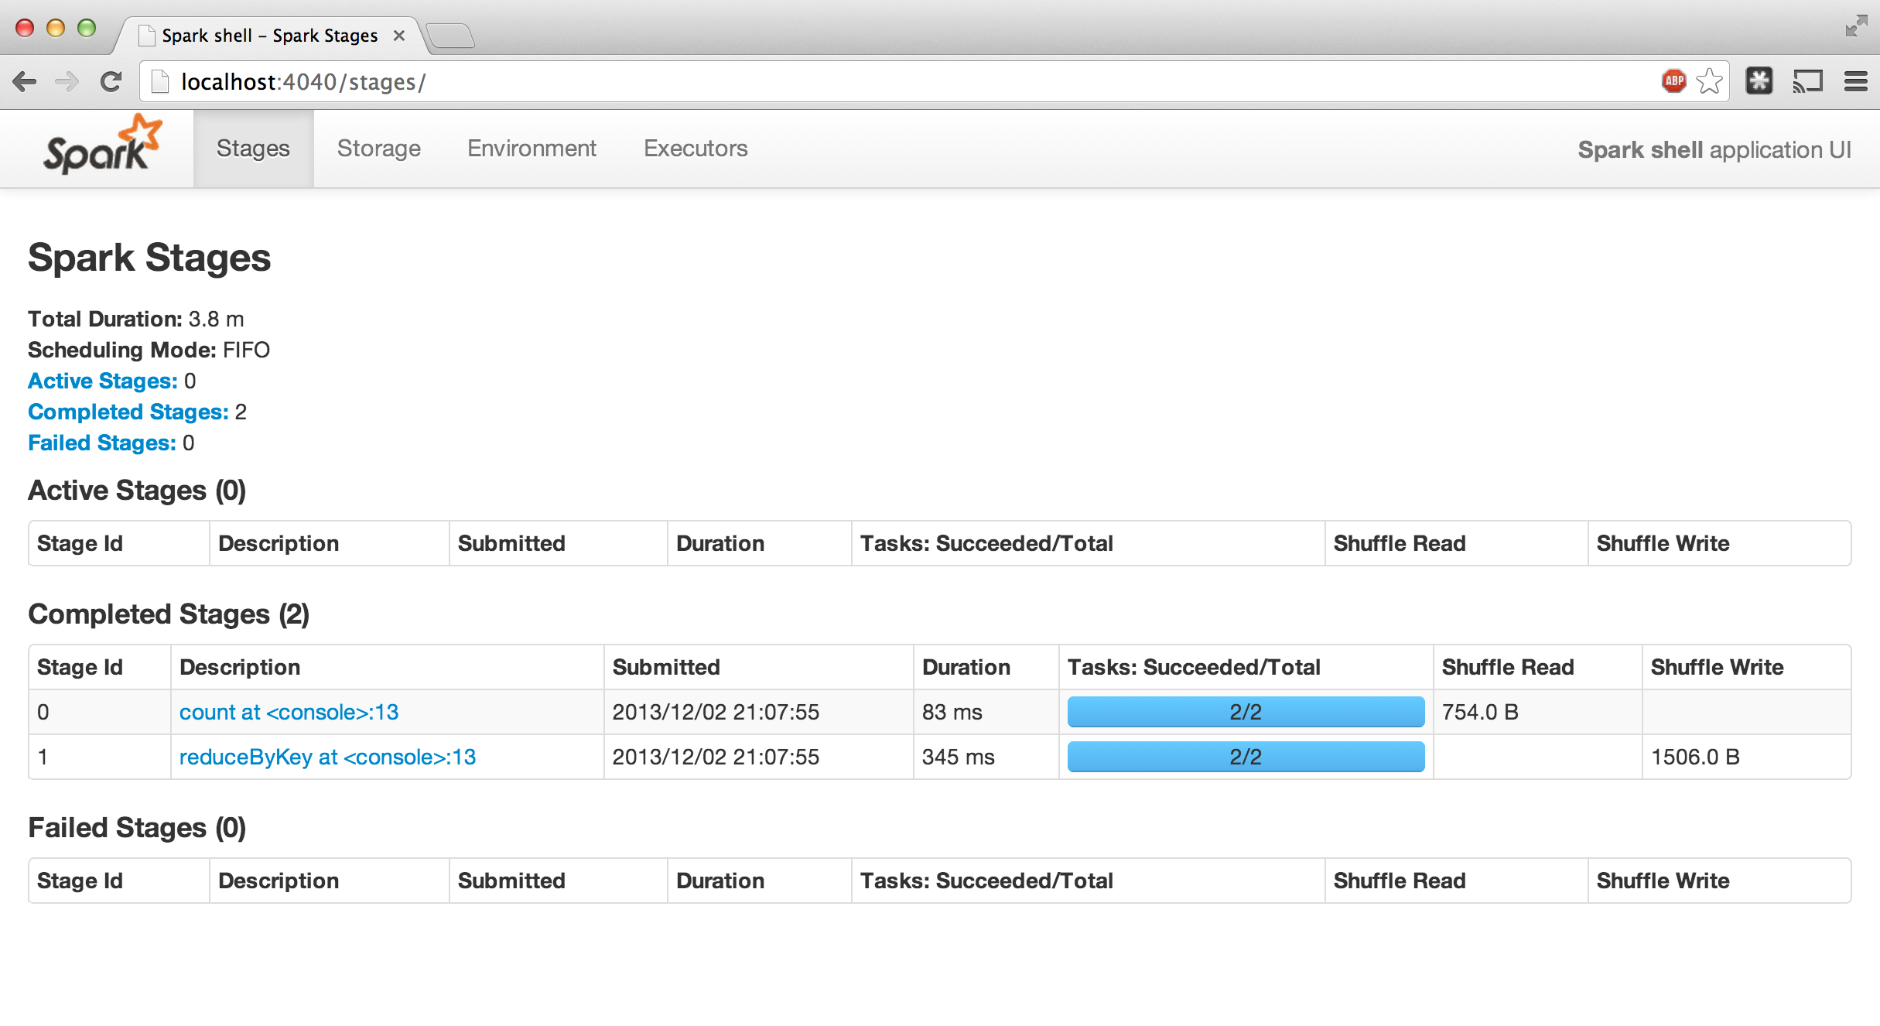
Administrative GUIs
http://<Standalone Master>:8080 (by default)

Slide 20
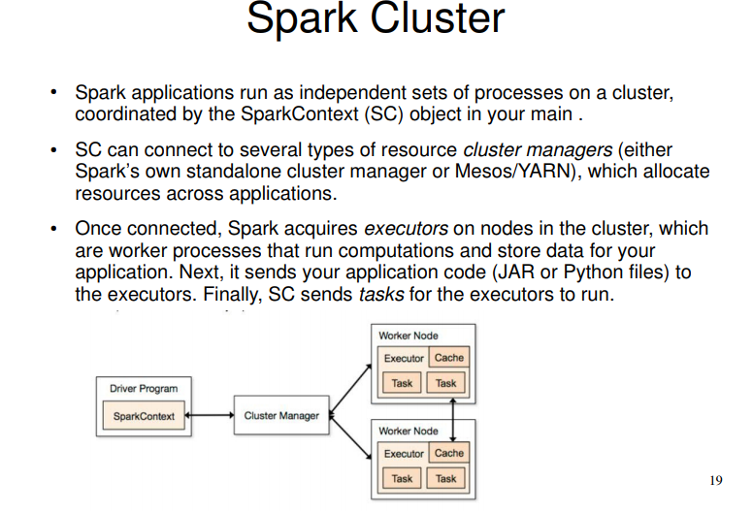
Spark Cluster

Slide 21
Local Execution
Just pass local or local[k] as master URL
Debug using local debuggers
For Java / Scala, just run your program in a debugger
For Python, use an attachable debugger (e.g. PyDev)
Great for development & unit tests

Slide 22
Cluster Execution
Easiest way to launch is EMR
Several options for private clusters:
Standalone mode (similar to Hadoop’s deploy scripts)
Mesos
Hadoop YARN
Amazon EMR

Slide 23
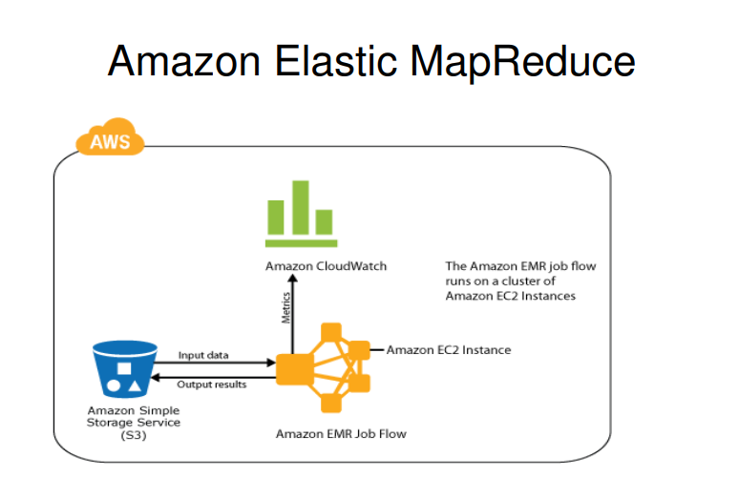
Amazon EMR

Slide 24
Real time data pipeline(Prod)
https://github.com/jjdblast/pipeline-1

Slide 25
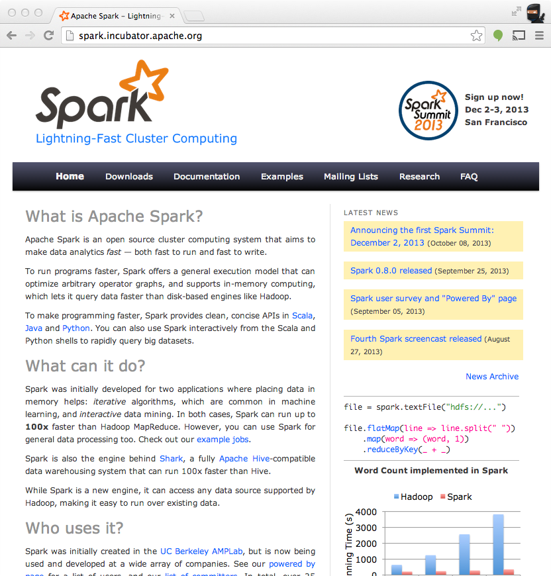
Get Started
Up and Running in a Few Steps
Download
Unzip
Shell
Project Resources
Examples on the Project Site
Examples in the Distribution
Documentation
http://spark.incubator.apache.org

