Slide 1

COFFEE SHOP SALES ANALYSIS
Business Intelligence Project
Tools Used:
• Excel
• Power BI
• Tableau
Prepared By:
Kumar Jyotiraditya
Date:
01-06-2026

Slide 2
Business Problem Statement
BUSINESS PROBLEM
The coffee shop chain lacked a centralized reporting system to monitor sales performance, customer activity, and store-level operations.
Challenges:
• Limited visibility into sales trends
• Difficulty identifying peak business hours
• Inconsistent store performance
• Lack of data-driven decision-making
Solution:
Develop an interactive Business Intelligence dashboard to analyze sales data and generate actionable insights.

Slide 3
Project Objectives
PROJECT OBJECTIVES
• Analyze overall sales performance
• Identify peak revenue-generating hours
• Compare store-wise performance
• Understand customer purchasing behavior
• Evaluate time-based sales patterns
• Generate business recommendations

Slide 4
Dataset Overview
DATASET OVERVIEW
Dataset:
Coffee Shop Sales Dataset
Total Transactions:
149,116
Total Revenue:
₹698.81K
Total Quantity Sold:
214.47K
Store Locations:
• Astoria
• Hell's Kitchen
• Lower Manhattan
Key Fields:
• Transaction ID
• Transaction Date
• Transaction Time
• Store Location
• Quantity Sold
• Revenue

Slide 5
Methodology
PROJECT METHODOLOGY
1. Data Collection
2. Data Cleaning
3. Feature Engineering
4. Exploratory Data Analysis
5. Dashboard Development
6. Insight Generation
7. Business Recommendations

Slide 6
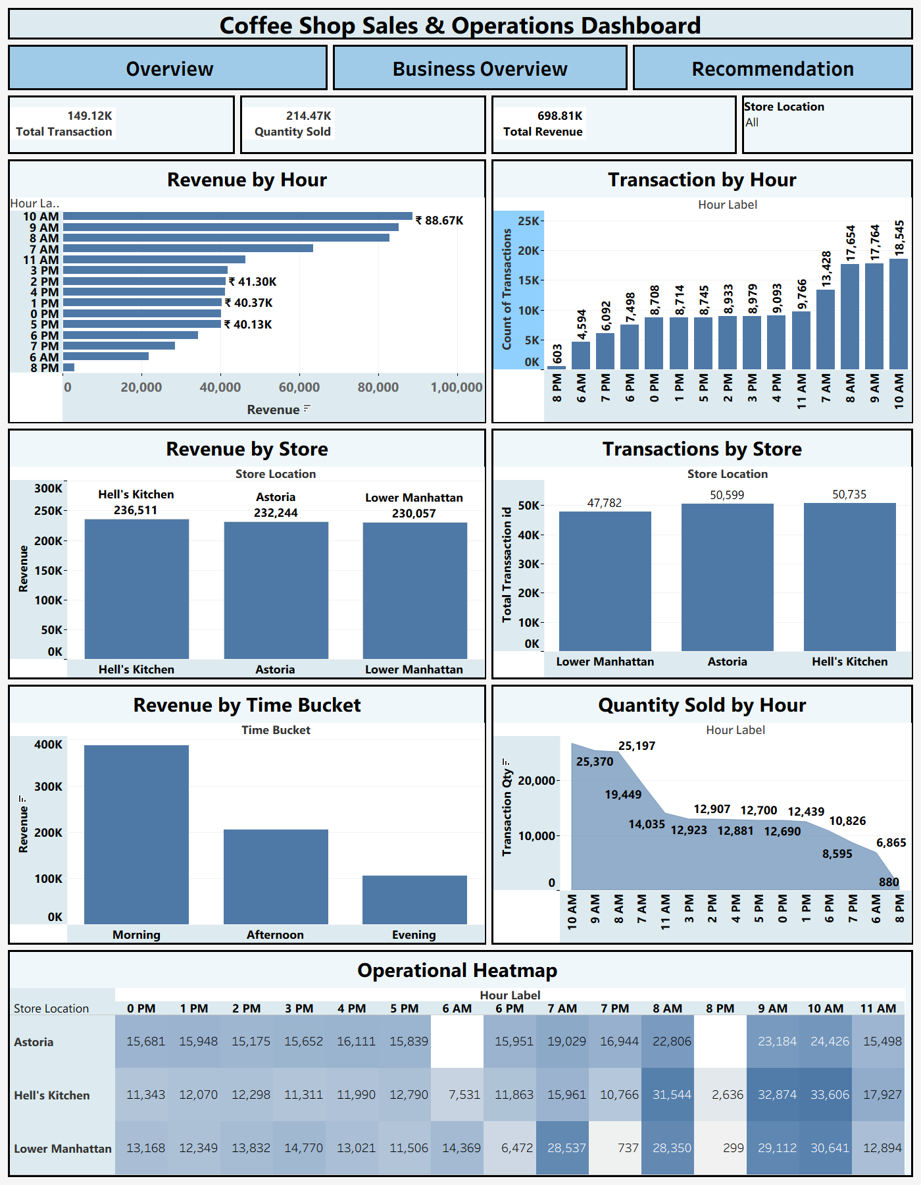
Dashboard Overview

Slide 7
Key Insights
KEY INSIGHTS
• Peak sales occur between 8 AM and 10 AM.
• Morning hours generate the highest revenue.
• Hell's Kitchen is the highest-performing store.
• Evening periods show lower customer demand.
• Revenue concentration is highest during morning operating hours.
• Store-level performance varies significantly across locations.

Slide 8
Business Recommendations
BUSINESS RECOMMENDATIONS
Morning Sales Optimization
• Increase staffing during peak hours
• Prioritize inventory replenishment
Store Performance Enhancement
• Replicate best-performing store strategies
Evening Revenue Improvement
• Introduce promotions and loyalty programs
Inventory Optimization
• Align inventory planning with demand trends

Slide 9
Business Impact
EXPECTED BUSINESS IMPACT
✔ Improved staffing efficiency
✔ Better inventory management
✔ Increased customer satisfaction
✔ Enhanced operational planning
✔ Data-driven decision-making
✔ Revenue growth opportunities

Slide 10
Conclusion
CONCLUSION
The Coffee Shop Sales Analysis project successfully transformed raw transactional data into actionable business insights using Excel, Power BI, and Tableau.
The dashboards identified peak business periods, customer purchasing trends, and store performance differences, enabling data-driven recommendations for improving operational efficiency and revenue performance.

Slide 11
THANK YOU

