Slide 1
From Pose to Behavior with JABS
Short Course on the Application of Machine Learning for Automated Quantification of Behavior
JAX · Bar Harbor · October 11–16, 2026
Vivek Kumar
These slides were made with the use of Claude and reviewed by Madison Raza and Vivek Kumar.
Notes:
Companion talk for the JABS module (90 min). Talk ≈25 min, hands-on notebook 60 min, wrap-up 5 min.
AI use disclosure (foot of the title slide): these slides were made with the use of Claude and reviewed by Madison Raza and Vivek Kumar.
Speaker reminder: do not dwell on time. Timing lives in the notebook, not in the talk.

Slide 2
JABS is one system from arena to genetics
TODAY'S HANDS-ON
JABS-DA
Data acquisition
Standardized arena and top-down video
JABS-AL
Annotation + training
Label in the GUI, train a classifier, classify new video
JABS-AI
Characterization + genetics
Strain-survey phenotypes and heritability (web app)
Why it works across labs: the pose model and classifiers transfer because the video looks the same everywhere.
Redrawn from Choudhary et al., eLife 2026;14:e107259, Fig 1 (CC BY 4.0)
Notes:
Redrawn from Fig 1, Choudhary et al. Five steps: acquisition (JABS-DA), annotation and training (JABS-AL), characterization and integration (JABS-AI). Today: AL hands-on; DA and AI as context.

Slide 3
Pose QC: what we did before labeling
0.3
A frame is low-confidence if its mean keypoint confidence is below 0.3
20%
A session is flagged if more than 20% of its frames are low-confidence
500
A session is flagged if it has fewer than 500 frames (likely truncated)
Result: all 25 sessions in the course data passed.
These are the thresholds we chose for this course. Check them against your own rig and behavior.
Notebook: Precomputed Tracking & QC
Notes:
Recap only: the precomputed site pages cover QC in depth. Keep to 2-3 minutes.
Say what we did, not that it is the right choice. Thresholds are set in the Precomputed Tracking & QC notebook (low_conf_threshold 0.3, max_low_conf_pct 20%, min_frames 500); the notebook output reports 25 of 25 sessions passing.

Slide 4
From labels to a classifier
Sparse labels, windowed features, XGBoost

Slide 5
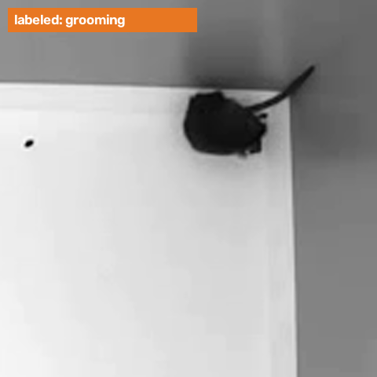
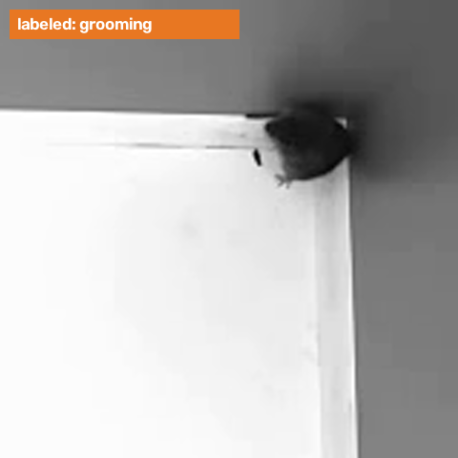
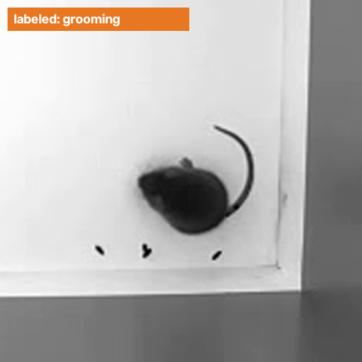
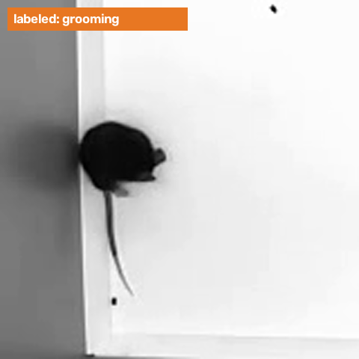
What a labeled grooming bout looks like
Session 2004
7.2 s bout
Session 2007
6.6 s bout
Session 2013
6.6 s bout
Session 2022
2.8 s bout
Four videos, one behavior. The tag marks the frames a person labeled as grooming.
Course data: Zenodo JABS example projects, doi:10.5281/zenodo.16697331. Clips are cropped around the mouse.
Notes:
Click a clip to play it; each is under 10 seconds. Each is one labeled grooming bout from a different video (sessions 2004, 2007, 2013 and 2022), with half a second before and after. The orange tag is on while the frames are labeled as grooming. The clip follows the mouse; the full arena is much larger. Clips are made by developer/scripts/make_grooming_clips.py from the Zenodo deposit, with the bouts read from the annotation files (30 fps).

Slide 6
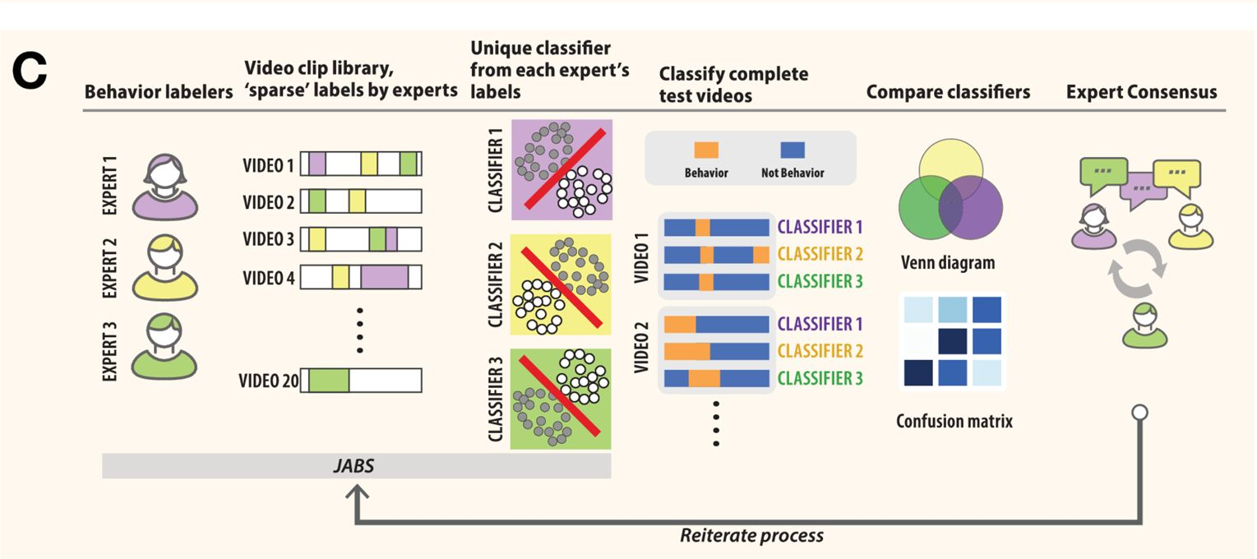
Label sparsely while training; label densely only to validate
CORE CONCEPT
Each expert's labels → their own classifier
Compare classifiers on held-out videos
Dense labels last, after the definition settles
Label sparsely to train. Label densely only to validate.
Choudhary et al., eLife 2026;14:e107259 (CC BY 4.0)
Notes:
Fig 3C. Each expert trains their own classifier from sparse labels; classifiers are compared on held-out videos; experts confer and iterate. Dense labels come last, once the behavior definition has stabilized — creating them first leads to drifting definitions.
Core concept: it is why session 2010 is the dense, held-out test in the demo.

Slide 7
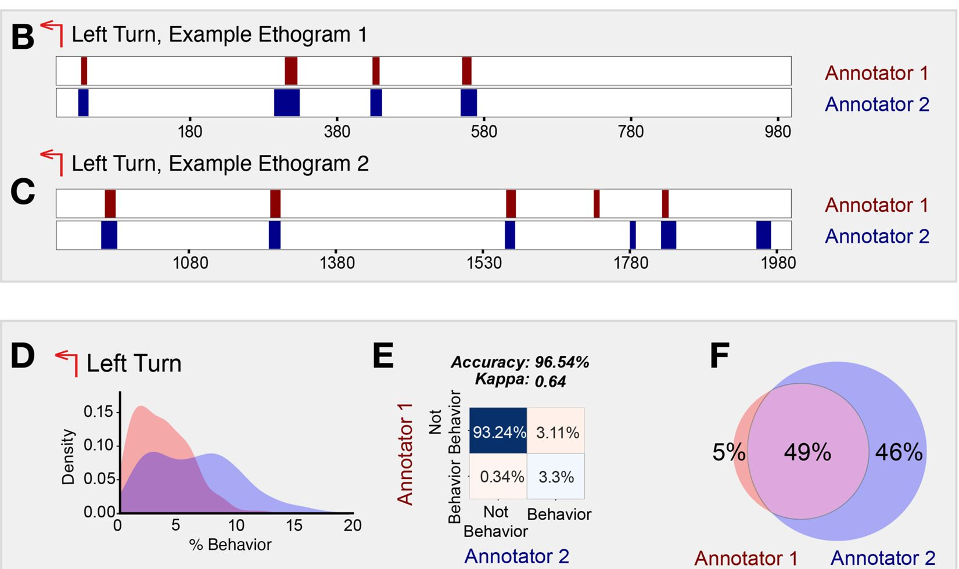
Accuracy hides disagreement when behavior is rare
Left turn, two annotators: accuracy 96.5%, κ = 0.64
Only 49% of behavior frames shared
Report κ, precision, recall and F1, not accuracy alone
Choudhary et al., eLife 2026;14:e107259 (CC BY 4.0)
Notes:
Fig 5. Two annotators' left-turn classifiers agree on 96.5% of frames, yet Cohen's κ = 0.64 and only 49% of behavior frames overlap. Turning occupies a few % of frames, so 'never turning' against annotator 2 already scores about 94%. Use this example for the null-model point: in course session 2010, grooming is 52.9% of reviewed frames, so the rare-behavior argument is general background here, not a description of the course data.

Slide 8
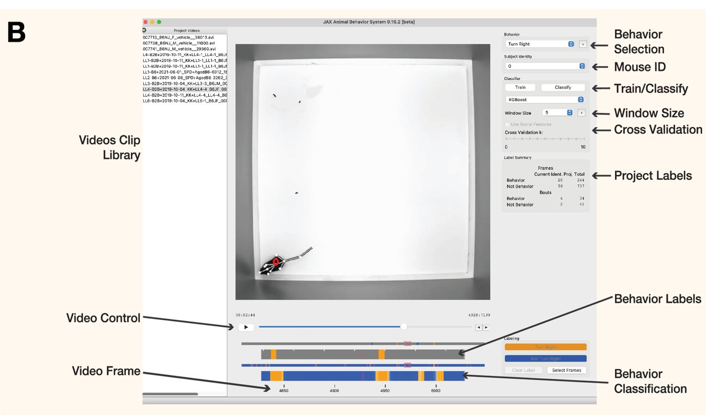
JABS-AL: label sparsely in the GUI, train in seconds
Label behavior and not-behavior; skip ambiguous frames
At least 100 labeled frames across 2 videos
Features come from pose alone
Choudhary et al., eLife 2026;14:e107259 (CC BY 4.0)
Notes:
Fig 3B. Label behavior and not-behavior with mouse or keys; leave ambiguous frames unlabeled. Training needs at least 100 labeled frames and 2 videos. Classifiers: Random Forest, gradient boosting, XGBoost. Features: distances, angles, velocities from 12 keypoints.
The companion handout carries the step-by-step labeling instructions. Features: keypoint distances, angles, linear and angular velocities; raw video is needed only to label, prediction uses pose alone.

Slide 9
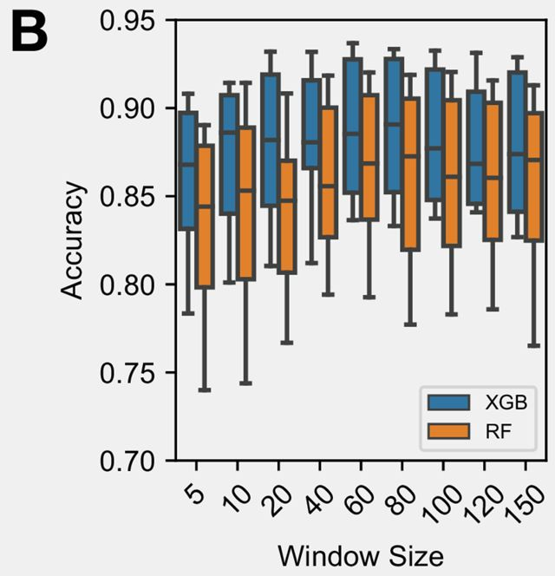
Behavior is temporal: choose the window to match the behavior
Each frame is classified using features from a window of frames around it.
The best window matches the behavior's time scale: about 60 frames (2 s each side) for grooming.
The GUI default is 5 frames; this course uses 60.
Idea: Kristin Branson's JAABA (Kabra 2013).
Choudhary et al., eLife 2026;14:e107259 (CC BY 4.0)
Notes:
Choudhary et al. 2026 Fig 4B: JABS accuracy vs window size (frames each side). Grooming peaks near 60 frames and falls for larger windows; XGBoost beats RF at every size. The earlier left panel (Geuther 2021 Fig 2C, a CNN taking a stack of frames) was removed because it does not describe the course method.
Optional experiment: change window size (GUI dropdown, or window_size for grooming in jabs/project.json), re-export and retrain, then compare F1 on session 2010 at 5, 30, 60 and 120 frames and collect results from the room.
Credit: the idea of window features comes from Kristin Branson's JAABA (Kabra et al., Nature Methods 2013; github.com/kristinbranson/JAABA). It is cited on the References slide.

Slide 10
An analogy: two people transcribe the same speech
the speech, left to right
Person A
sentence 1
sentence 2
sentence 3
letters = frames
sentences = bouts
2a + 2b: split by a pause, so stitch
um: too short, so filter out
Person B
sentence 1
2a
2b
um
sentence 3
Letter by letter (frame by frame): starts and ends differ, so it looks like disagreement.
Sentence by sentence (bout by bout): each sentence overlaps by at least half, so they agree.
Notes:
Two people transcribe the same speech. They agree on every sentence but start and end a few letters apart, and one of them splits a sentence at a pause and catches a stray 'um'. Letter by letter they look like they disagree; sentence by sentence (matching sentences by overlap) they agree. Frames are letters, bouts are sentences. Stitching joins a sentence split by a short pause; filtering drops a fragment too short to be a sentence. The next two slides show this on real classifier output: the ethograph and stitch-and-filter.

Slide 11
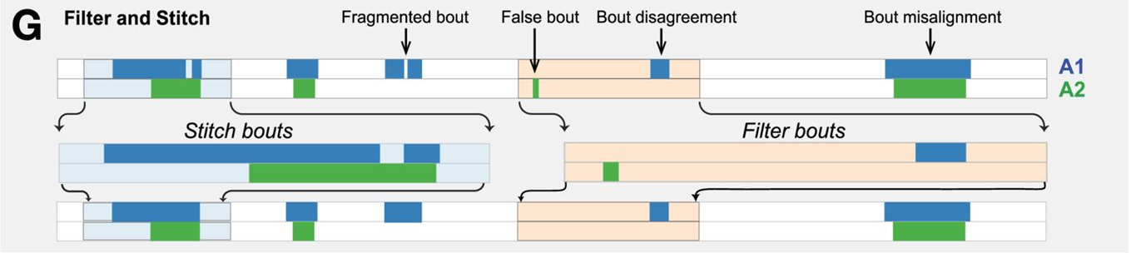
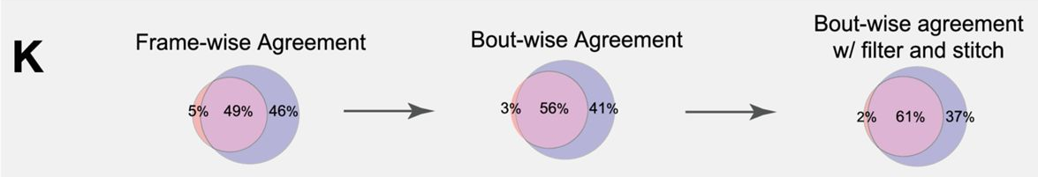
Stitch and filter before comparing classifiers
Like the speech: join a split sentence (stitch), drop a stray 'um' (filter).
Choudhary et al., eLife 2026;14:e107259 (CC BY 4.0)
Notes:
Fig 6G and 6K. Stitch fragmented bouts across short gaps, then drop bouts shorter than a threshold; tune both thresholds per behavior. Agreement: 49% frame-wise → 56% bout-wise → 61% after stitching and filtering. Document the parameters you use.

Slide 12
Is the classifier right?
Metrics and data efficiency

Slide 13
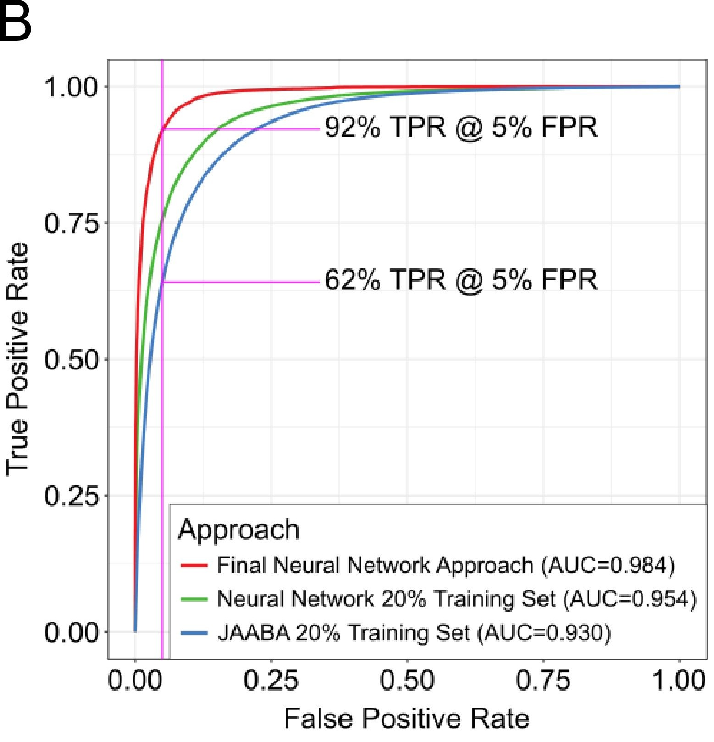
What performance mean?
F1 is set at one threshold: move the threshold and F1 changes
AUROC does not depend on the threshold
5% FPR at 0.62 to 0.92 TPR across methods
Geuther et al., eLife 2021;10:e63207 (CC BY 4.0)
Notes:
Geuther 2021 Fig 3A–B. Human agreement vs model accuracy on the validation set; ROC curves with TPR at 5% FPR marked (62% to 92% across approaches). JABS reports accuracy, F1, AUROC, TPR, FPR and TPR@5%FPR. Panel A (not shown): human agreement 0.948 vs final network 0.936 on validation.
Human agreement on the validation set was 0.948 against 0.936 for the final network.

Slide 14
From behavior to biology
Phenotypes, strain surveys, genetics

Slide 15
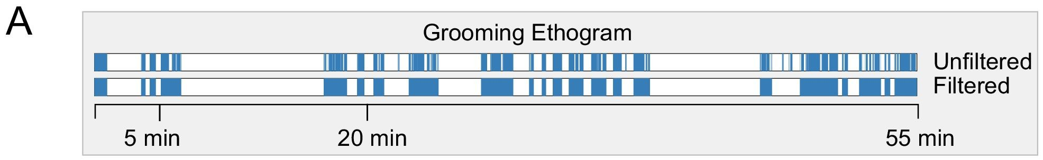
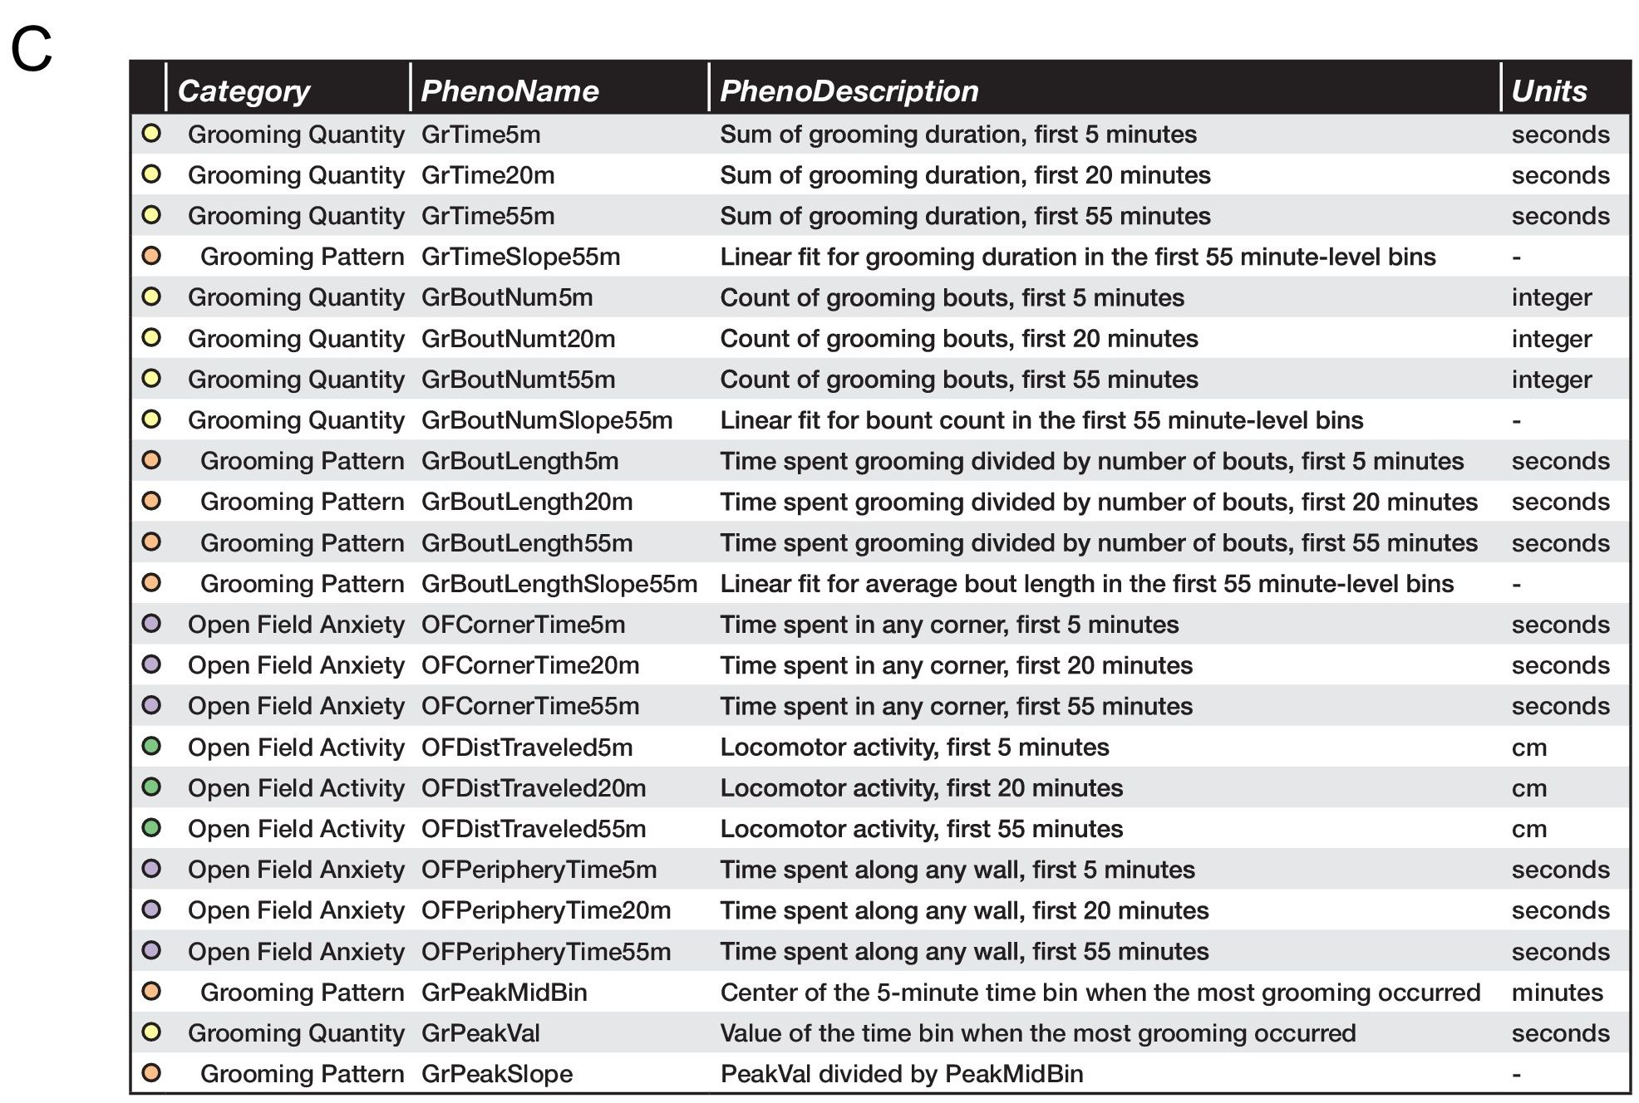
Concept: predictions become phenotypes
A One grooming ethogram, summarized at 5, 20 and 55 min
C The phenotype table: 3 bout measures (time, number, mean length) × 3 time bins, plus pattern and open-field measures
Geuther et al., eLife 2021;10:e63207 (CC BY 4.0)
Notes:
Geuther 2021 Fig 4A, 4C. A grooming ethogram summarized at 5, 20 and 55 min into total time, number of bouts and mean bout length, plus pattern metrics. The same three bout measures × three time bins define the nine aggregate phenotypes per classifier in JABS-AI.
Optional if time is short. Concept slide; the next slide is the real-world example.

Slide 16
Take it home
Tutorial: github.com/KumarLabJax/getting-started-with-jabs
JABS docs: kumarlabjax.github.io/JABS-behavior-classifier
Course data: Zenodo JABS example projects, doi:10.5281/zenodo.16697331
Strain-survey video + pose: Harvard Dataverse, doi:10.7910/DVN/SAPNJG
Aging dataset: EMBER-DANDI, doi:10.60533/ember-dandi.000466/0.261009.2220
BXD dataset: Harvard Dataverse, doi:10.7910/DVN/RQYI04
Your own rig: the tutorial's 'Your Own Data!' page (setup, pose, QC, training)
Questions about JABS: jabs@jax.org
Notes:
Leave this up during Q&A.
Leave this up during Q&A. Aging dataset: EMBER-DANDI dandiset 000466 (https://doi.org/10.60533/ember-dandi.000466/0.261009.2220). BXD dataset: https://doi.org/10.7910/DVN/RQYI04.

Slide 17
References
Choudhary A, Geuther BQ, Sproule TJ, Beane G, Kohar V, Trapszo J, Kumar V. JAX Animal Behavior System (JABS), a genetics-informed, end-to-end advanced behavioral phenotyping platform for the laboratory mouse. eLife 2026;14:e107259. doi:10.7554/eLife.107259
Geuther BQ, Peer A, He H, Sabnis G, Philip VM, Kumar V. Action detection using a neural network elucidates the genetics of mouse grooming behavior. eLife 2021;10:e63207. doi:10.7554/eLife.63207
Ye S, Filippova A, Lauer J, Schneider S, Vidal M, Qiu T, Mathis A, Mathis MW. SuperAnimal pretrained pose estimation models for behavioral analysis. Nat Commun 2024;15:5165. doi:10.1038/s41467-024-48792-2
Kabra M, Robie AA, Rivera-Alba M, Branson S, Branson K. JAABA: interactive machine learning for automatic annotation of animal behavior. Nat Methods 2013;10(1):64-67. doi:10.1038/nmeth.2281
Segalin C, Williams J, Karigo T, Hui M, Zelikowsky M, Sun JJ, Perona P, Anderson DJ, Kennedy A. The Mouse Action Recognition System (MARS) software pipeline for automated analysis of social behaviors in mice. eLife 2021;10:e63720. doi:10.7554/eLife.63720
Figures reproduced under CC BY 4.0; panels cropped from the published figures.
Notes:
Both references verified against PubMed (PMID 41770219, 33729153).
Ye et al. 2024 added from slides/10.1038_s41467-024-48792-2-citation.ris (CC BY 4.0).
JAABA (Kabra et al. 2013) and MARS (Segalin et al. 2021) added, confirmed in PubMed.
Open item: final check that this reference list is adequate and that all five references exist.

Slide 18
Backup
Extra slides if time allows

Slide 19
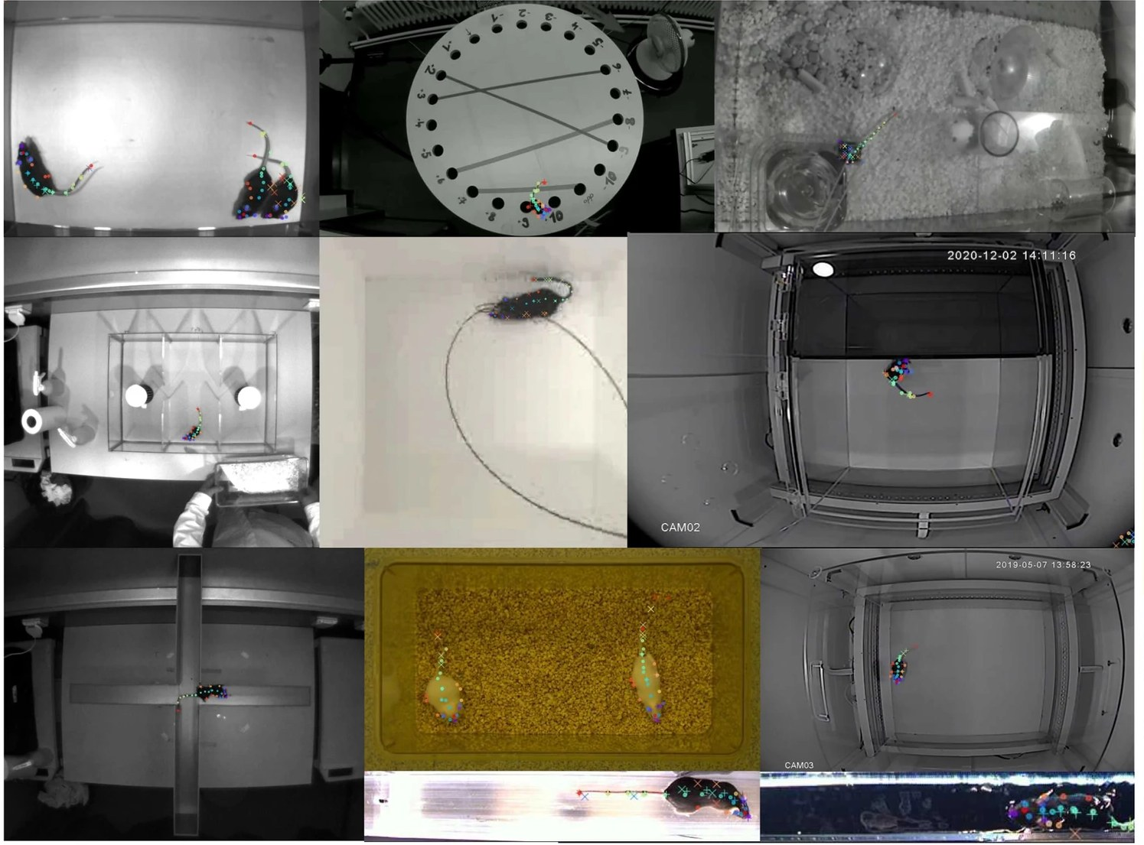
Classifiers transfer only when the video matches
The JABS rig:
Top-down camera ~100 cm above a 52 cm arena
800 × 800 px at 30 fps
940 nm IR: same image day and night
No default video compression (it adds a periodic keyframe signal)
Frame rate: grooming ≈7 Hz needs ≥14 fps (Nyquist)
Validate pose on your own setup first.
Top-view mouse datasets differ in arena, lighting and camera.
Arena montage: Ye et al., Nat Commun 2024;15:5165, Fig 1g, cropped (CC BY 4.0)
Notes:
Source: Choudhary et al. 2026, Group 1 and 2 specifications. Point to the 'Your Own Data!' page on the tutorial site for students with their own rigs.
The bullets describe the JABS rig (Choudhary et al. 2026, Group 1 and 2 specifications). Advice for students with their own rigs: validate pose on your own setup before training anything.
Camera setup detail: walls fill 5-15% of the frame; frame rate follows Nyquist (grooming syntax ≈7 Hz needs ≥14 fps); default video compression uses fixed keyframes that add a periodic signal to features.
Figure: Ye et al. 2024 (SuperAnimal), Fig 1g, 27-keypoint predictions across datasets; CC BY 4.0, cropped.
Open item: add a figure of our own arenas with specs, sourced from Choudhary et al. 2026 Groups 1 and 2.

Slide 20
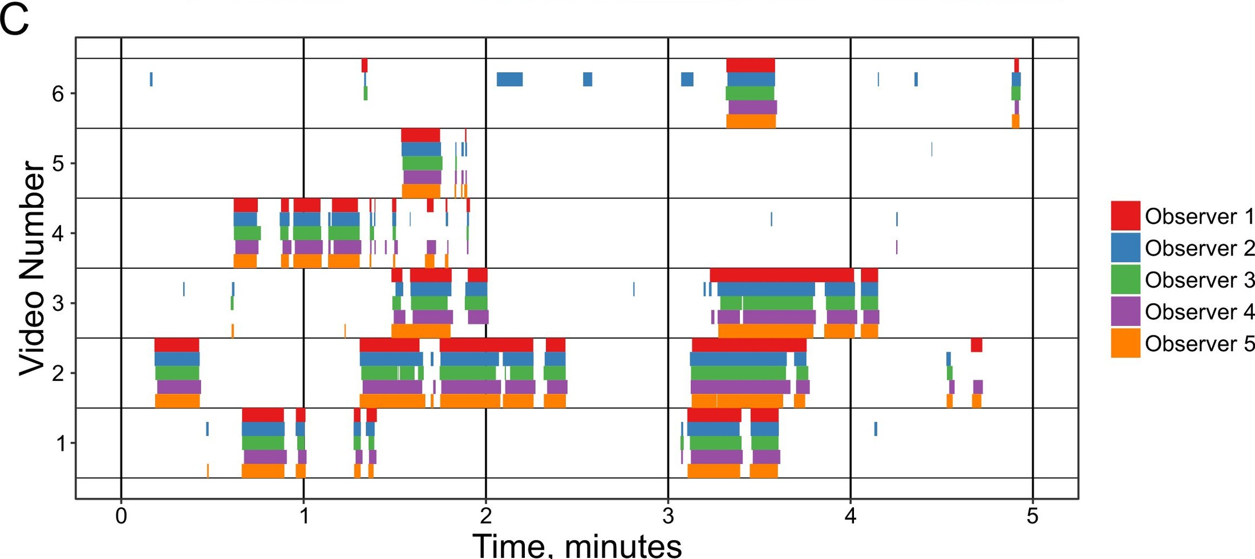
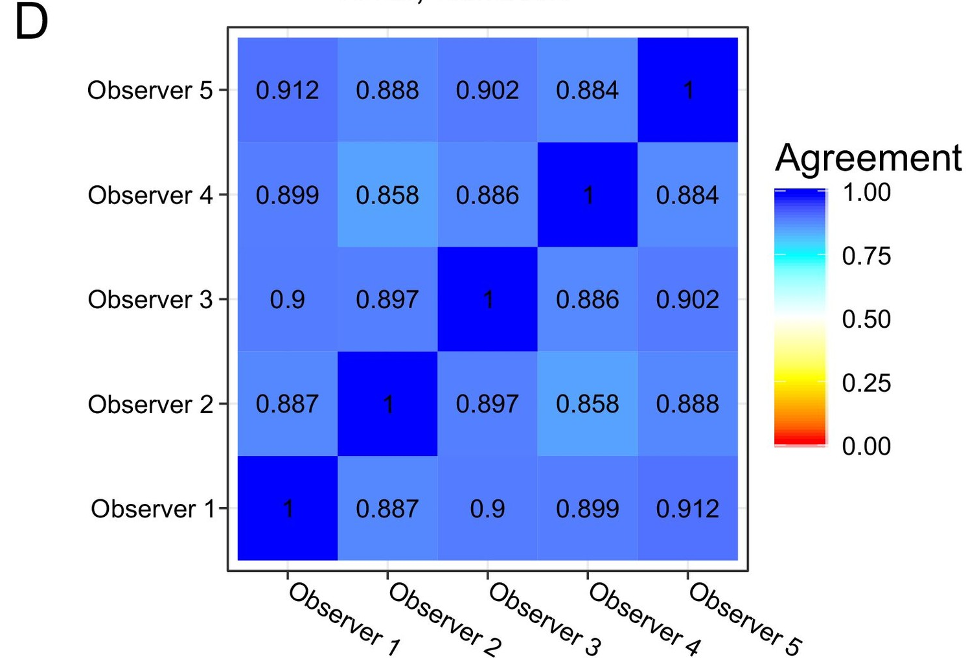
Trained humans agree on 89% of grooming frames
Dense labels from trained humans set the ceiling a classifier is judged against.
Geuther et al., eLife 2021;10:e63207 (CC BY 4.0)
Notes:
Geuther 2021 Fig 1C–D. Five trained annotators labeled the same six videos; mean pairwise agreement 89.13% (range 0.858–0.912). Disagreements: missed bouts, misaligned starts and ends, skipped breaks. This is the ceiling a classifier is judged against.

Slide 21
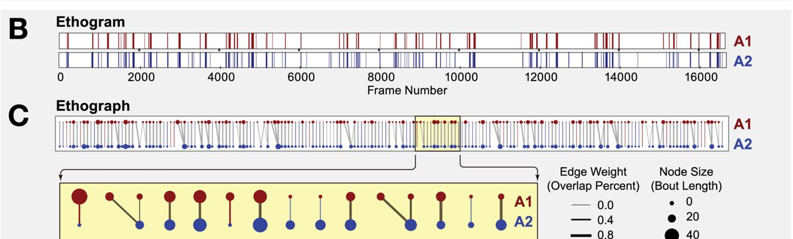
Compare bouts, not frames: the ethograph
Nodes = bouts (the sentences); edges = overlap
Most disagreement is at bout edges
Bout agreement at ≥50% overlap
Choudhary et al., eLife 2026;14:e107259 (CC BY 4.0)
Notes:
Fig 6B–C. Ethogram vs ethograph: a bipartite graph where nodes are bouts (size = length, color = annotator) and edges are temporal overlap. Most frame disagreement sits at bout starts and ends.
Companion to the previous slide: the transcription analogy maps onto this figure (sentences = bouts).

Slide 22
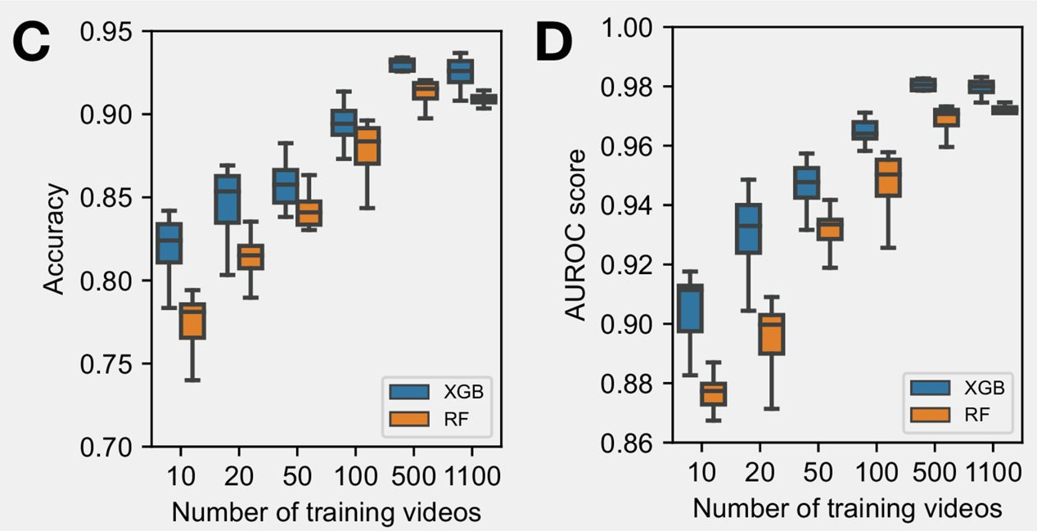
Pose-based classifiers need little labeled data
10 videos (~1.3% of frames): accuracy ≈85%, AUROC ≈0.94
Halving the training data costs only ≈1% TPR at 5% FPR
XGBoost beats Random Forest at every size
Choudhary et al., eLife 2026;14:e107259 (CC BY 4.0)
Notes:
Fig 4C–D. 10 training videos (~1.3% of 2.18 M frames) reach accuracy approaching 85% and AUROC ≈0.94. Halving the training data from 100% to 50% cost ≈1% TPR at 5% FPR. Best JABS accuracy 0.936 vs 0.937 for the 3D CNN on the same benchmark.
With all data, window 60 and XGBoost, accuracy is 0.936 against 0.937 for a 3D CNN.

Slide 23
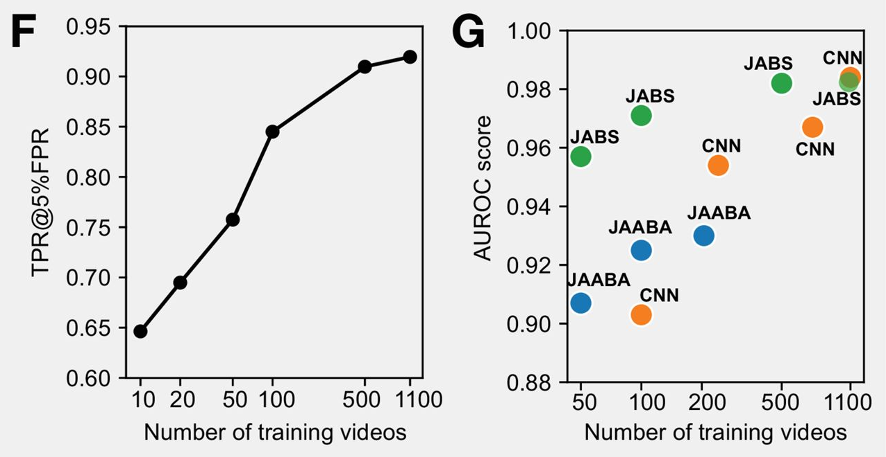
With few labels, keypoints beat raw pixels
With few labels, pose-based JABS beats JAABA and a 3D CNN
12 keypoints per frame: far fewer numbers to learn from
The gap closes as labels increase
Choudhary et al., eLife 2026;14:e107259 (CC BY 4.0)
Notes:
Fig 4F–G. TPR at 5% FPR rises with training videos. JABS (pose) outperforms JAABA and a 3D CNN when training data are limited; the approaches converge as labels increase.

Slide 24
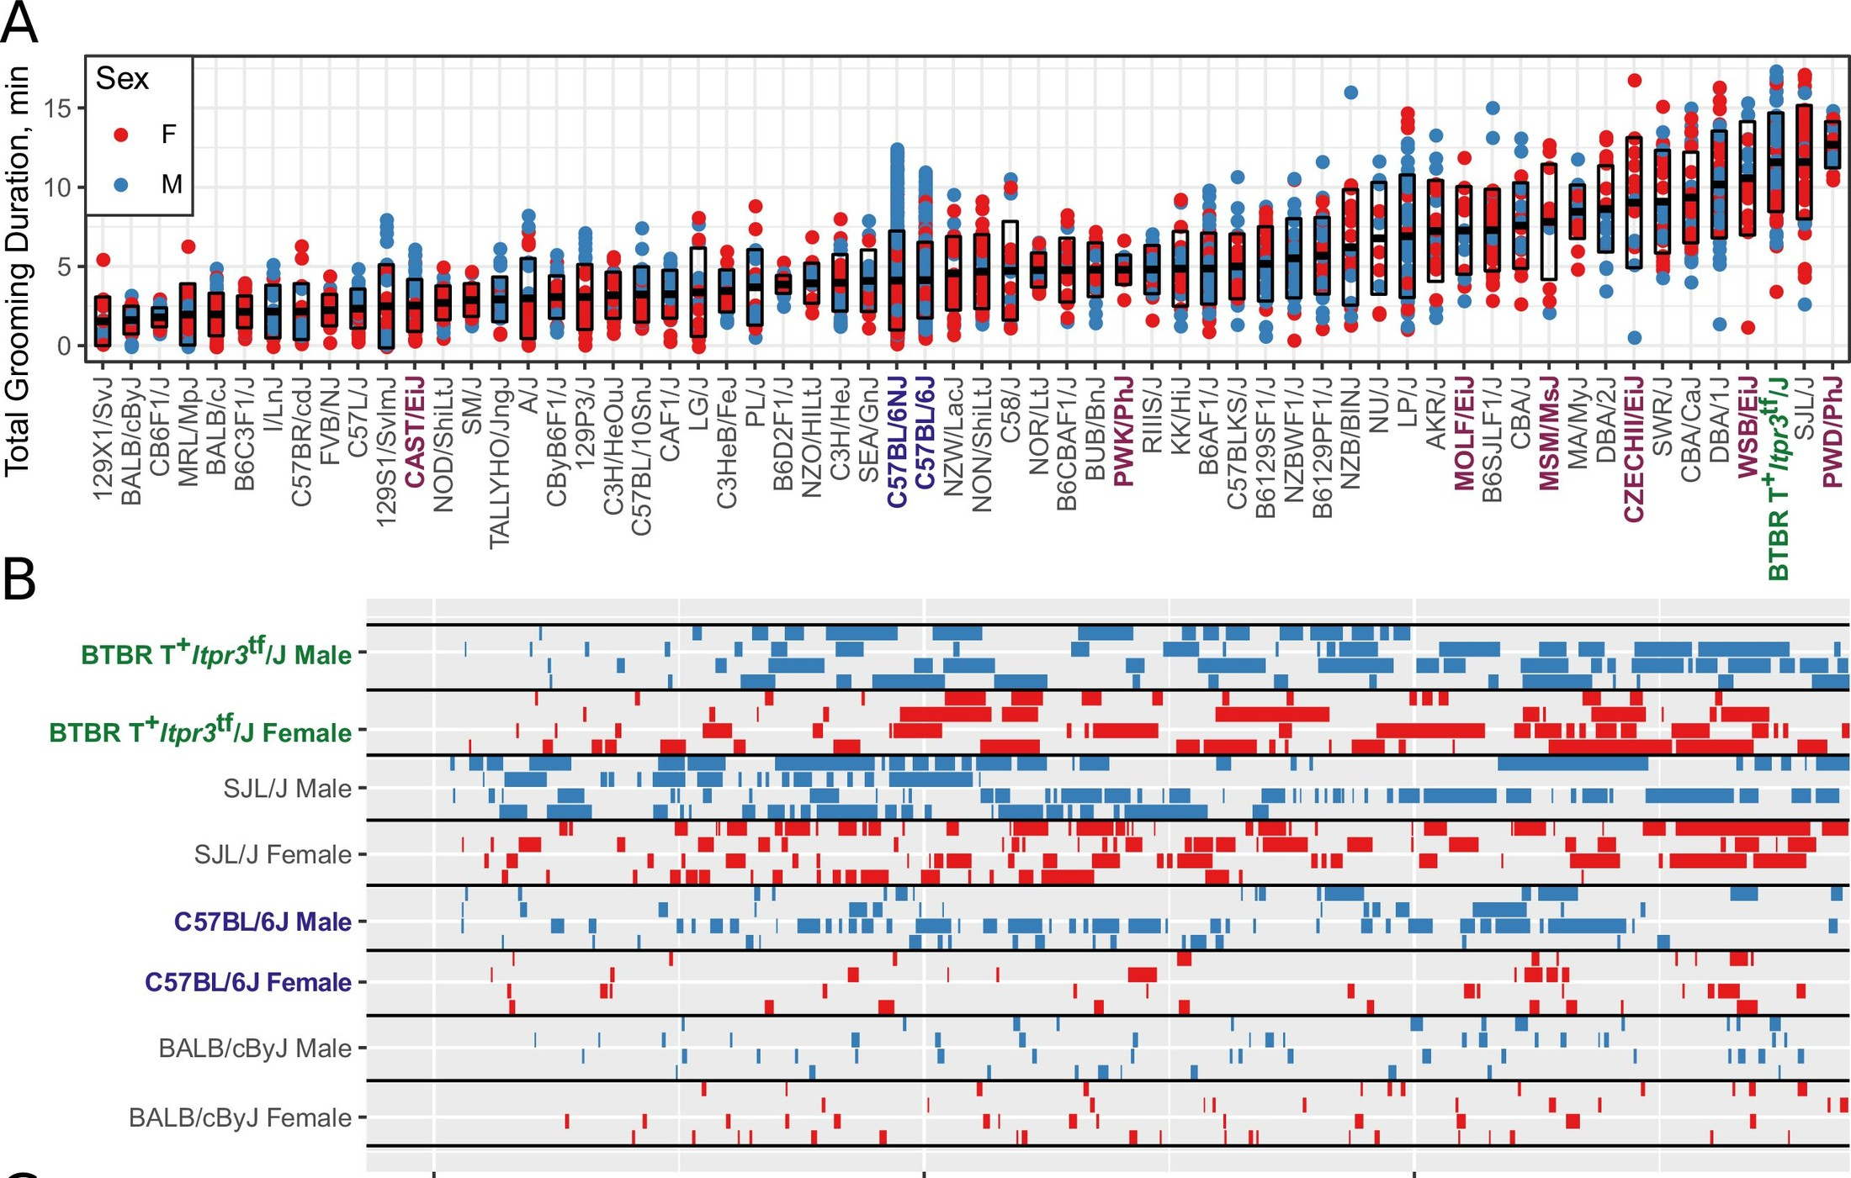
Example: strain surveys reveal heritable variation in grooming
2457 mice from 62 strains
Smooth gradient in total grooming time
Wild-derived strains groom more, in longer bouts
Geuther et al., eLife 2021;10:e63207 (CC BY 4.0)
Notes:
Geuther 2021 Fig 6A–B. 2457 mice, 62 strains, 2252 h of open field. Total grooming time forms a smooth gradient across strains; wild-derived strains enriched at the high end. BTBR, SJL/J high; C57BL/6J, BALB/cByJ low.
2252 h of open-field video in total.

Slide 25
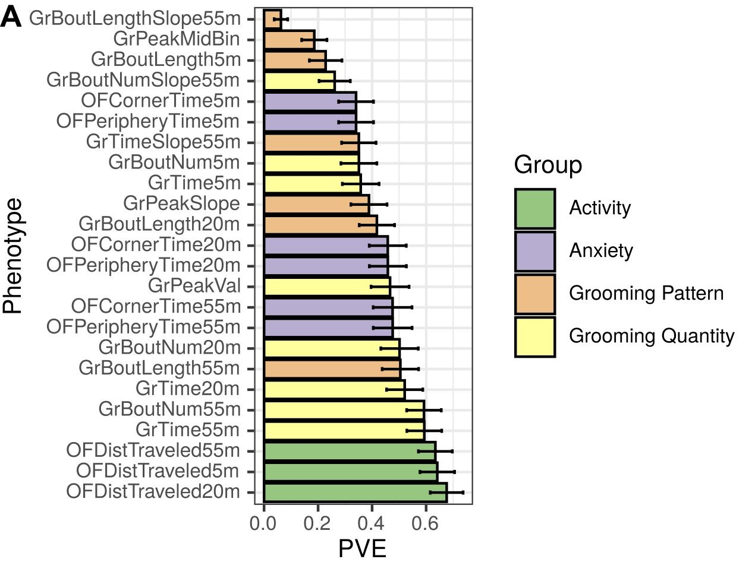
Backup: grooming measures differ in how heritable they are
Heritability (PVE): the share of variation explained by genetic variants, 0 to 1
Grooming measures span about 0.05 to 0.6
20 and 55 minute measures are more heritable than 5 minute ones
Two classifiers, same behavior: prefer the more heritable
Geuther et al., eLife 2021;10:e63207, Fig 9A (CC BY 4.0)
Notes:
Backup. Figure: Geuther et al. 2021 Fig 9A, SNP heritability (PVE) of grooming and open-field phenotypes; it replaces Choudhary et al. 2026 Fig 8B, whose phenotype codes are harder to read. Reading it: PVE is the share of variation explained by genetic variants; grooming measures run from about 0.05 (bout-length slope) to about 0.6; 20 and 55 minute measures are more heritable than 5 minute ones. Choudhary et al. 2026 add that when two experts' classifiers differ, prefer the more heritable one; genetic correlation shows whether they measure the same construct.

Slide 26
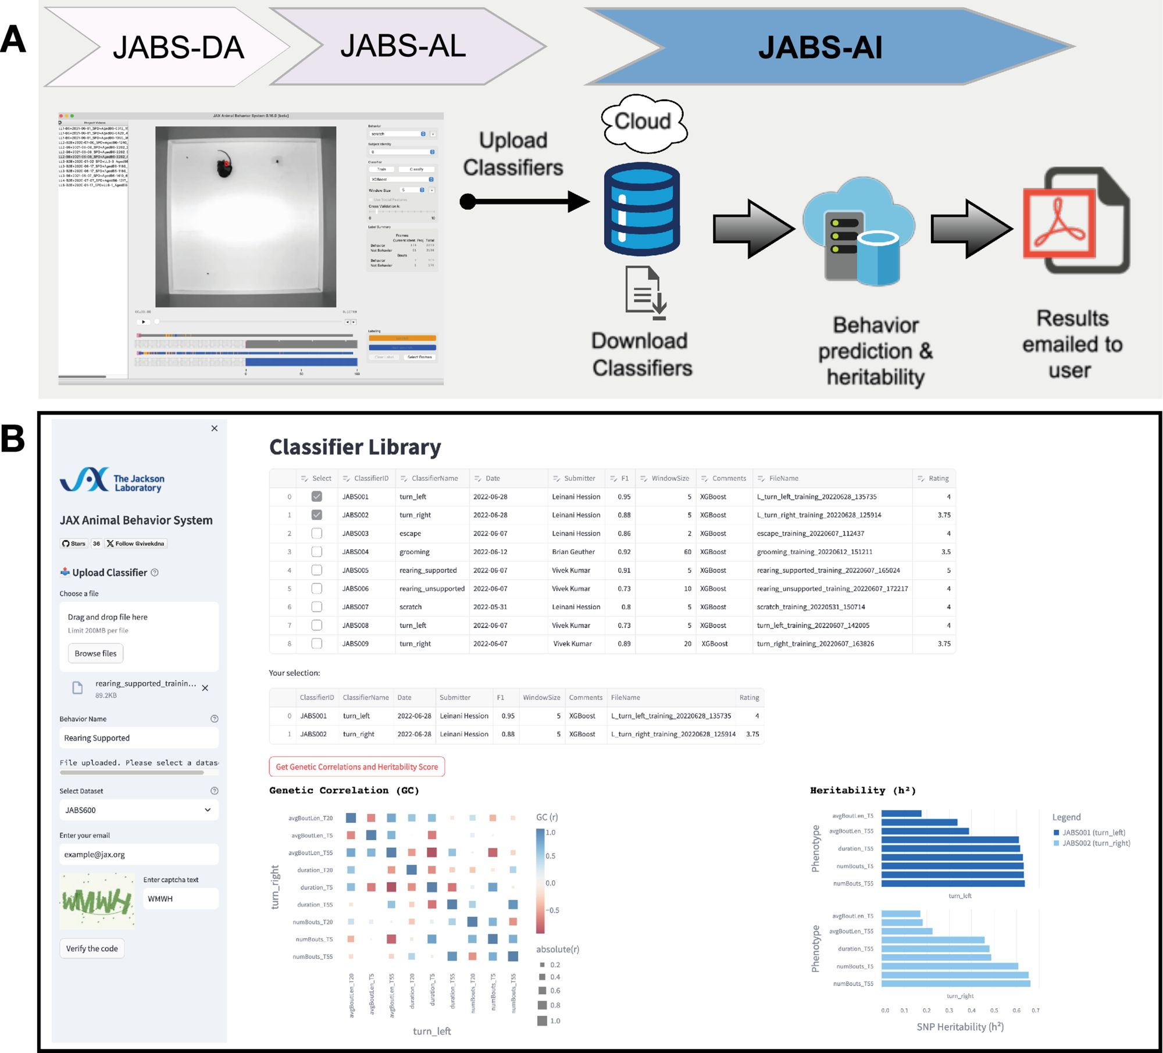
JABS-AI: share a classifier, get strain-survey genetics back
Upload a JABS-AL classifier
Runs on JABS600 or JABS1200
Returns strain heatmap, heritability, genetic correlation
Download others' classifiers
Choudhary et al., eLife 2026;14:e107259 (CC BY 4.0)
Notes:
Fig 9. Upload a classifier trained in JABS-AL; it runs on JABS600 or JABS1200 and returns behavior density plots, a strain heatmap, heritability and genetic correlations by email within a few hours. Datasets: JABS600, JABS1200, JABS-BxD (Harvard Dataverse).
Open item: confirm whether JABS-AI is launched and how the course links to it; the slide needs a redesign once that is known.

