Slide 1
Capstone Project
Hotel Booking Analysis
Kumar Mhaske

Slide 2
Points to Discuss:
Agenda
Problem Statement
Business Objective
Data summary
Univariate analysis
Some important questions
Conclusion
Challenges

Slide 3
Agenda
To discuss the analysis of given hotel bookings data set.
We’ll be doing analysis of given data set in following ways :
Univariate analysis
Hotel wise analysis
Distribution Channel wise analysis
Booking cancellation analysis
Timewise analysis
By doing this we’ll try to find out key factors driving the hotel bookings trends.

Slide 4
Problem Statement
BUSINESS PROBLEM OVERVIEW
Have you ever pondered the ideal season of the year to reserve a hotel room? Or the ideal duration of stay to obtain the most affordable daily rate? What to do if you wanted to forecast whether a hotel will unreasonably receive a lot of unique requests? his lodging You can better investigate those questions by using a dataset! This data collection comprises booking information for a resort hotel and a city hotel, as well as information about the date the reservation was made. duration of stay. among other variables, the number of adults, kids, and/or babies, and the quantity of parking places. The data no longer contains any information that might be used to individually identify you. Investigate and evaluate the data to find crucial elements.

Slide 5
Business Objective
To find best time of year to book a hotel room

Slide 6
Data Summary
Given data set has different columns of variables crucial for hotel bookings. Some of them are:
hotel: The category of hotels, which are two resort hotel and city hotel.
is_cancelled : The value of column show the cancellation type. If the booking was cancelled or not.
Values[0,1], where 0 indicates not cancelled.
lead_time : The time between reservation and actual arrival.
stayed_in_weekend_nights: The number of weekend nights stay per reservation
stayed_in_weekday_nights: The number of weekday nights stay per reservation
meal: Meal preferences per reservation.[BB,FB,HB,SC,Undefined]
Country: The origin country of guest.

Slide 7
Data Summary(contd..)
market_segment: This column show how reservation was made and what is the purpose
of reservation. Eg, corporate means corporate trip, TA for travel agency.
distribution_channel: The medium through booking was made [[I Direct,Corporate,TA/TO,undefined,GDS.]
Is_repeated_guest: Shows if the guest is who has arrived earlier or not. Values[0,1]-->0
indicates no and 1 indicated yes person is repeated guest.
days_in_waiting_list: Number of days between actual booking and transact.
customer_type: Type of customers( Transient, group, etc.)

Slide 8
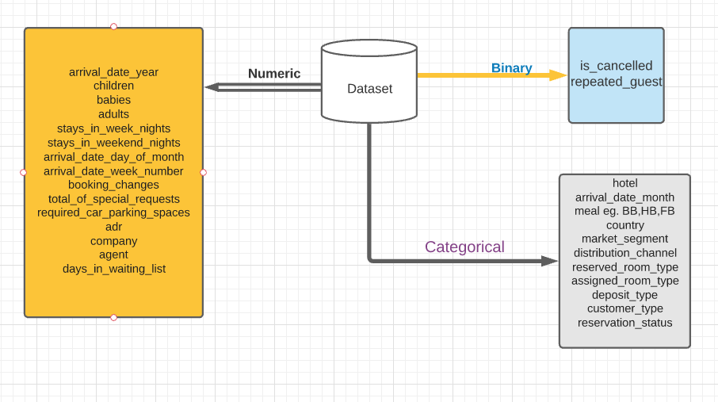
Data Summary

Slide 9
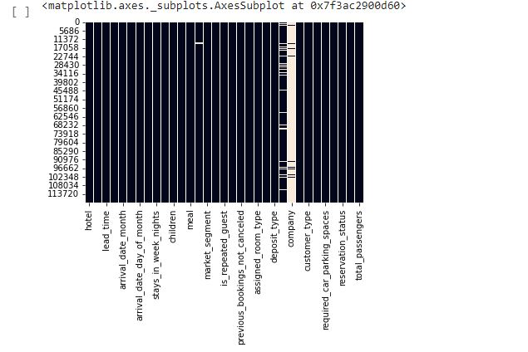
Visualizing the missing values , Checking Null Value by plotting Heatmap

Slide 10
Univariate Analysis
While doing univariate analysis of given hotel booking dataset, we answered following questions:
Which agent made most of bookings?
Which room type is in most demand and which room type generates highest adr?
From which country most of the customers are coming?
How many percentages of city Hotels and Resort Hotels?
Which Customer Types has the most stay duration?
Which Hotel has the most visitors?

Slide 11
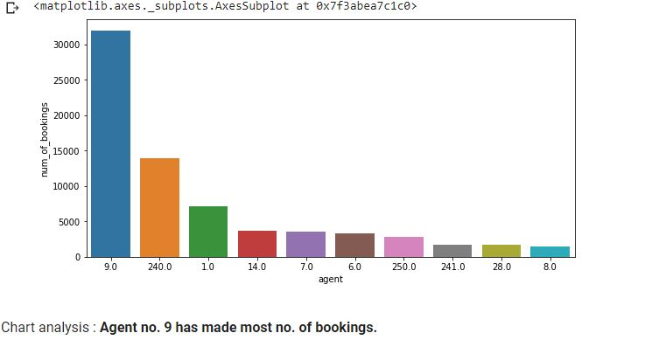
Agent with id no. 9 made most of the bookings.

Slide 12
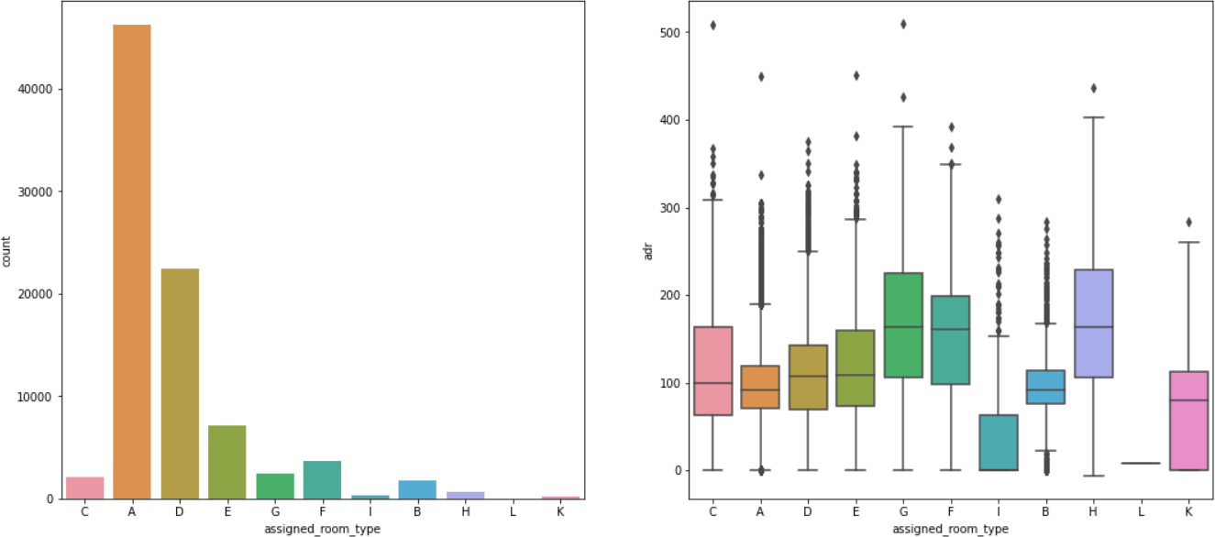
Type A room is most demanded by customers.
Room types C, G and H are some of the highest
adr(average daily rate) generating rooms.
.

Slide 13
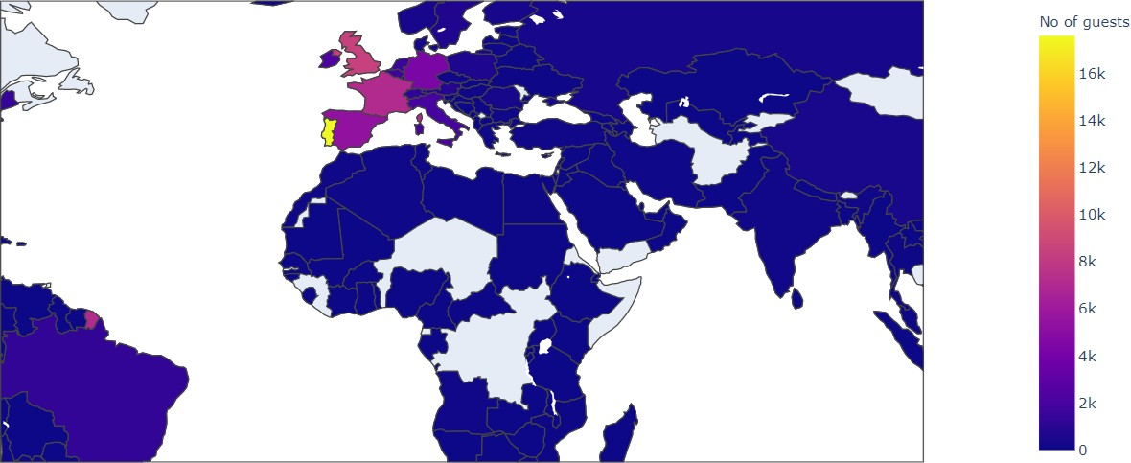
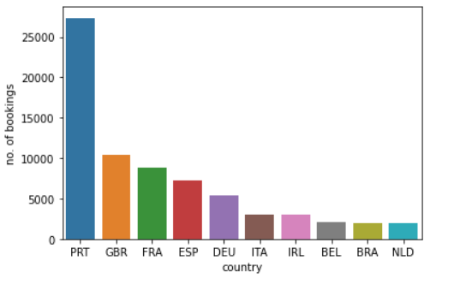
Most of the customers from European countries like Portugal, Great Britain, France and Spain.

Slide 14
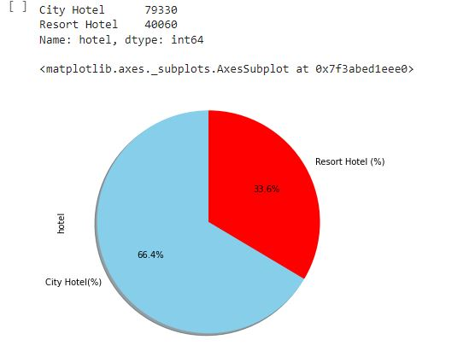
there are 66.4% city Hotels and 33.6% Resort Hotels.

Slide 15
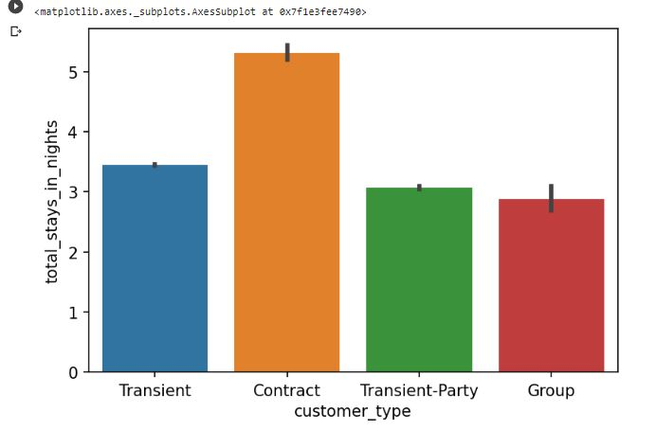
Contract ' of Customer Types has the most stay duration.

Slide 16
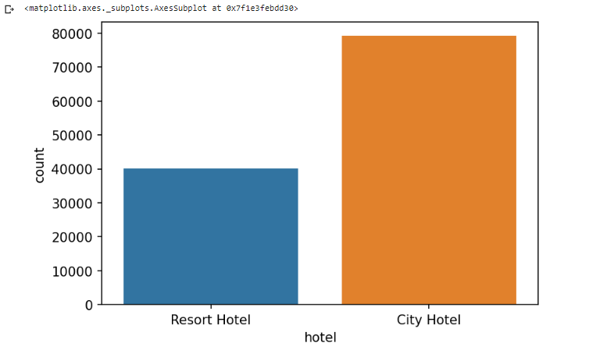
City Hotel has the most visitors.

Slide 17
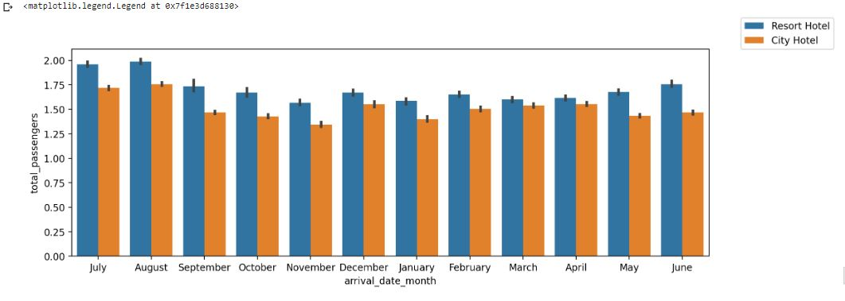
In both hotels most bookings were made from July to August . In all months, the most passengers are for Resort Hotel ..

Slide 18
Some important questions
Some other analysis are also done, which are as follows:
What are the different reason for special requests
What is the optimal stay length for better deal for customers
How adr is affected by total staying period in hotels.

Slide 19
Conclusion
There are 66.4% city Hotels and 33.6% Resort Hotels.
In month of january and february lead time is low.
Contract ' of Customer Types has the most stay duration.
City Hotel has the most visitors.
The people from PRT country reserved a hotel with most number of babies and children.
PRT Country has most customers.
City Hotel has the maximum ADR (Average Daily Rate) which is 5400.0
Agent no. 9 has made most no. of bookings.
Most demanded room type is A, but better adr rooms are of type H, G and C also. Hotels should increase the no. of room types A and H to maximise revenue.
The Most of the customers are from PRT, GBR,FRA and ESP Countries
In both hotels most bookings were made from July to August . In all months, the most passengers are for Resort Hotel .

Slide 20
Challenges
There was a lot of duplicate data.
Choosing appropriate visualization techniques to use was difficult.
A lot of null values were there in the dataset.

Slide 21
Thank You

