Slide 1

Startup Funding in India: An Exploratory Analysis
Insights from Startup Fundings in India

Slide 2



Our Team
Batch 265 & 266
e
01
Deepika G
B.Tech (IT)
e
02
Shaik Fayaz
B.Tech (EEE)
e
03
Kumar Raju N
B Com(Gen)

Slide 3
The objective of Project:
Analyze startup investment trends in India based on the dataset.
Identify key patterns, and insights regarding investment amounts, industries, and locations.
Explore the behavior of investors and startup founders in the Indian startup ecosystem.
Facilitate better decision-making and understanding of the dynamics within the Indian Startup landscape.

Slide 4




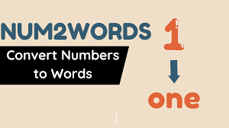

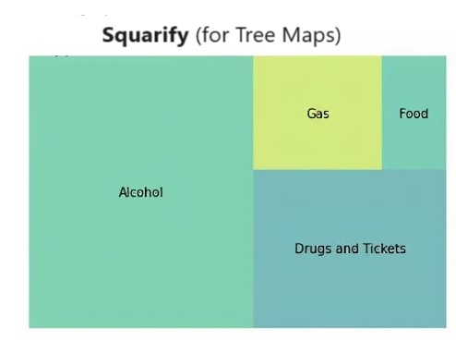
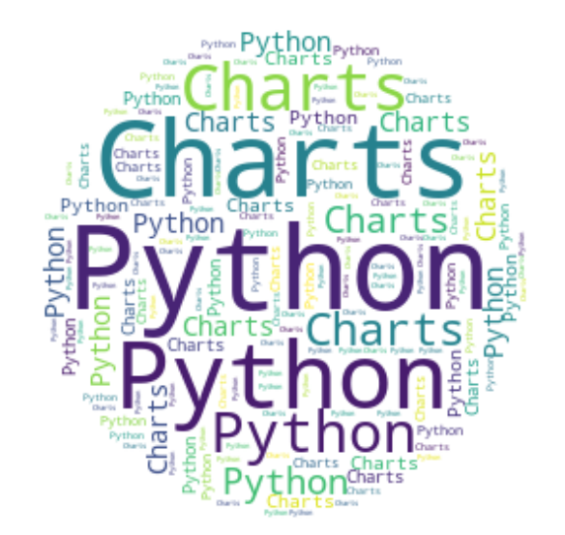

Libraries Used
Numerical Computation
Data Manipulation
Web Scraping
Statistical Visualization
Number to word conversion
Plotting
Tree Map Visuals
Word cloud generation
HTTP Requests

Slide 5
Web Scraping of Data :
Web scraping is the process of extracting data from websites.
It involves fetching HTML content from web pages and parsing it to extract the desired information.
Web scraping can be performed manually or automated using software tools called web scrapers.
This technique allows us to gather large amounts of data from various sources on the internet for analysis, research, or other purposes.

Slide 6

Data Source :
Link : - https://trak.in/india-startup-funding-investment-2015/
Description : -
Trak.in provides comprehensive coverage of startup funding and investment trends in India.
The data collected from this source offers valuable insights into the funding landscape, including details such as startup names, industry verticals, investment amounts, and investors involved.
Trak.in is a trusted source for tracking developments in the Indian startup community and serves as a valuable resource for who are interested in understanding the dynamics of startup funding in India.

Slide 7
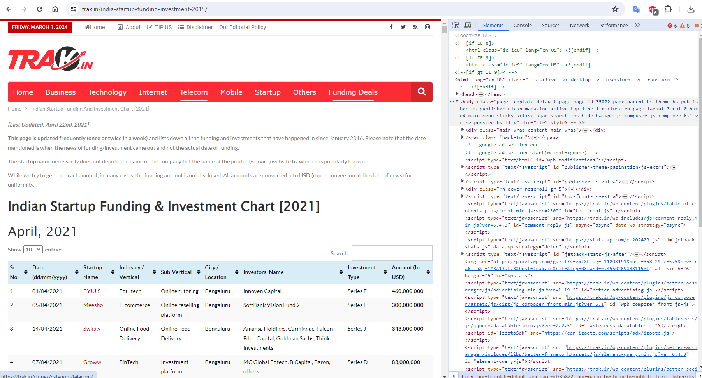
Data Source – https://Trak.in

Slide 8
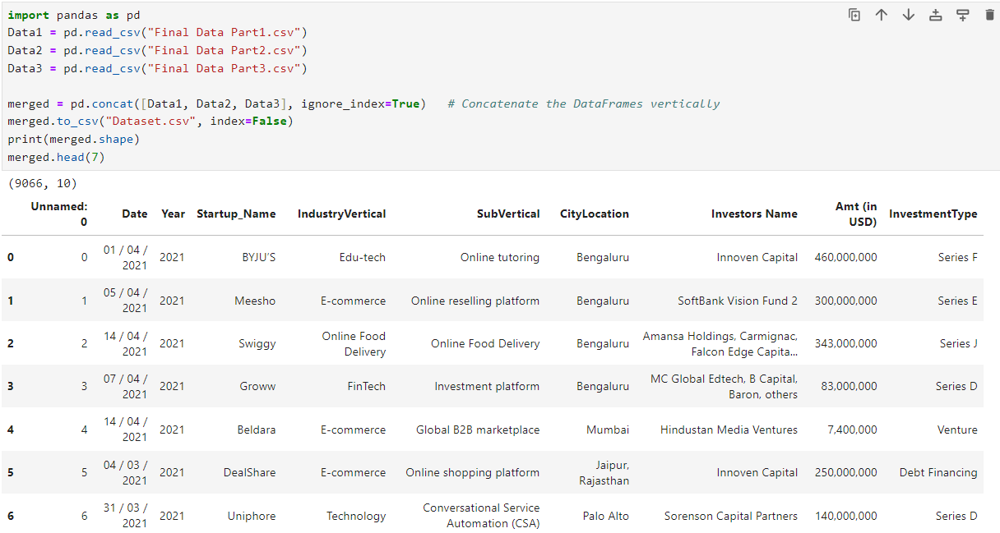
Data Collection :
The dataset was collected through web scraping from Trak.in, a website that tracks startup funding and investment trends in India.
Web scraping involved extracting relevant information from the website's pages, including startup names, industry verticals, investment amounts, and investors involved.
Raw Data

Slide 9
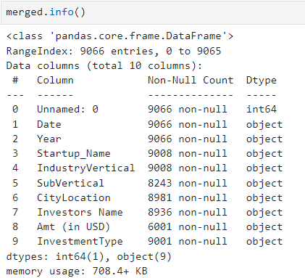
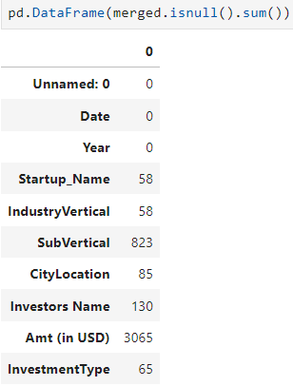
Data info() : Null info() :

Slide 10
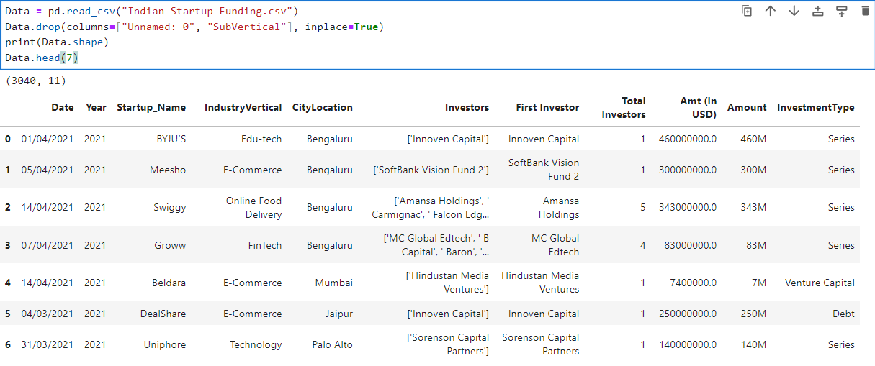
Cleaned Data
Data Cleaning Process :
Handling Missing Values: Imputation (Null Values)
Removing Duplicates: Removing duplication
Standardization: Uniformity (Data formets & Units)
Text Cleaning: Preprocessing (Removing = [ , ] [ . ] [ / ] [ # ] etc..

Slide 11
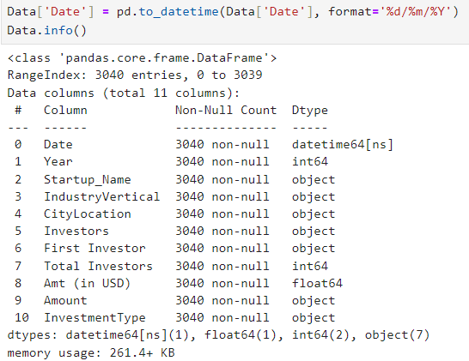
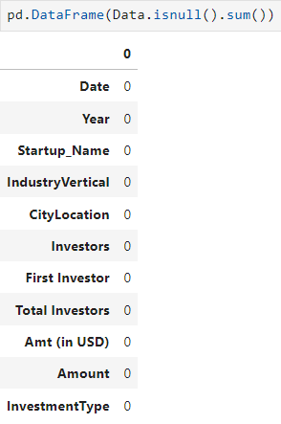
Data.info(): Data.isnull():

Slide 12

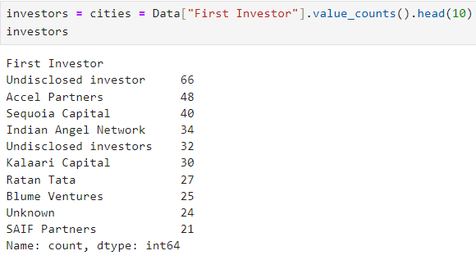
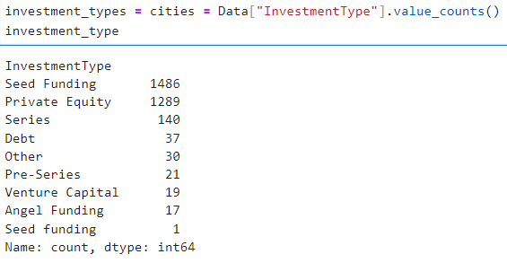
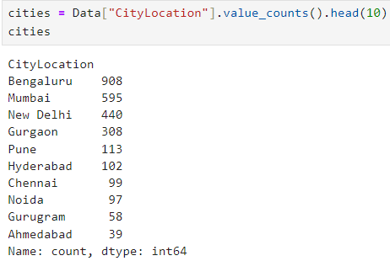
Understanding Individual Variables
First Investor InvestmentType
CityLocation

Slide 13

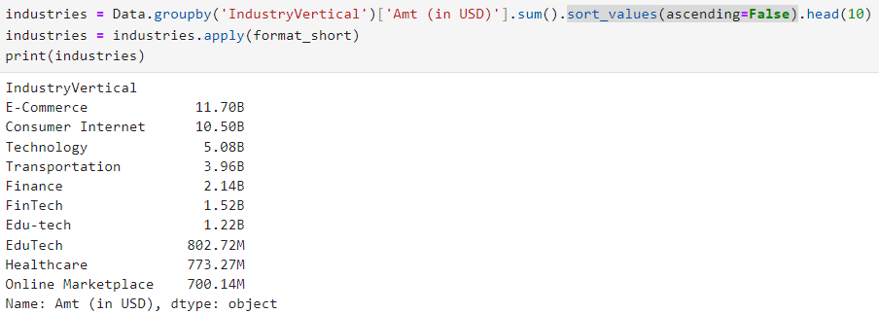
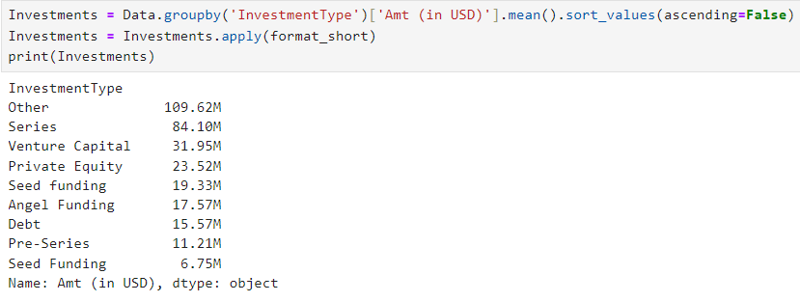
Exploring Relationships Between Variables
( IndustryVertical ) [Amount (in USD)]
( InvestmentType ) [ Amount (in USD) ]

Slide 14

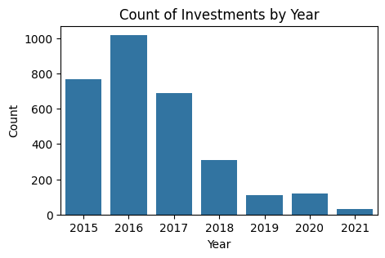
A. The number of count in investments by year
Observations :
The number of investments peaked in 2016 with nearly 1000 investments.
There was a significant decline in investments in 2017, and it continued to decrease until 2020.

Slide 15

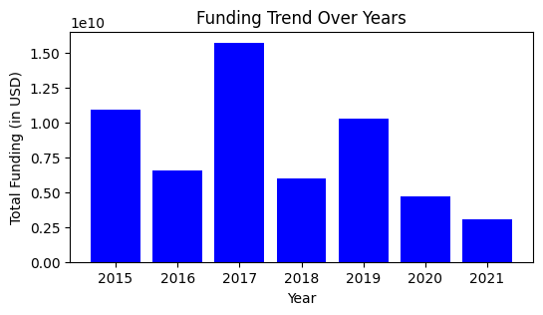
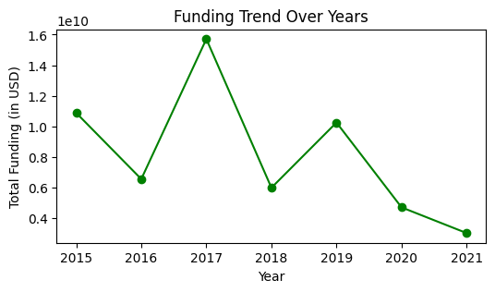
B. The total funding trend amount varied over the years?
Observations :
The funding amount showed a steady increase
from 2016 to 2017.
2017 had the highest funding.
Significant Drop 2018 witnessed a significant drop in funding

Slide 16

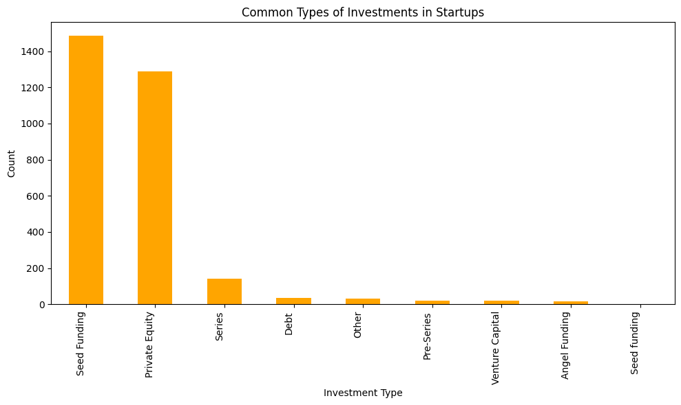
C. The common types of investments made in startups
Observations :
Private Equity : It has the highest count among all investment types and also popular choice for early – stage startups.
Seed Equity : It is also have a significant count. And Seed funding is the most common type of investment for startups.
Series : it’s shows a notable count, they occur after seed funding and help startups
Other Types : Debt, pre-series, Venture capital have a minimal count. These types are less common compared to
Private Equity and Seed Funding

Slide 17

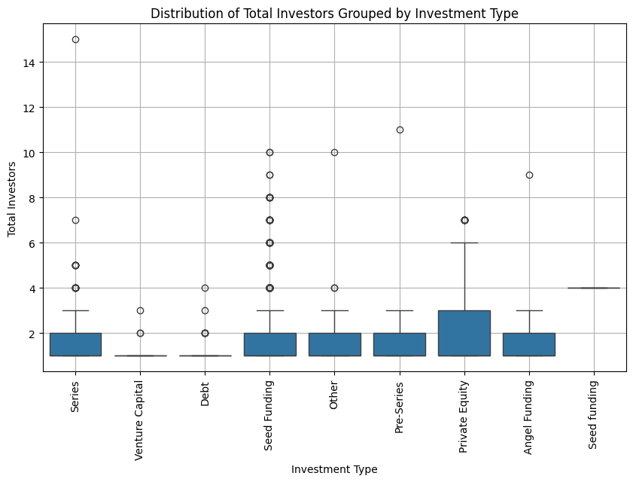
D. The distribution of total investors grouped by investment type.
Observations :
Seed Funding and Private Equity have the highest median number of investors.
There is a significant variation in the number of investors in Private Equity. As indicated as outliers.
Venture Capital and Angle Funding have similar distribution, with no outliers

Slide 18

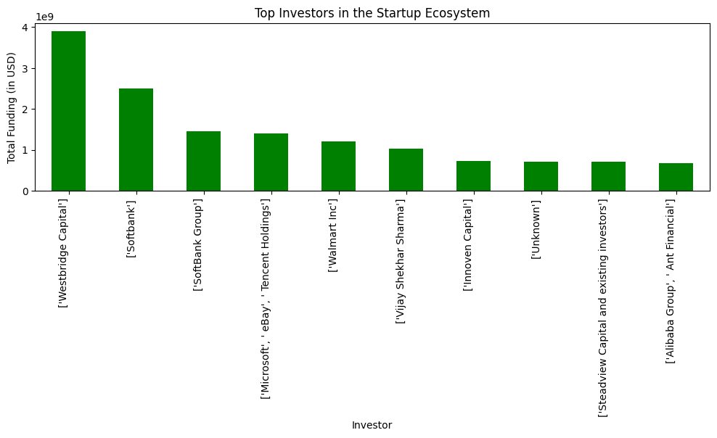
E. The top investors in the startup ecosystem?
Observations :
Westbridge Capital has the highest funding, followed by SoftBank, Tiger Global Management, and others.
Following Westbridge Capital, we see [SoftBank Group] and Tencent Holdings as prominent investors

Slide 19

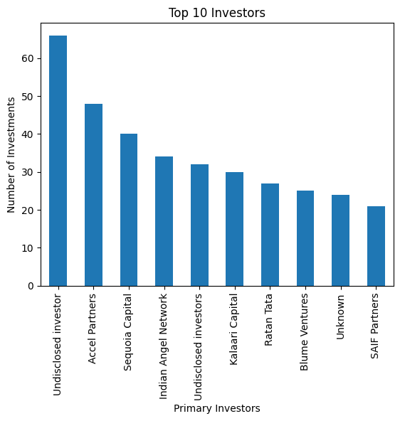
F. Top 10 Investors by Number of Investments
Observations :
Accel Partners and Sequoia Capital: These well-known these well known venture capitalfirms closely follow, with approximately 45 and 35 respectively.
Kallari capital is not as profolic as the two, Kalaari Capital still makes a substantial contribution.

Slide 20

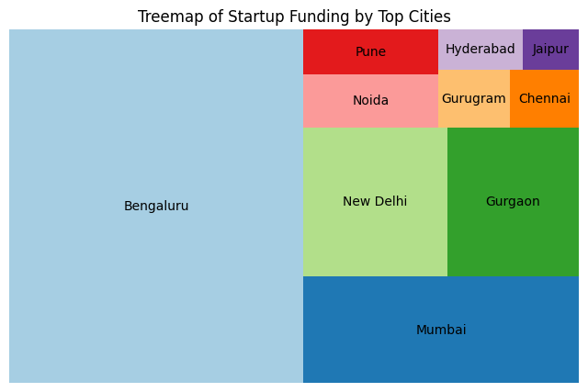
G. Cities which have top Startup fundings
Observations :
Bangalore has the highest Startup fundings.
Mumbai and Gurgaon are also have more Startup fundings and them we can compare half of the Bangalore Startup fundings.

Slide 21

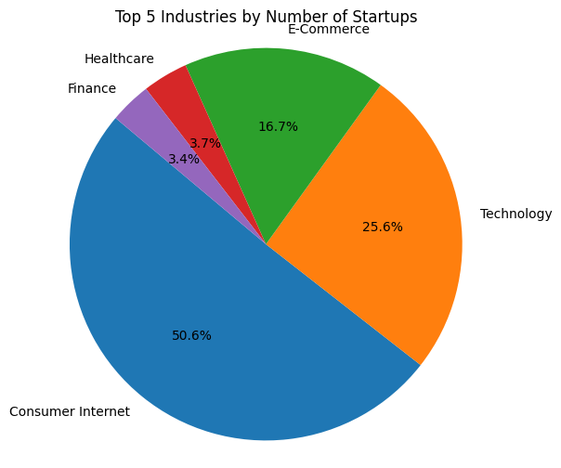
H. The top 5 industries by the number of startups?
Observations :
Consumer Internet sector leads the way with approximately 50.6% of startups.
Consumer internet companies are cover a wide range of services. Including e – commerce, Social Media, Entertainment and Online Market places
Technology startups account for around 25.6% of the total.These companies are focus on software development.

Slide 22

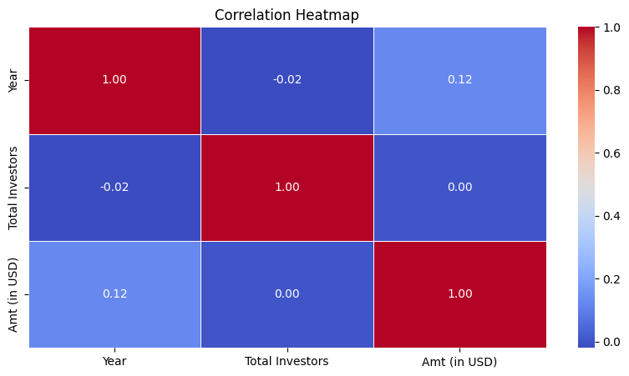
I . Correlation between Amt (in USD), Total Investors & Year
Observations :
Perfect Positive Correlation:
Each Variable positively with itself.
There is a very weak negative correlation of approximately -0.05 between Year and Investors.
And approximately 0.12 between Year and amount, as well as between Total investos and amount

Slide 23

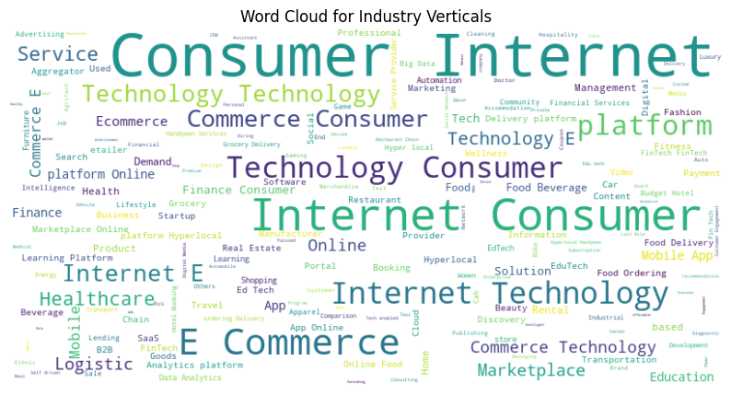
J . Word Cloud for Industry Verticals

Slide 24
Conclusion :
Most of the Funding is either Private Equity or Seed Funding. A large number of Startups based in Metropolitan cities like Bangalore and Mumbai are funded. Technology-based startups that provide their services to the everyday probable to get a lot of funding. Investors are mainly showing interest in Consumer Internet and technology. Westbridge Capital stands out as the top investor, contributing the highest amount of funding. Bangalore continues to dominate the startups in India.

Slide 25

THANK YOU

